Slide 1

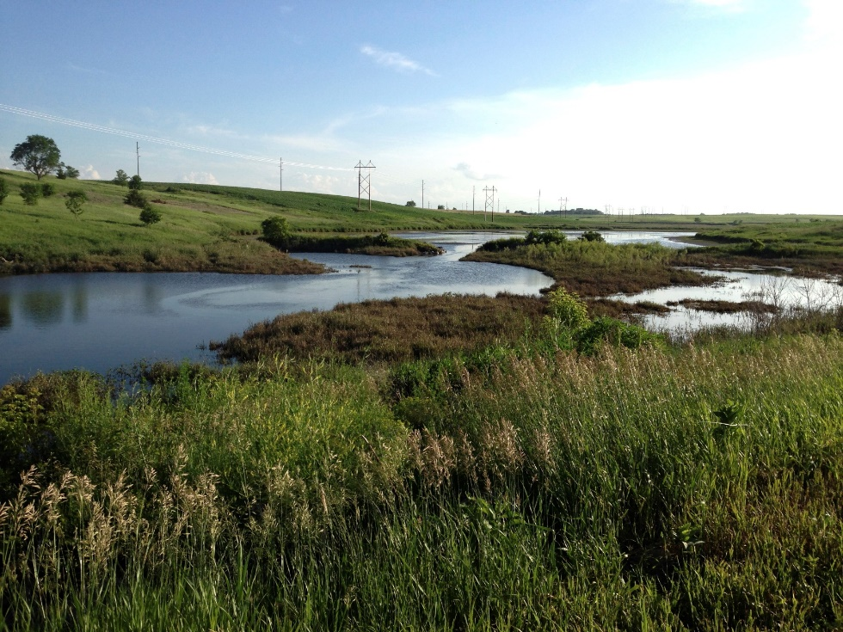
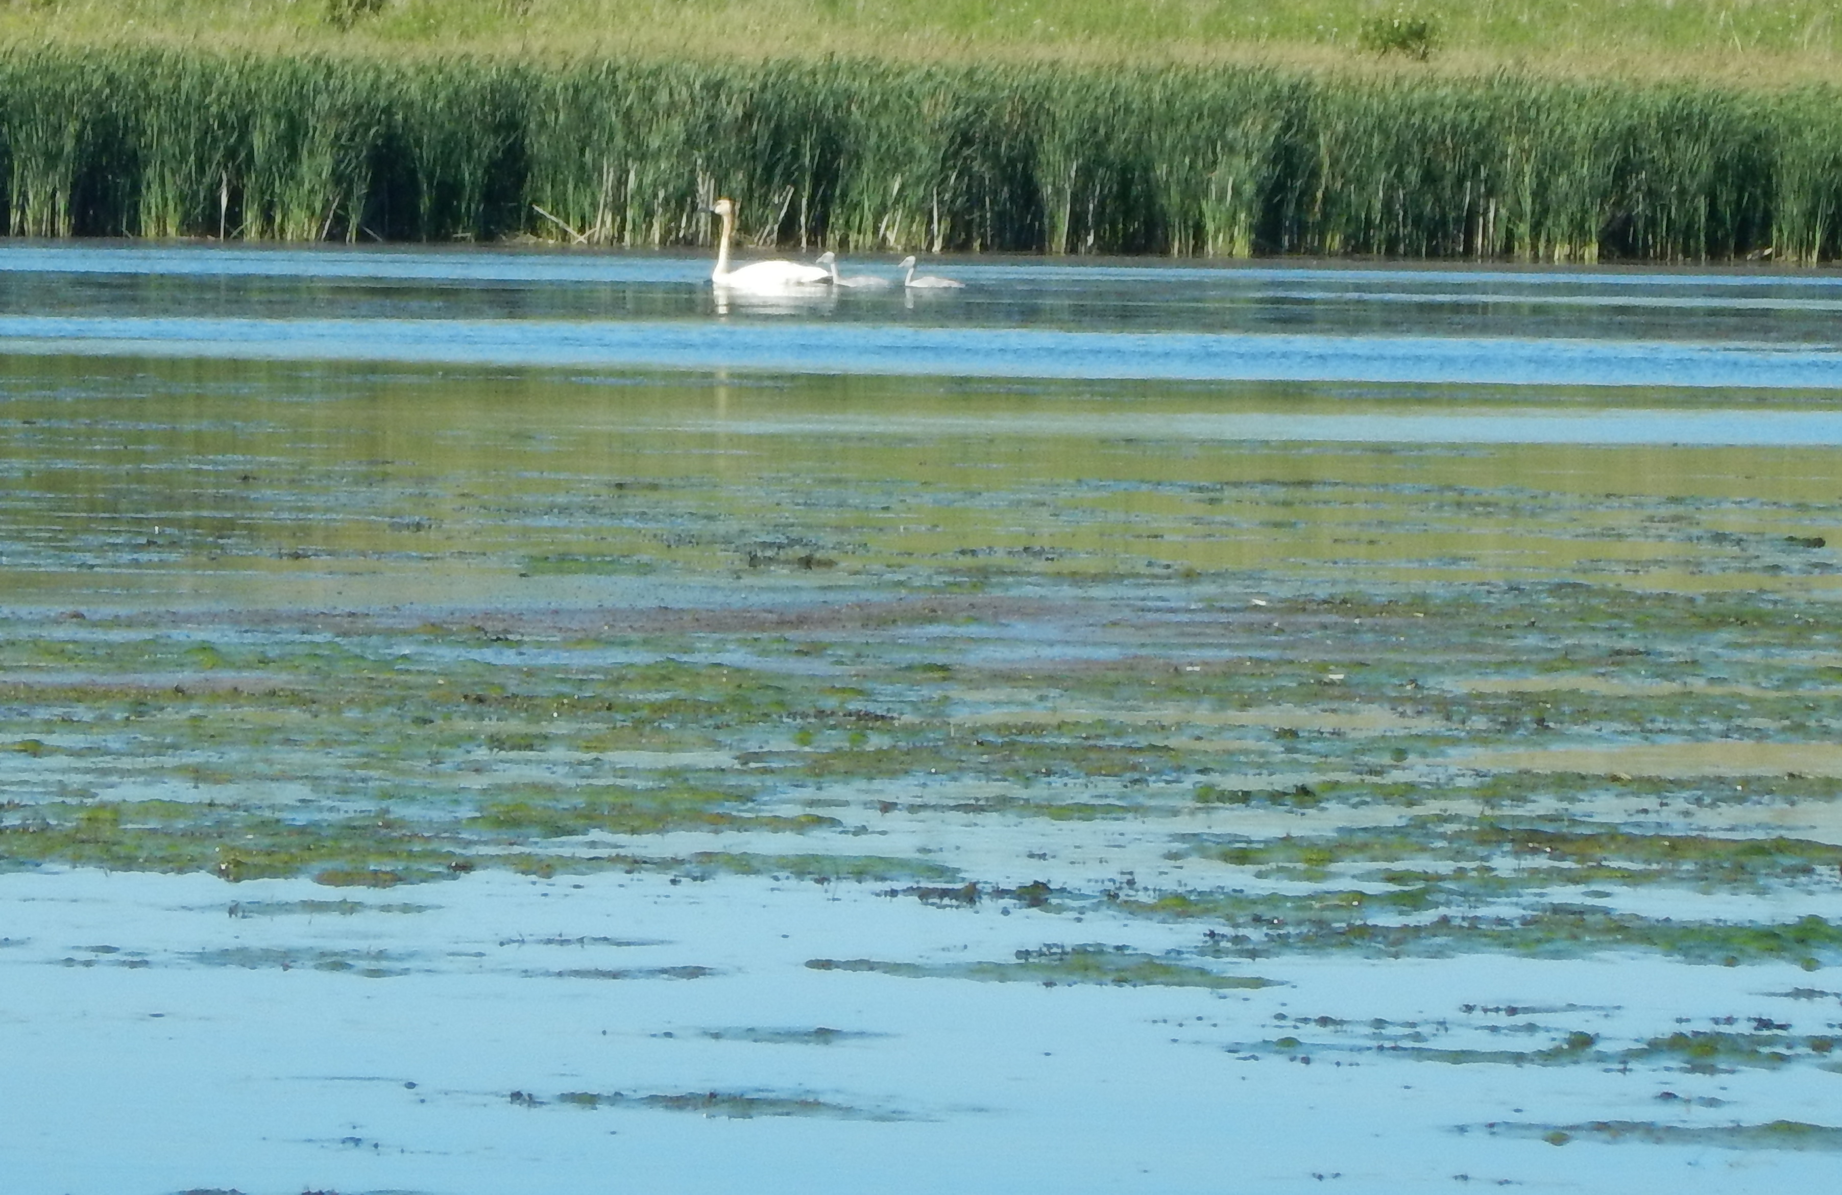
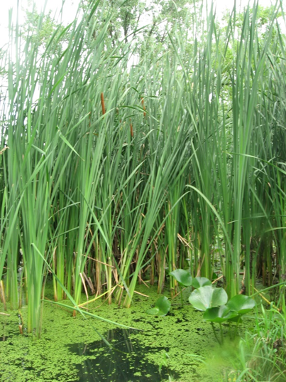
Quantifying nutrient removal in floodplains and other fluvial wetlands
Amy Hansen
Upper Mississippi River Conference
Moline, Illinois
Oct 25, 2018

Slide 2
Assessing wetland nitrate removal at a watershed scale
  Amy Hansen, Christy Dolph, Jacques Finlay, Efi Foufoula-Georgiou, P. Hawthorne, T. Campbell, S.J. Cho, B. Dalzell, J. Czuba, S. Rabotyagov
  Funding:
  NSF grant SEES-1415206 under the Water Sustainability and Climate Program (WSC): SEES Fellows: Leveraging the waterscape to increase agricultural landscape sustainability
  NSF grant EAR-1209402 under the Water Sustainability and Climate Program (WSC): REACH (REsilience under Accelerated CHange)
Controls on floodplain denitrification
  Abby Tomasek, Jessica Kozarek, Miki Hondzo, M. Sadowsky, N. Lurndahl, C. Staley, P. Wang, T. Kaiser
  Funding:
  Minnesota Department of Agriculture
  USDA award 2015-67019-23600

Slide 3
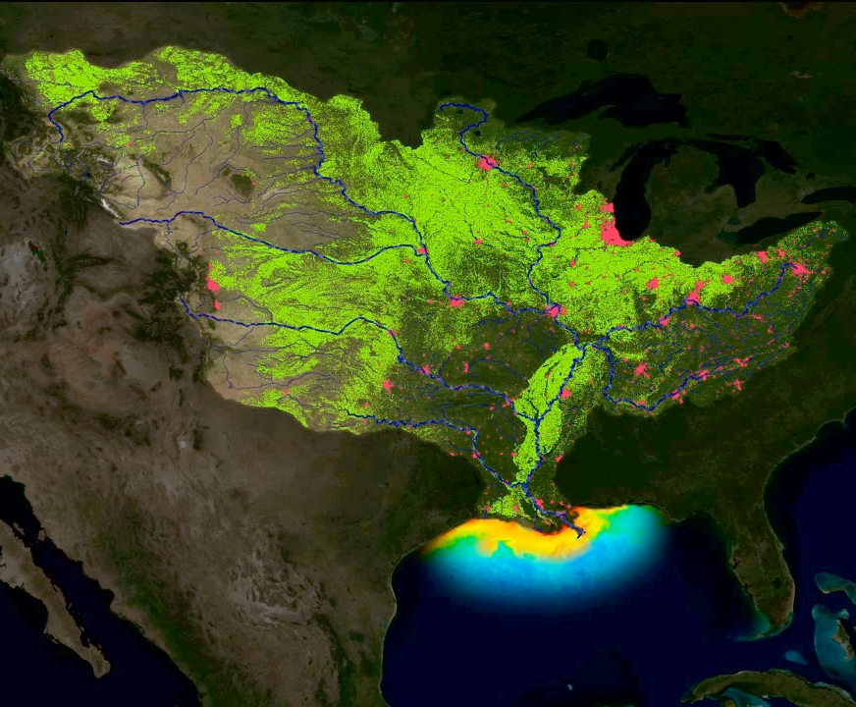
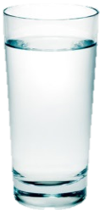
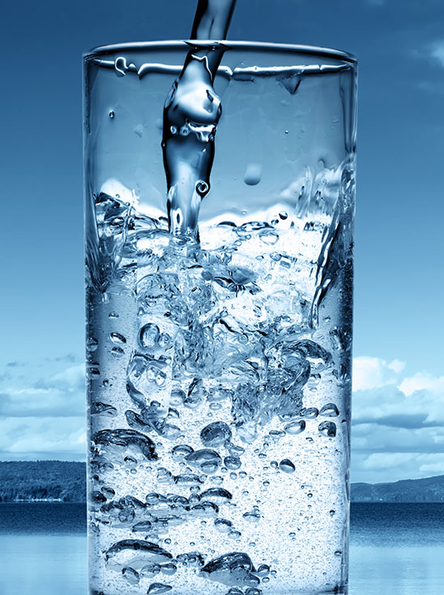
The Dead Zone
Notes:
Excess nitrogen in surface waters can cause environmental degradation locally and downstream. In response to the northern Gulf of Mexico dead zone, many of the highest contributing states have developed nutrient reduction strategies calling for up to 45% reductions in annual nitrate loads.
Excess nitrate also effects whether water is drinkable or whether we install very costly treatments to remove it. Concentrations above 10 mg/L are harmful to human health.
High NO3 concentrations are detrimental to sensitive biota at > ~ 1mg/L (Wagenhoff et al 2016, Dubrovsky et al 2010)

Slide 4
Delivered annual nitrogen yield
SPARROW model results
Robertson et al. 2014
Notes:
This slide illustrates that the MRB is on par with the worst. I got this from a slide from the USGS SPARROW model website matl not from a published paper but it probably is published (should find that).

Slide 5
Agriculture is primary source of excess nutrients in region.

Slide 6
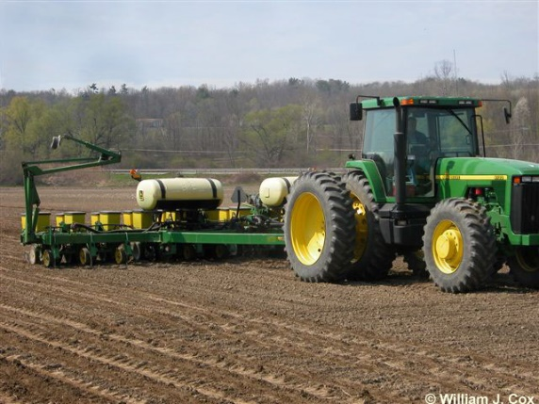
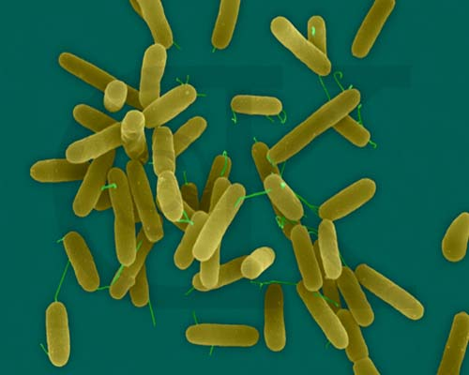
To reduce stream nitrate
Reduce nitrate inputs
Increase nitrate removal
Notes:
There are two primary processes that remove nitrate once it is in streams – denitrification and assimilation. In the spring months when NO3 loading is highest, assimilation is minimal. We focus on denitrification.
Denitrification, is a microbial oxidation-reduction process that reduces NO₃⁻ to di-nitrogen gas. It is carried out anaerobically by a wide range of respiratory microbes. Organic carbon is the primary electron donor for the denitrification process.

Slide 7
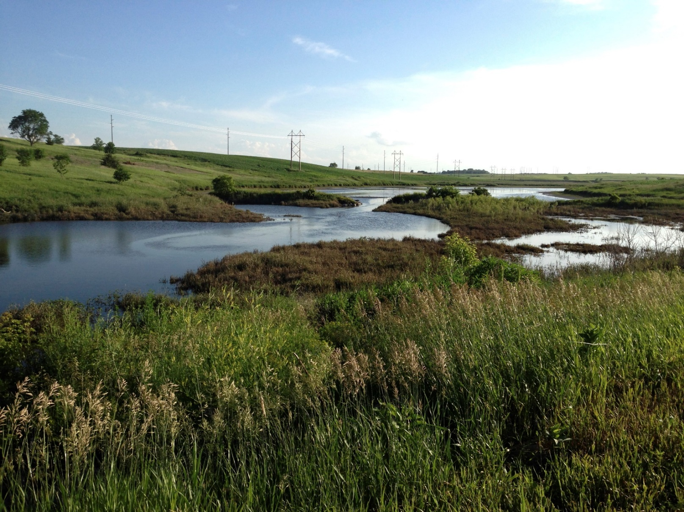
Why wetlands?
Wetlands are sites of high nitrate removal rates
Wetlands are sites of high water residence time
Notes:
Studies of individual wetlands consistently show high nitrate removal rates from wetland inlet to outlet. This may be due to high residence times or enhanced uptake rates. Wetland vegetation also leaches organic carbon so may enhance downstream denitrification rates by supplementing organic carbon supplies.

Slide 8
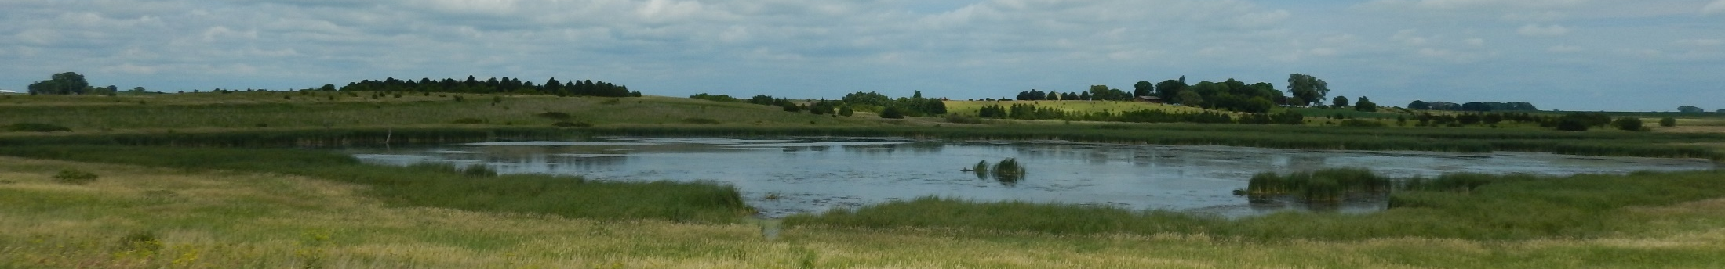
Fundamental questions addressed by research:
How (cost) effective are wetlands at reducing nitrate concentrations and loads at a watershed scale?
What controls the effectiveness of (fluvial) wetlands at removing nitrate?
Notes:
What controls the effectiveness of (fluvial) wetlands at removing nitrate?
Nitrate and organic carbon availability
Water residence times
Wetland location within the fluvial network
Presence of denitrifying bacteria
Environmental conditions

Slide 9
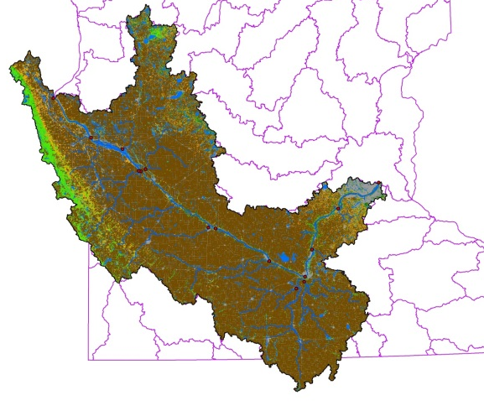
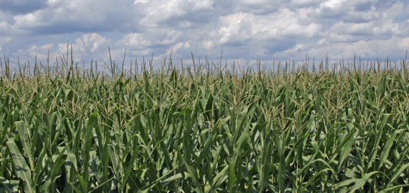
Minnesota River Basin
Corn, corn-soy
Notes:
~80% row-crop ag, primarily corn-sow, lots of fertilizer to achieve high productivity.

Slide 10
Sampling plan:
Hansen et al., 2018, Nature Geosciences.

Slide 11
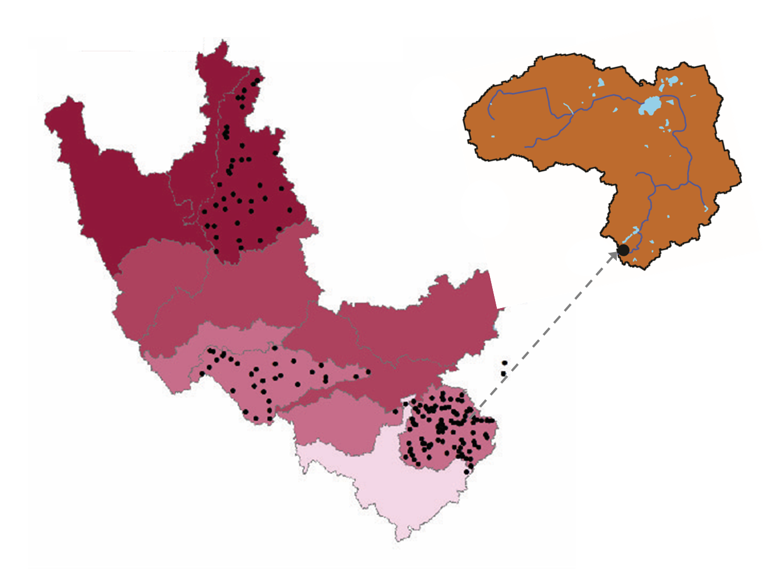
Hansen et al., 2018, Nature Geosciences.

Slide 12
Hansen et al., 2018, Nature Geosciences.

Slide 13
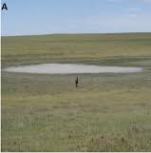
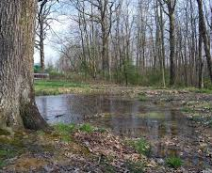
Measurable contribution of ephemeral wetlands to nitrate removal under high streamflow conditions
Hansen et al., 2018.

Slide 14
Our answers to the
fundamental questions addressed by research:
How (cost) effective are wetlands at reducing nitrate concentrations and loads at a watershed scale?
  Percent wetland cover was predictive of nitrate concentration (interception fraction improves predictive ability)
  Ephemeral wetland effect evident for high streamflow conditions
Notes:
What controls the effectiveness of (fluvial) wetlands at removing nitrate?
Nitrate and organic carbon availability
Water residence times
Wetland location within the fluvial network
Presence of denitrifying bacteria
Environmental conditions

Slide 15
Fundamental questions addressed by research:
How (cost) effective are wetlands at reducing nitrate concentrations and loads at a watershed scale?
What controls the effectiveness of (fluvial) wetlands at removing nitrate?
Notes:
What controls the effectiveness of (fluvial) wetlands at removing nitrate?
Nitrate and organic carbon availability
Water residence times
Wetland location within the fluvial network
Presence of denitrifying bacteria
Environmental conditions

Slide 16

Multi-objective trade-off analysis
Inputs
Models
Outputs
Watershed model (SWAT)
Phosphorus
Precipitation
Near channel sediment model (MOSM)
Sediment
Candidate landscape
hydrology
Aquatic denitrification model (NNM)
Nitrate
hydrology
terrestrial NO3 inputs
Evaluate objective function, define new candidates

Slide 17
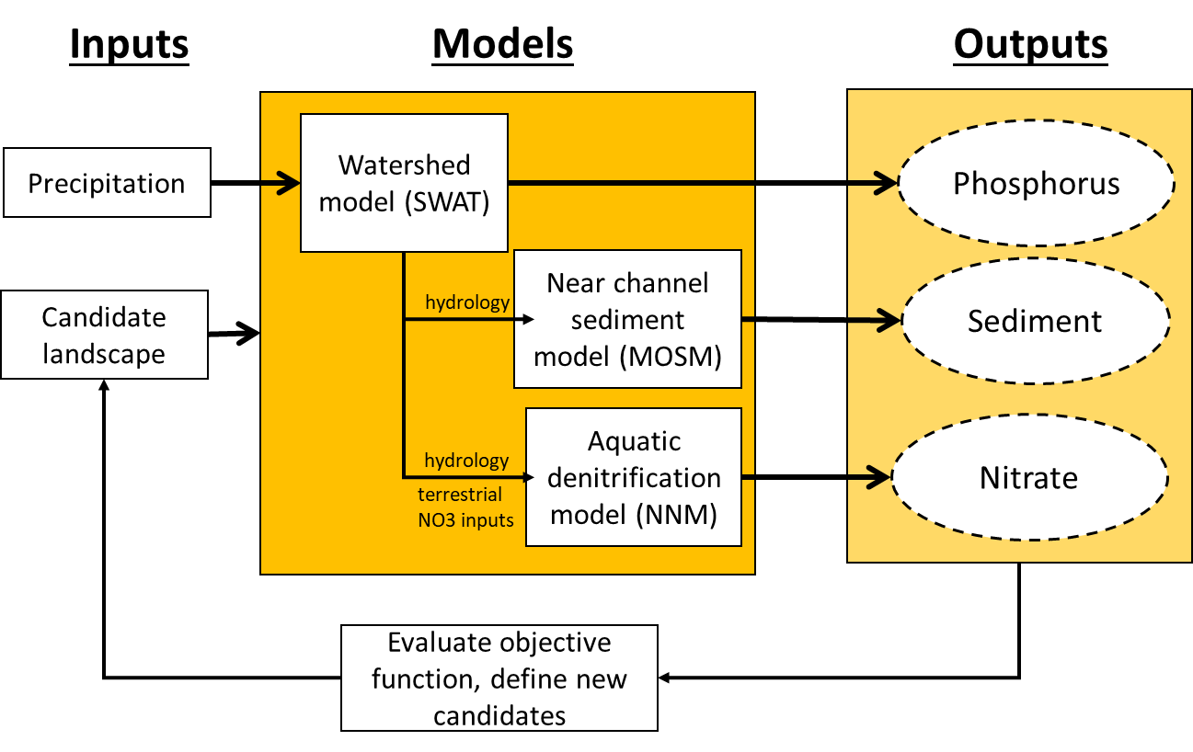
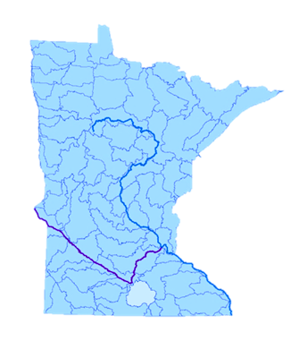
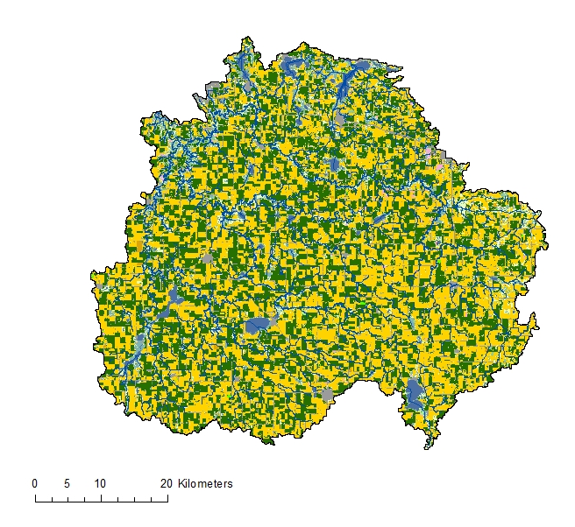
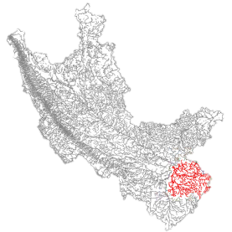
Le Sueur River Basin

Slide 18
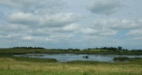
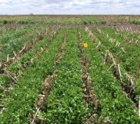
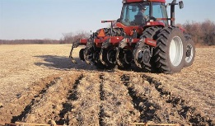
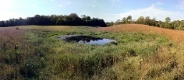
Candidate landscapes
Wetland options:
Present or absent
Location: fluvial or isolated
Size: small, medium, large
Type: shallow marsh or deep pond
Field management options:
Fertilizer management
Reduced tillage
Vegetated filter strips
Grassed waterway
Bluff/bank management:
Ravine tip stabilization
Channel bank stabilization
Notes:
34 field management actions
14 wetland options
Near channel sediment control
And ravine management

Slide 19
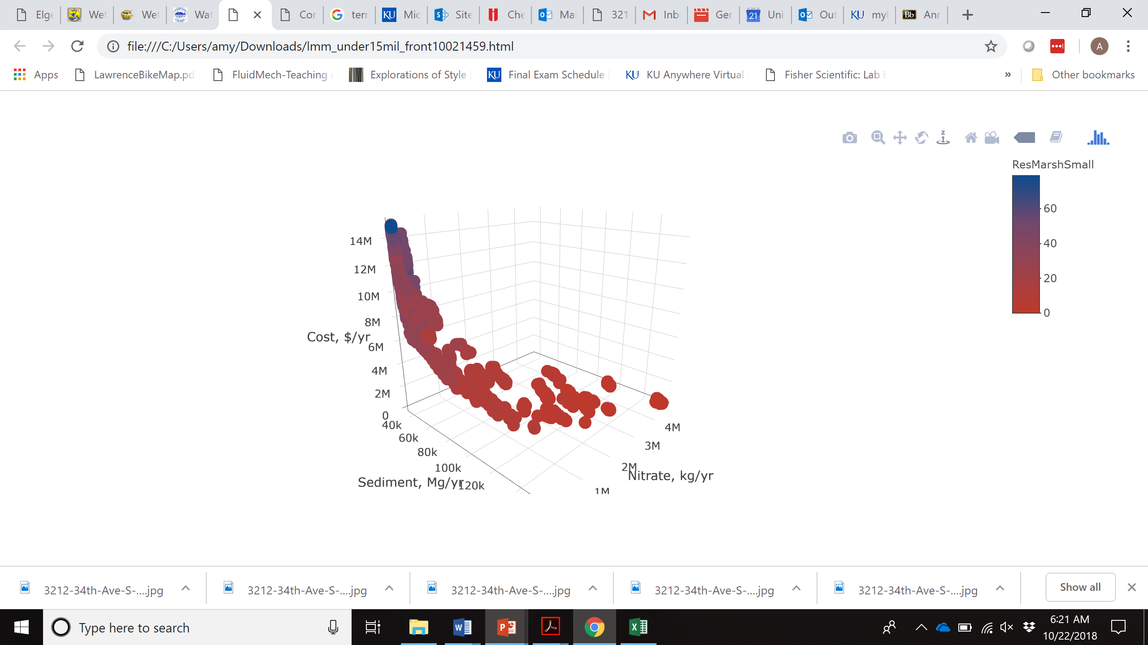
Pareto efficiency frontier

Slide 20
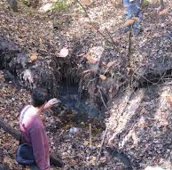
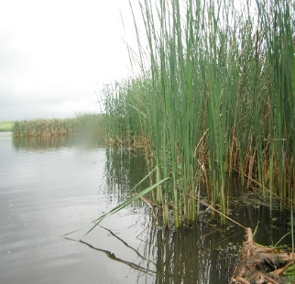
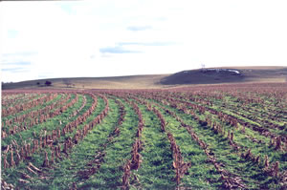
Selection frequency for management options
Next step: Determine patterns in optimal fluvial marsh location.

Slide 21
Our answers to the
fundamental questions addressed by research:
How (cost) effective are wetlands at reducing nitrate concentrations and loads at a watershed scale?
  Percent wetland cover was predictive of nitrate concentration (interception fraction improves predictive ability)
  Ephemeral wetland effect evident for high streamflow conditions
  Small fluvial marshes (i.e. backwaters or constructed treatment wetlands) most cost effective management option for simultaneous control of N, P and S
Notes:
What controls the effectiveness of (fluvial) wetlands at removing nitrate?
Nitrate and organic carbon availability
Water residence times
Wetland location within the fluvial network
Presence of denitrifying bacteria
Environmental conditions

Slide 22
Fundamental questions addressed by research:
How (cost) effective are wetlands at reducing nitrate concentrations and loads at a watershed scale?
What controls the effectiveness of (fluvial) wetlands at removing nitrate?
Notes:
What controls the effectiveness of (fluvial) wetlands at removing nitrate?
Nitrate and organic carbon availability
Water residence times
Wetland location within the fluvial network
Presence of denitrifying bacteria
Environmental conditions

Slide 23
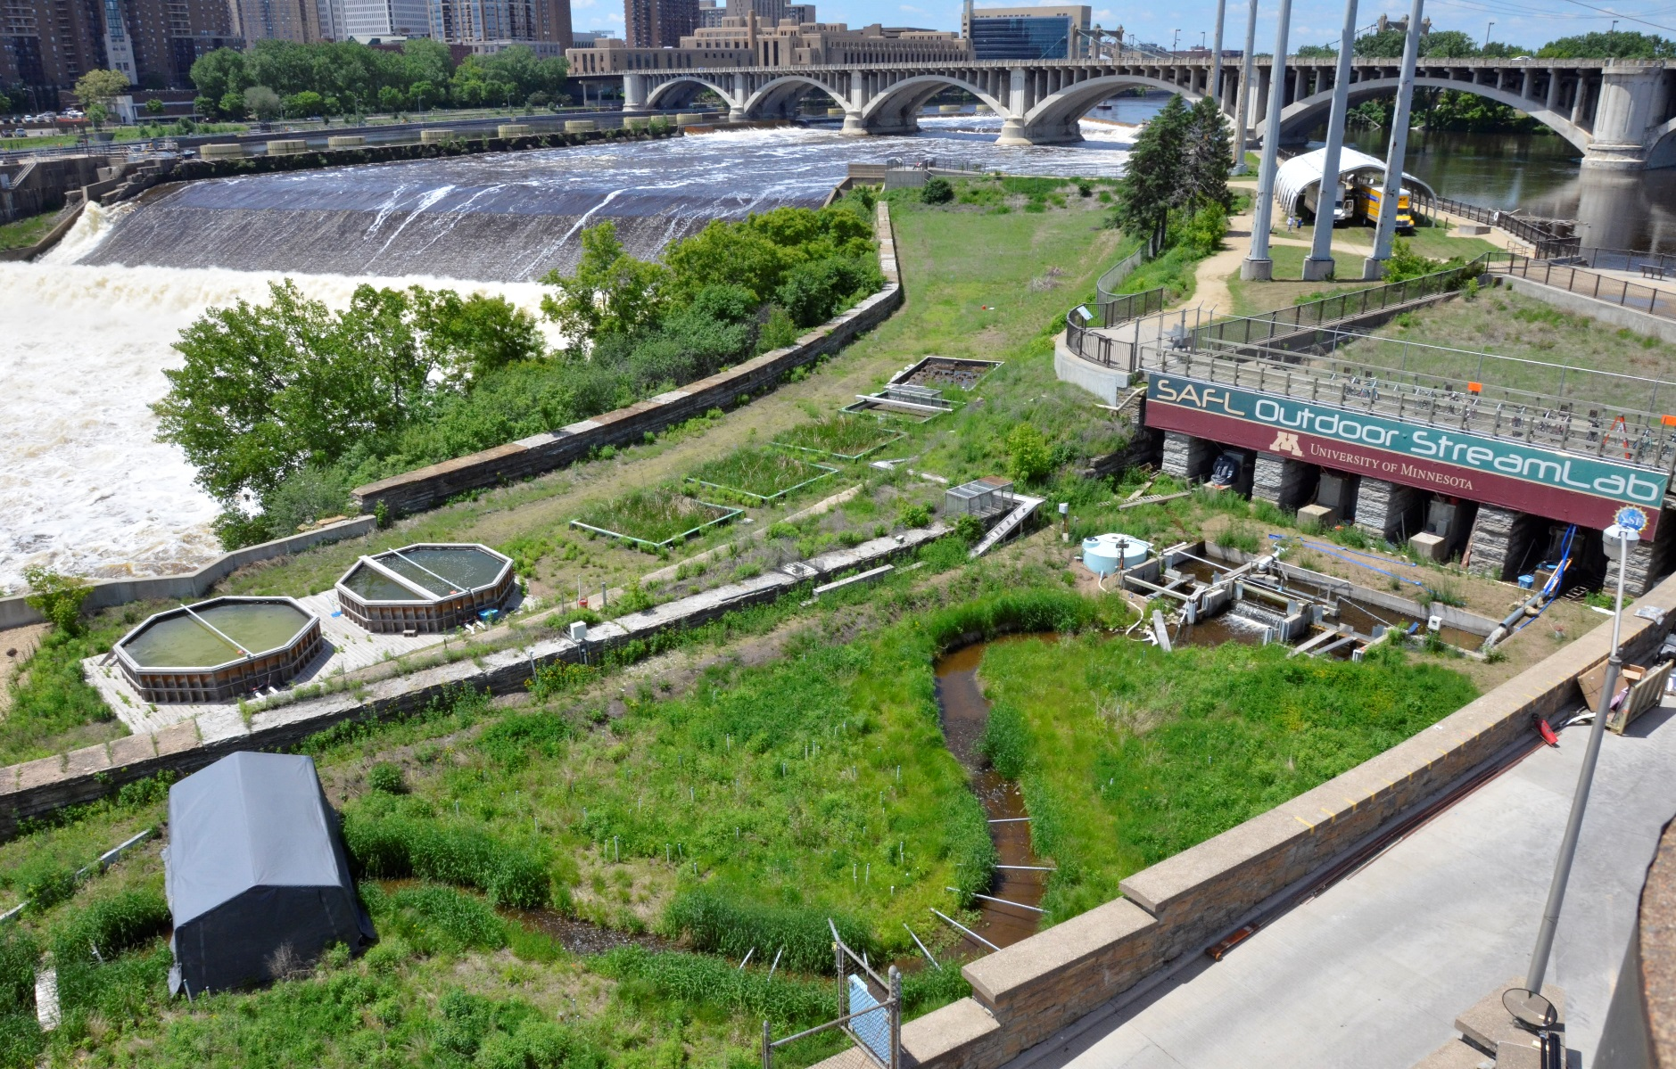
Microbial denitrification dynamics
in floodplains (and channels and test basins)
Abby Tomasek, Jess Kozarek, Miki Hondzo, M. Sadowsky, N. Lurndahl, C. Staley, P. Wang, T. Kaiser

Slide 24

OSL Flood Experiments

Slide 25
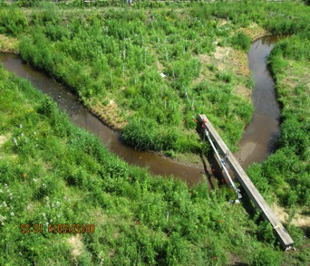
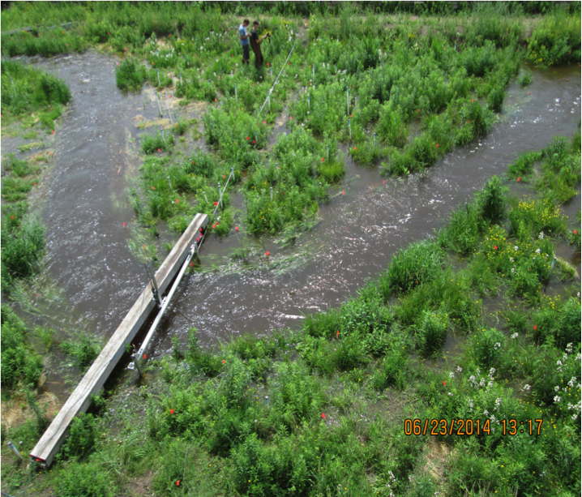
Floodplain denitrification
Average Flow: 25 L/s
Flood Flow: 950 L/s
Tomasek et al. 2017a,b
Tomasek et al. (submitted)

Slide 26
June Flood Results

Slide 27
June Flood Results
In-channel denitrification rates significantly decreased after flooding

Slide 28
June Flood Results
Floodplain denitrification rates significantly increased up to 1 day after flooding, then returned to pre-flood levels by 3 days after

Slide 29
June Flood Results
Floodplain denitrification rates much greater than in-channel rates

Slide 30
Answers:
How (cost) effective are wetlands at reducing nitrate concentrations and loads at a watershed scale?
  Percent wetland cover was predictive of nitrate concentration (interception fraction improves predictive ability)
  Ephemeral wetland effect evident for high streamflow conditions
  Small fluvial marshes (i.e. backwaters or constructed treatment wetlands) most cost effective management option for simultaneous control of N, P and S
What controls the temporal effectiveness of (fluvial) wetlands at removing nitrate?
  Nitrate concentration. Denitrification rates increased for 1 day after flooding with higher nitrate water (but not for flood with low nitrate water)
  Stability/disruption of microbial community. Overall bacterial abundances (16S rRNA) decreased at both in-channel and floodplain sites but denitrification response differed (lower in channel, higher in floodplain compared to base conditions)
  Inundation history (results not shown)
Notes:
What controls the effectiveness of (fluvial) wetlands at removing nitrate?
Nitrate and organic carbon availability
Water residence times
Wetland location within the fluvial network
Presence of denitrifying bacteria
Environmental conditions

Slide 31
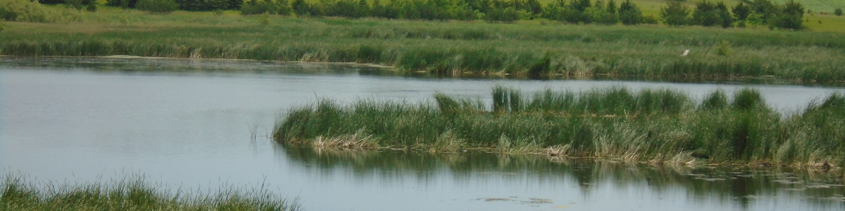
Questions?
amy.hansen@ku.edu
Published components of this research:
Czuba, J.A., A.T. Hansen, E. Foufoula-Georgiou, and J.C. Finlay. 2018. Contextualizing wetlands within a river network to assess nitrate removal and inform watershed management, Water Resources Research. DOI: 10.1002/2017WR021859.
Hansen, A.T., C.L. Dolph, E. Foufoula-Georgiou, J.C. Finlay. 2018. Contribution of wetlands to nitrate removal at the watershed scale, Nature Geosciences. DOI: 10.1038/s41561-017-0056-6.
Hansen, A. T., C. D. Dolph, and J. C. Finlay. 2016. Do wetlands enhance downstream denitrification in agricultural landscapes? Ecosphere. 7(10): e01516. 10.1002/ecs2.1516
Tomasek, A., J. L. Kozarek, M. Hondzo, N. Lurndahl, M. J. Sadowsky, P. Wang & C. Staley (2017a) Environmental drivers of denitrification rates and denitrifying gene abundances in channels and riparian areas. Water Resources Research, 53, 6523-6538.
Tomasek, A., C. Staley, P. Wang, T. Kaiser, N. Lurndahl, J. L. Kozarek, M. Hondzo & M. J. Sadowsky (2017b) Increased Denitrification Rates Associated with Shifts in Prokaryotic Community Composition Caused by Varying Hydrologic Connectivity. Frontiers in Microbiology, 8.
Tomasek, A. A., T. D. Barman, P. Wang, J. L. Kozarek, C. Staley, M. J. Sadowsky & M. Hondzo (2018) The Effects of Turbulence and Carbon Amendments on Nitrate Uptake and Microbial Gene Abundances in Stream Sediment. Journal of Geophysical Research-Biogeosciences, 123, 1289-1301.

