Slide 1
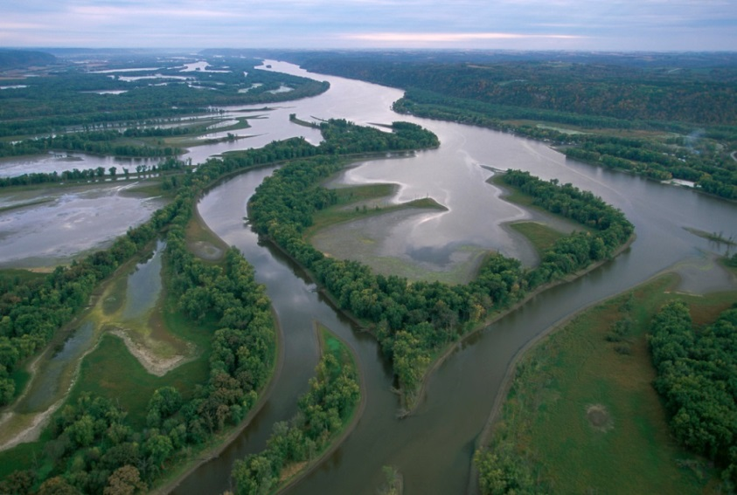
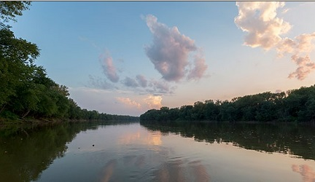
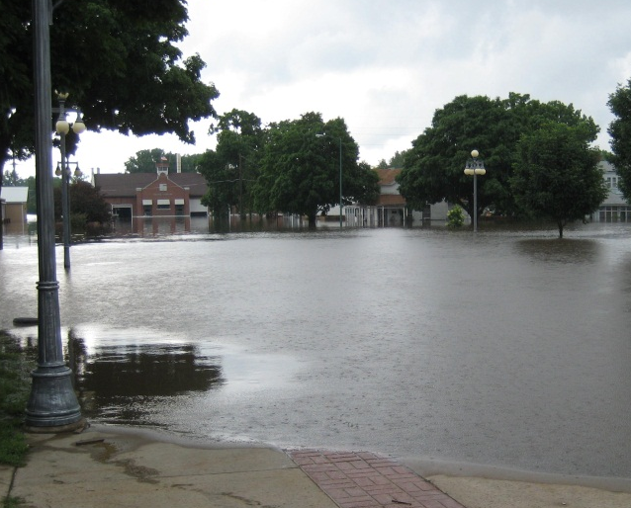
Prioritizing Floodplains to Restore the Mississippi River Basin
Kris Johnson, PhD
The Nature Conservancy
October 24, 2018

Slide 2
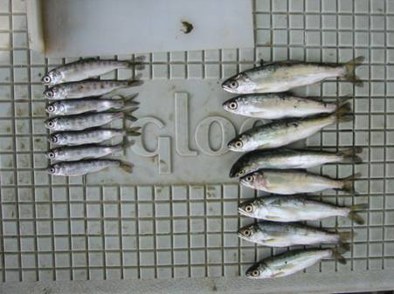
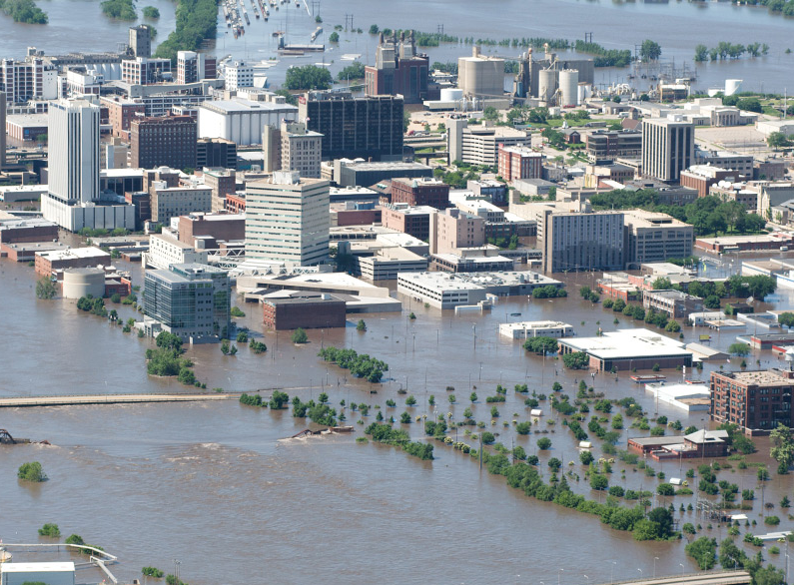
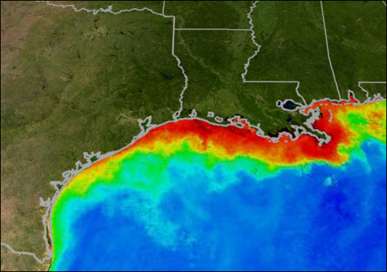
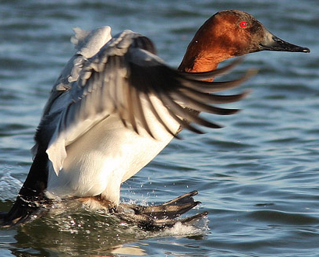
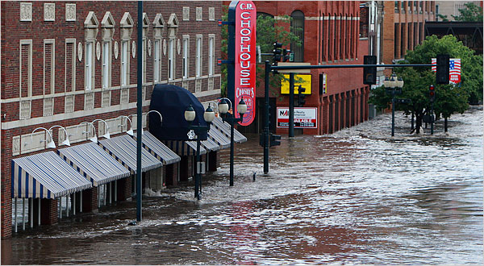
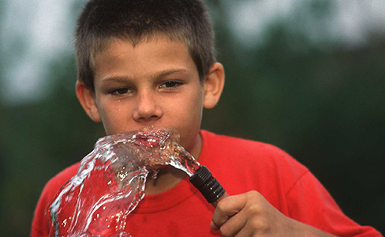
Multiple Benefits of Floodplains

Slide 3
Successful Floodplain Projects

Slide 4
Floodplain Prioritization
How do we scale up?
Where to invest?

Slide 5


Floodplain Analysis
41 million people at risk
$5 TRILLION exposed
Wing et al 2018

Slide 6
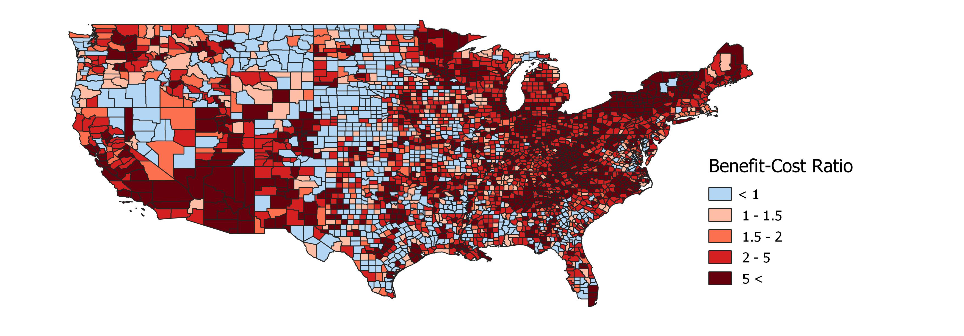
Floodplain Analysis
Floodplain conservation provides
cost-effective flood damage reduction
Johnson et al in preparation

Slide 7
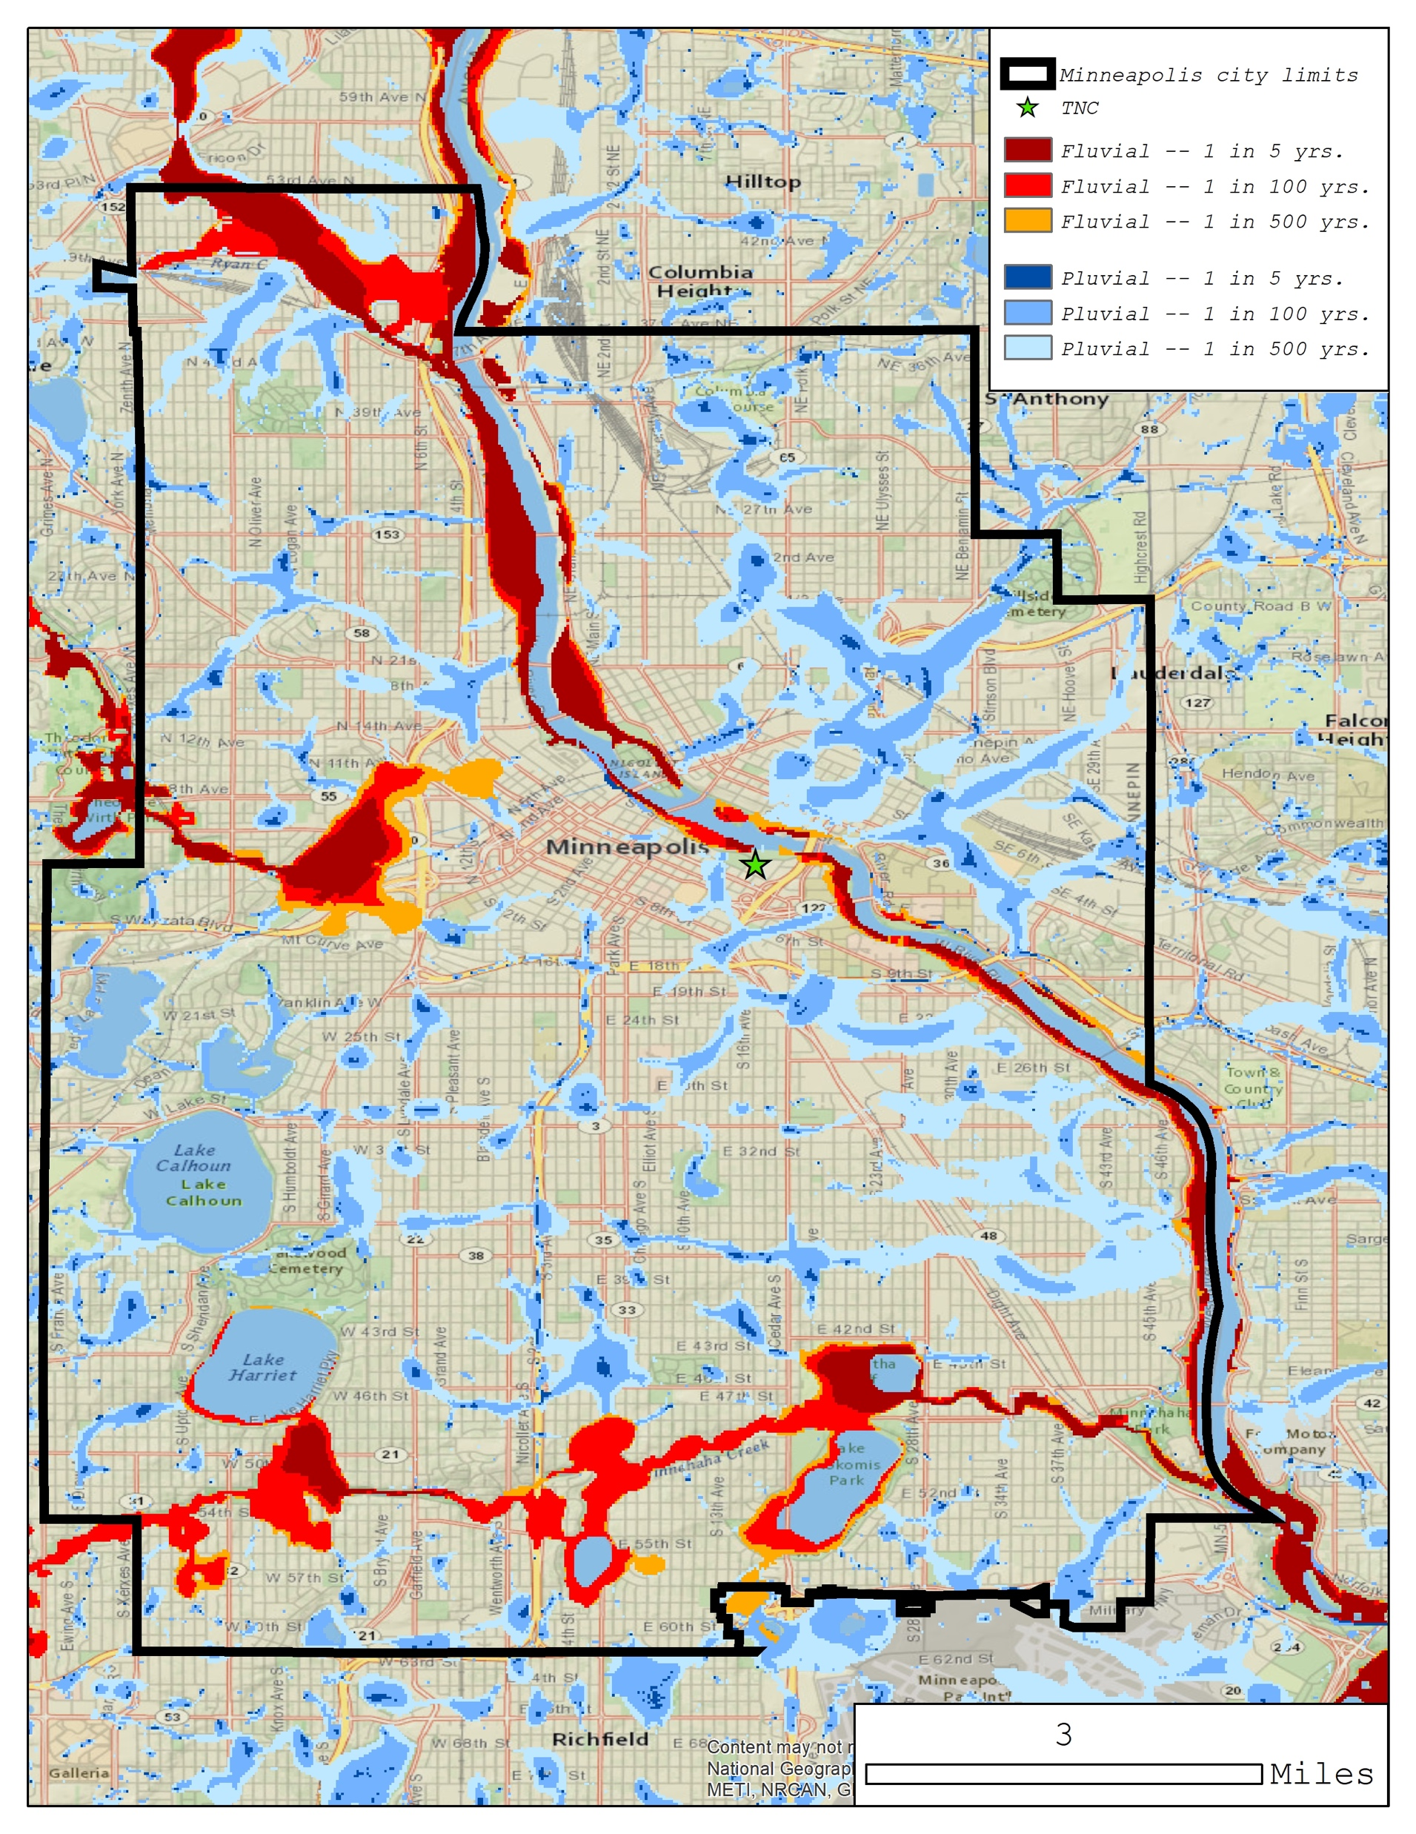
Floodplain Prioritization
Nutrients: Gulf of Mexico &
local water quality
Flooding: exposure, damages &
social vulnerability
Biodiversity: species, habitat priorities
& landscape connectivity

Slide 8
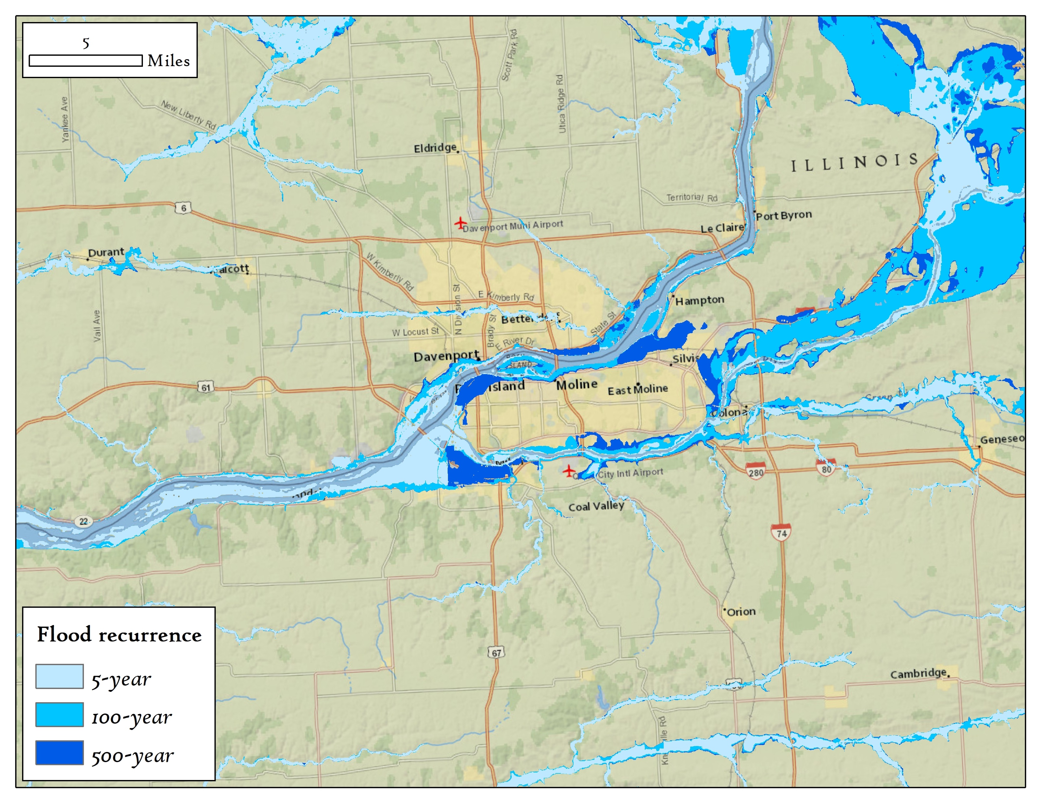
Floodplain Prioritization

Slide 9
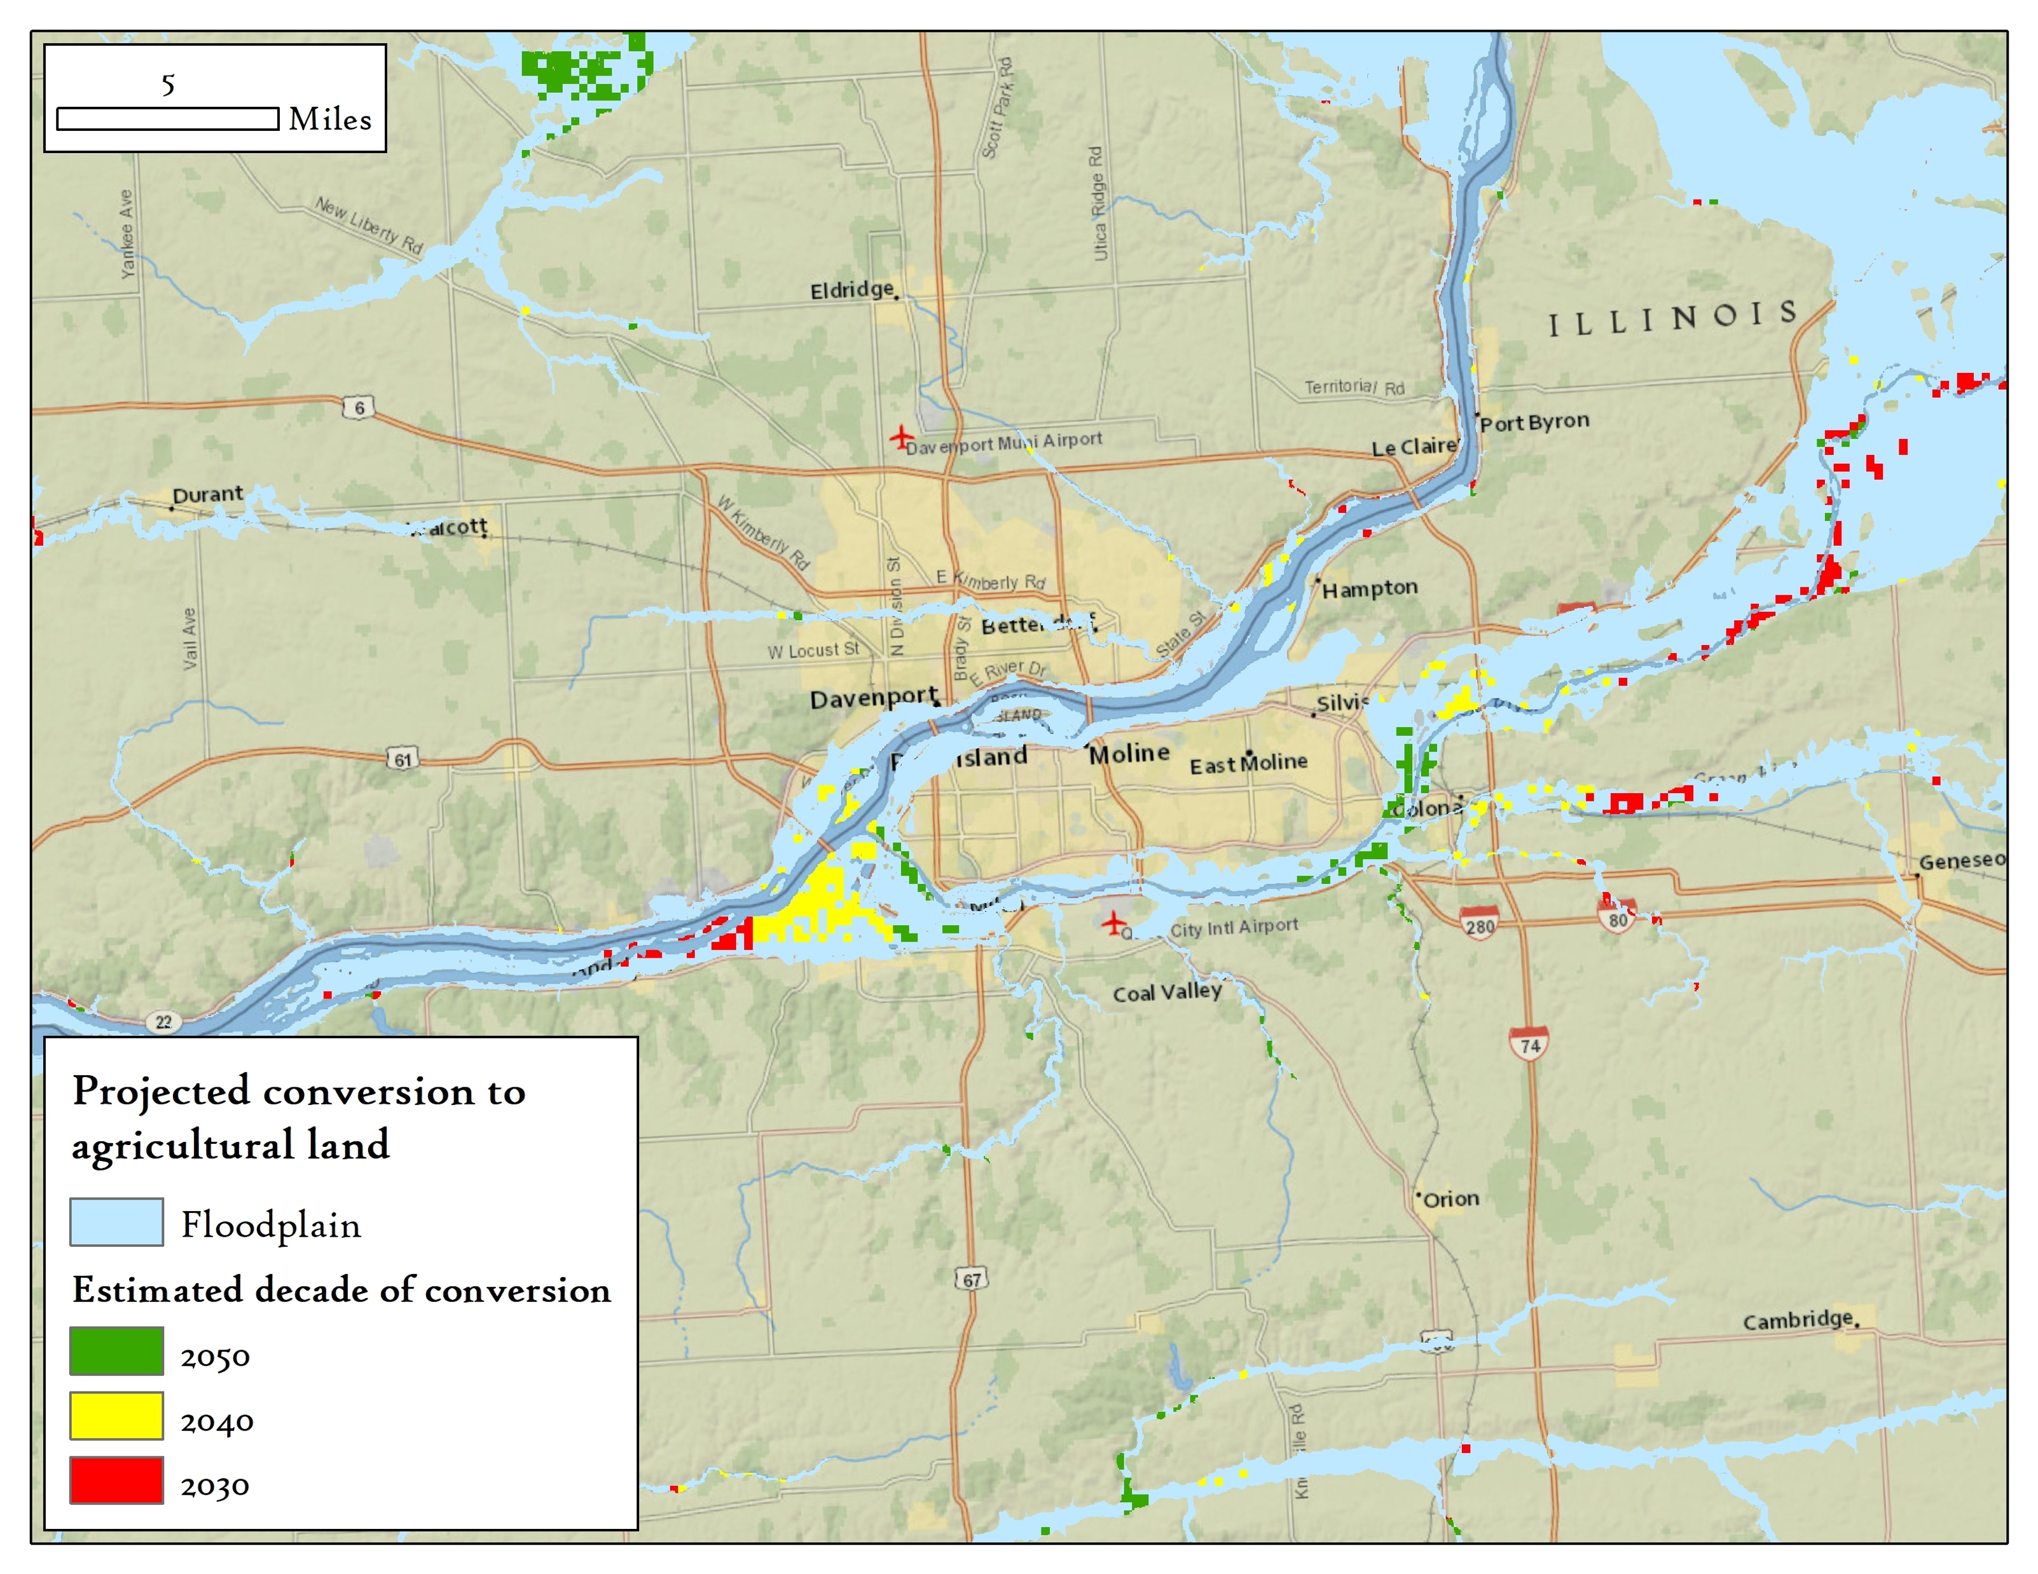
Floodplain Prioritization

Slide 10
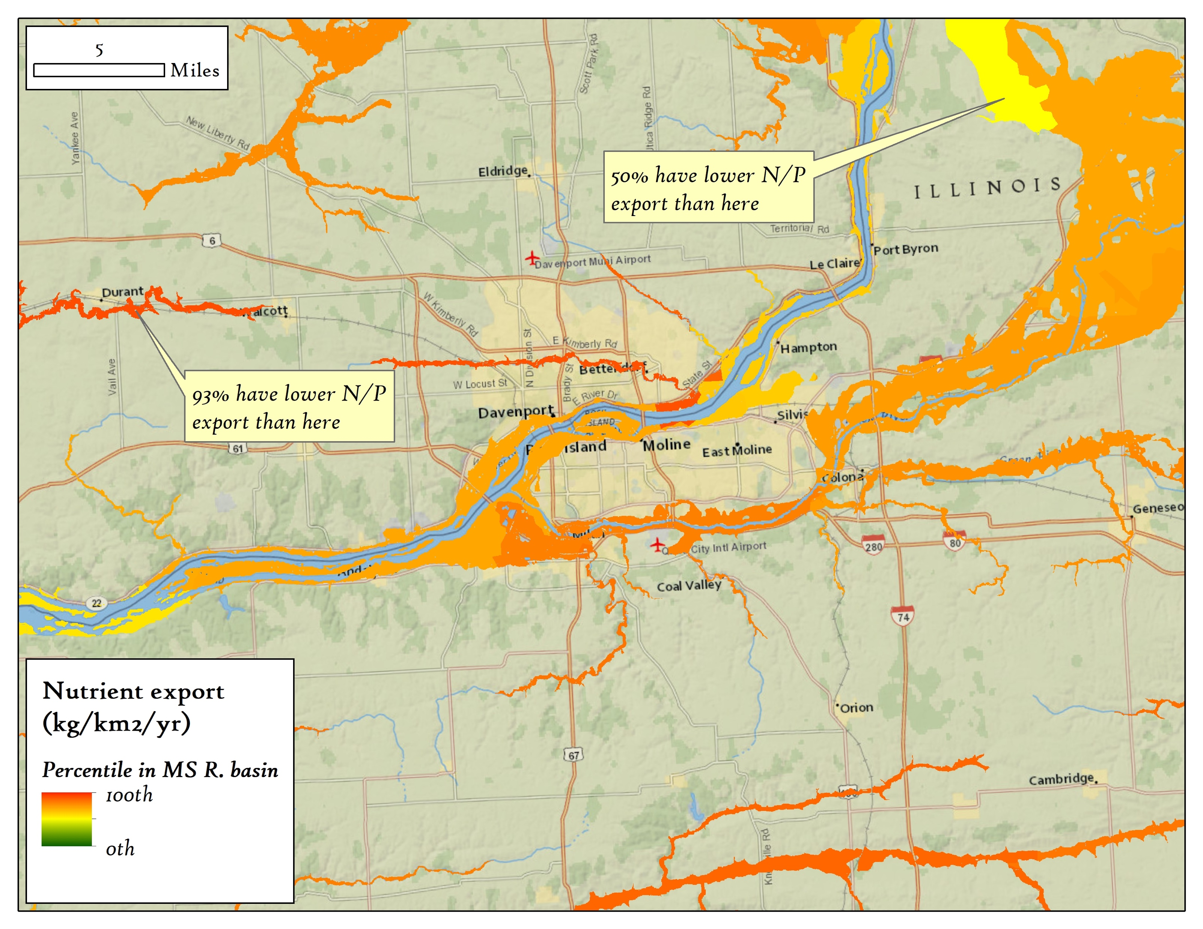
Floodplain Prioritization

Slide 11
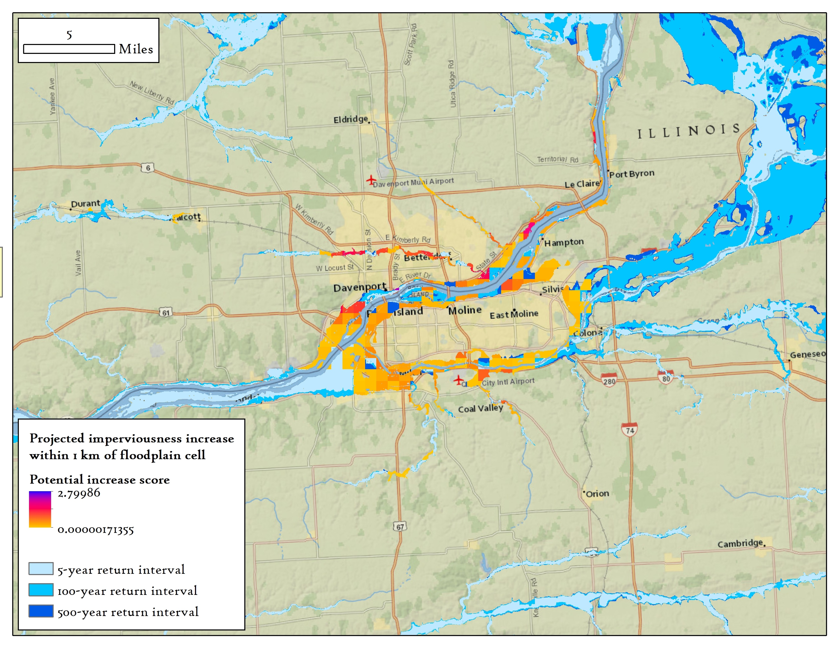
Floodplain Prioritization

Slide 12
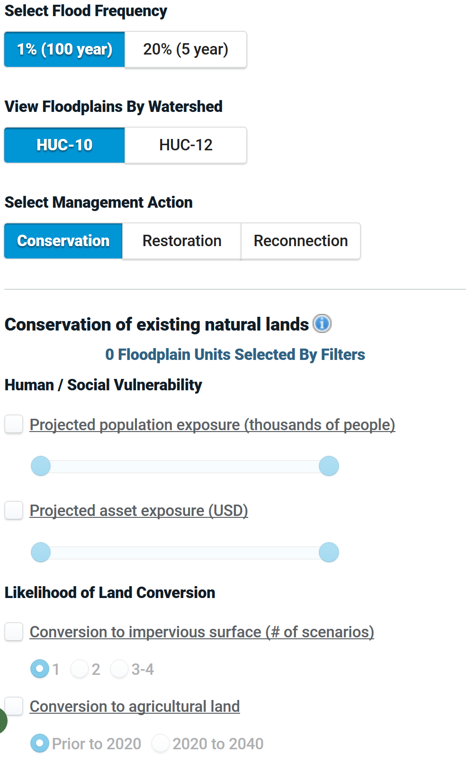
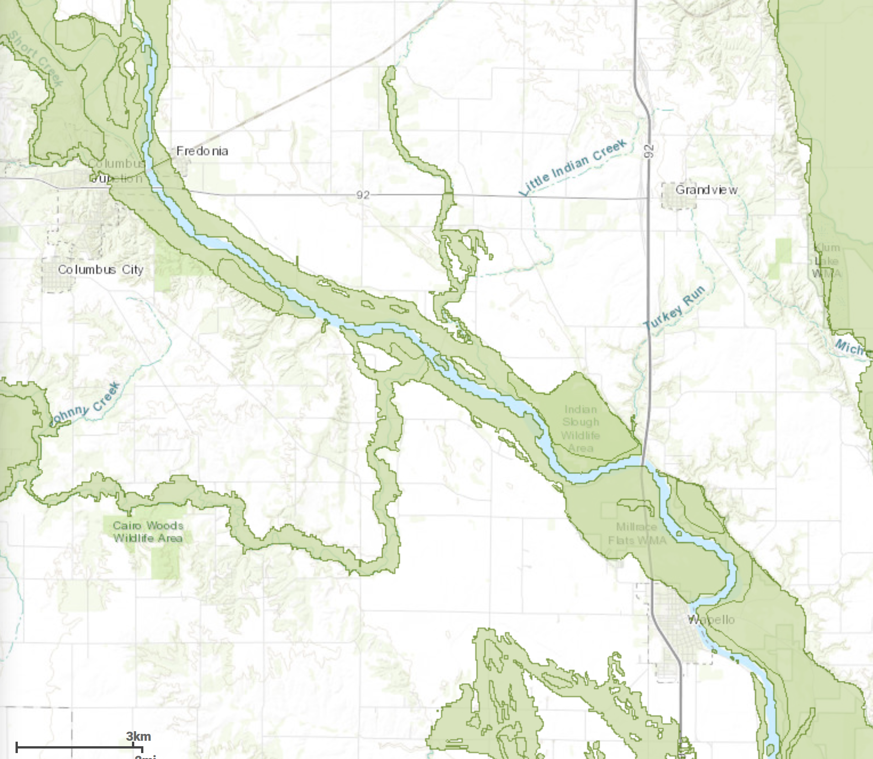
Floodplain Explorer Decision Tool

Slide 13
Questions?
kjohnson@tnc.org

