Slide 1
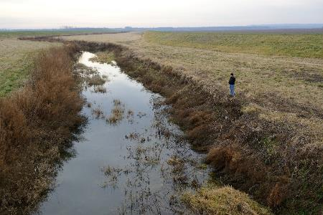
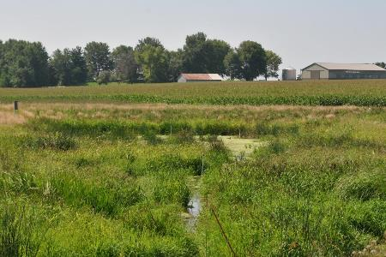
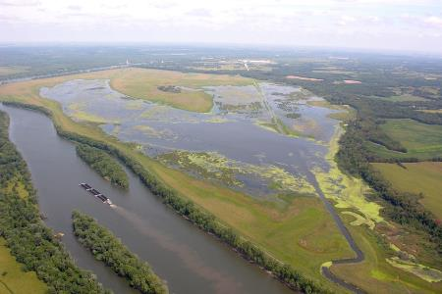
The Floodplain Connection:
The Role of Small to Large Restored Wetlands in Improving Water Quality
Jill Kostel, PhD
Senior Environmental Engineer
The Wetland Initiative
jkostel@wetlands-initiative.org

Slide 2
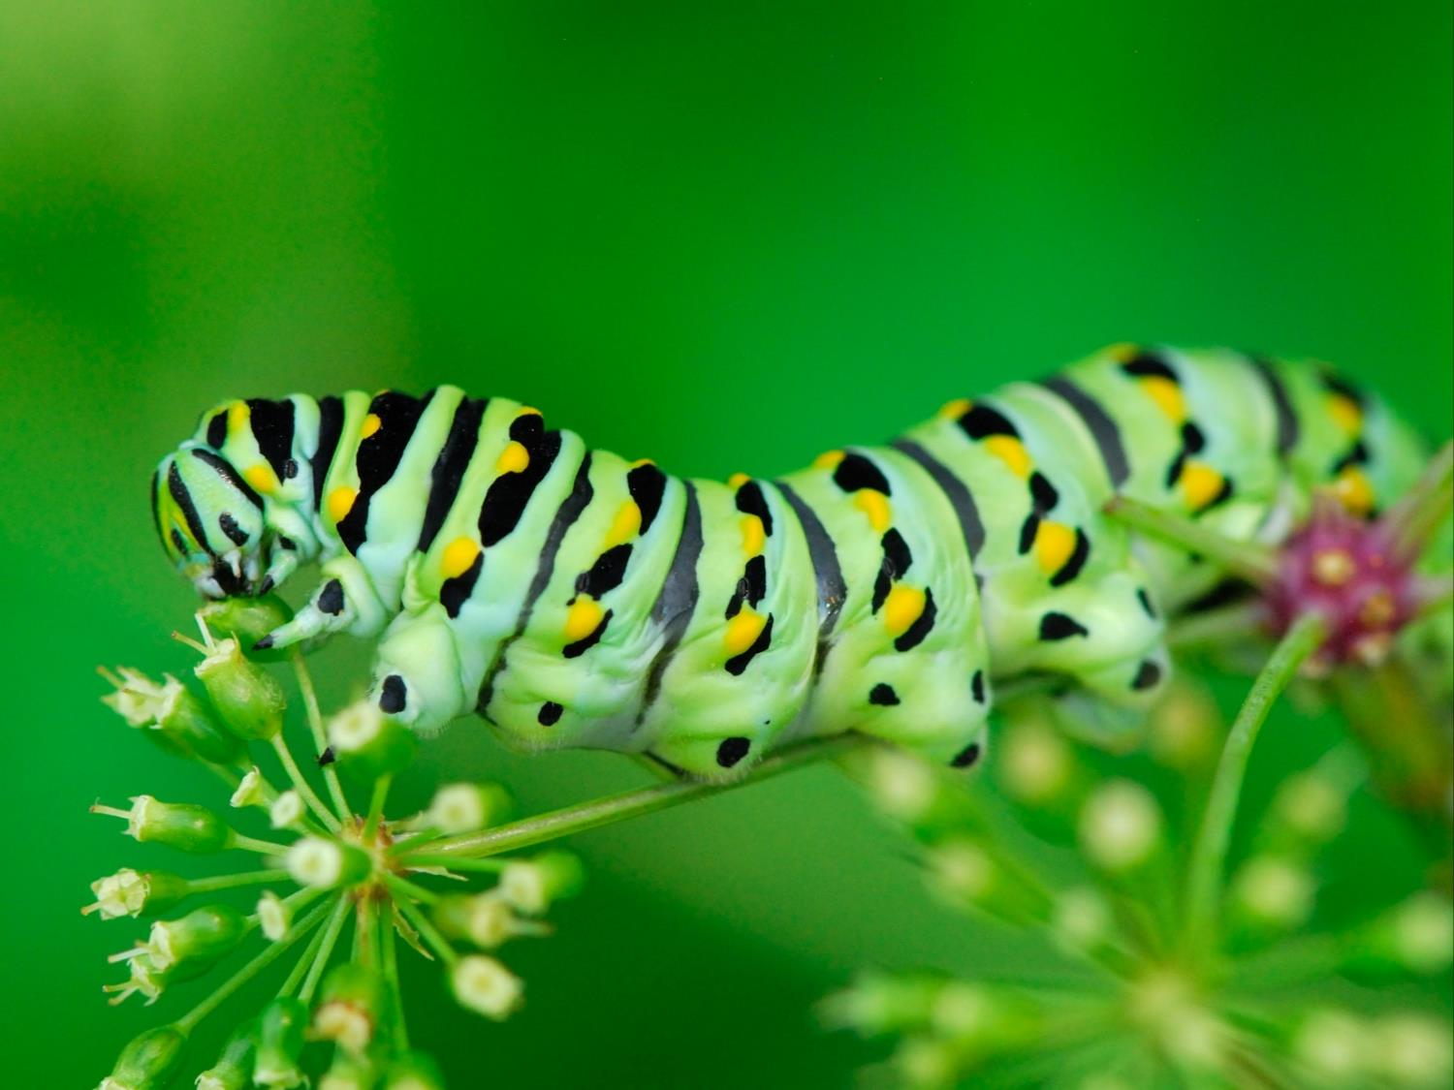

The Wetlands Initiative is a nonprofit dedicated to restoring the wetland resources of the Midwest to improve water quality, increase wildlife habitat and biodiversity, and reduce flood damage.

Slide 3
Wetland values and functions
SERVICE | WETLANDS
Environmental Goods | Food Fresh Water Fuel
Regulating Services | Carbon Storage Climate Regulation Flood Regulation Groundwater Replenishment Water Quality Improvement Shoreline Stabilization Biodiversity/Wildlife Habitat
Support Services | Primary Production Nutrient Cycling Soil Formation
Cultural Services | Aesthetic Spiritual Educational Recreation

Slide 4
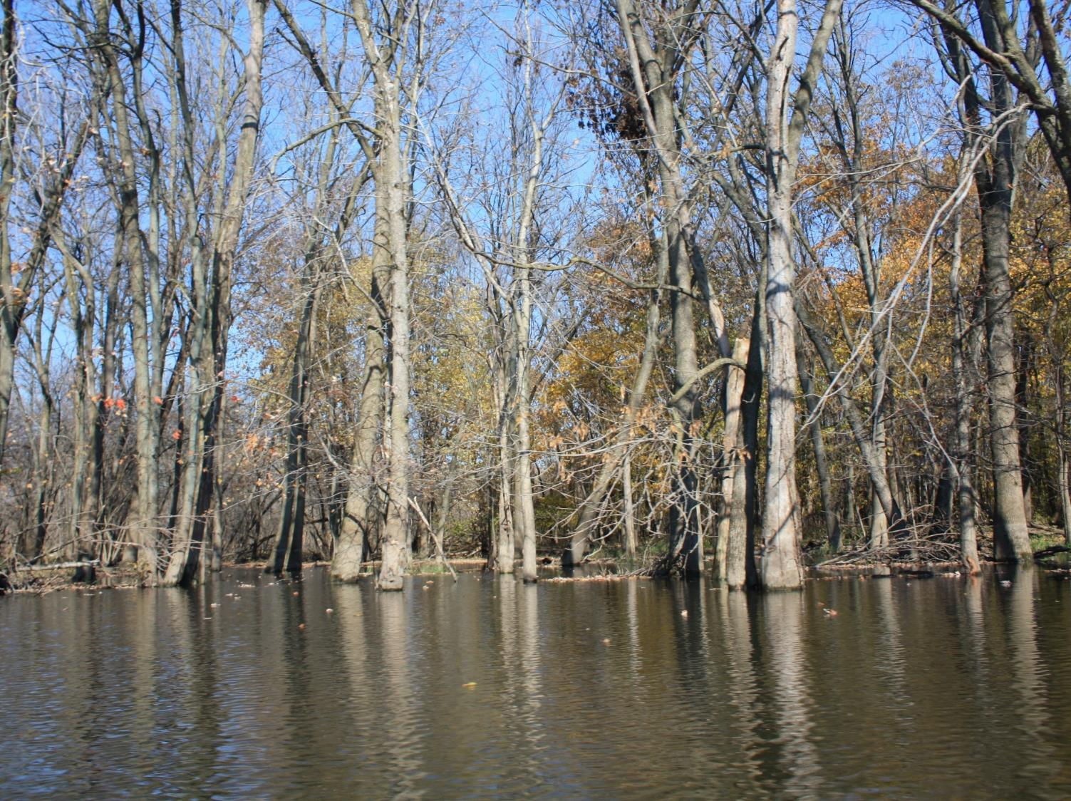
BIG SPONGE (FLOOD STORAGE)

Slide 5
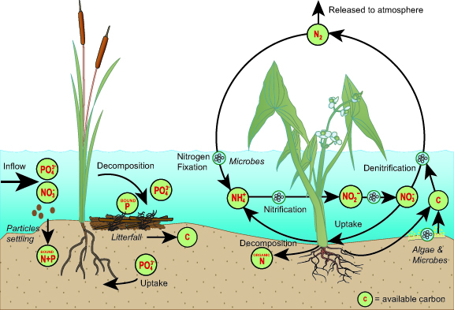
WETLAND NUTRIENT DYNAMICS
(Symbols courtesy of the Integration and Application Network, University of Maryland Center for Environmental Science at ian.umces.edu/symbols/)

Slide 6
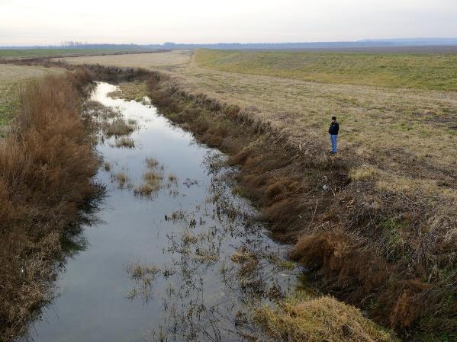
Floodplain wetlands
Position and scale of floodplain wetlands (restored or constructed) for water quality improvement
Along main river channels on adjacent floodplain or behind levees
Within the headwaters areas of small watersheds
  On field edges between farm and receiving waters
  Within ditch or stream channel
Hydrologic connection to the floodplain and wetland areas
Natural hydrologic interaction
“Restored” connection
Designed hydrologic connection
TRIB TO ILLINOIS RIVER

Slide 7
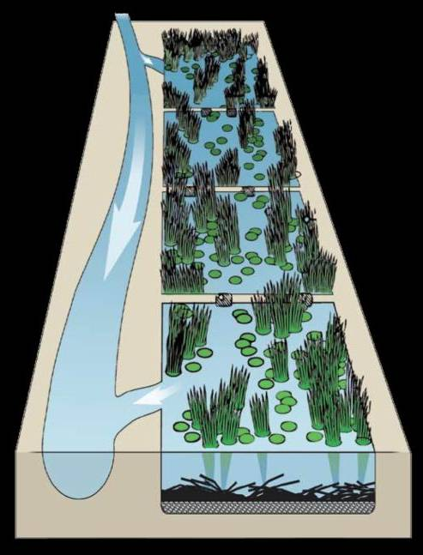
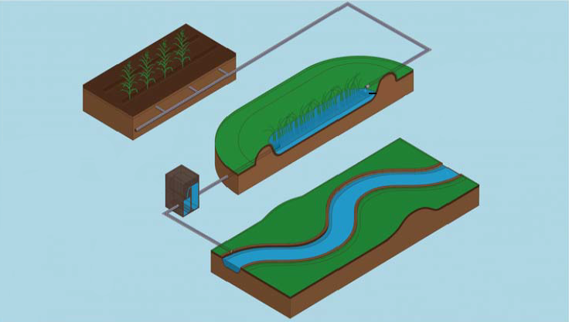
Scale of Floodplain wetlands
(NRCS)
Floodplain of main-stem rivers
(large-scale restored wetlands)
Floodplain of headwater streams
(multiple, small-scale restored or created wetlands)

Slide 8
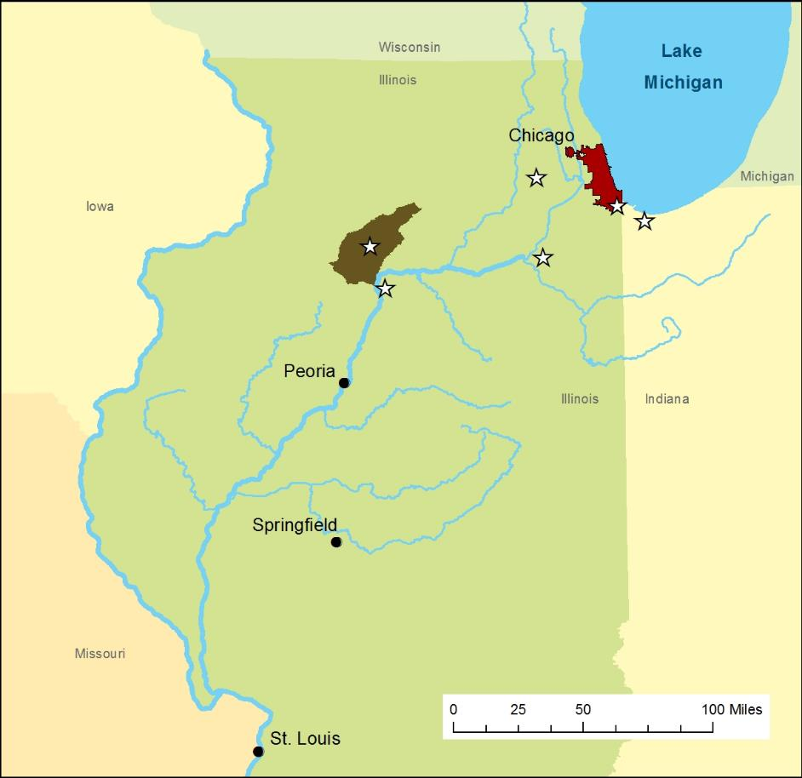
TWI Restoration project sites
Dixon Waterfowl Refuge (Hennepin, IL)
Little Calumet River Basin (near Gary, IN)
Springbrook #1, Phase 1 (Wheaton, IL)
SmartWetland sites (Big Bureau Creek Watershed, IL)
3
4
2
1

Slide 9
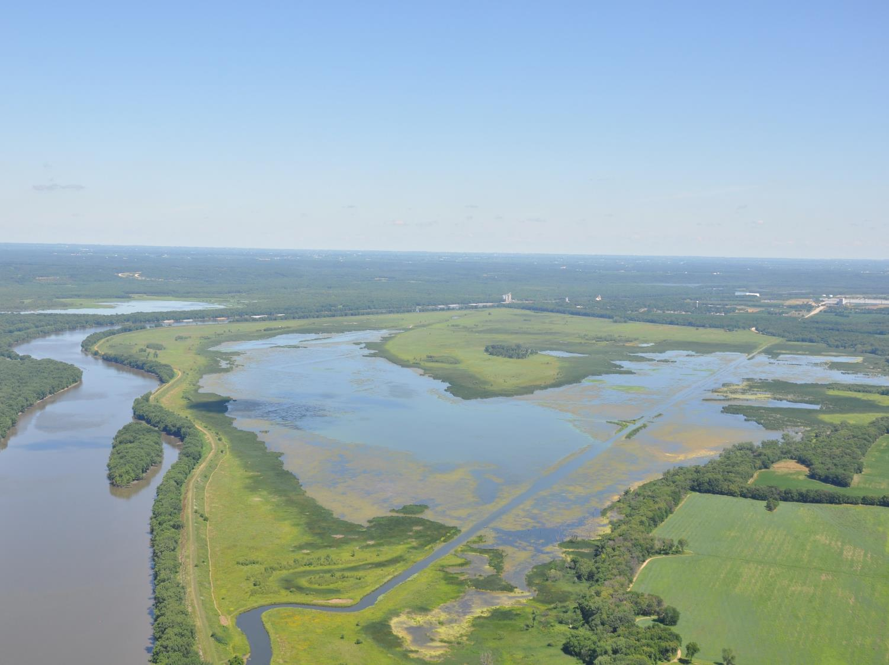
1. SUE & WES DIXON WATERFOWL REFUGE
FORMER HENNEPIN LEVEE DRAINAGE DISTRICT (~50 YR LEVEL)
OUTLET TO IL RIVER

Slide 10
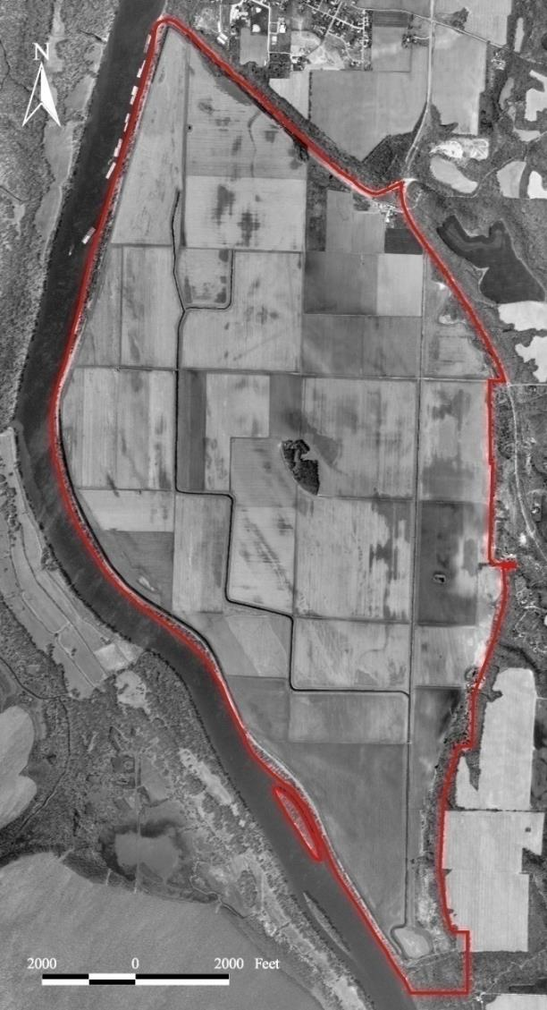
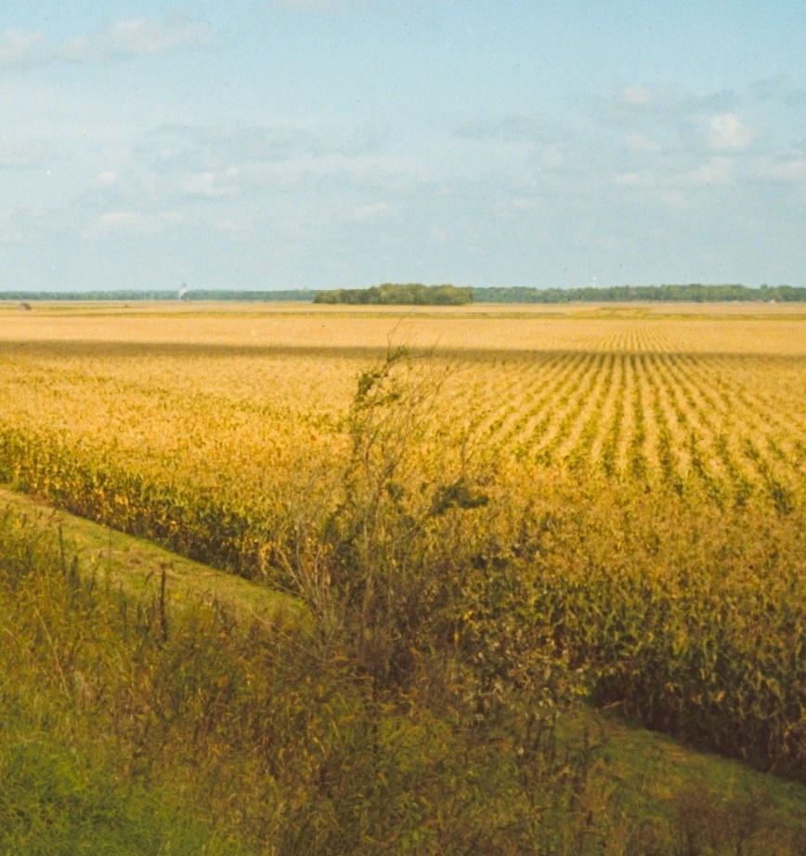
1996 (PRE-RESTORATION)

Slide 11
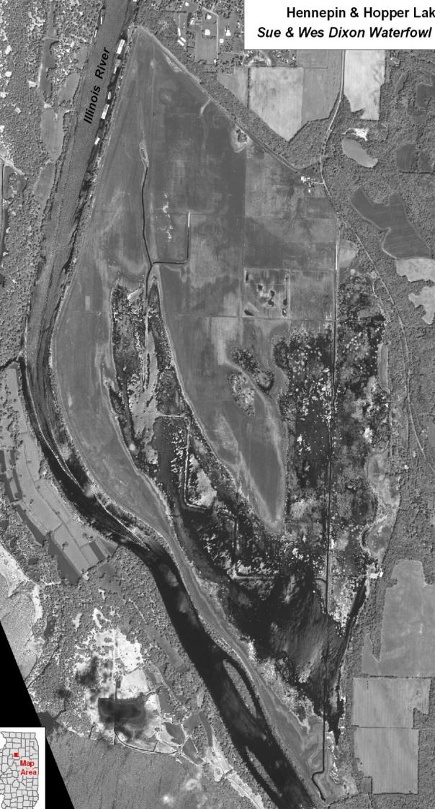
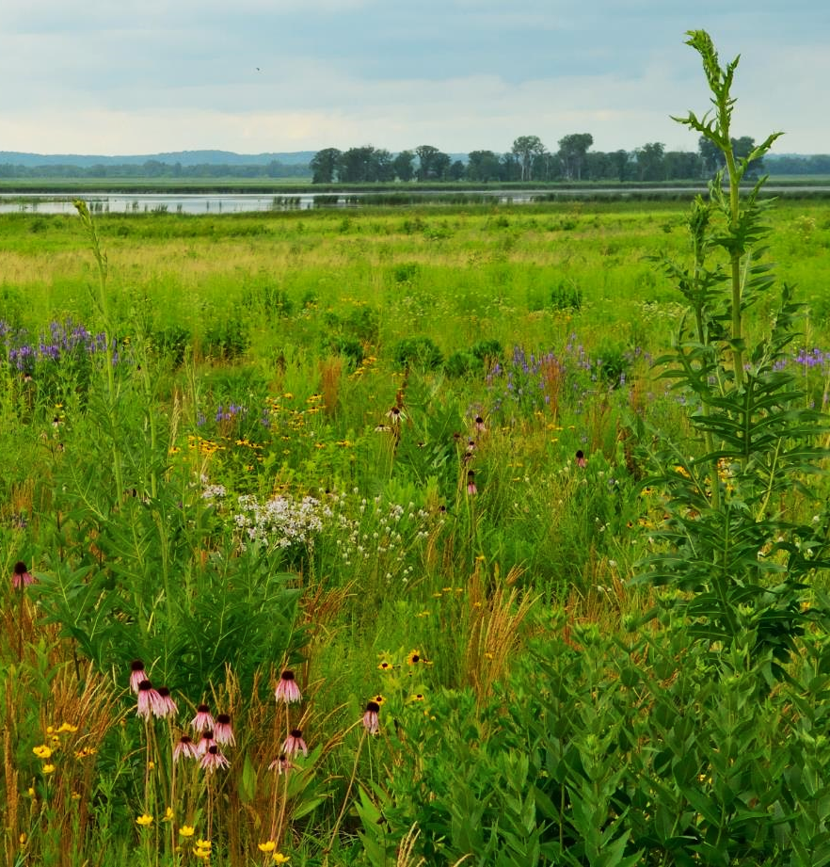
RESTORATION STARTED IN 2004
BIODIVERSITY DESIGN TARGET

Slide 12
Water quality (No₃-N)
DISCHARGING LOWER NITRATE CONCENTRATIONS
SEEP (FIELD EDGE SAMPLES)
OPEN LAKE SAMPLES

Slide 13
RECONNECTION TO ILLINOIS RIVER?
IT’S A DIFFERENT RIVER NOW
455
1870
450
445
440
1870 H&H
LAKE LEVEL
438
435
430
River Stage (feet NGVD 1929)
J
F
M
A
M
J
J
A
S
O
N
D
455
1993
450
445
1940 PEORIA DAM POOL
440
438
2014 H&H
LAKE LEVEL
435
430
J
F
M
A
M
J
J
A
S
O
N
D
River stage level at Henry, IL

Slide 14
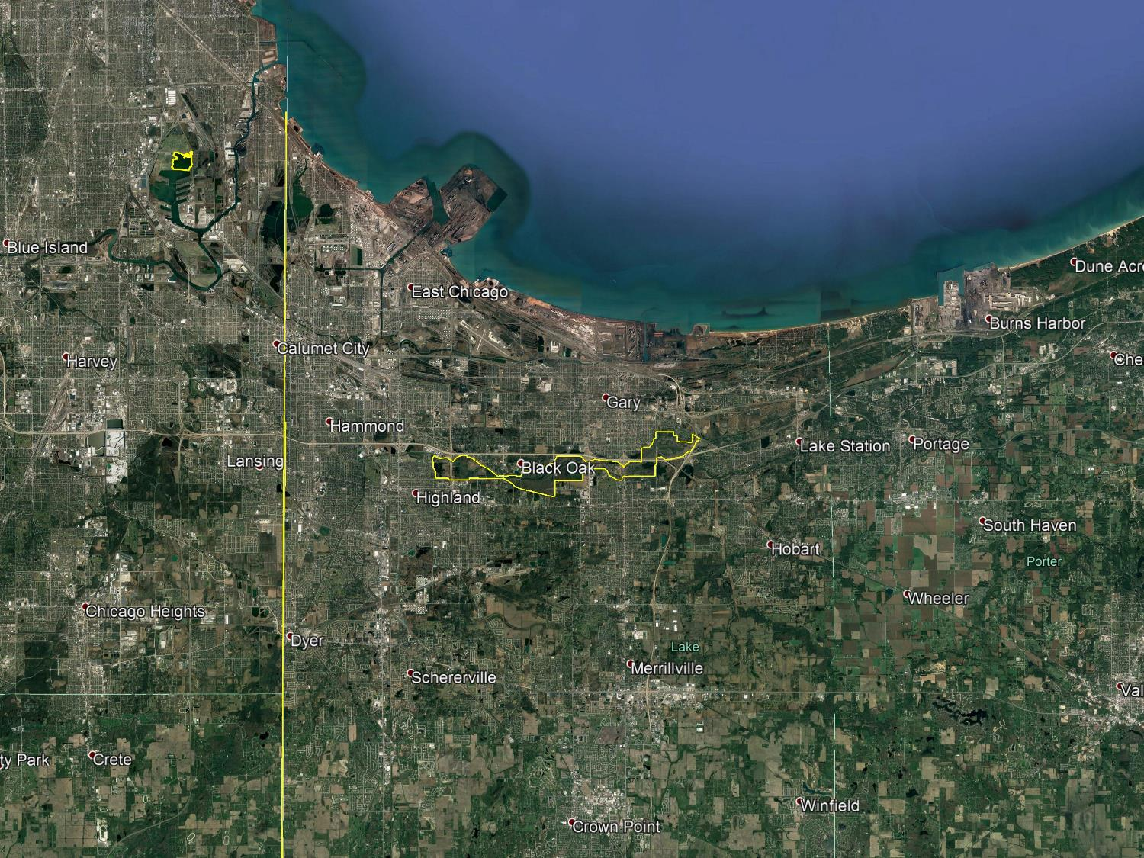
2. Little calumet river basin

Slide 15
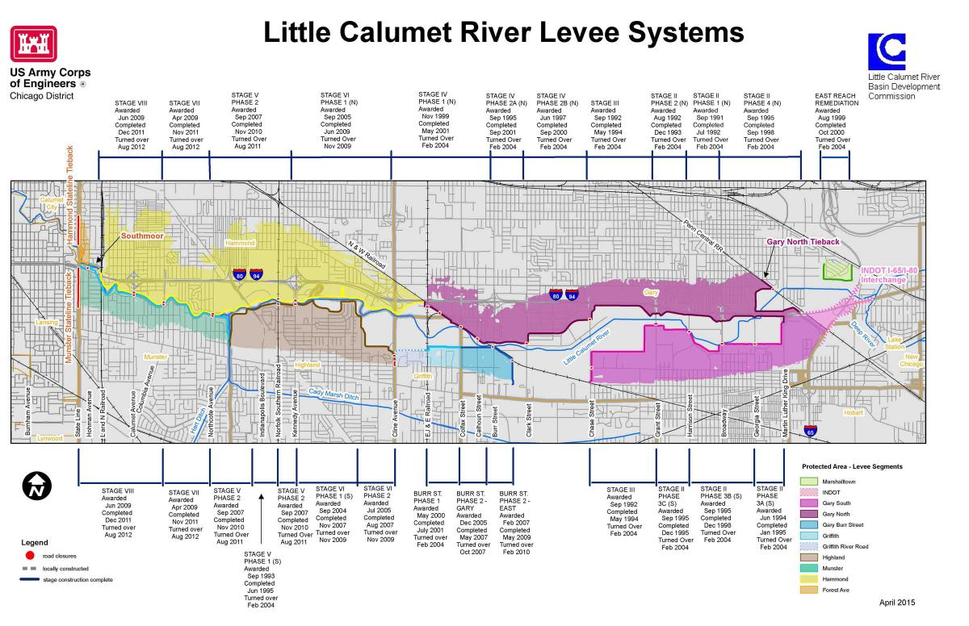
Little calumet river basin
Protection of 3,500 acres of existing residential, industrial, and transportation uses
Flood protection up to 200 year level via set-back levees, levees, and floodwalls
2,000 acre river/recreation corridor

Slide 16
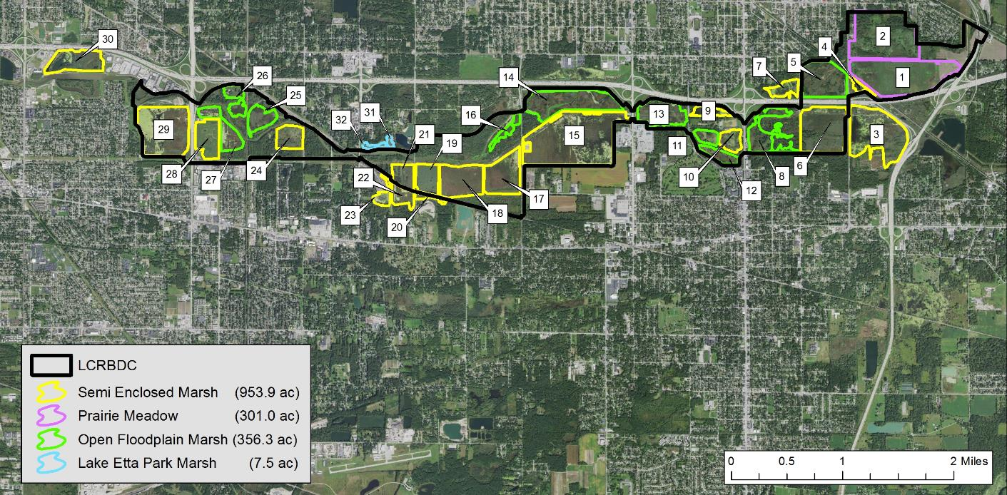


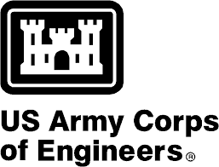


Little calumet river basin
Opportunity to restore/enhance wetland areas for bird habitat

Slide 17
Little calumet river basin
MLKS POOL
MLKN DAM
BASE FLOW

Slide 18
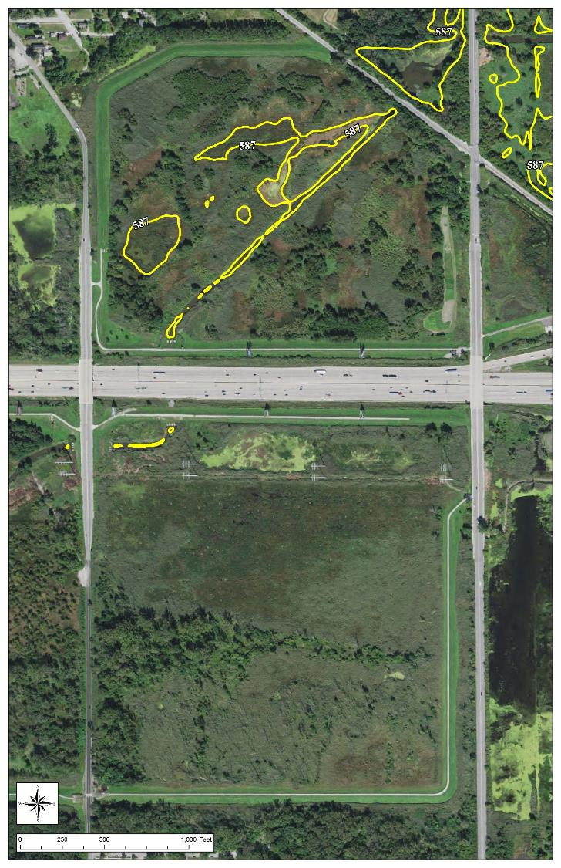
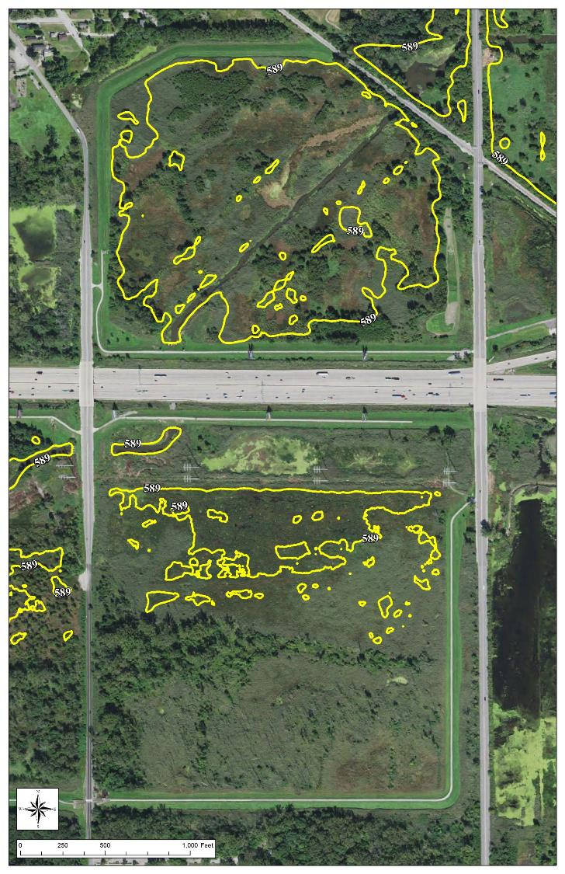
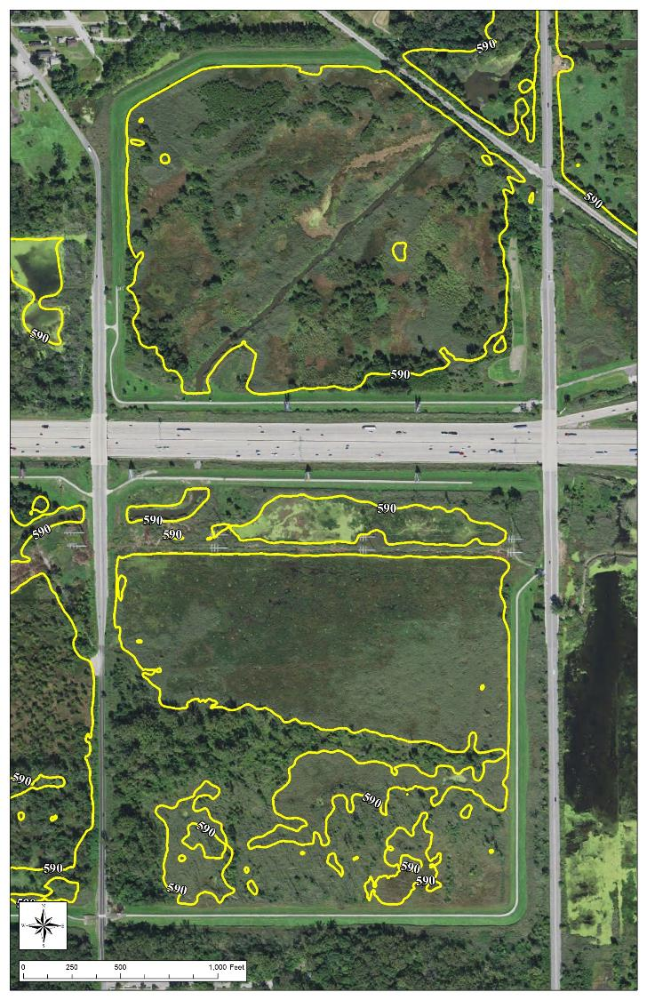
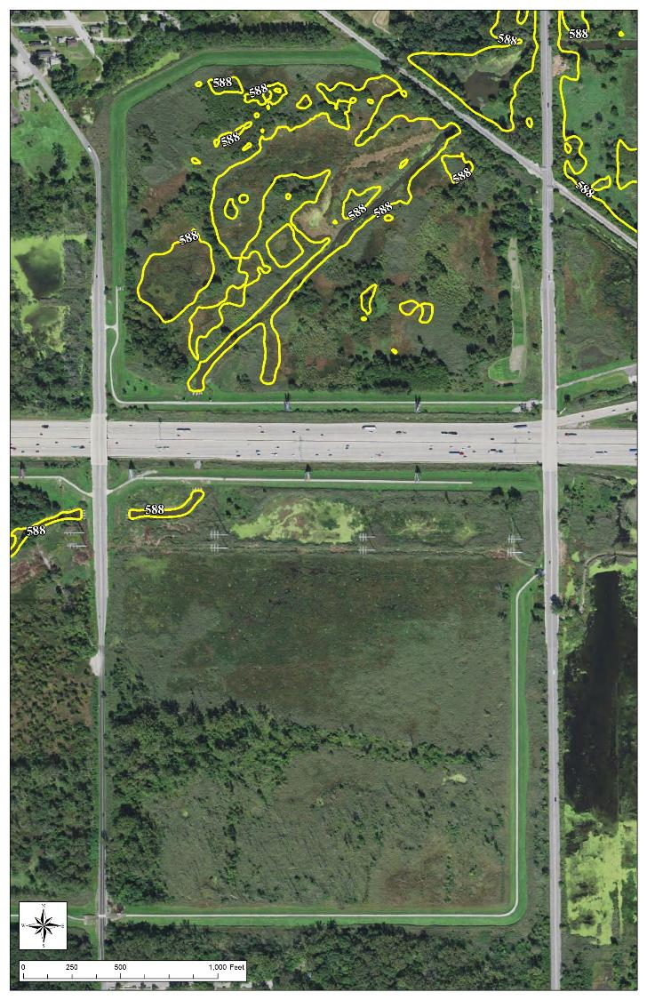
El. 587
El. 588
El. 590
El. 589

Slide 19
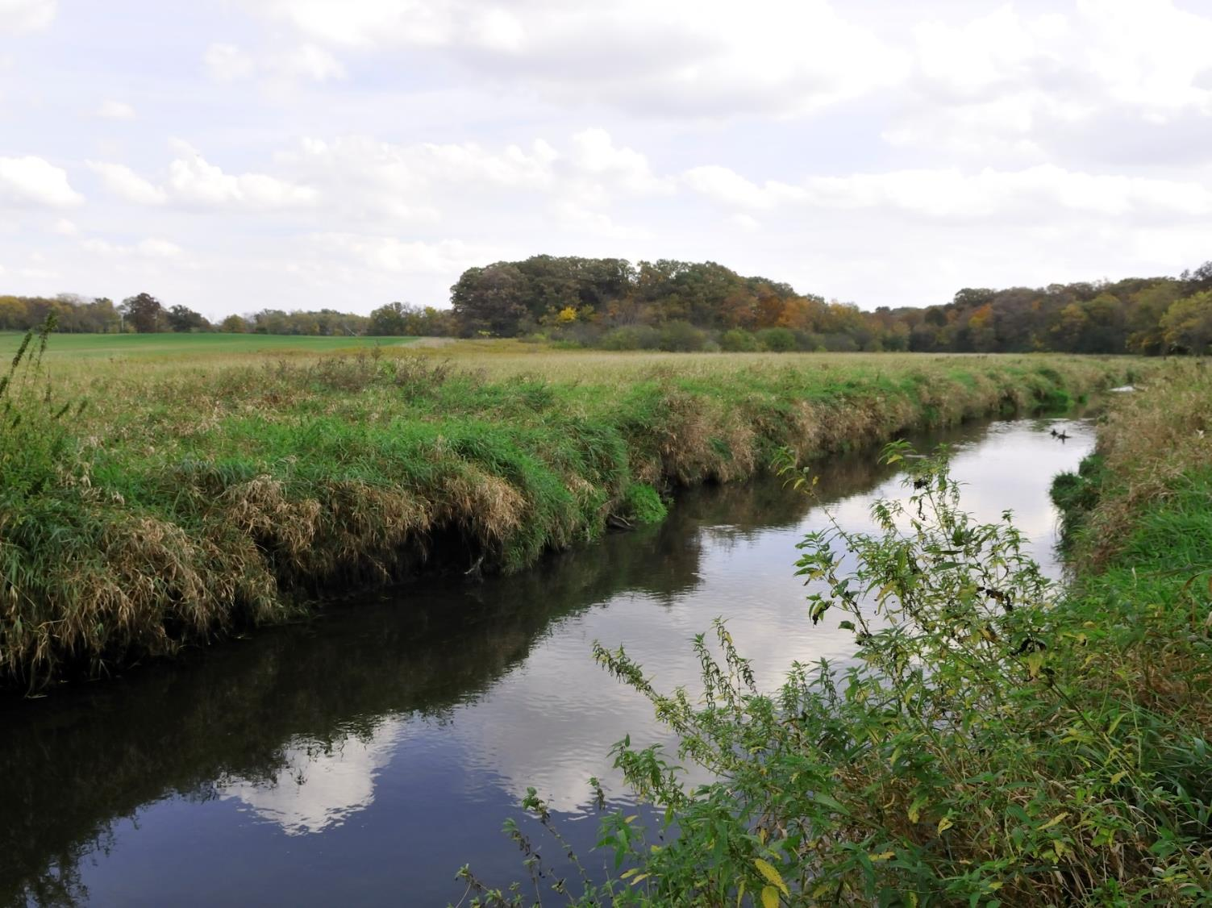
3. Springbrook #1
St. James Farm, Forest Preserve District of DuPage County

Slide 20
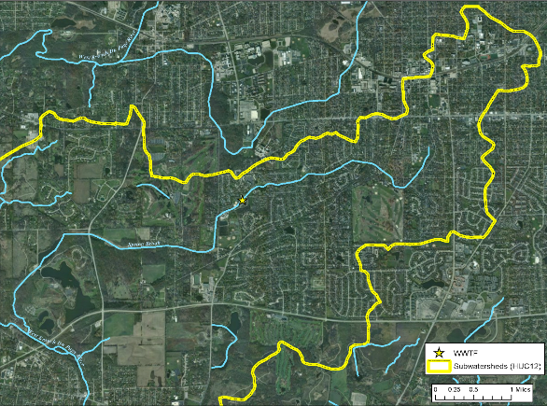
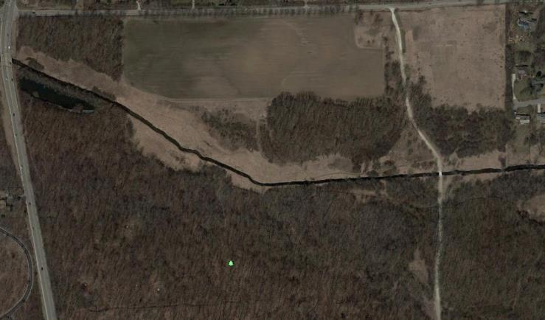
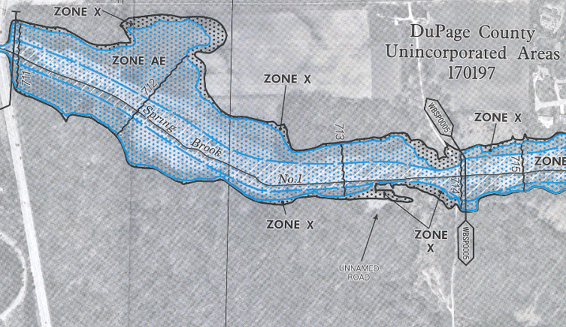
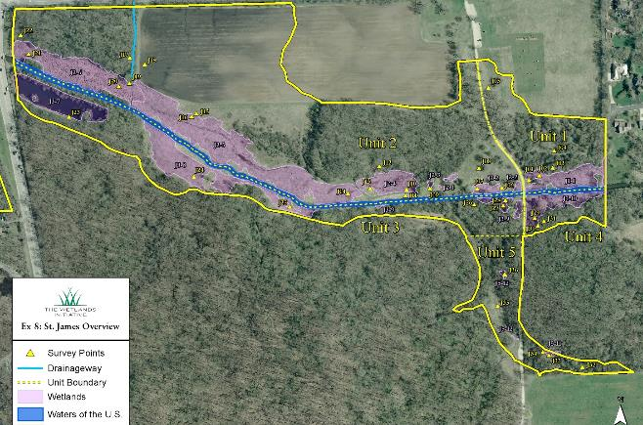
Springbrook #1
TYPICAL URBAN STREAM SYSTEM: CHANNELIZED, INCISED, AND DRAINED

Slide 21
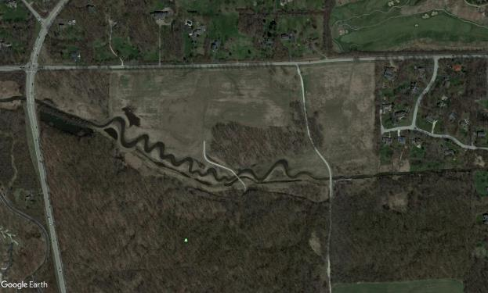
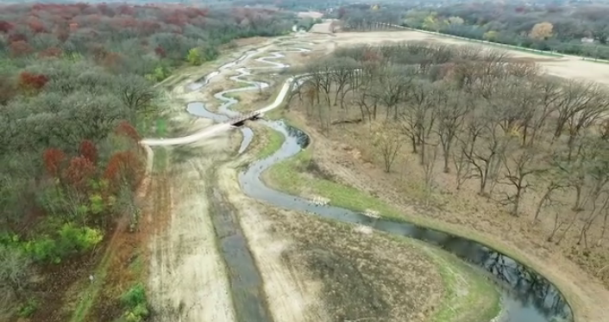
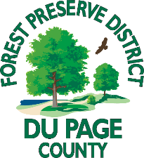



Springbrook #1
WATERS OF U.S. MIGITATION SITE
Promote ground/surface water exchange
Improve connectivity
2,800 linear ft reconnected with floodplain
2,000 linear ft remeandered
~3 acres wetland marsh restoration

Slide 22
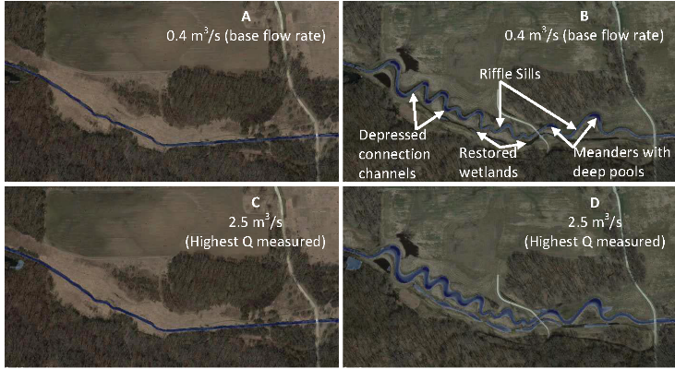
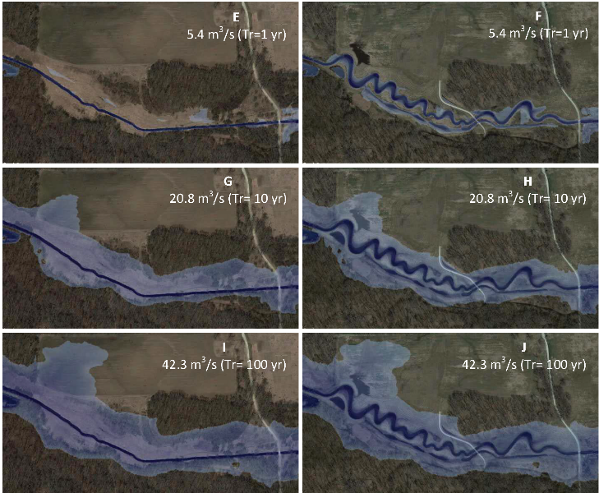
Springbrook #1
STREAM AND FLOODPLAIN FUNCTION UPLIFT
BEFORE
AFTER
Additional nutrient removal:
188 tons/yr sediment
188 lbs/yr phosphorous
377 lbs/yr nitrogen
BEFORE
AFTER
Improved hydraulic connection between stream channel and floodplain at lower flow condition
(J. Marquez Reina, 2017)

Slide 23
4. BIG BUREAU CREEK WATERSHED
CONSTRUCTED WETLANDS AS A NUTRIENT REDUCTION SOLUTION FOR TILED CROPLAND
(Bennett, BC SWCD)

Slide 24
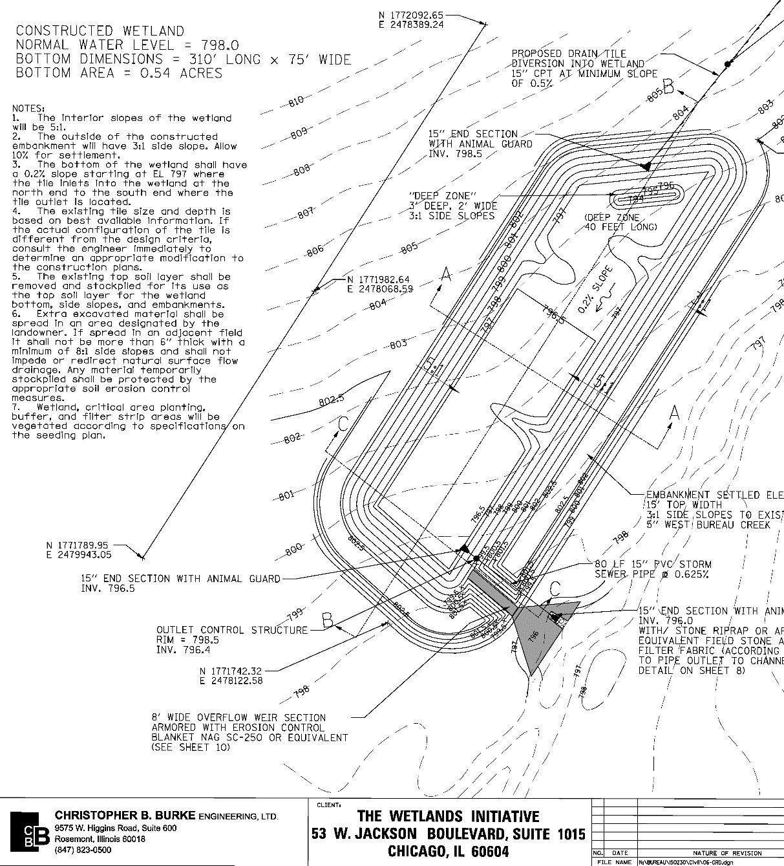
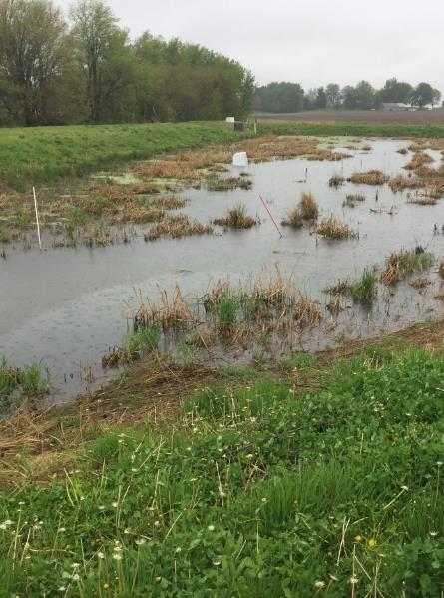
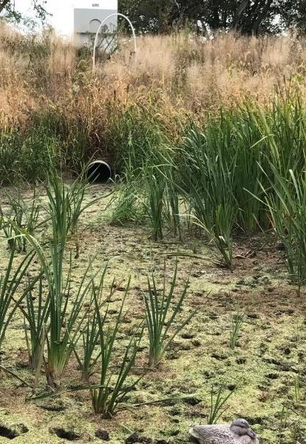
TILE DRAINAGE WETLANDS
Sited and designed to intercept agricultural runoff prior to ditch or stream
Created or constructed emergent marsh system
Located in riparian areas in the headwaters of smaller watersheds

Slide 25
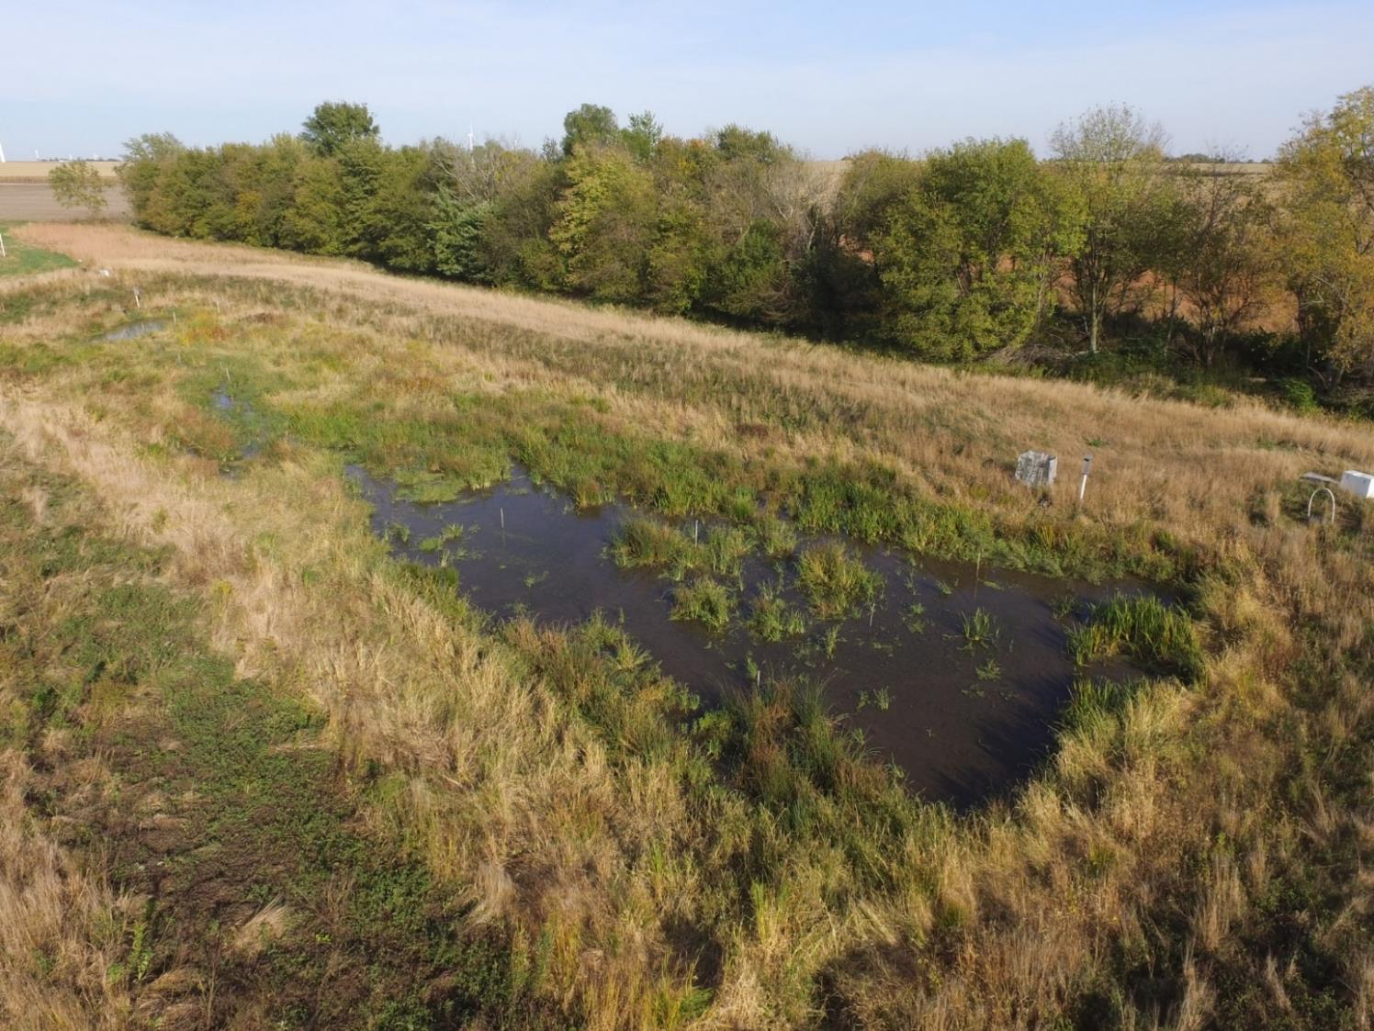
TILE INLET
Bureau County CW1 Highlights
2016:
2,425 lbs NO₃-N, 220 lbs SRP
12% avg annual NO₃-N removal
3.8% OM sediments (carbon)
2017:
1,323 lbs NO₃-N 0 lbs SRP
35% avg annual NO₃-N removal
5.2% OM sediments (carbon)
(Bennett, BC SWCD)

Slide 26
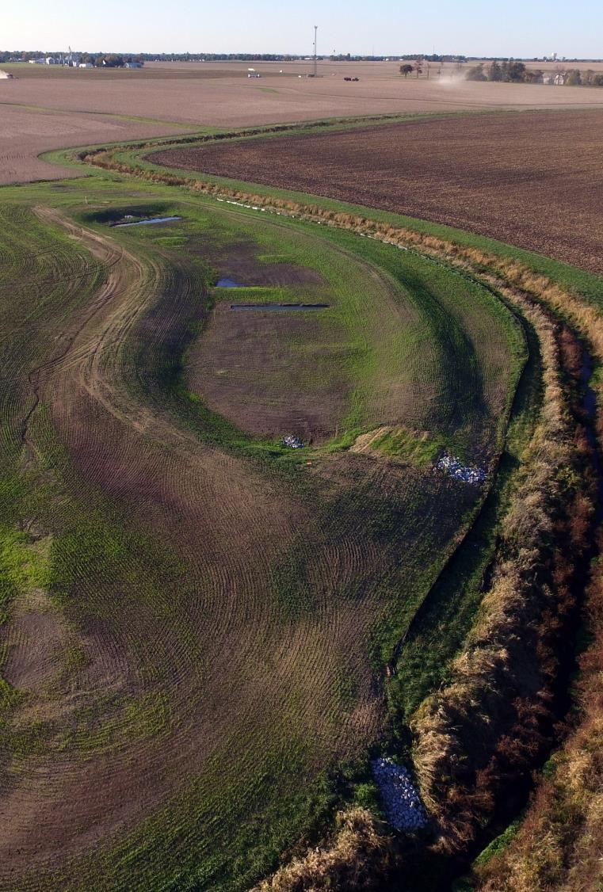
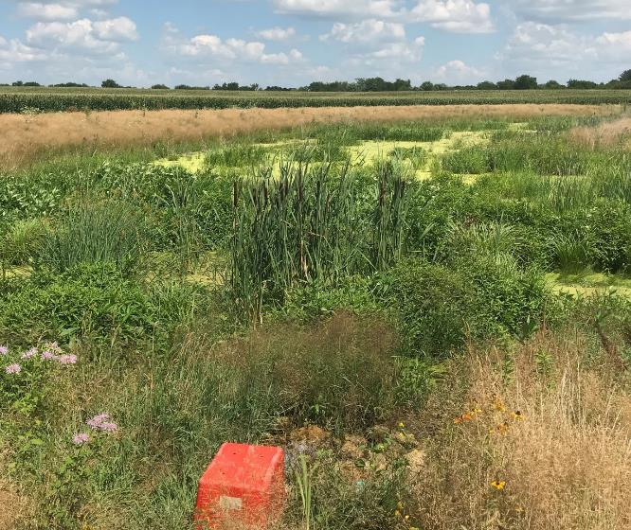
TILE INLET
(Izadmehr, UIC)
Bureau County CW2 Highlights (2017-)
0.8 acre treatment wetland
~30 acres tile drainage captured
64% avg annual NO₃-N removal
7.1% OM sediments (hydric soils)
(Bennett, BC SWCD)
(Kevin Bennett, BC SWCD)

Slide 27
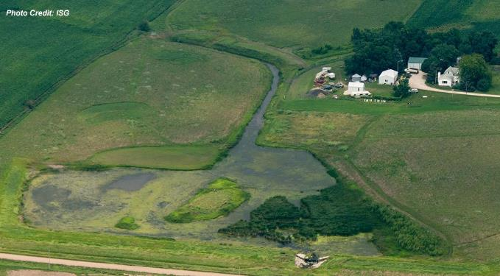
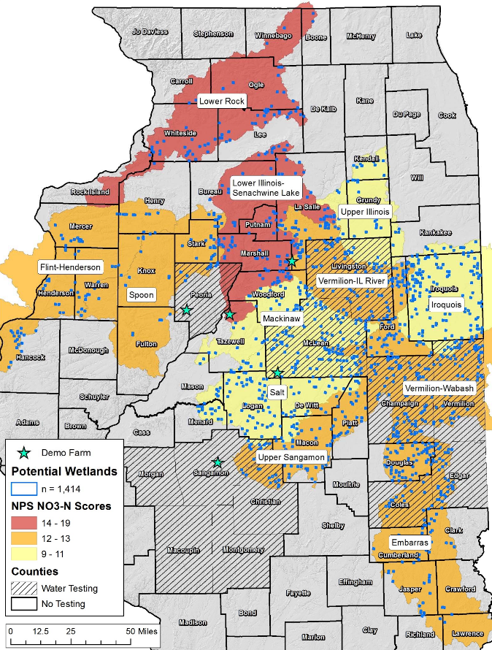
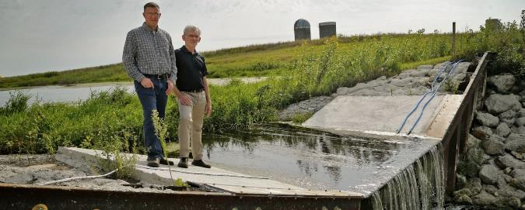
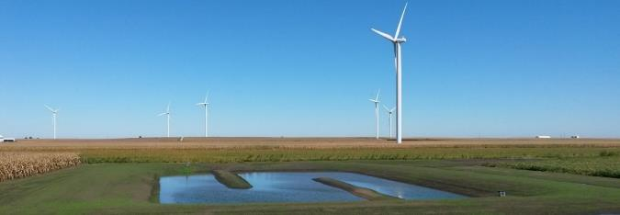
Farm runoff wetlands
Iowa Department of Agriculture and Land Stewardship
CREP Nutrient Removal Wetland
(Des Moines Register, 2015)
(Kirkham, TNC)
The Nature Conservancy Mackinaw River Watershed

Slide 28
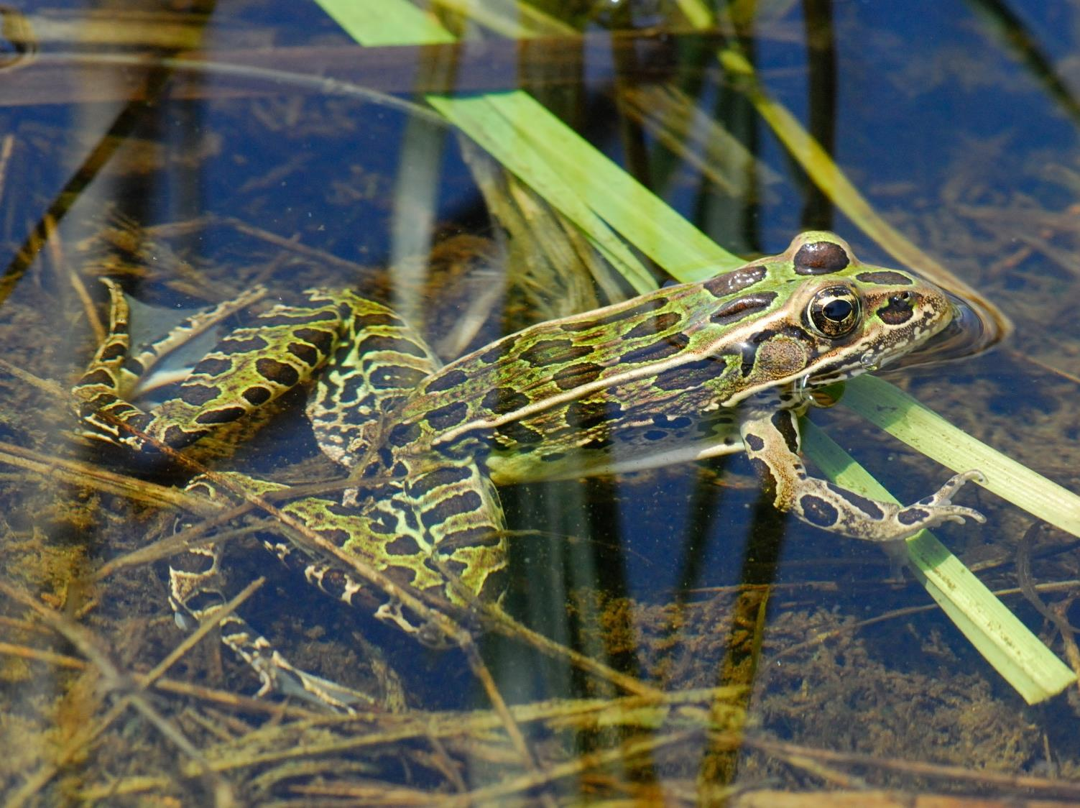

www.wetlands-initiative.org

