Slide 1

LiDAR use in Illinois
Rita Lee, P.E., CFM
Office of Water resources

Slide 2
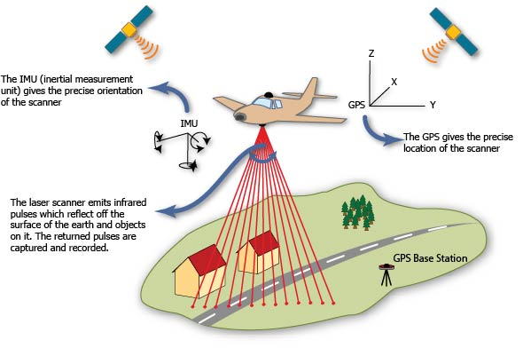
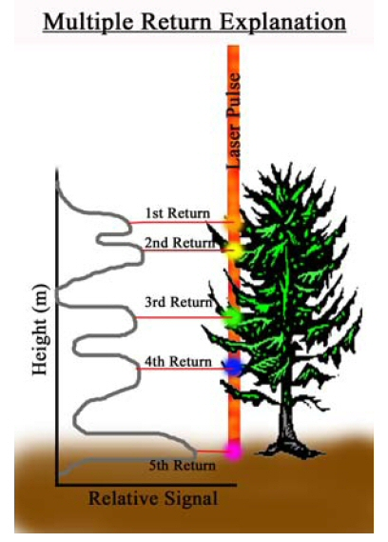
Light Detection And Ranging
Notes:
Infrared pulses of light are reflected from the ground in the same way that RADAR works. The spot where the light beam is pointed is measured precisely using inertial measurement of the plane orientation and differential GPS location. This allows the elevation where the beam strikes to be calculated based on reflection return time. Pulses reflected early indicate tree canopy or other structures above ground level.

Slide 3
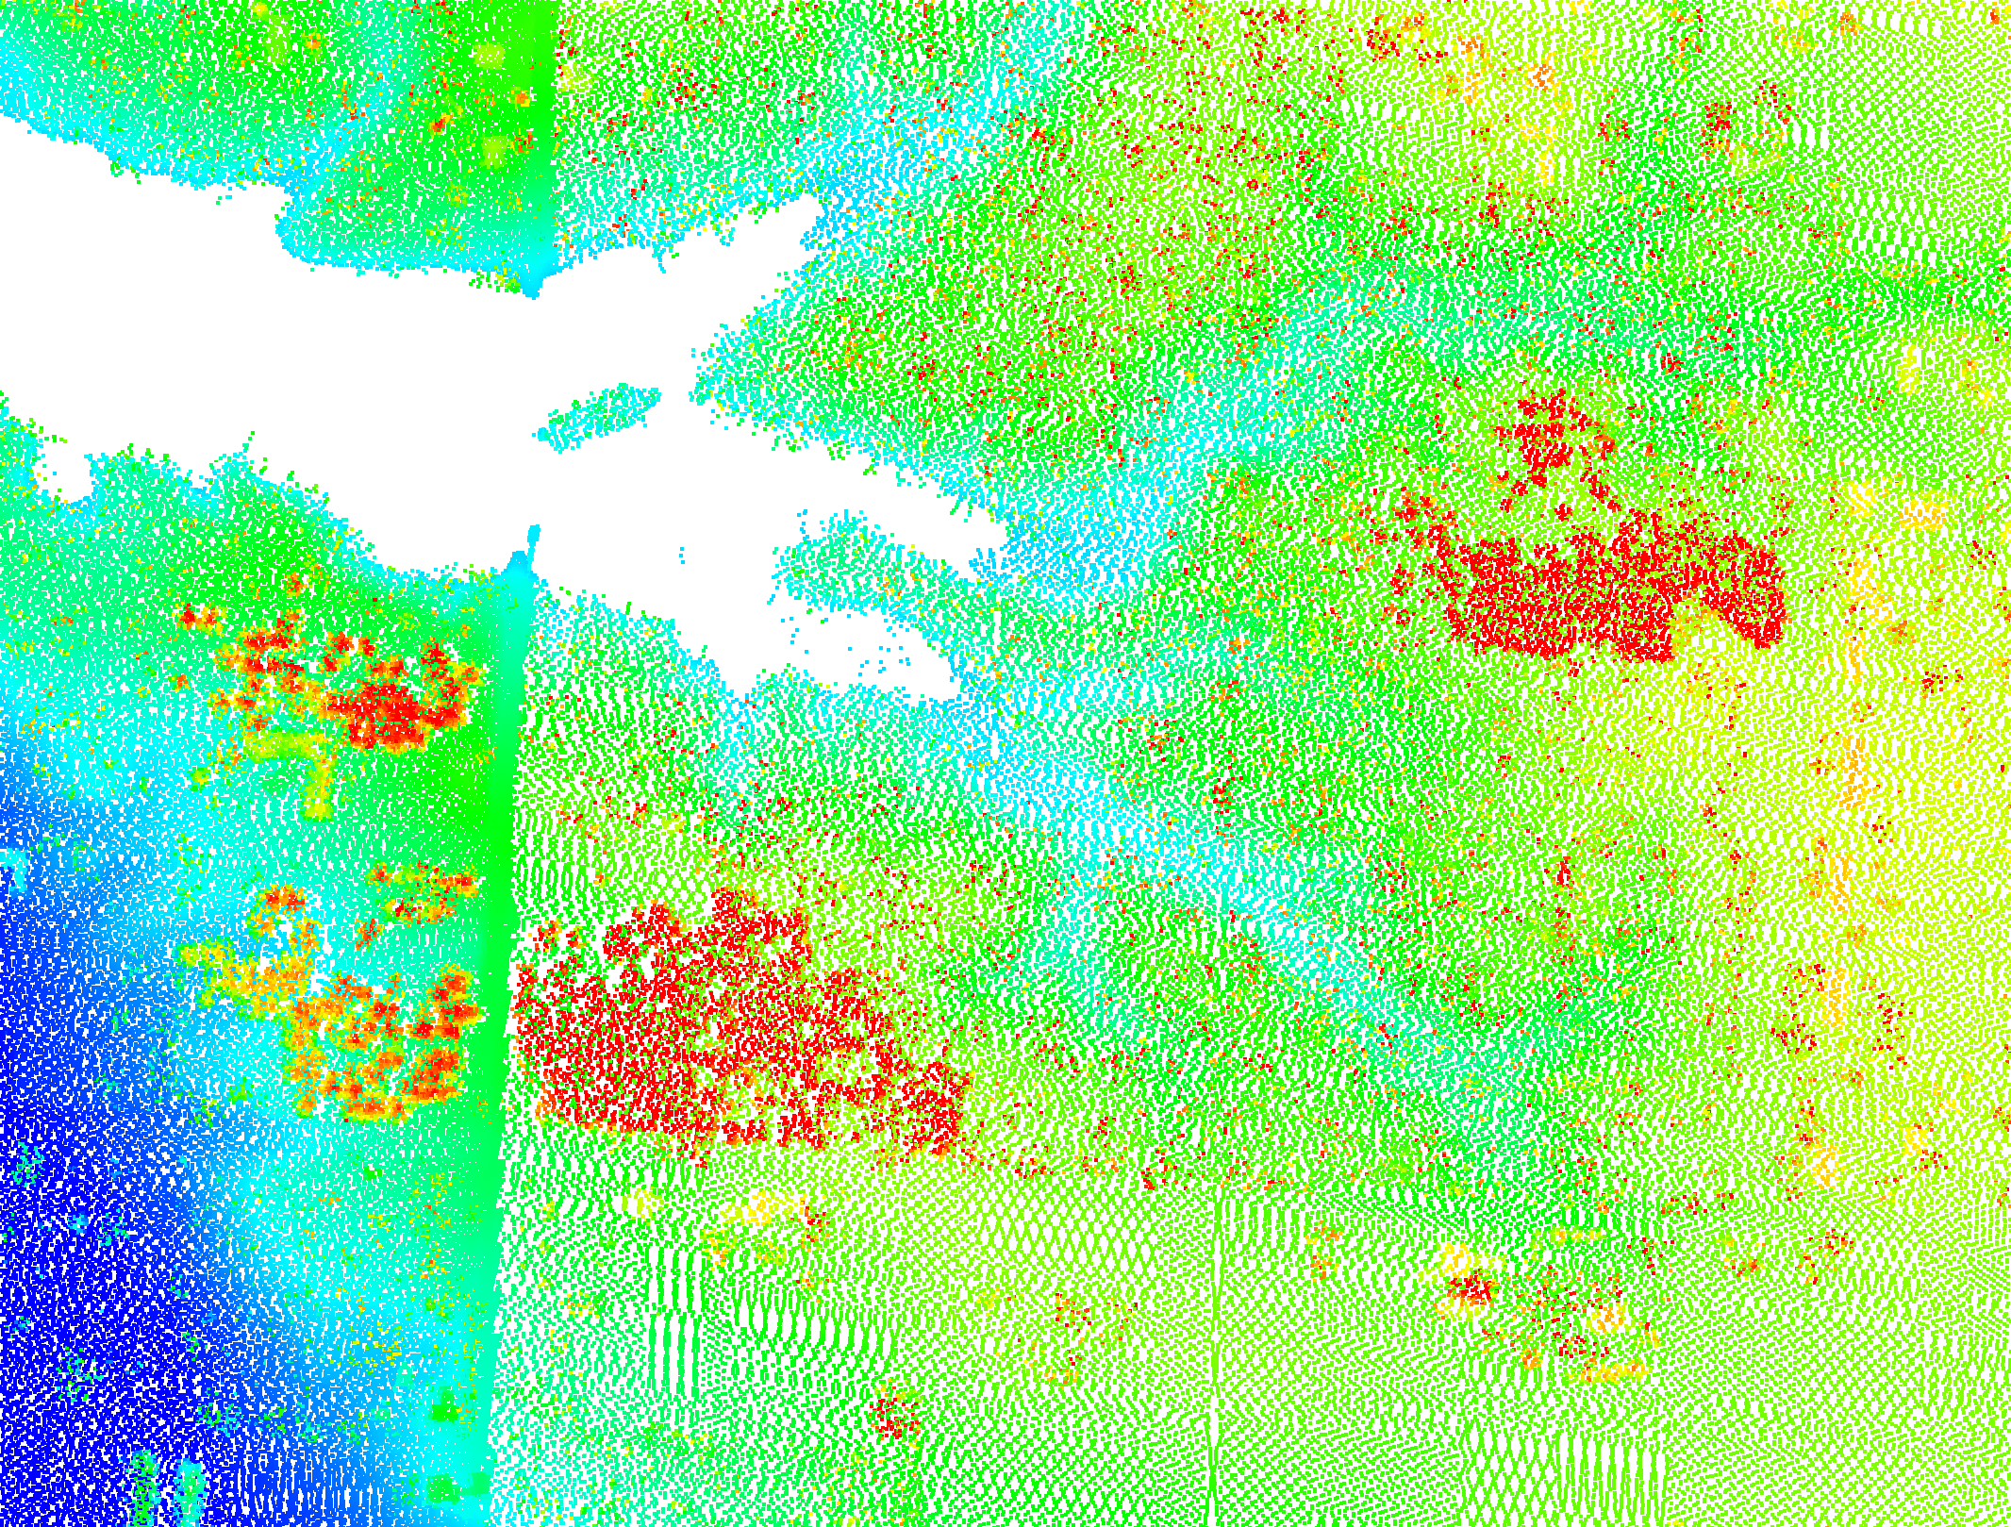
LiDAR produces a “point cloud” of data. Special software is used to produce derived products such as contours and elevation surfaces.

Slide 4
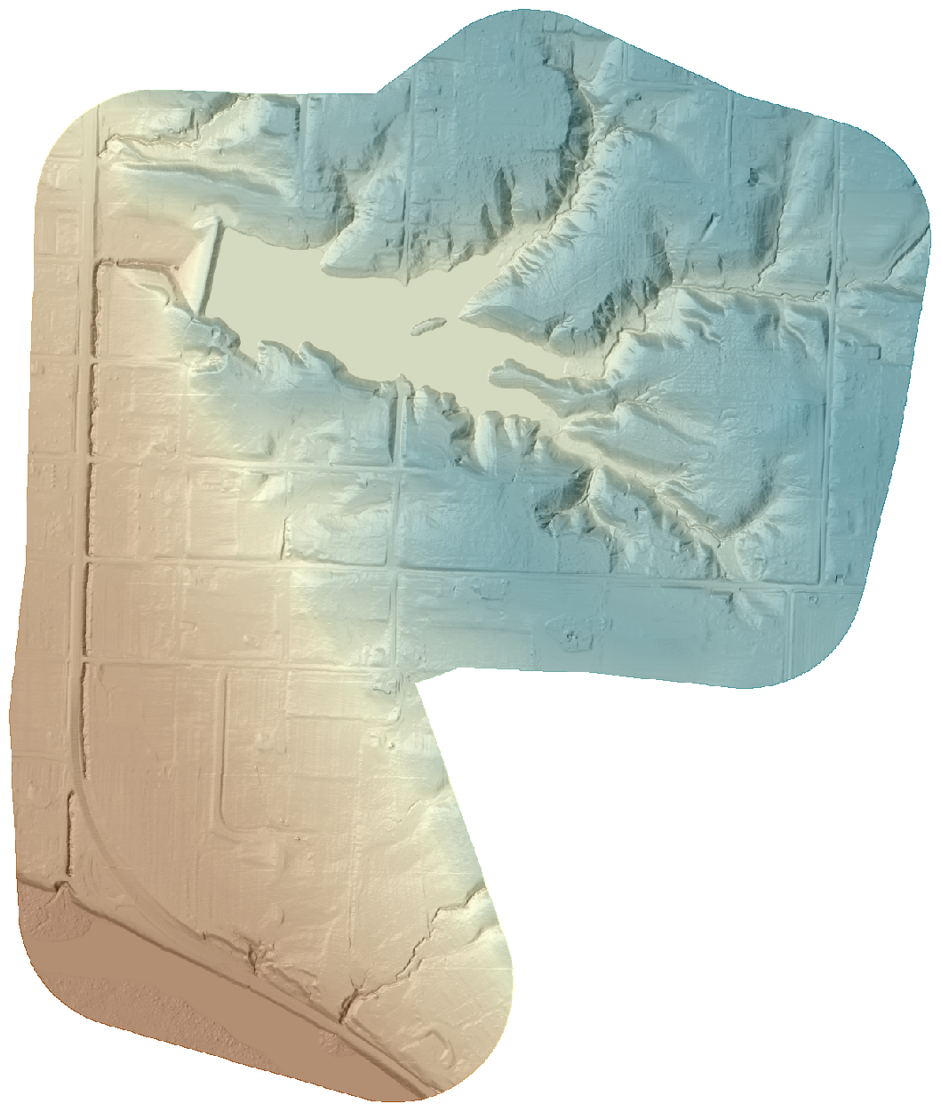
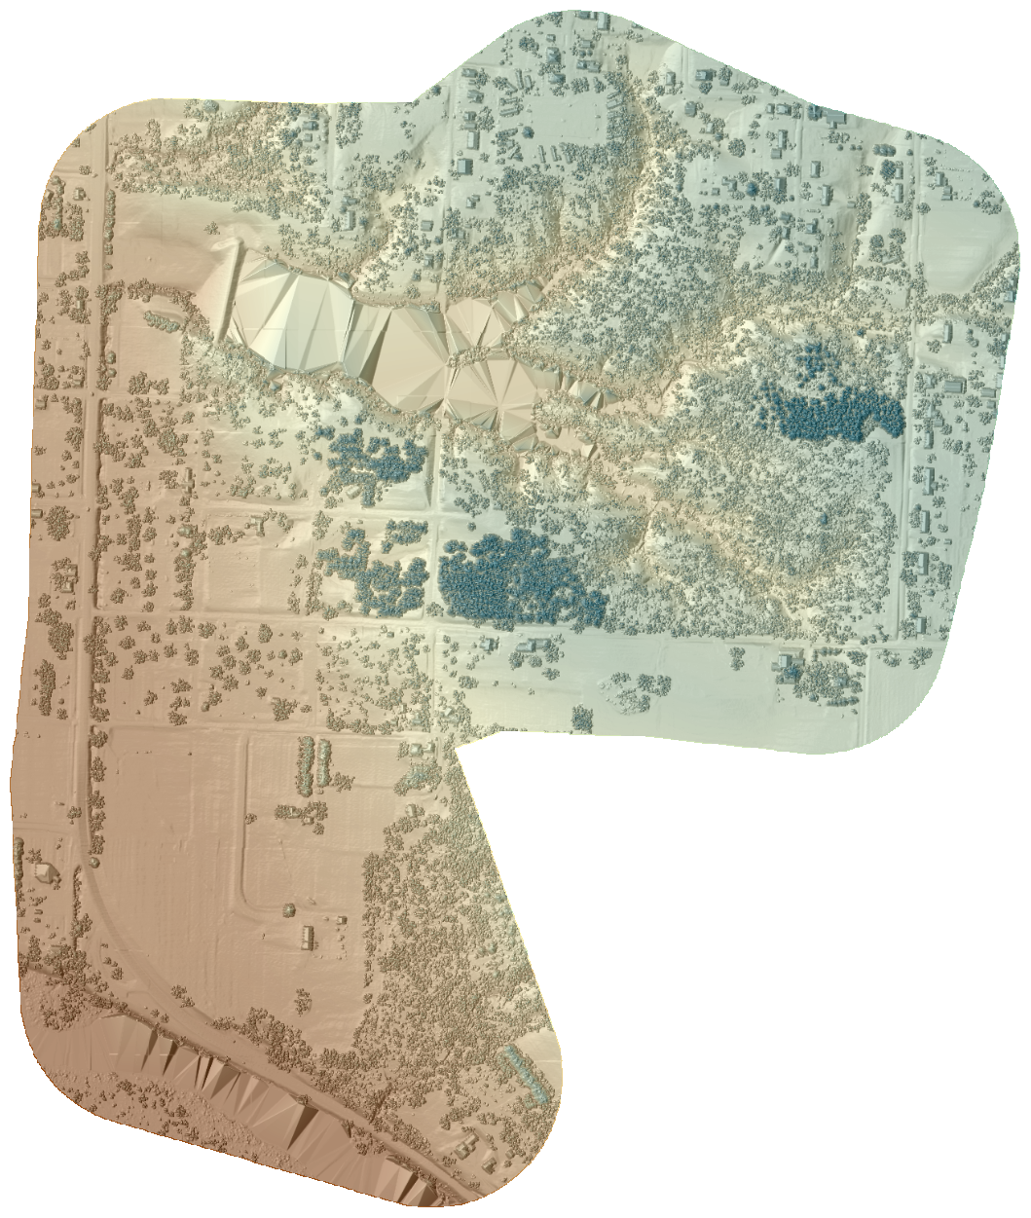
Bare Earth
All Returns
Shaded Relief Derived Product
Notes:
You can see from the examples, the version with all returns shows trees and other above ground clutter.

Slide 5
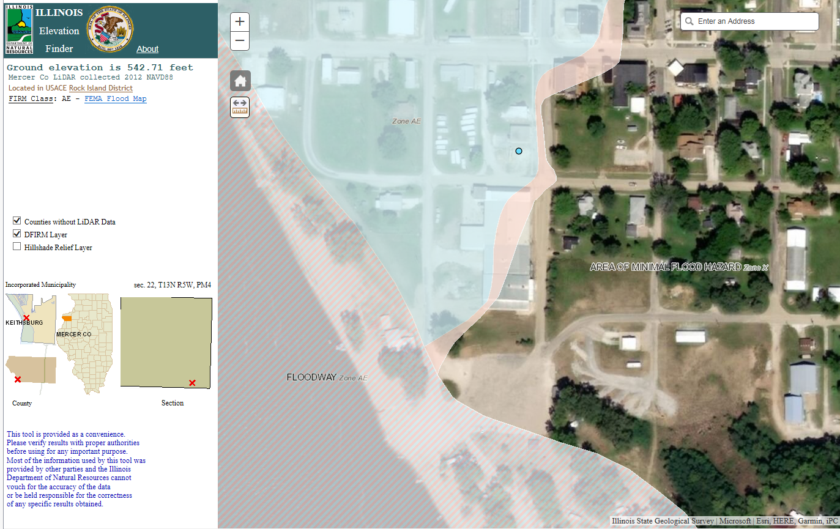
Elevation Finder
LOMA Feasibility

Slide 6
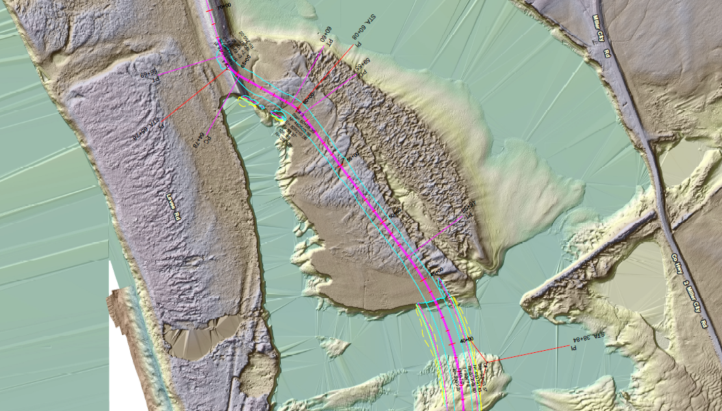
Construction Planning/Design
Define Existing Surface
Borrow Areas/Volumes
Notes:
Len Small Levee Breach Repair

Slide 7
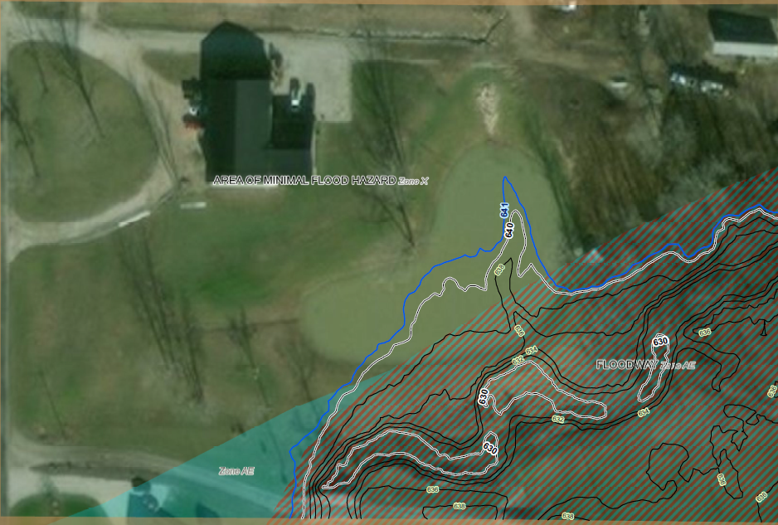
Enforcement
Define violations
Conditions to return to compliance
Notes:
This is an example of an actual enforcement case. A small dam for a pond was constructed in the floodway. The contours were generated from LiDAR data to show where the natural surface was.

Slide 8
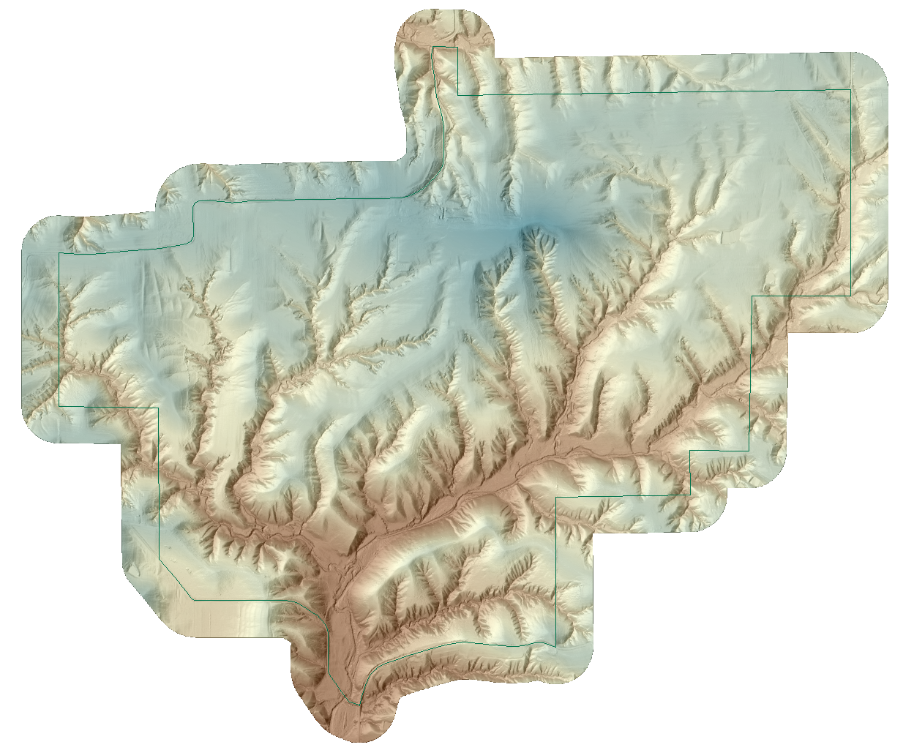
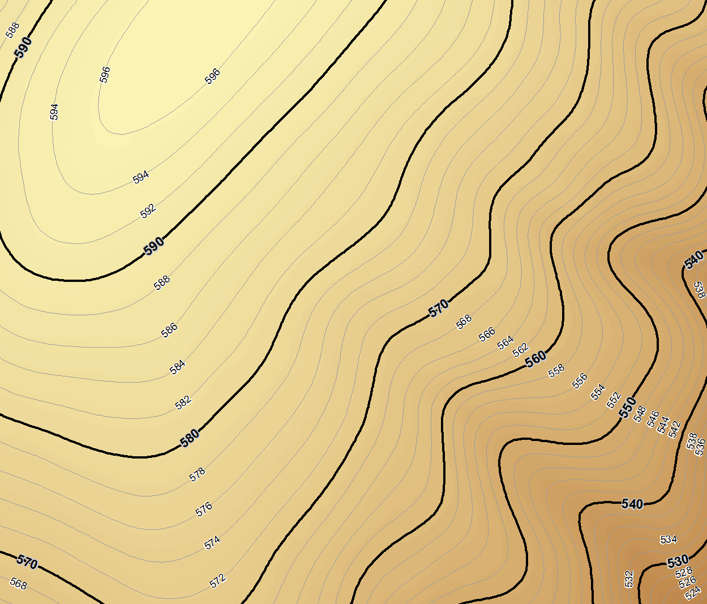
Facility Maps
Maps indicating elevation with hill shade or contours
Notes:
Example of Buckhorn

Slide 9
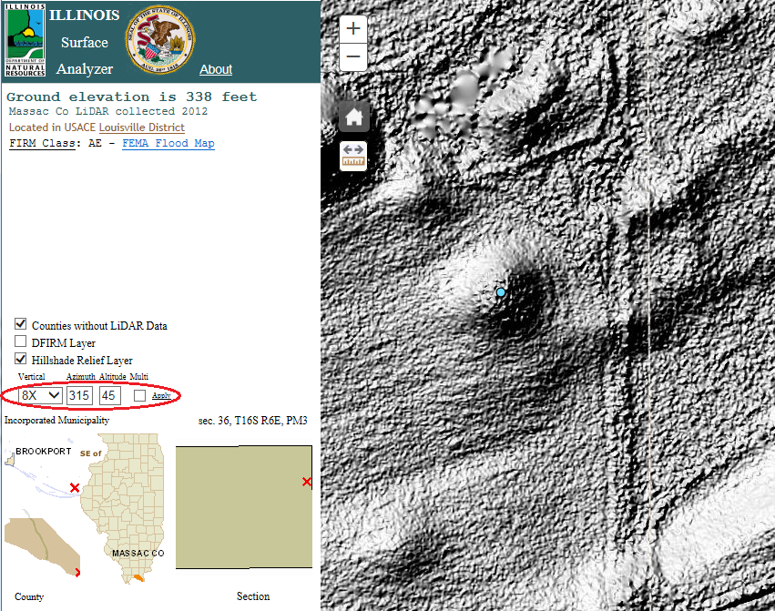
Evaluate Archeological Sites
Use LiDAR data with various adjusted vertical exaggeration, illumination angle and height to find man made earthen structures
Notes:
This example is part of Kincaid Mounds. This is shown in a prototype web application for surface evaluation.

Slide 10
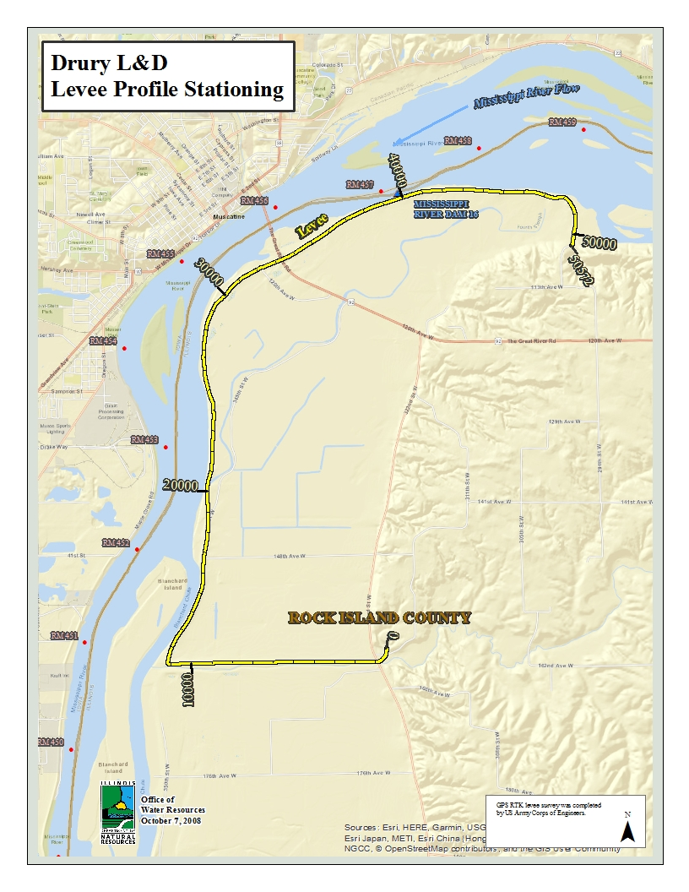
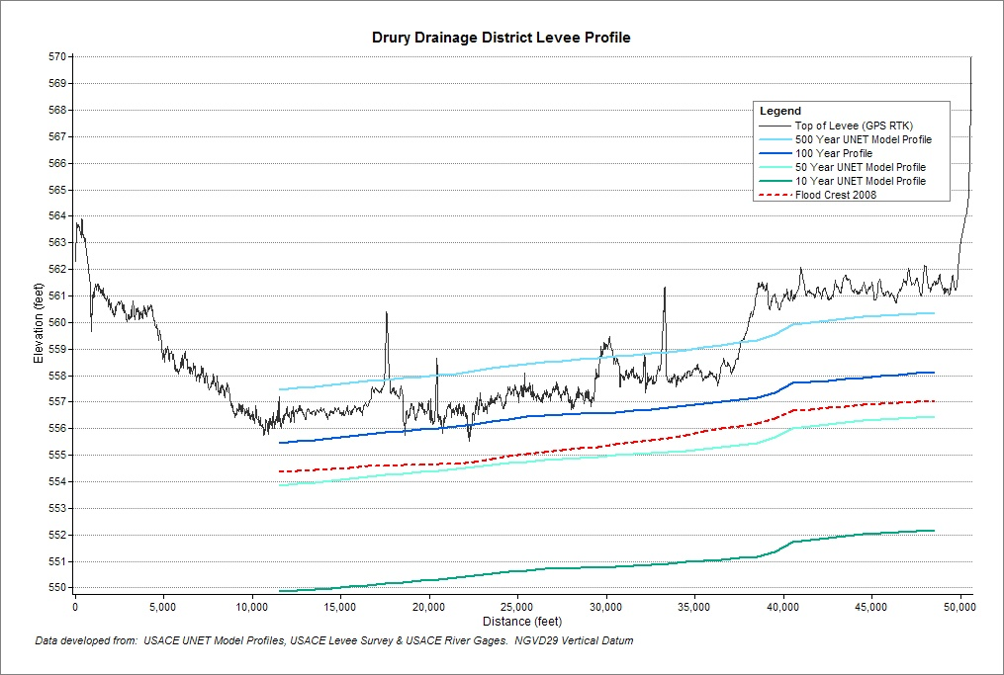
Levee Low Spots

Slide 11
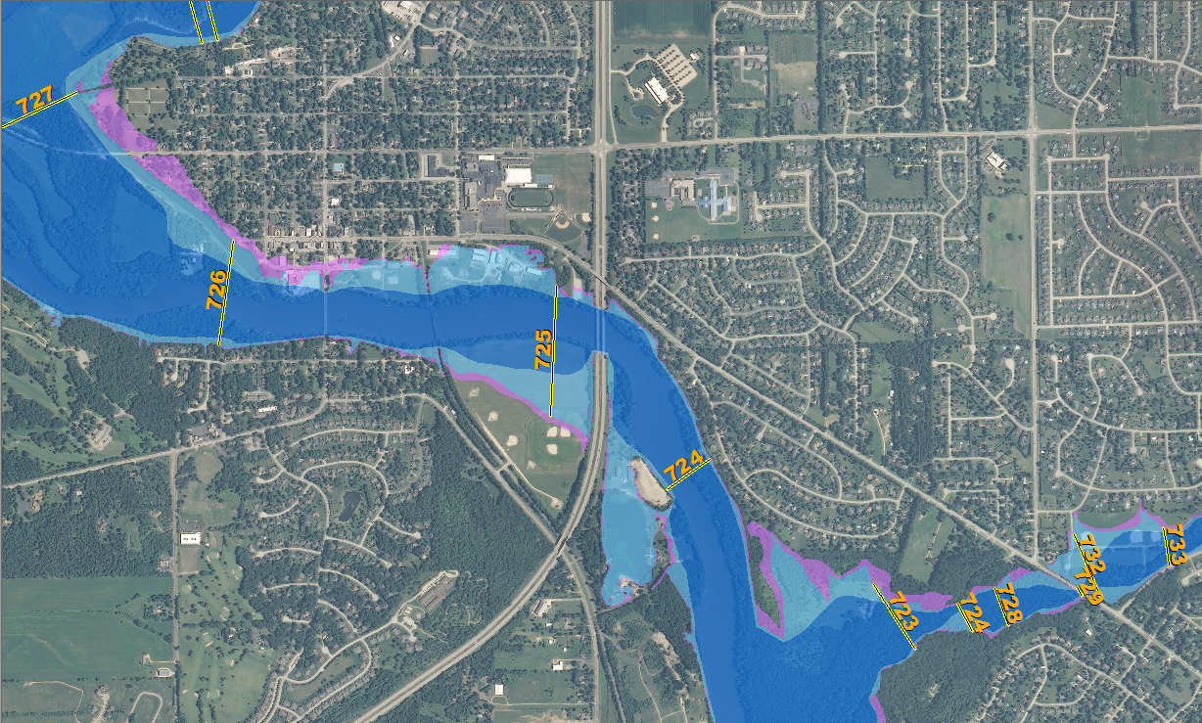
Flood Inundation Mapping
Intent:
  Visualize flooding extent at various river levels
  Enable informed decisions about flood risk
  Provide detailed information for planning and mitigation decisions

Slide 12
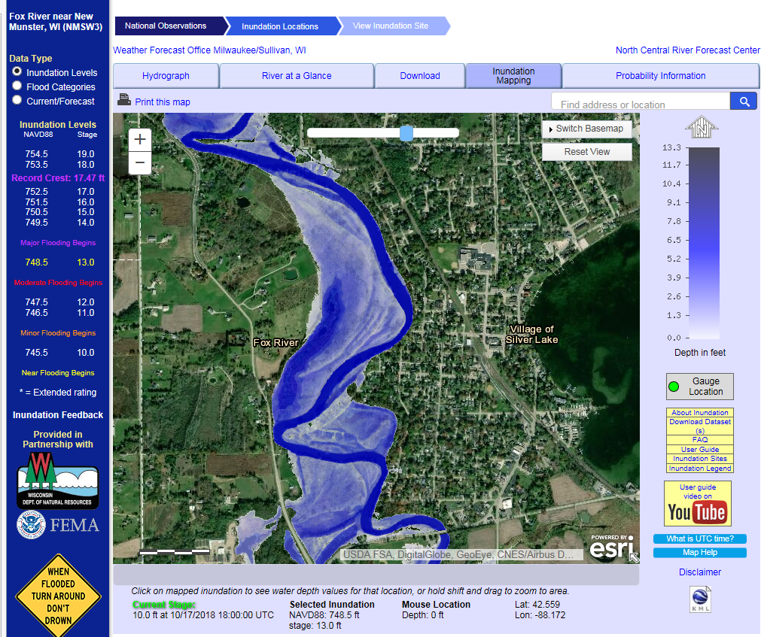
Available Inundation Mapping
National Weather Service AHPS

Slide 13
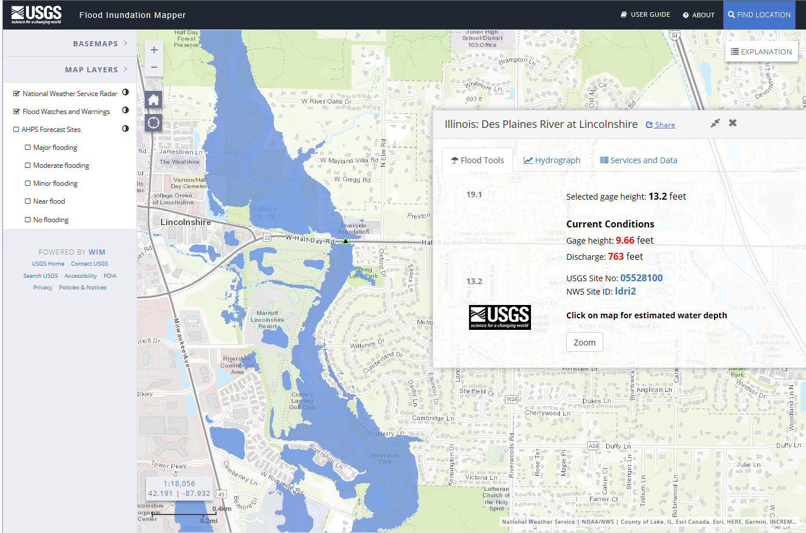
Available Inundation Mapping
USGS

Slide 14
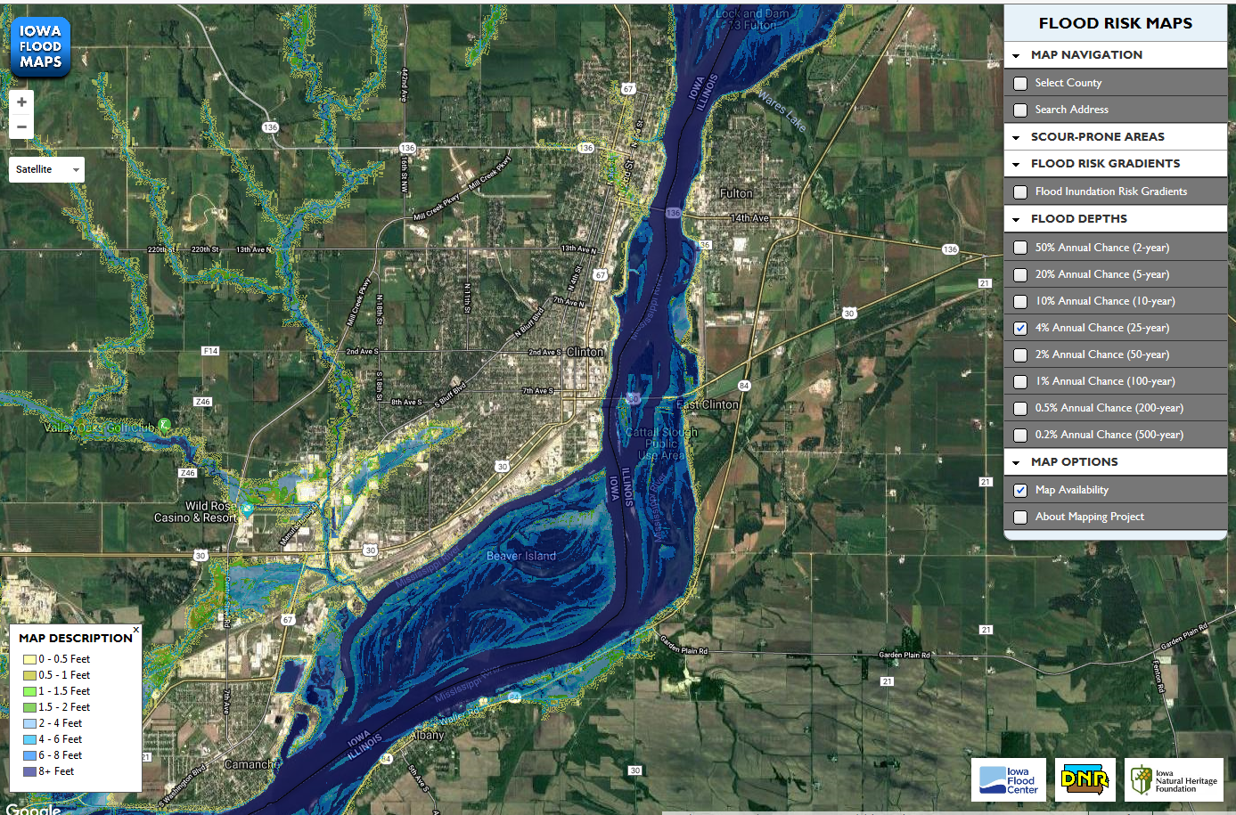
Available Inundation Mapping
Iowa Flood Center

Slide 15

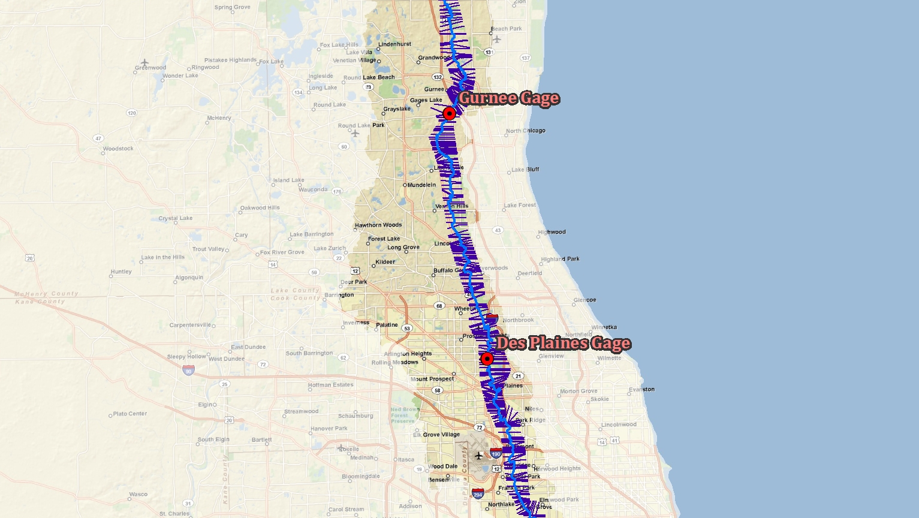
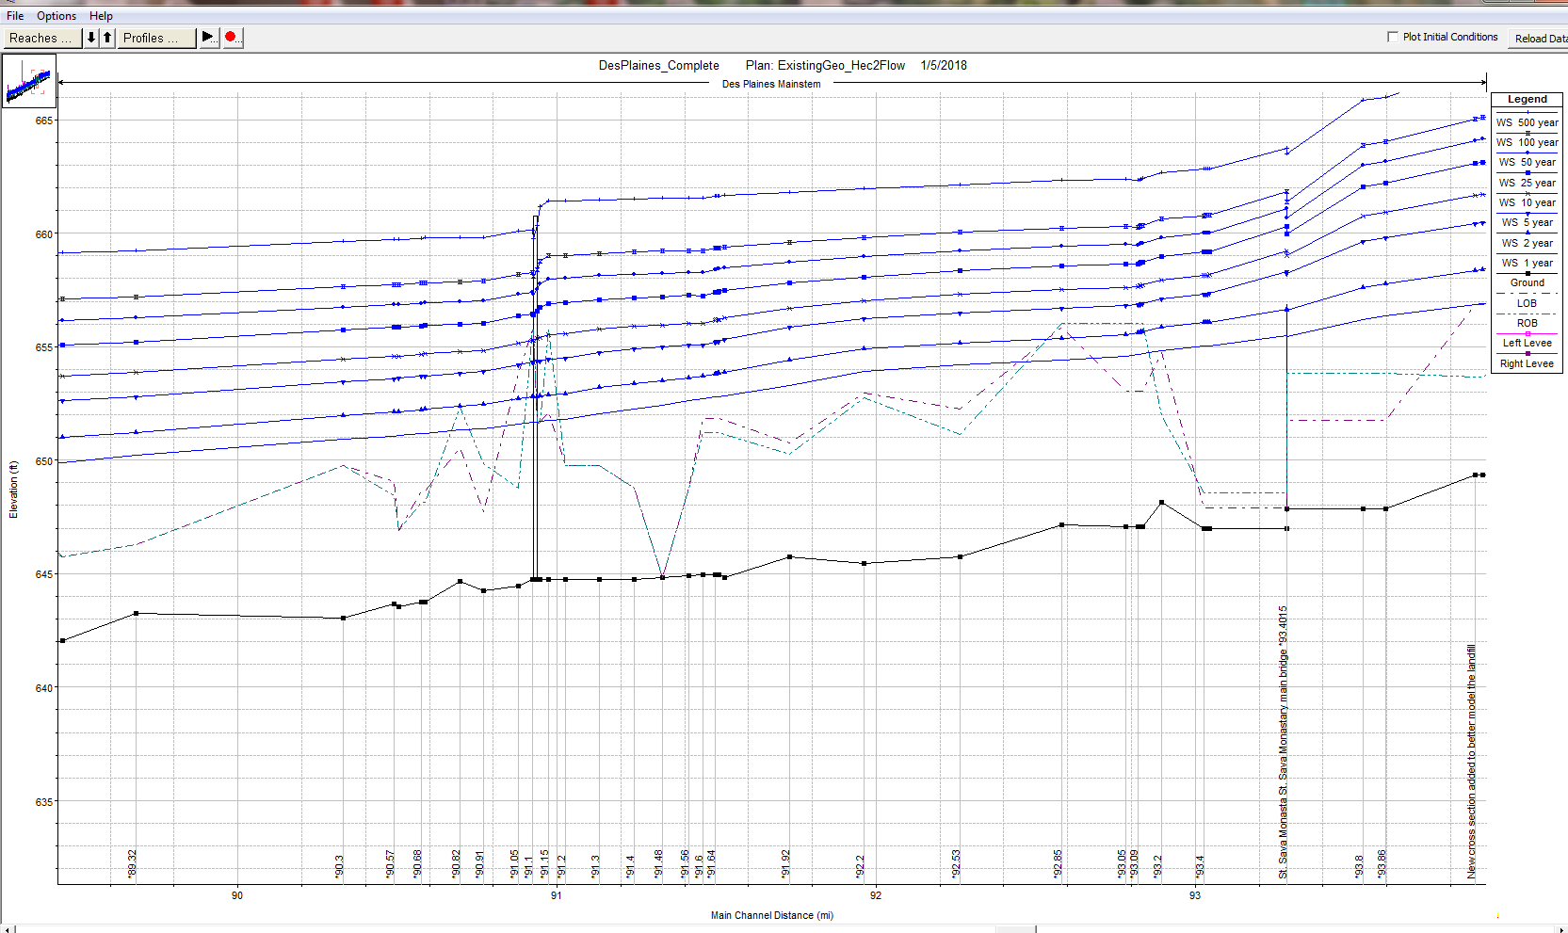
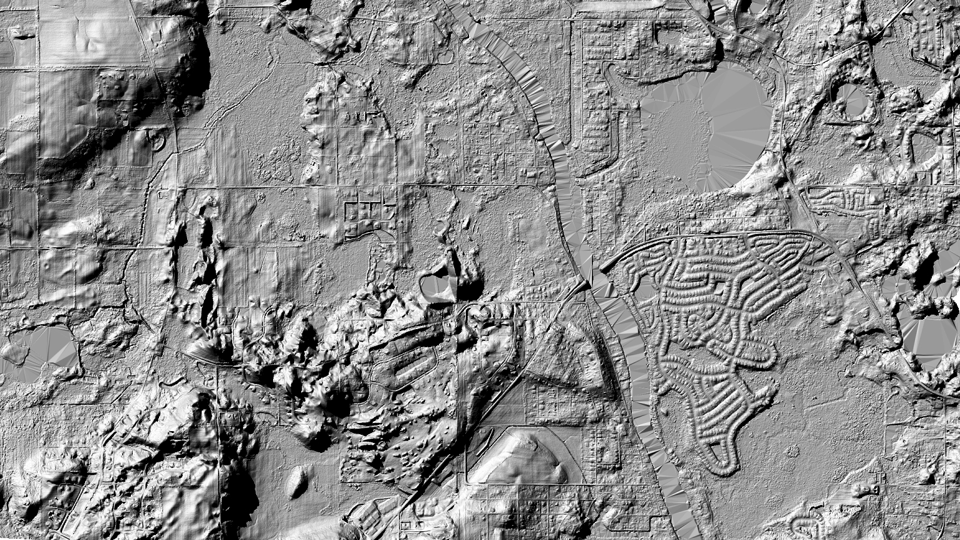
3 Things are needed for Inundation Mapping:
Detailed Hydraulic Model
Lidar
River Gage

Slide 16
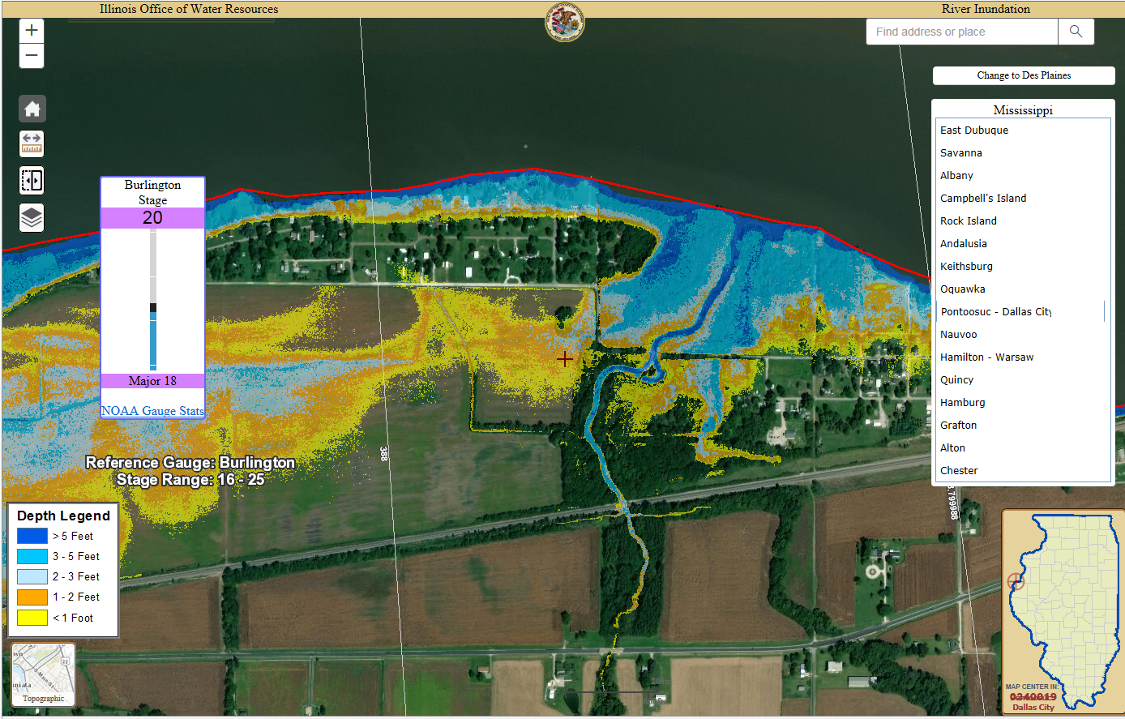
Illinois Inundation Mapping

Slide 17
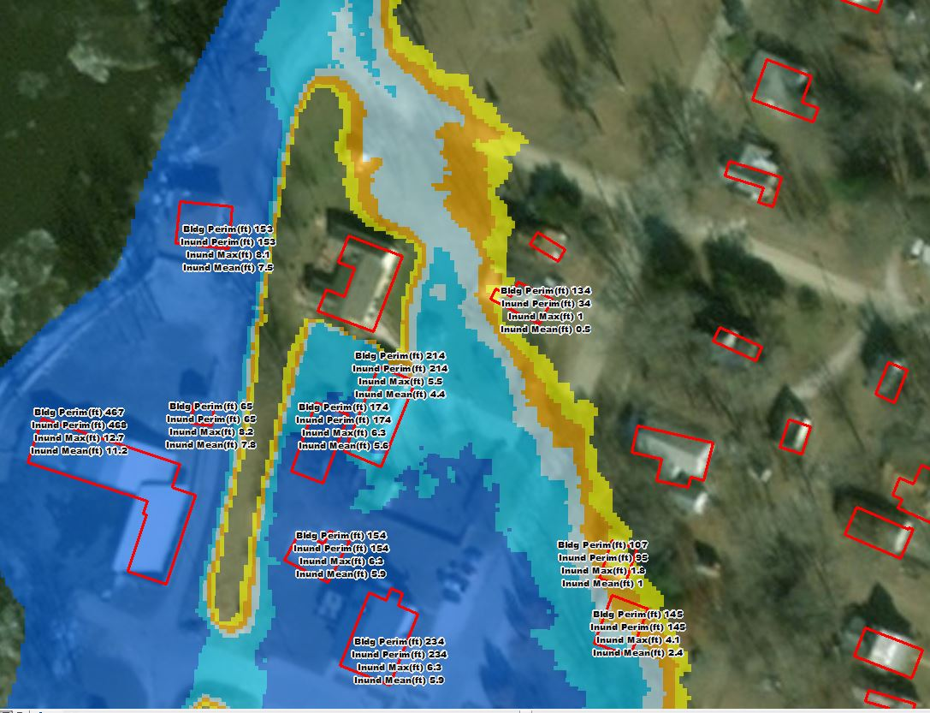
Highlight Structures
Building footprint from LiDAR data
Impacts to the building:
  Max Depth of Inundation
  Mean depth of Inundation
  Building Perimeter
  Length of Building perimeter that is inundated

Slide 18
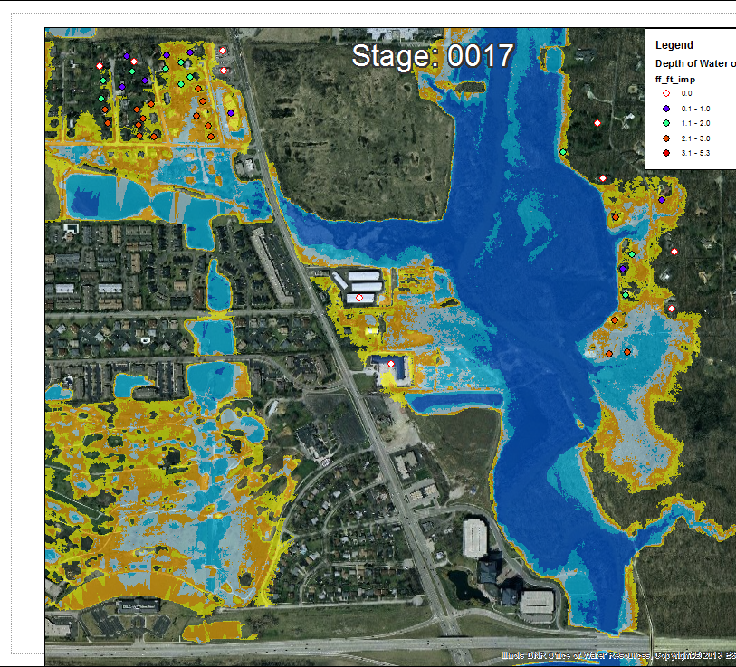
Surveyed Buildings
Estimate water levels in the building.
Estimate a value of damages for a storm or per stage.

Slide 19
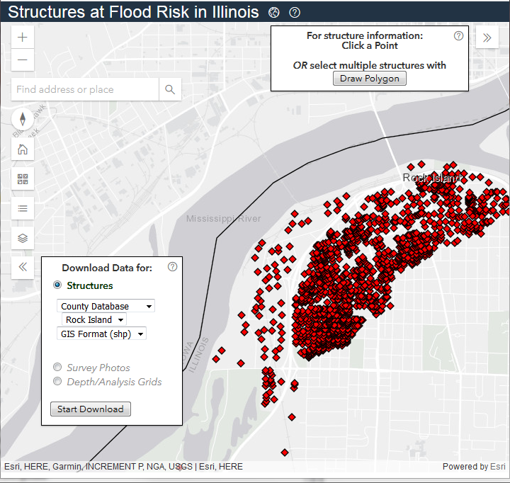



Rock Island County Structural Flood Damage Assessment
Recognize and enhance activities to build risk awareness and understanding.
Building surveys were completed to determine the first floor and low water entry elevations for structures in the 100-Year (1% Chance exceedance) floodplain.
Hazus analysis of the potential flood damages was completed.
Information can be used in Hazard Mitigation Planning

Slide 20
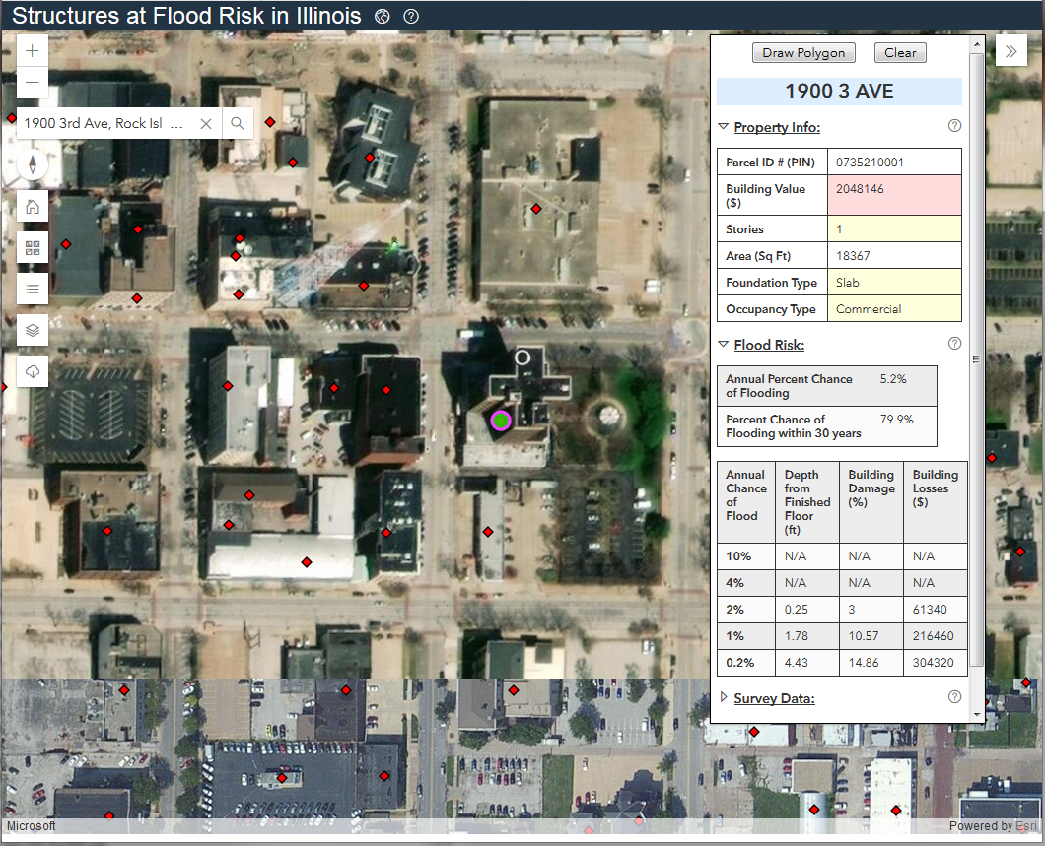
Hazus Analysis – Frequency Results

Slide 21
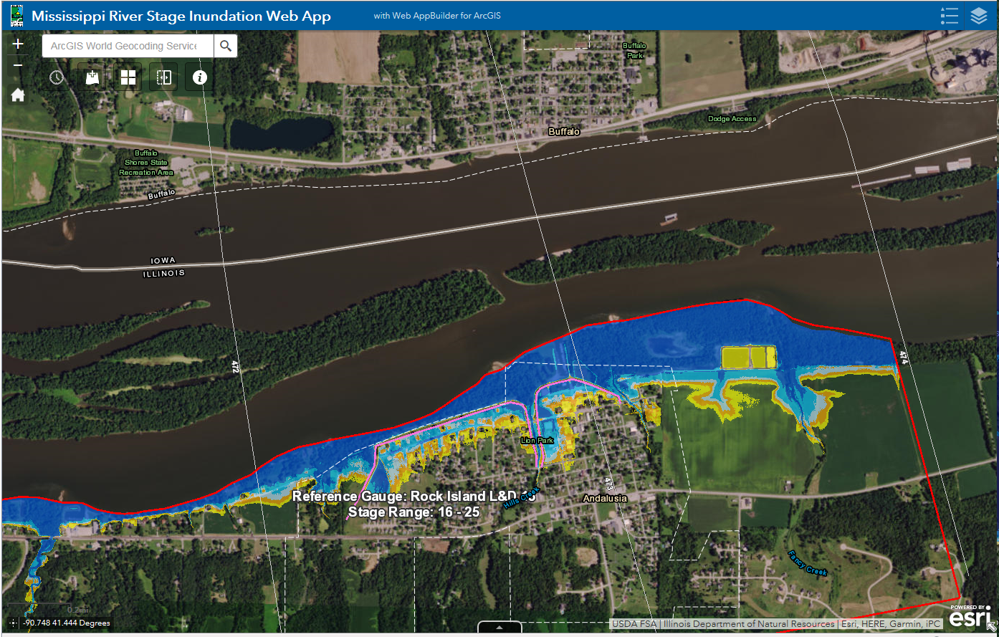
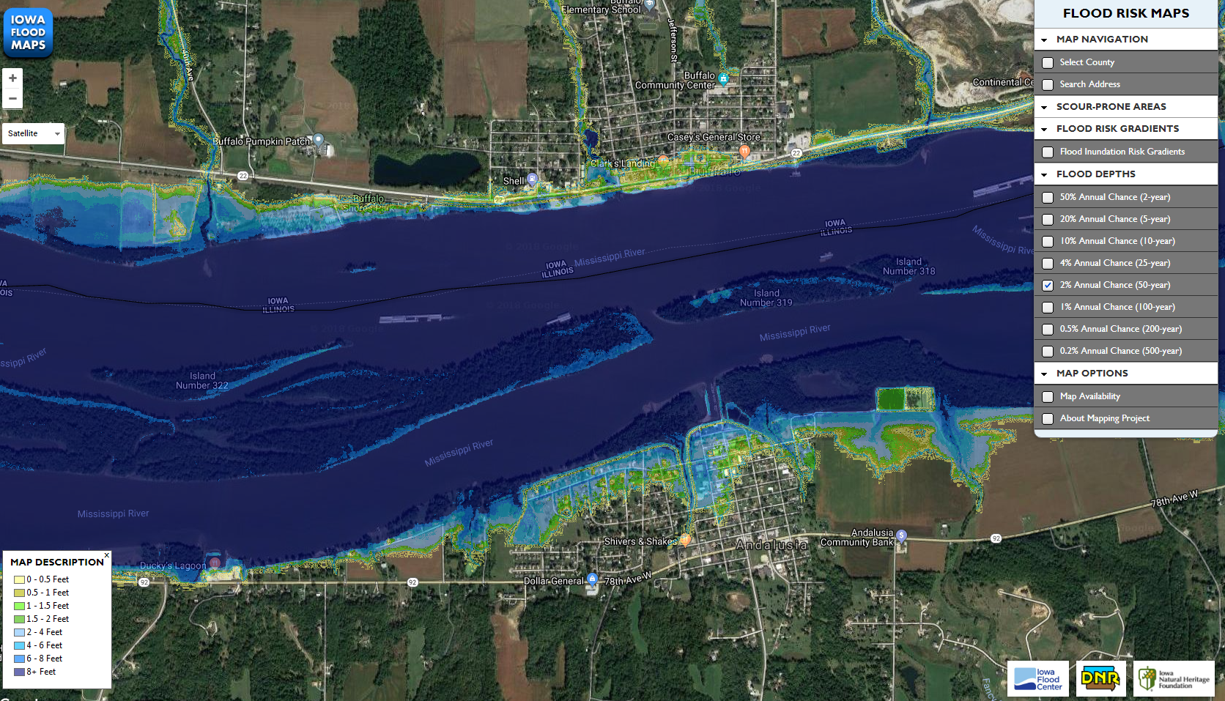
Uniform Mississippi River
Inundation Maps
Illinois – Stage 21Rock Island Gage Iowa – 2% Annual Exceedance

Slide 22
Uniform Mississippi River
Inundation Maps
Use Corps Mississippi River Corridor (Bank to Bank) Lidar
Use Corps Flow Frequency Study Profiles
Stage Incremental Inundation or Frequency Inundation

Slide 23
Thank You
Rita Lee, P.E., CFM
Engineering Studies Section Chief
Illinois DNR Office of Water Resources
Rita.lee@Illinois.gov

