Slide 1



Slide 2
Estimating the Economic Benefits of Mitigation: A Loss Avoidance Case Study for the City of Ottawa, Illinois
Upper Mississippi River Conference
October 2018
Brad McVay, GISP, CFM
Chris Hanstad, P.E., CFM
Sally McConkey, P.E., CFM, D. WRE.

Slide 3

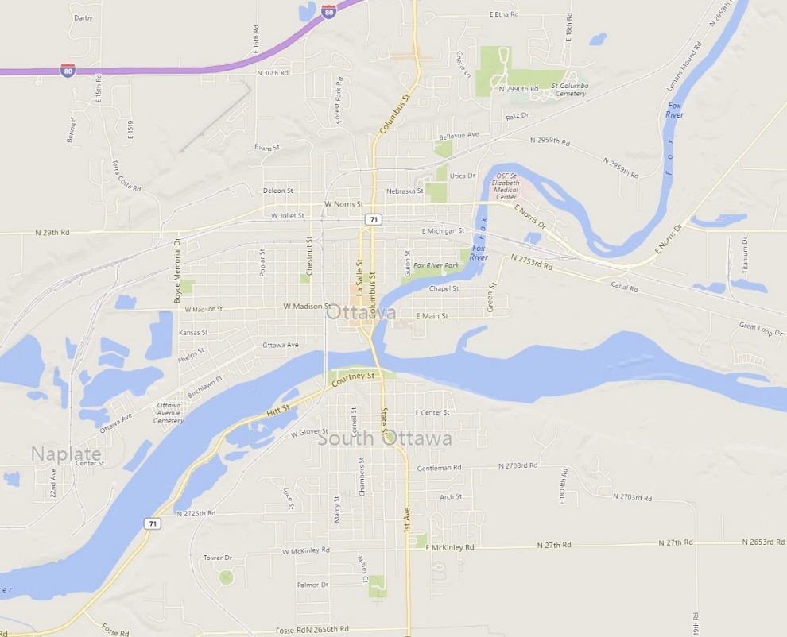
Overview
City of Ottawa, IL
  Population: 18,768 (2016 Estimate. U.S. Census)
  Confluence of Illinois River and Fox River
Major Flood in 1996
Over the past 20 years Ottawa has been working to remove at-risk structures from the floodplain
Case study
  Estimate the Return on Investment (ROI) for these buyouts
  State of Illinois Hazard Mitigation Plan

Slide 4
BCA versus Loss Avoidance
Benefit-Cost Analysis (BCA) vs. Loss Avoidance
  BCA
    Estimate of future benefits of a mitigation project
    Benefit Cost Ratio (BCR)
    Total Benefits / Total Cost
  Loss Avoidance Analysis
    Estimate of the return on investment from real flood events that have occurred in the past
    Return on Investment
    Losses Avoided / Project Investment * 100
Looking at what could happen vs. what has happened

Slide 5
Project Partners
Illinois State Water Survey (ISWS)
Illinois Emergency Management Agency (IEMA)
Critical Infrastructure Resilience Institute (CIRI)
Illinois Department of Natural Resources, Office of Water Resources (IDNR/OWR)
City of Ottawa
LaSalle County

Slide 6
Topics
Description of Project Area (City of Ottawa)
History
  Flooding
  Funding
Gathering and Developing Data for Analysis
Hazus Analysis
Timeline of Buyouts and Results
Central Elementary School and Heritage Harbor
Observations

Slide 7
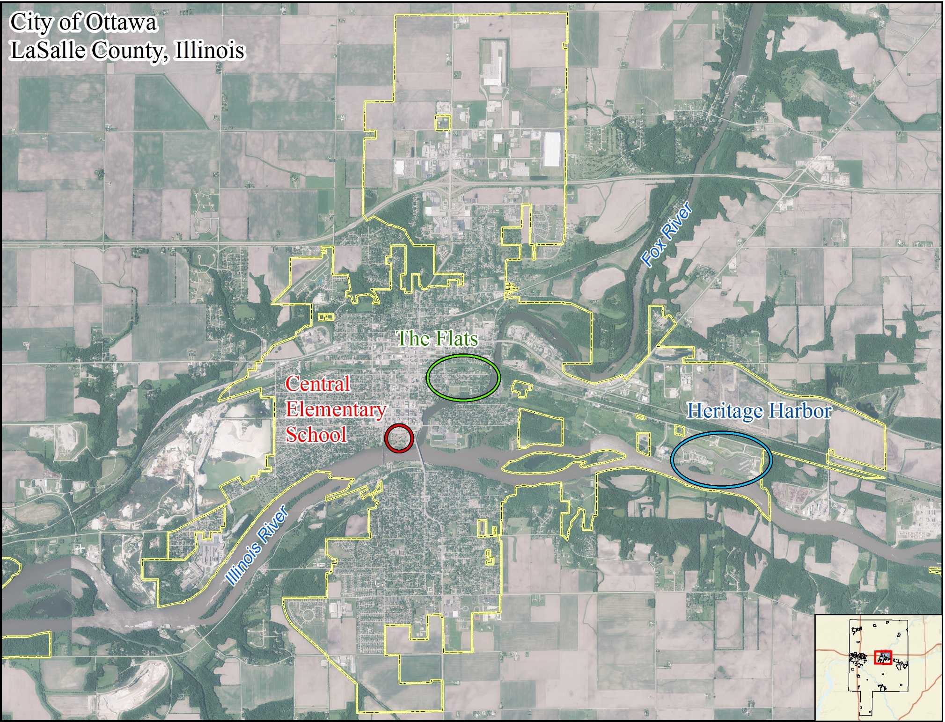
Notes:
Located at the confluence of the Fox River and the Illinois River
The Flats & former Central Elementary School mitigated flooding locations
Heritage Harbor, a success for higher standards

Slide 8
Recent History of Flooding
Fox River at Dayton
  Flood Stage: 12’
  Moderate: 14’
  Major: 24’
Peaks
  Peak of Record: 24.63’ (Oct. 1954)
  7/19/1996: 24.47’
  2/22/1997: 21.46’
  1/17/2005: 17.53’
  8/24/2007: 16.86’
  9/14/2008: 21.48’
  4/19/2013: 20.74’
  2/21/2018: 15.94’
  Source: LaSalle Co. FIS, NWS Advanced Hydrologic Prediction Service
Illinois River at Ottawa
  Flood Stage: 463’
  Moderate: 466’
  Major: 469’
Peaks
  Started Recording 2008
  9/16/2008: 472.21’
  3/11/2009: 470.23’
  4/19/2013: 473.72’
  2/22/2018: 471.49’
  Source: NWS Advanced Hydrologic Prediction Service
Notes:
Fox at Dayton – the 1996 provided the impetus for the buyouts, subsequent flooding 1997 – 2018 used to determine the losses avoided
Illinois River at Ottawa gage since its installation 10 years ago, has recorded peaks associated with major flooding 4 times

Slide 9
Mitigation Buyout Funding
Buyout Funding
  FEMA – Mitigation Programs & Public Assistance
  IDNR
    Provided funds for 5 structures in 2001
  Department of Commerce and Economic Opportunity (DCEO)
  City of Ottawa
Notes:
Vertical 2017 dollars
Horizontal years
Orange - Public assistance
Cyan – HMGP /OWR/DCEO projects

Slide 10
Topics
Description of City of Ottawa
History
  Flooding
  Buyouts
Gathering and Developing Data for Analysis
Hazus Analysis
Timeline of Buyouts and Results
Central Elementary School and Heritage Harbor
Observations and Limitations

Slide 11
Data for Analysis
Building Inventory
  Points representing each buyout structure used in analysis
Flood Depth Grids
  Generated from 16 modeled historical flood events between 1996 and 2018

Slide 12
Structure Data Sources
Parcel GIS Shapefile
  Provided by LaSalle County
Spreadsheets of buyouts provided by Ron Davis (former State Hazard Mitigation Officer, Illinois Emergency Management Agency)
  Addresses and valuation data
Buyout files from IDNR/OWR
City of Ottawa
  Mike Sutfin
  Nancy Stisser
Notes:
Ron Davis valuation data examples include: Acquisition Cost, Demolition Cost, Cost for Appraisals, legal and recording fees, etc.
Buyout files from IDNR in paper format
Nancy Stisser works for Ottawa and sent us the appraisals and helped confirm some of the structure data.

Slide 13
Building Inventory
Converted GIS parcel polygons into points
Used historical orthophotos to place points where structures used to exist
Worked with the City of Ottawa to confirm information about the structures
  Appraisals for each structure
  Characteristics
Year of buyouts
  Assessor’s Website
  Match Last Sale Price to Acquisition Cost
Notes:
Historical Orthophotos from Google Earth
Ottawa confirmed structure information (Square footage, year built, number of stories, foundation type, appraised value, building material.)
Year of Buyouts: For the structures that did not have the acquisition year, I looked up the last sale price on the assessors website and if it matched the Acquisition Cost that were in the spreadsheets I used that sale date and the buyout year.

Slide 14
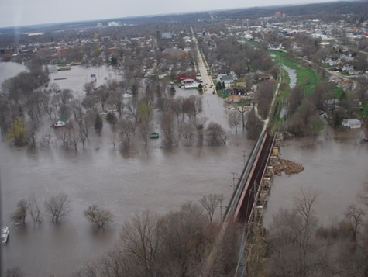
Building Inventory
64 structures identified in this analysis
  Some are multiple structures on same parcel
Occupancy
  57 Residential
    43 Single Family Dwelling
    7 Duplexes
    1 6-Unit Apartment Building
  5 Commercial
  1 Industrial
  Central Elementary School

Slide 15
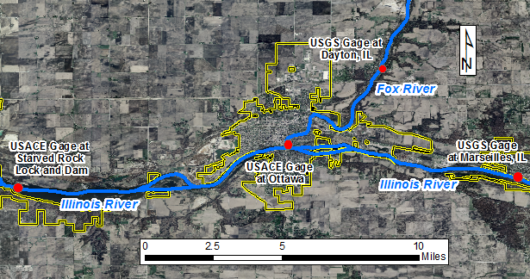
Flood Inundation Mapping for Observed Events (Depth Grids)
USGS gages at Dayton and Marseilles provided peak flows
USACE gages at Starved Rock and Ottawa provided stage
Notes:
Ottowa stage gage since 2008

Slide 16
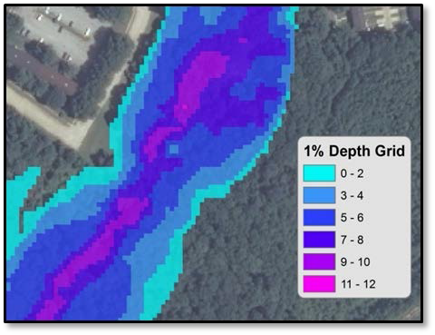
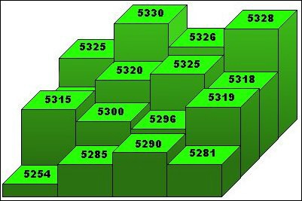
Flood Inundation Mapping (Depth Grids)
Depth grids were created for observed flood events from the results of HEC-RAS models for the Illinois River and Fox River
Notes:
The Illinois River HEC-RAS model used the combined flows from the Dayton gage and Marseilles gage along with the Starved Rock stage as a starting elevation.
The Fox River HEC-RAS model used the Dayton gage flows along with the Ottawa stage as a starting elevation
The USACE Ottawa gage has only been recording stage since 2008
For flood events prior to 2008 the Illinois River HEC-RAS model served as an estimate of the Fox River starting elevation at Ottawa.

Slide 17
Topics
Description of City of Ottawa
History
  Flooding
  Funding
Gathering and Developing Data for Analysis
Hazus Analysis
Timeline of Buyouts and Results
Central Elementary School and Heritage Harbor
Observations and Limitations

Slide 18

Hazus Loss Estimation Tool
Loss estimation software designed by FEMA
Works with ESRI’s ArcGIS software
Purpose is to provide the means to identify and reduce risk from natural hazards
Four Models:
  Flood
  Earthquake
  Hurricane
  Tsunami
Hazus 4.0

Slide 19
Levels of analysis
Input
detailed engineering
data
Combination of local and default hazard, building, and damage data
Default hazard, inventory, and damage information
Level 3
Required
user effort and
sophistication
Level 2
Level 1
Notes:
HAZUS has three levels of analysis. This project will use Level 2. 5

Slide 20
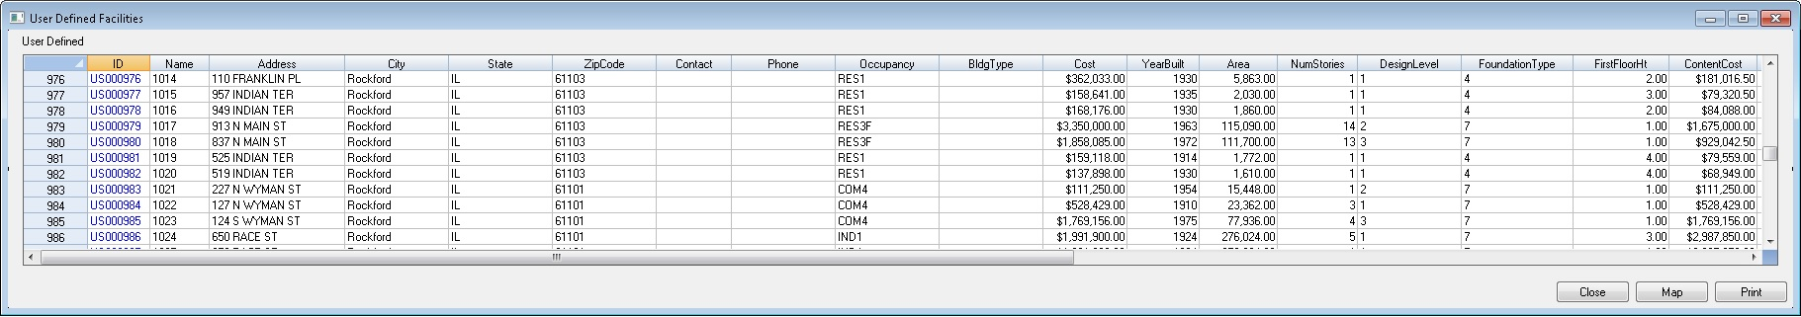
Input for Level 2+ Analysis
Building Inventory
  Point feature class in a personal gdb
  Contains the attributes for each buyout structure
  Latitude and Longitude values to represent location
Flood Depth Grids
  ESRI Grid format
Notes:
Points for each structure: A level 1 analysis uses the built in Hazus General Building Stock (GBS) which is aggregated to the census block level.

Slide 21
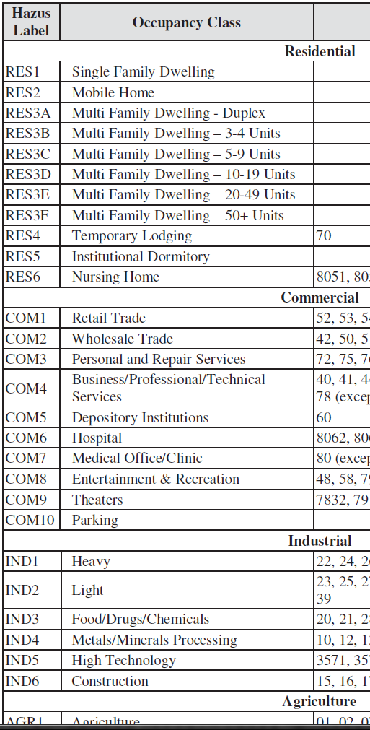
Structure data for Hazus
Occupancy Class
Residential
Commercial
Industrial
Agricultural
Government
Religious
Notes:
Building “Use”
Structures were categorized based on Hazus recognized Occupancy Classes
Note 11 types of residential, 10 types of commercial and so on

Slide 22
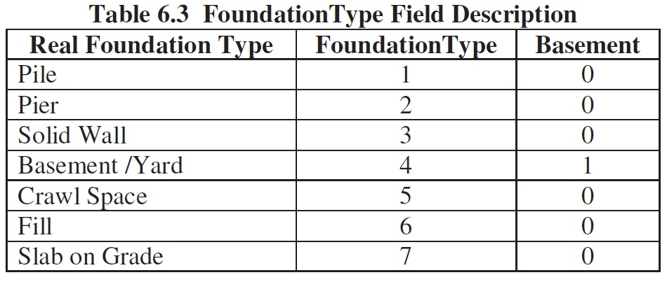
Structure Input Data for Hazus
Appraised value (Converted to 2018 U.S. Dollars, Bureau of Labor Statistics-Consumer Price Index)
Square Footage
Number of Stories
Year Built
Foundation Type
Content cost – estimated by HAZUS based on occupancy type
Notes:
Design level is based off of the Year Built as shown in the upper right table.

Slide 23
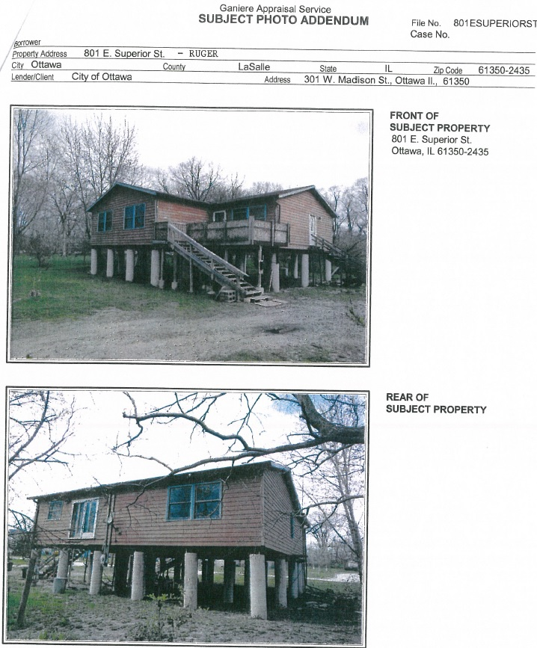
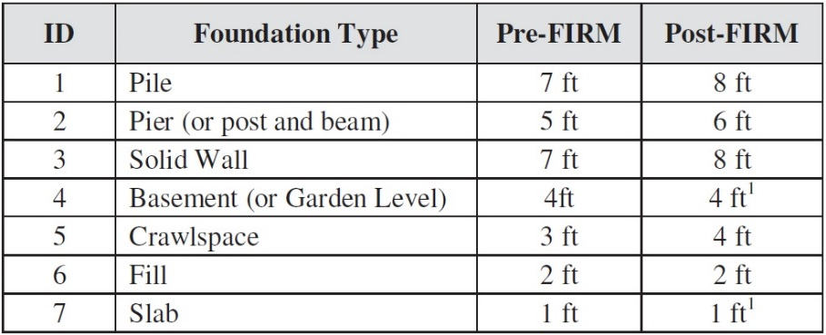
Structure Data for Hazus
First Floor Height
  The height of the first floor, in feet, above ground elevation.
Notes:
Estimated First Floor Height based on the pre-demolition photos in the property appraisals.

Slide 24
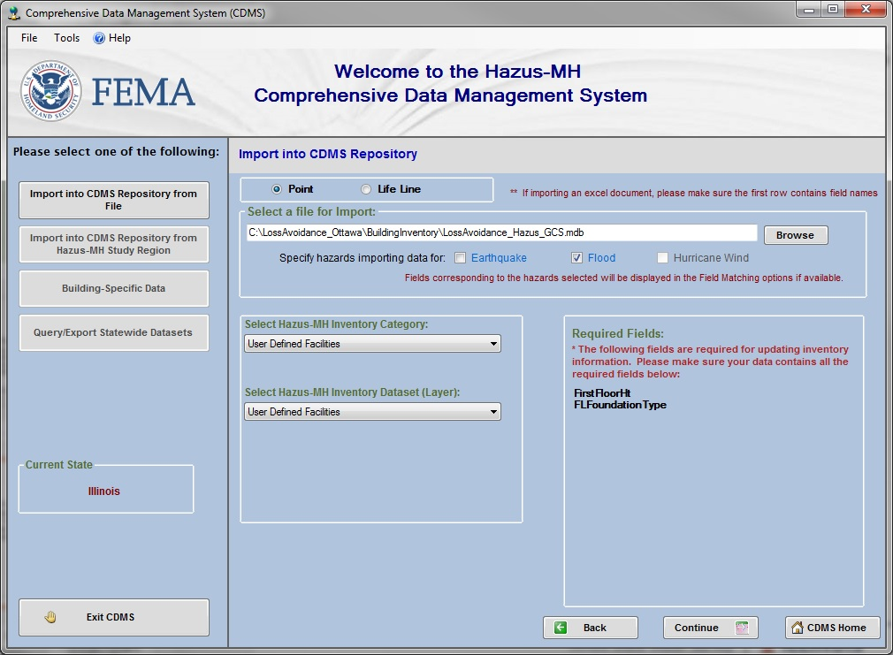
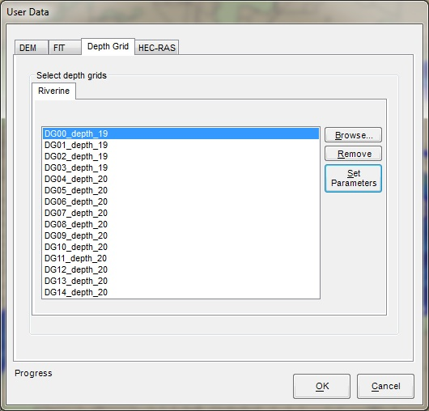
Hazus Analysis
Import user data into Hazus
  Building Inventory
    Import into CDMS
  Depth Grids
Notes:
CDMS is Comprehensive Data Management System used to upload data into Hazus.

Slide 25
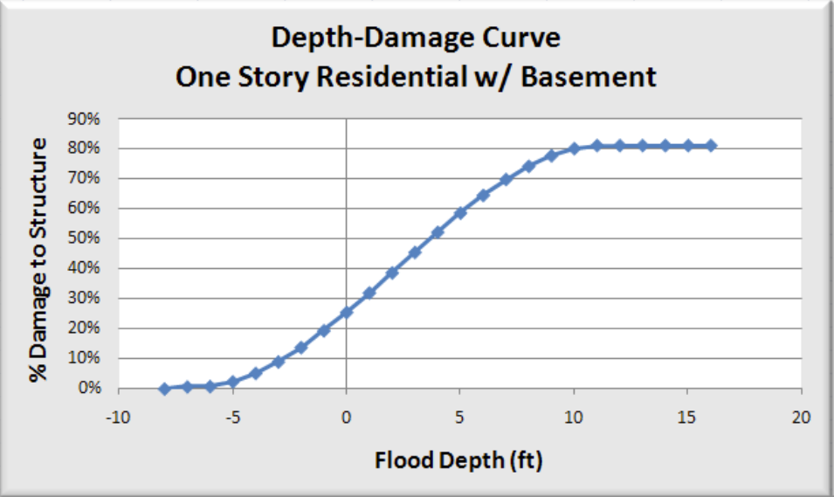
HAZUS Analysis - Depth-Damage Curves
Percentage of damage is calculated for each structure based on the depth of flooding.
  Based on Attributes of the structures
  For buildings, first floor height
  For equipment, height above first floor
Damage percentage is used to determine loss in USD
Depth of flooding
Depth used for damage estimation

Slide 26
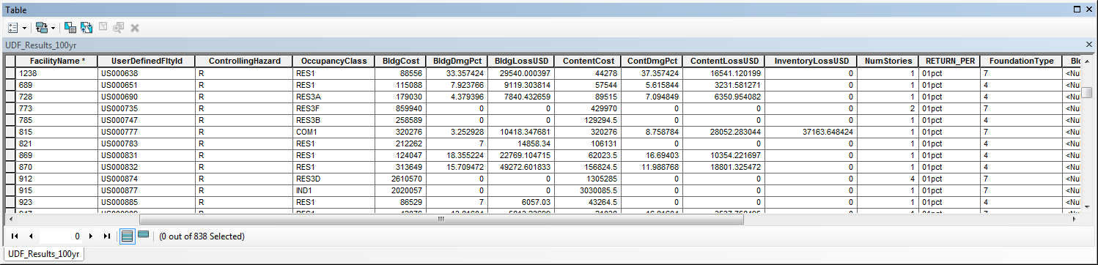
Analysis Output
Building Loss
Content Loss
Business Inventory Loss
Structure Percent Damaged

Slide 27
Topics
Description of City of Ottawa
History
  Flooding
  Funding
Gathering and Developing Data for Analysis
Hazus Analysis
Timeline of Buyouts and Results
Central Elementary School and Heritage Harbor
Obstacles
Drone Flight

Slide 28
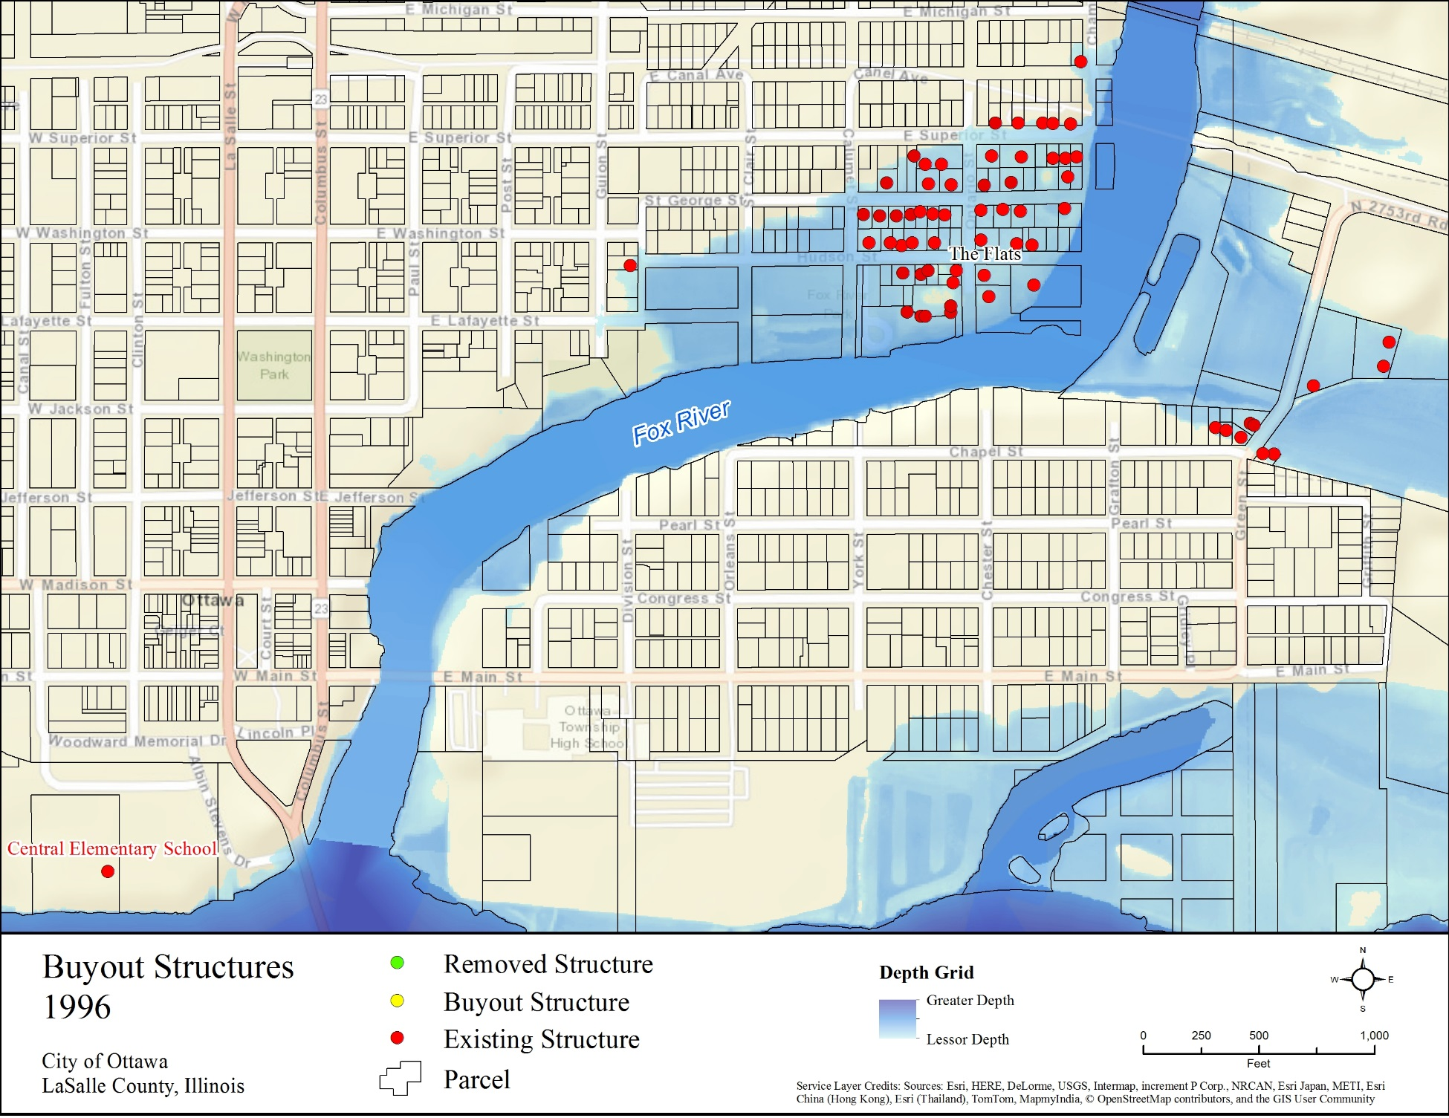
Year | Impacted Structures | Cumulative Losses Avoided | Number of Buyouts | Cumulative Project Investment | ROI
1996 | N/A | N/A | N/A | N/A | N/A
Notes:
Removed Structure = Structure that has been removed
Buyout Structure = Structure that was bought out in the year the map represents
Existing Structure = Structure that still exists/has not been bought out as of the year the map represents
Impacted Structures: Structures that would have been impacted by the flood event had they not been previously removed.
Number of Buyouts: Buyouts that occurred in the year of the map.

Slide 29
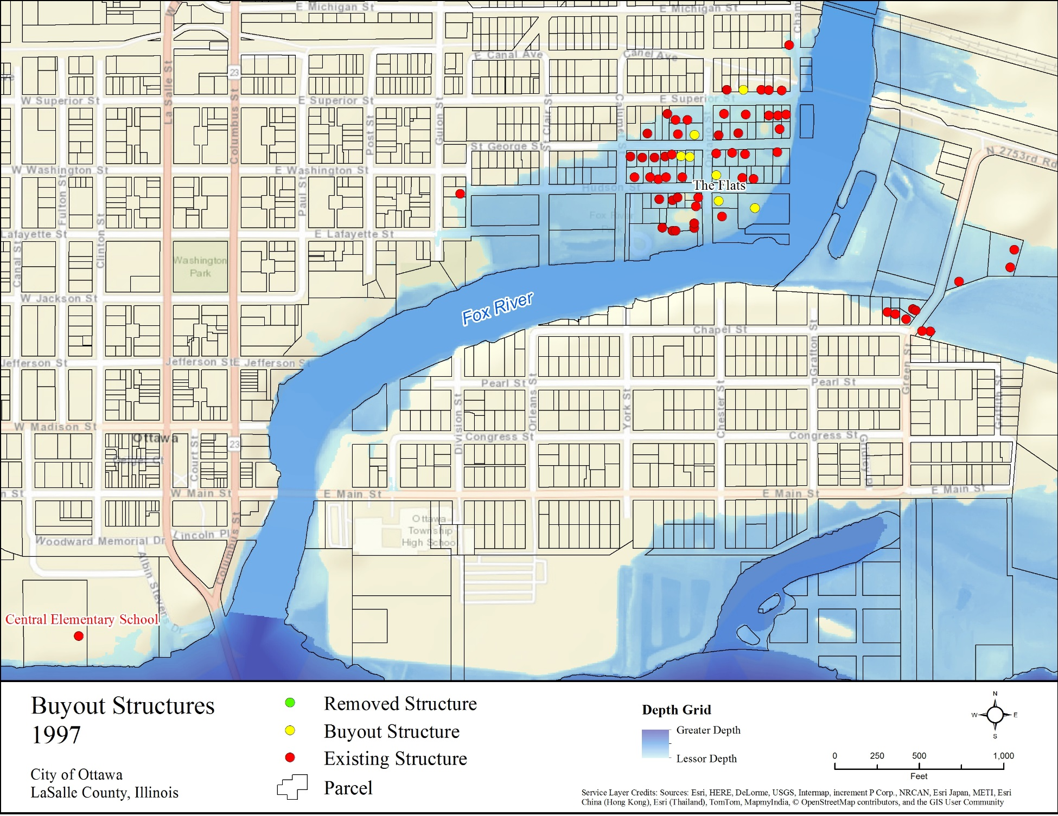
Year | Impacted Structures | Cumulative Losses Avoided | Number of Buyouts | Cumulative Project Investment | ROI
1996 | N/A | N/A | N/A | N/A | N/A
1997 | N/A | N/A | 7 | $442,800 | N/A
Notes:
Removed Structure = Structure that has been removed
Buyout Structure = Structure that was bought out in the year the map represents
Existing Structure = Structure that still exists/has not been bought out as of the year the map represents
Impacted Structures: Structures that would have been impacted by the flood event had they not been previously removed.
Number of Buyouts: Buyouts that occurred in the year of the map.

Slide 30
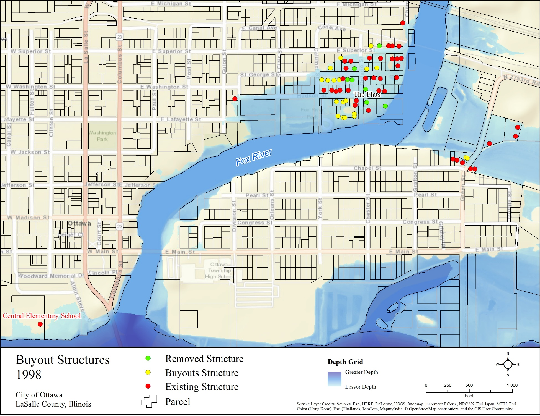
Year | Impacted Structures | Cumulative Losses Avoided | Number of Buyouts | Cumulative Project Investment | ROI
1996 | N/A | N/A | N/A | N/A | N/A
1997 | N/A | N/A | 7 | $442,800 | N/A
1998 | 6 | $176,000 | 19 | $1,938,000 | 9%
Notes:
Removed Structure = Structure that has been removed
Buyout Structure = Structure that was bought out in the year the map represents
Existing Structure = Structure that still exists/has not been bought out as of the year the map represents
Impacted Structures: Structures that would have been impacted by the flood event had they not been previously removed.
Number of Buyouts: Buyouts that occurred in the year of the map.

Slide 31
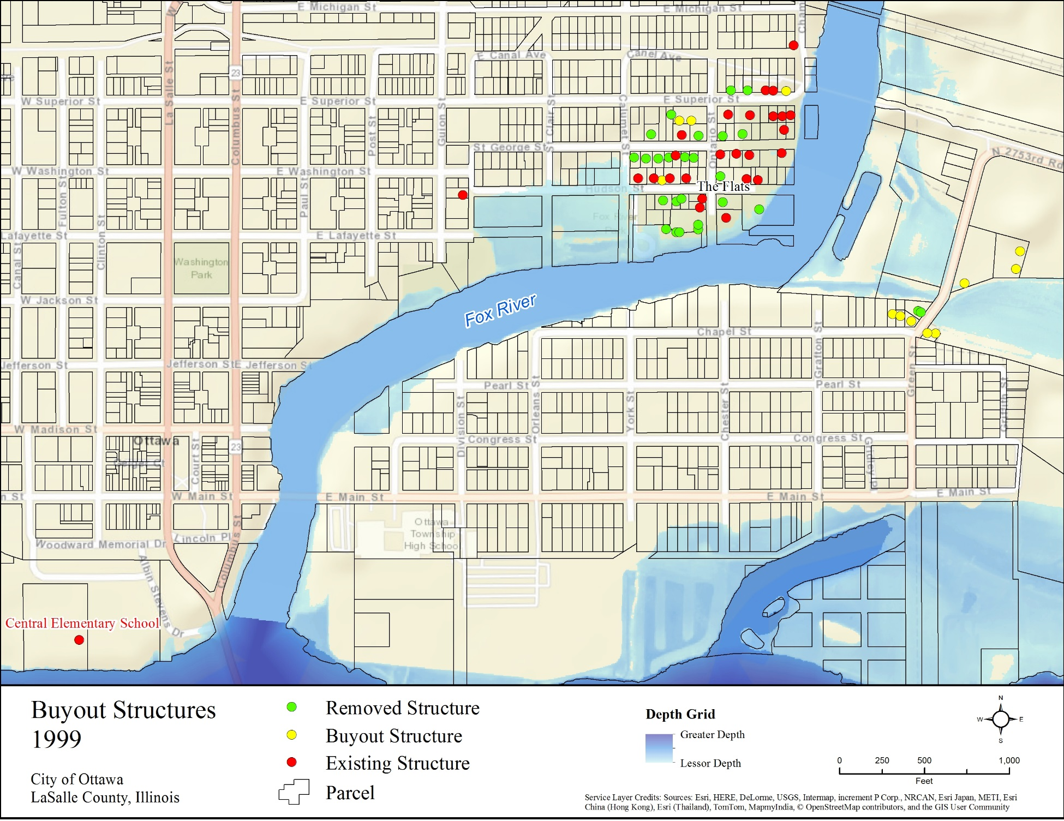
Year | Impacted Structures | Cumulative Losses Avoided | Number of Buyouts | Cumulative Project Investment | ROI
1997 | N/A | N/A | 7 | $442,800 | N/A
1998 | 6 | $176,000 | 19 | $1,938,000 | 9%
1999 | 1 | $179,000 | 12 | $2,946,000 | 6%
Notes:
Removed Structure = Structure that has been removed
Buyout Structure = Structure that was bought out in the year the map represents
Existing Structure = Structure that still exists/has not been bought out as of the year the map represents
Impacted Structures: Structures that would have been impacted by the flood event had they not been previously removed.
Number of Buyouts: Buyouts that occurred in the year of the map.

Slide 32

Year | Impacted Structures | Cumulative Losses Avoided | Number of Buyouts | Cumulative Project Investment | ROI
1999 | 1 | $179,000 | 12 | $2,946,000 | 6%
2000 | N/A | $179,000 | 11 | $3,678,000 | 5%
2001 | 3 | $187,000 | 5 | $4,099,000 | 5%
Notes:
Removed Structure = Structure that has been removed
Buyout Structure = Structure that was bought out in the year the map represents
Existing Structure = Structure that still exists/has not been bought out as of the year the map represents
Impacted Structures: Structures that would have been impacted by the flood event had they not been previously removed.
Number of Buyouts: Buyouts that occurred in the year of the map.

Slide 33
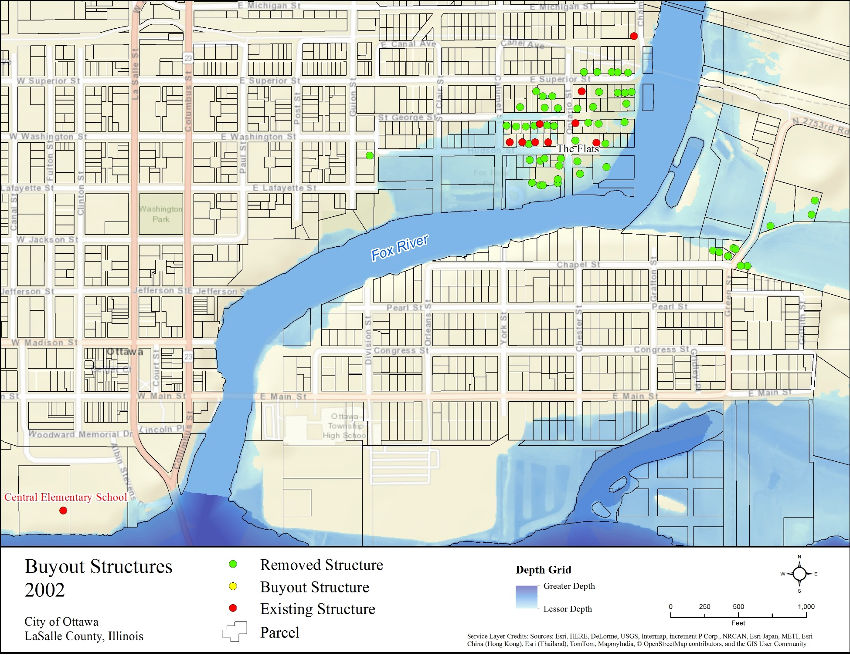
Year | Impacted Structures | Cumulative Losses Avoided | Number of Buyouts | Cumulative Project Investment | ROI
2000 | N/A | $179,000 | 11 | $3,678,000 | 5%
2001 | 3 | $187,000 | 5 | $4,099,000 | 5%
2002 | 12 | $392,000 | N/A | $4,099,000 | 10%
Notes:
Removed Structure = Structure that has been removed
Buyout Structure = Structure that was bought out in the year the map represents
Existing Structure = Structure that still exists/has not been bought out as of the year the map represents
Impacted Structures: Structures that would have been impacted by the flood event had they not been previously removed.
Number of Buyouts: Buyouts that occurred in the year of the map.

Slide 34

Year | Impacted Structures | Cumulative Losses Avoided | Number of Buyouts | Cumulative Project Investment | ROI
2001 | 3 | $187,000 | 5 | $4,099,000 | 5%
2002 | 12 | $392,000 | N/A | $4,099,000 | 10%
2004 | 1 | $396,000 | N/A | $4,099,000 | 10%
Notes:
Removed Structure = Structure that has been removed
Buyout Structure = Structure that was bought out in the year the map represents
Existing Structure = Structure that still exists/has not been bought out as of the year the map represents
Impacted Structures: Structures that would have been impacted by the flood event had they not been previously removed.
Number of Buyouts: Buyouts that occurred in the year of the map.

Slide 35

Year | Impacted Structures | Cumulative Losses Avoided | Number of Buyouts | Cumulative Project Investment | ROI
2002 | 12 | $392,000 | N/A | $4,099,000 | 10%
2004 | 1 | $396,000 | N/A | $4,099,000 | 10%
2005 | 18 | $669,000 | N/A | $4,099,000 | 16%
Notes:
Removed Structure = Structure that has been removed
Buyout Structure = Structure that was bought out in the year the map represents
Existing Structure = Structure that still exists/has not been bought out as of the year the map represents
Impacted Structures: Structures that would have been impacted by the flood event had they not been previously removed.
Number of Buyouts: Buyouts that occurred in the year of the map.

Slide 36
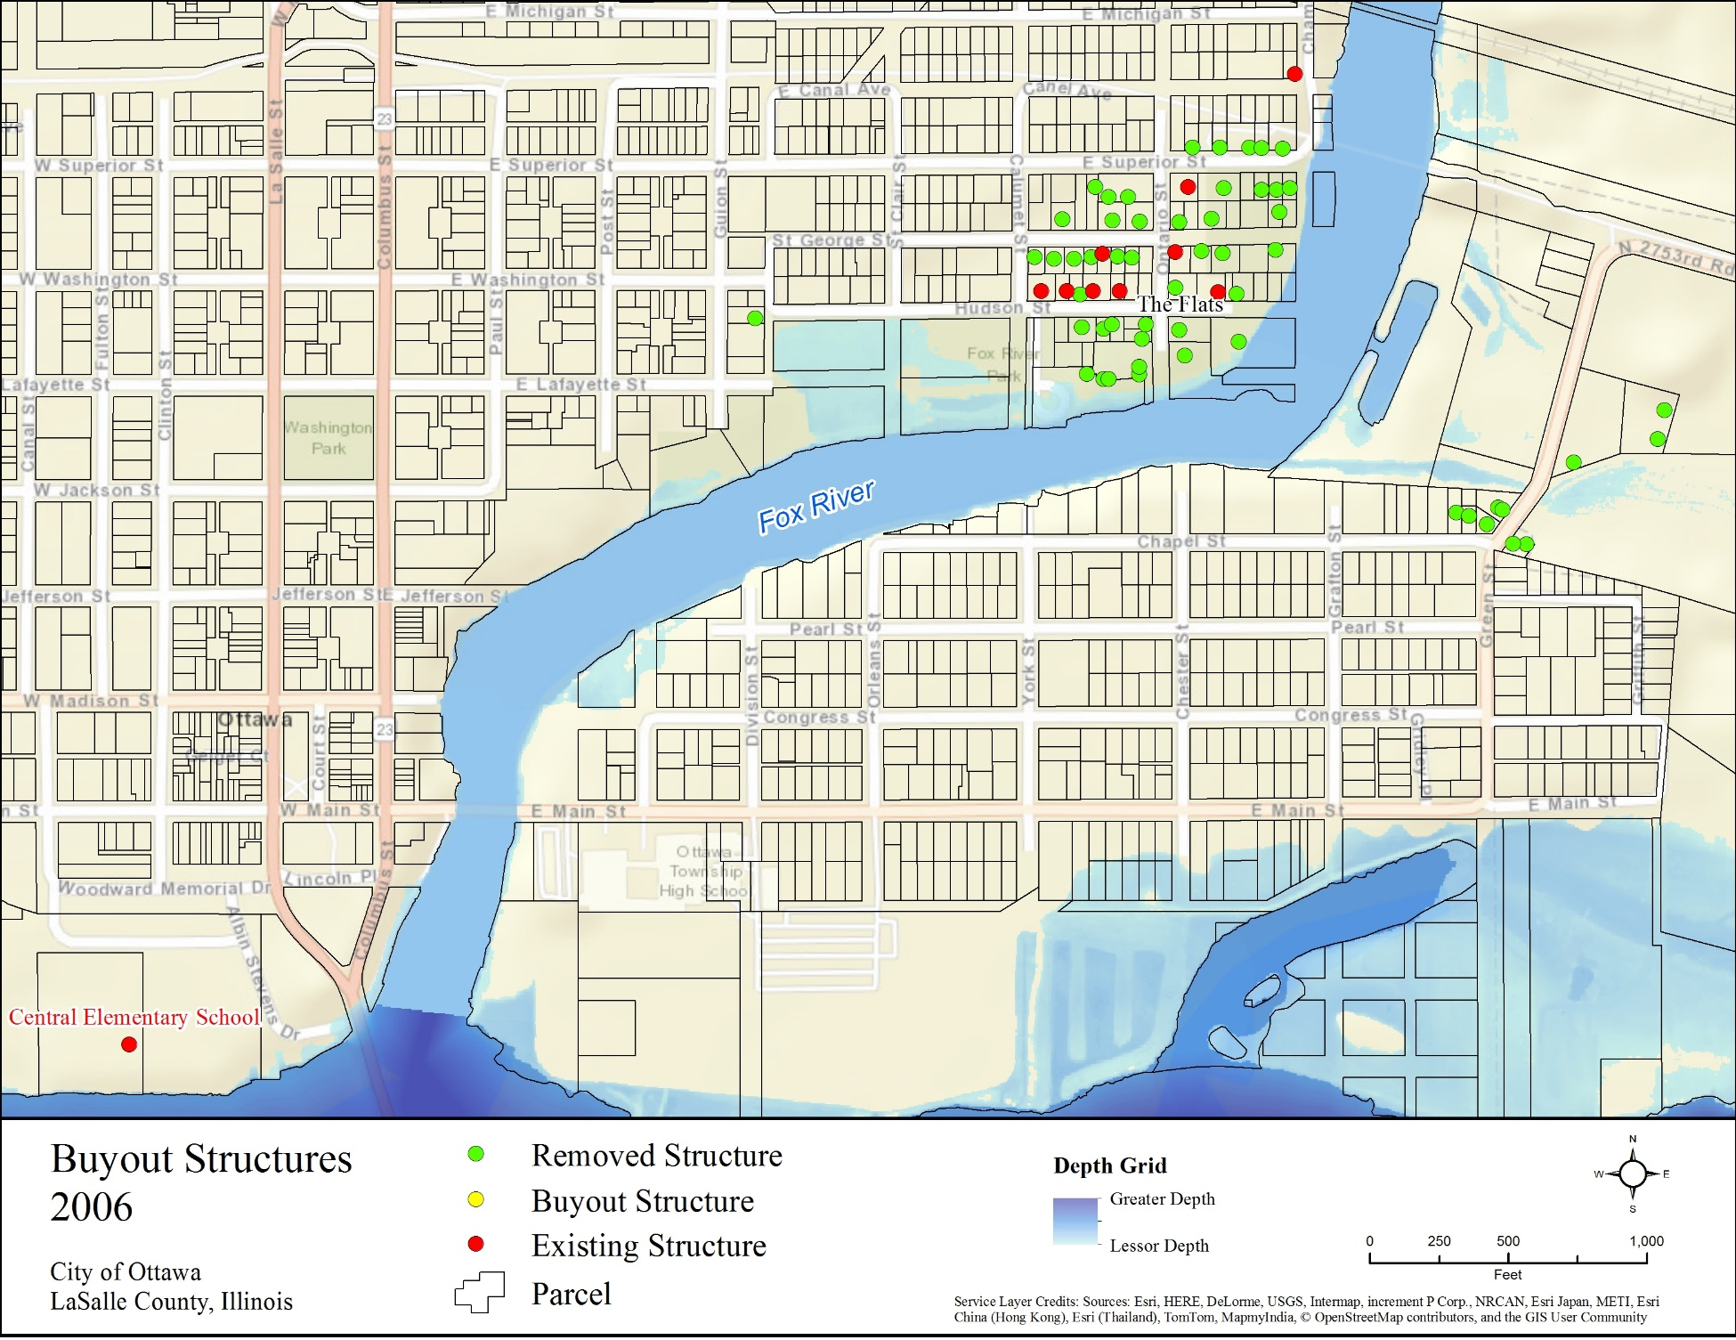
Year | Impacted Structures | Cumulative Losses Avoided | Number of Buyouts | Cumulative Project Investment | ROI
2004 | 1 | $396,000 | N/A | $4,099,000 | 10%
2005 | 18 | $669,000 | N/A | $4,099,000 | 16%
2006 | 0 | $669,000 | N/A | $4,099,000 | 16%
Notes:
Removed Structure = Structure that has been removed
Buyout Structure = Structure that was bought out in the year the map represents
Existing Structure = Structure that still exists/has not been bought out as of the year the map represents
Impacted Structures: Structures that would have been impacted by the flood event had they not been previously removed.
Number of Buyouts: Buyouts that occurred in the year of the map.

Slide 37
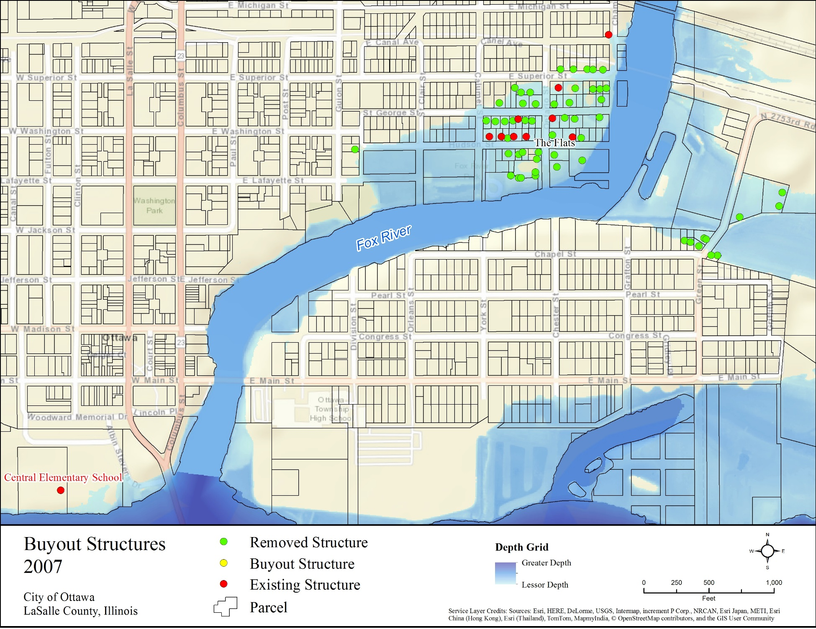
Year | Impacted Structures | Cumulative Losses Avoided | Number of Buyouts | Cumulative Project Investment | ROI
2005 | 18 | $669,000 | N/A | $4,099,000 | 16%
2006 | 0 | $669,000 | N/A | $4,099,000 | 16%
2007 | 46 | $1,551,000 | N/A | $4,099,000 | 38%
Notes:
Removed Structure = Structure that has been removed
Buyout Structure = Structure that was bought out in the year the map represents
Existing Structure = Structure that still exists/has not been bought out as of the year the map represents
Impacted Structures: Structures that would have been impacted by the flood event had they not been previously removed.
Number of Buyouts: Buyouts that occurred in the year of the map.

Slide 38
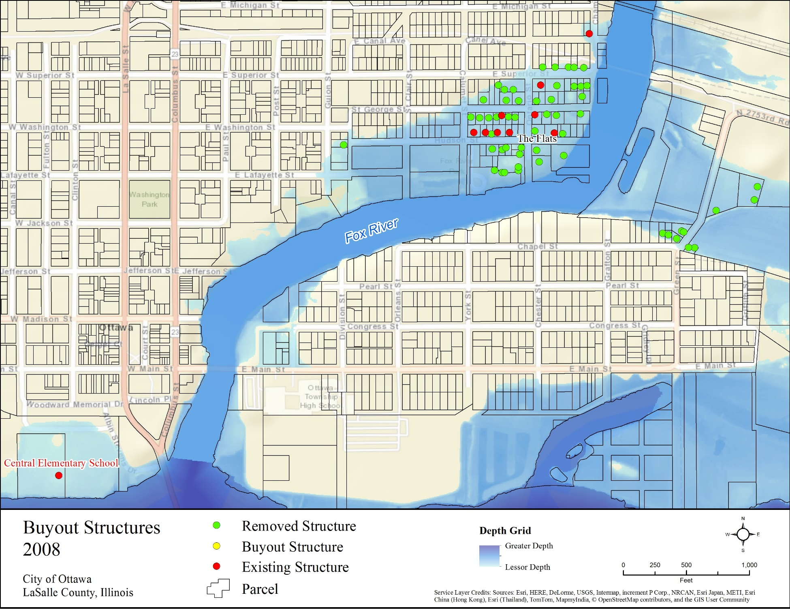
Central Elementary school not included in results
Year | Impacted Structures | Cumulative Losses Avoided | Number of Buyouts | Cumulative Project Investment | ROI
2006 | 0 | $669,000 | N/A | $4,099,000 | 16%
2007 | 46 | $1,551,000 | N/A | $4,099,000 | 38%
2008 | 54 | $3,852,000 | N/A | $4,099,000 | 94%
Notes:
Removed Structure = Structure that has been removed
Buyout Structure = Structure that was bought out in the year the map represents
Existing Structure = Structure that still exists/has not been bought out as of the year the map represents
Impacted Structures: Structures that would have been impacted by the flood event had they not been previously removed.
Number of Buyouts: Buyouts that occurred in the year of the map.

Slide 39
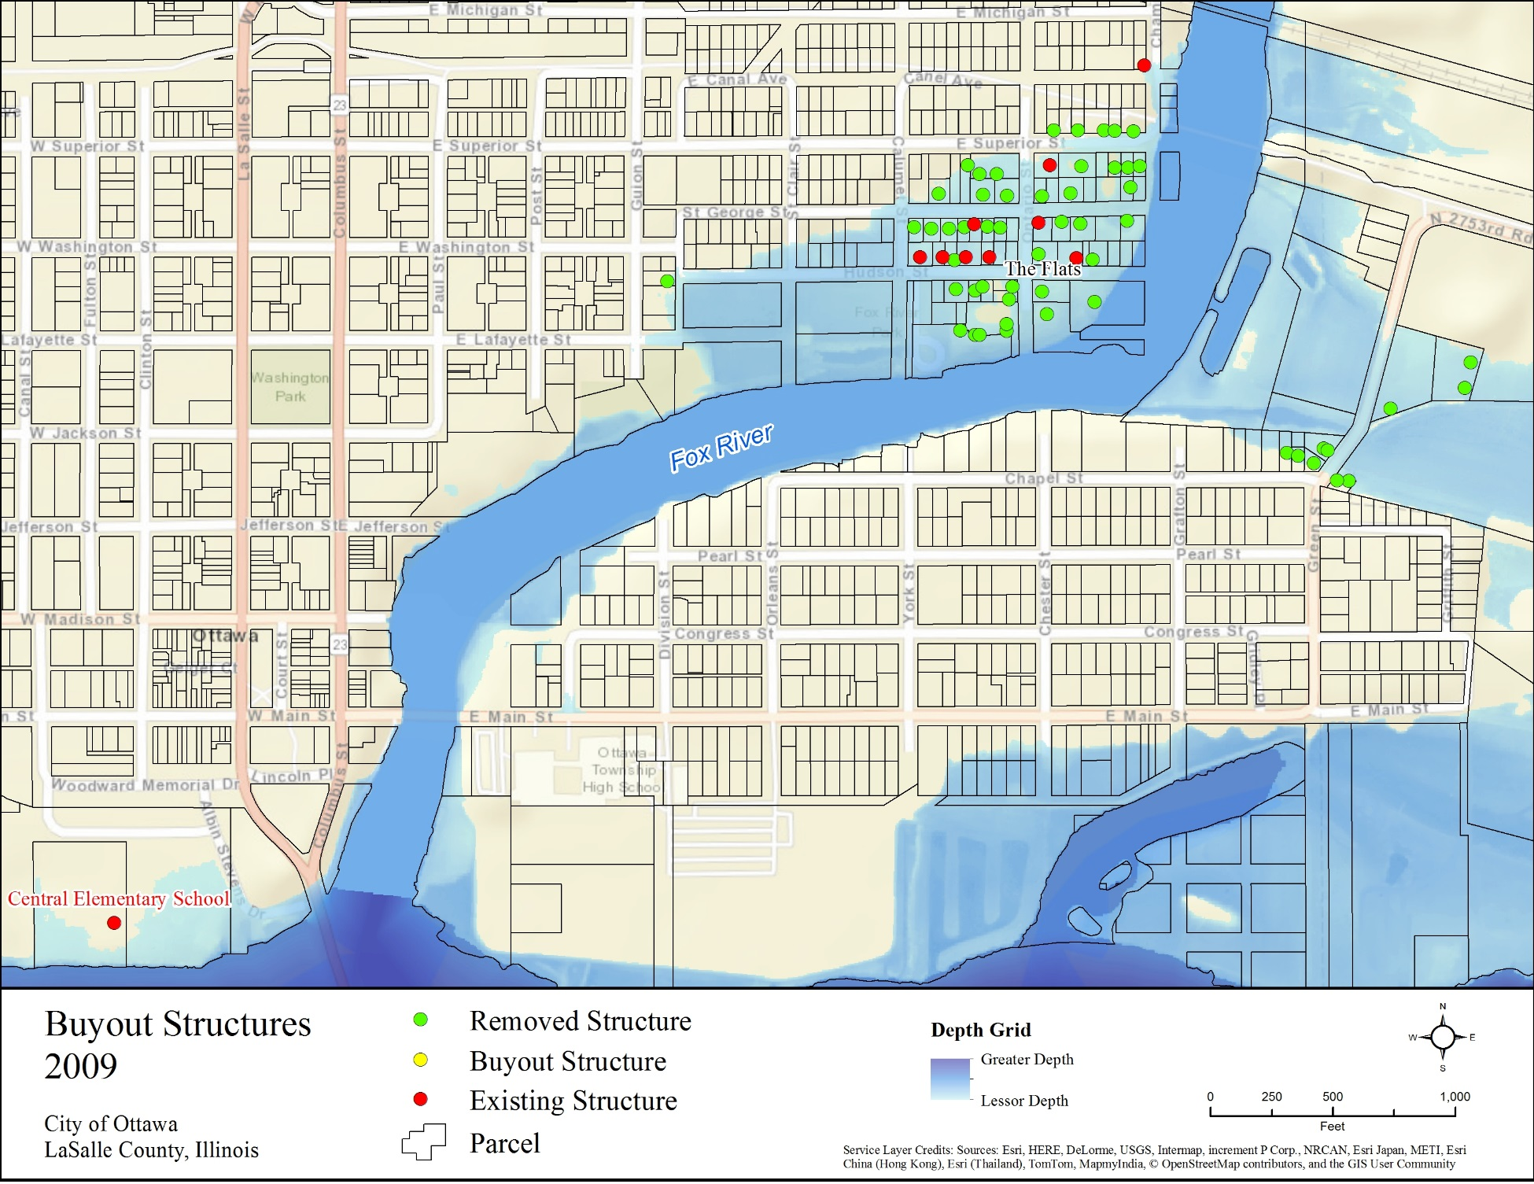
Central Elementary school not included in results
Year | Impacted Structures | Cumulative Losses Avoided | Number of Buyouts | Cumulative Project Investment | ROI
2007 | 46 | $1,551,000 | N/A | $4,099,000 | 38%
2008 | 54 | $3,852,000 | N/A | $4,099,000 | 94%
2009 | 47 | $4,940,000 | N/A | $4,099,000 | 121%
Notes:
Removed Structure = Structure that has been removed
Buyout Structure = Structure that was bought out in the year the map represents
Existing Structure = Structure that still exists/has not been bought out as of the year the map represents
Impacted Structures: Structures that would have been impacted by the flood event had they not been previously removed.
Number of Buyouts: Buyouts that occurred in the year of the map.

Slide 40
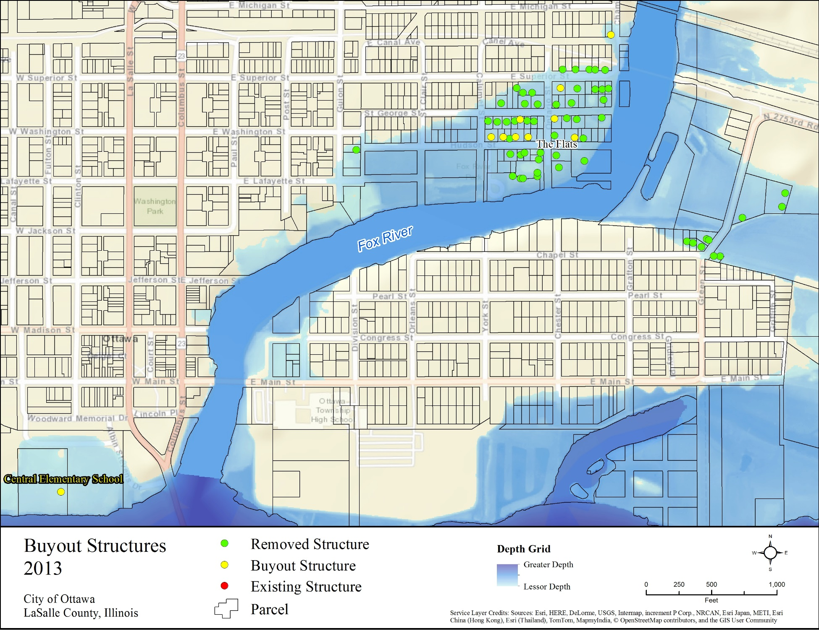
Central Elementary school not included in results
Year | Impacted Structures | Cumulative Losses Avoided | Number of Buyouts | Cumulative Project Investment | ROI
2009 | 47 | $4,940,000 | N/A | $4,099,000 | 121%
2012 | N/A | $4,940,000 | 4 | $4,482,000 | 110%
2013 | 58 | $7,553,000 | 5 | $4,938,000 | 153%
Notes:
Removed Structure = Structure that has been removed
Buyout Structure = Structure that was bought out in the year the map represents
Existing Structure = Structure that still exists/has not been bought out as of the year the map represents
Impacted Structures: Structures that would have been impacted by the flood event had they not been previously removed.
Number of Buyouts: Buyouts that occurred in the year of the map.

Slide 41
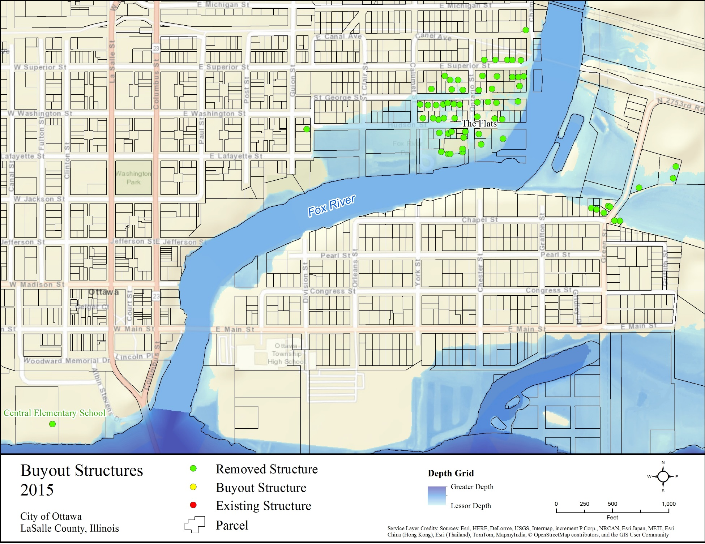
Central Elementary school not included in results
Year | Impacted Structures | Cumulative Losses Avoided | Number of Buyouts | Cumulative Project Investment | ROI
2012 | N/A | $4,940,000 | 4 | $4,482,000 | 110%
2013 | 58 | $7,553,000 | 5 | $4,938,000 | 153%
2015 | 20 | $7,839,000 | N/A | $4,938,000 | 159%
Notes:
Removed Structure = Structure that has been removed
Buyout Structure = Structure that was bought out in the year the map represents
Existing Structure = Structure that still exists/has not been bought out as of the year the map represents
Impacted Structures: Structures that would have been impacted by the flood event had they not been previously removed.
Number of Buyouts: Buyouts that occurred in the year of the map.

Slide 42
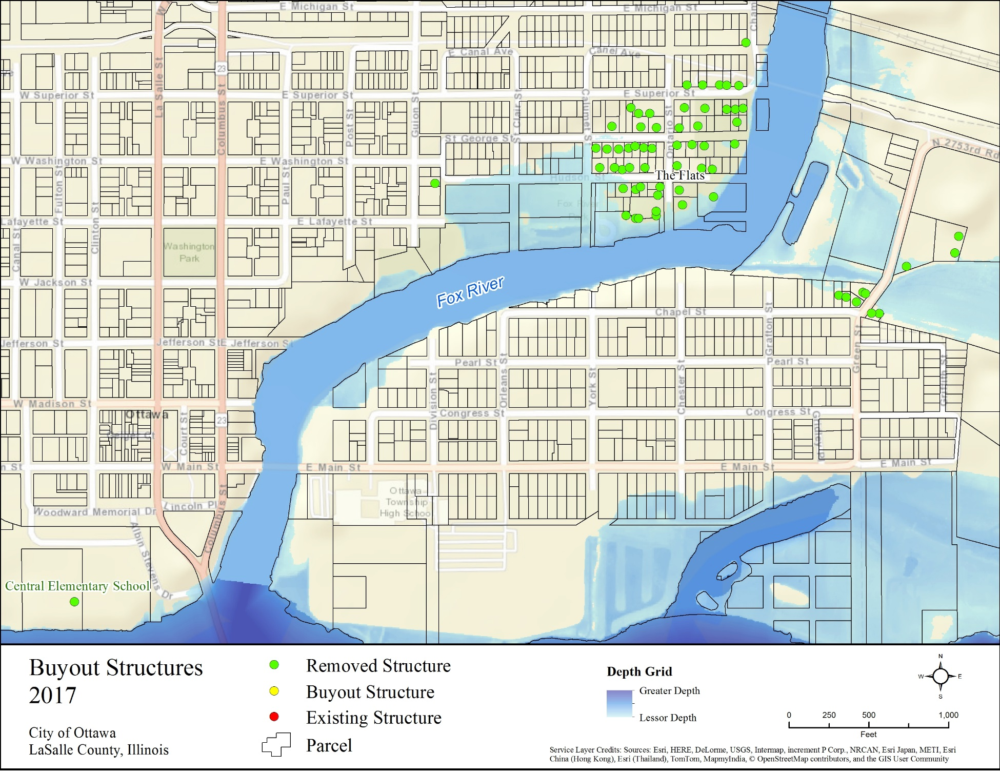
Central Elementary school not included in results
Year | Impacted Structures | Cumulative Losses Avoided | Number of Buyouts | Cumulative Project Investment | ROI
2013 | 58 | $7,553,000 | 5 | $4,938,000 | 153%
2015 | 20 | $7,839,000 | N/A | $4,938,000 | 159%
2017 | 4 | $7,900,000 | N/A | $4,938,000 | 160%
Notes:
Removed Structure = Structure that has been removed
Buyout Structure = Structure that was bought out in the year the map represents
Existing Structure = Structure that still exists/has not been bought out as of the year the map represents
Impacted Structures: Structures that would have been impacted by the flood event had they not been previously removed.
Number of Buyouts: Buyouts that occurred in the year of the map.

Slide 43
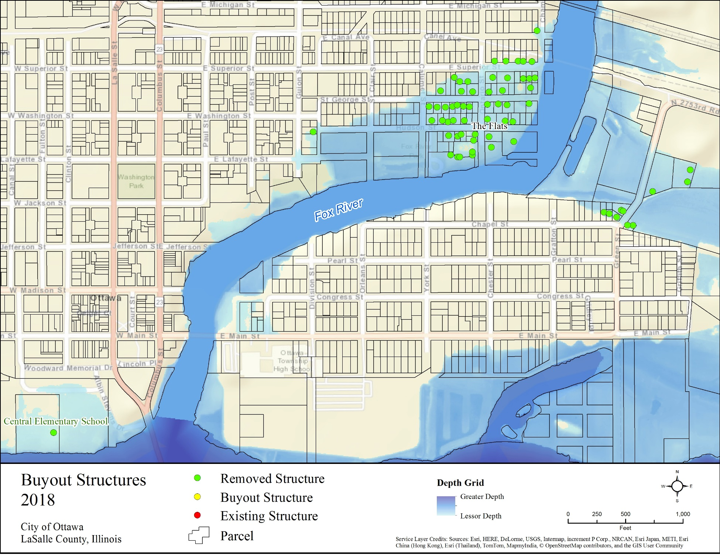
Central Elementary school not included in results
LA =$9,679,000
ROI=196%
Year | Impacted Structures | Cumulative Losses Avoided | Number of Buyouts | Cumulative Project Investment | ROI
2015 | 20 | $7,839,000 | N/A | $4,938,000 | 159%
2017 | 4 | $7,900,000 | N/A | $4,938,000 | 160%
2018 | 61 | $9,679,000 | N/A | $4,938,000 | 196%
Notes:
Removed Structure = Structure that has been removed
Buyout Structure = Structure that was bought out in the year the map represents
Existing Structure = Structure that still exists/has not been bought out as of the year the map represents
Impacted Structures: Structures that would have been impacted by the flood event had they not been previously removed.
Number of Buyouts: Buyouts that occurred in the year of the map.

Slide 44
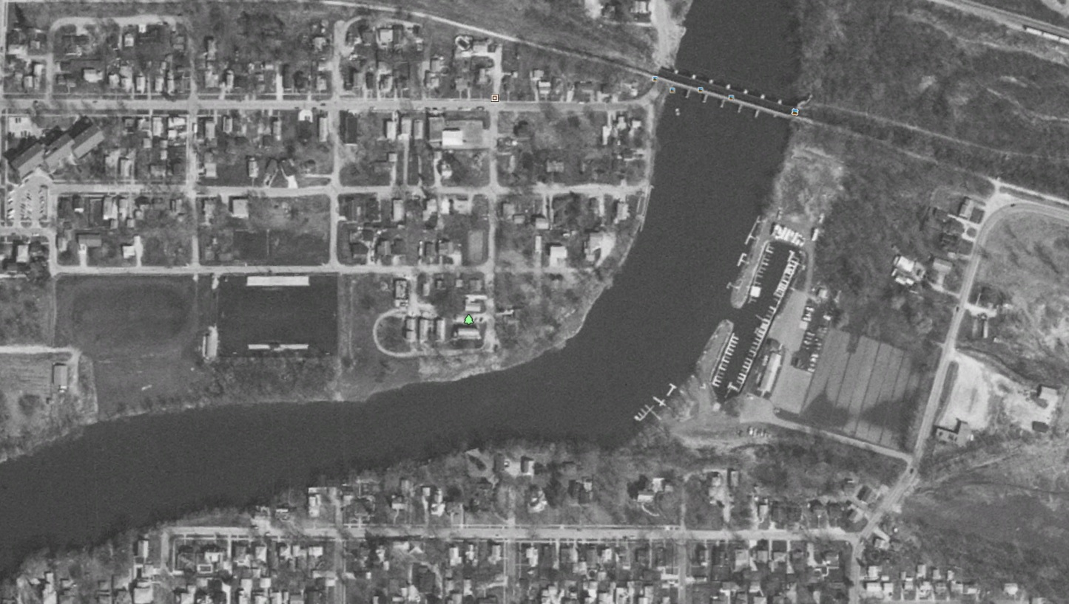
March 25th, 1998

Slide 45
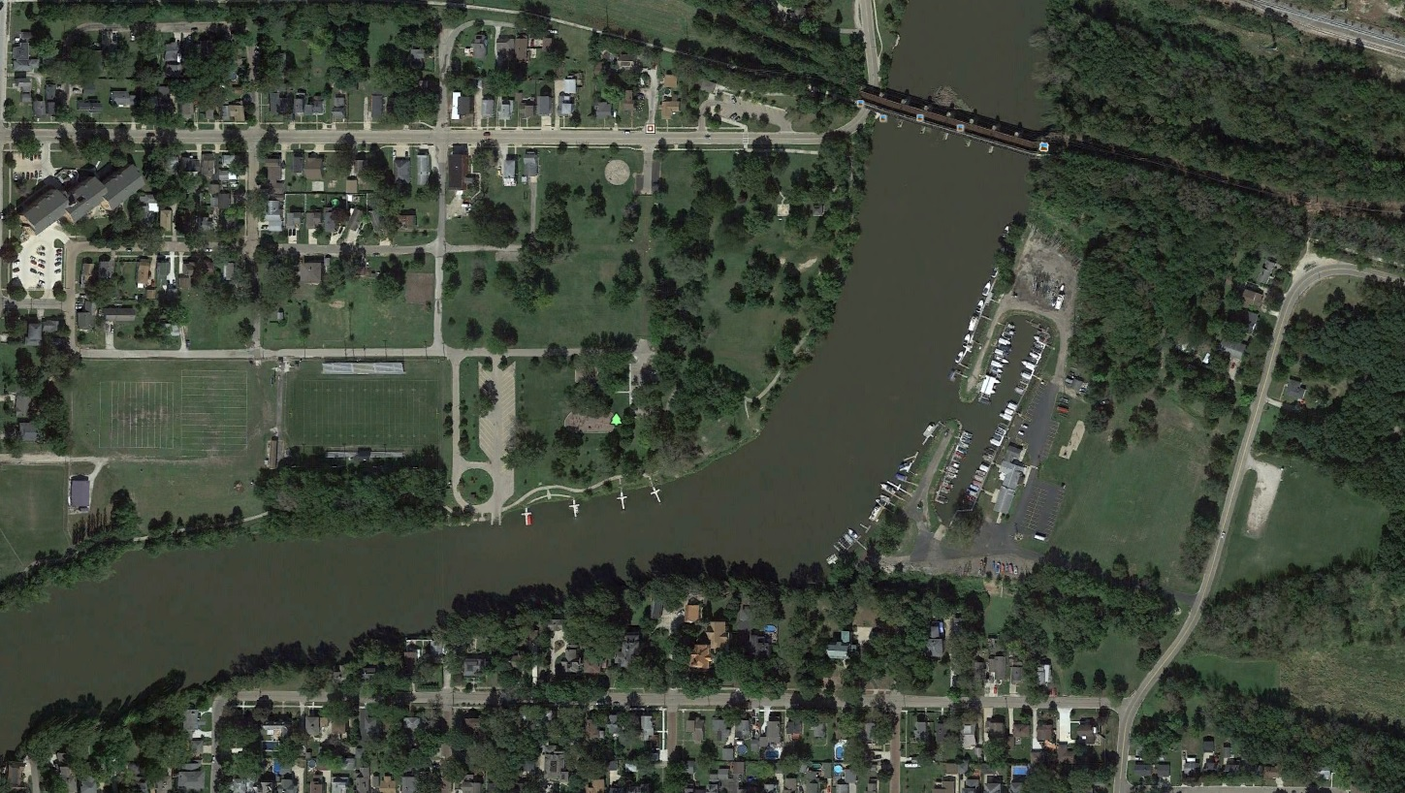
September 20th, 2015

Slide 46
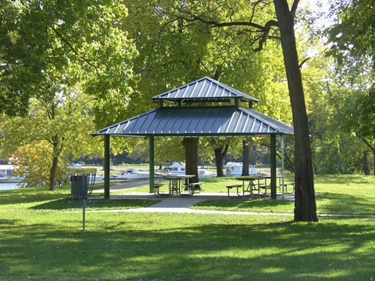
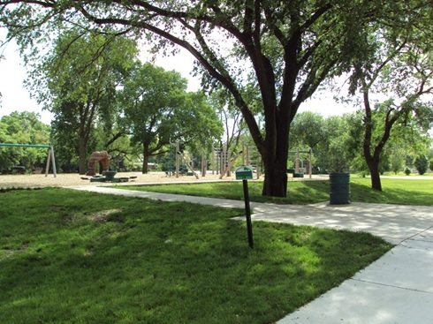
Current Conditions
Fox River Park
Playground
Green Space

Slide 47
Topics
Description of City of Ottawa
History
  Flooding
  Funding
Gathering and Developing Data for Analysis
Hazus Analysis
Timeline of Buyouts and Results
Central Elementary School and Heritage Harbor
Observations and Limitations

Slide 49
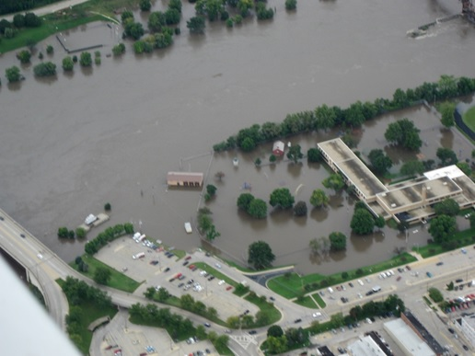
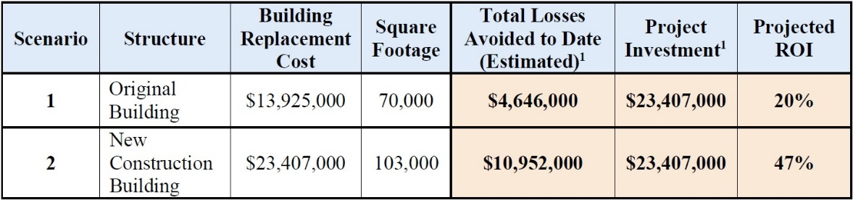
Central Elementary School
Flooded Sept. 2008
Demolished in August, 2013
New, larger school built out of floodplain
Funds awarded
  FEMA $12 million
  Illinois $10 million
  (adjusted to 2018 dollars)
Modeled flood event is April, 2013
Notes:
Original Building: If original school building was left at that location.
New Construction Building: Represents if the new school were built in the same location of the original.

Slide 50
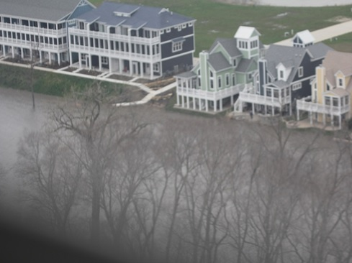
Heritage Harbor
High value Condominiums
New construction required to be 2 feet above the 1% annual chance base flood elevation.
Building Value
  Estimated Fair Market Value using 2018 assessor’s data.

Slide 51
Heritage Harbor
Hazus Analysis
  Depth Grids
    1% Annual Chance Flood event
  Ran analysis with two versions of each structure
    With current elevation
    With simulated elevation 2’ below current conditions
Event Type | Projected Structures impacted without 2' Higher Elevation Requirement | Total Loss without 2' Higher Elevation Requirement | Total Loss with Current Construction | Total Losses Avoided
1% Annual Chance Flood (100 year) | 33 | $2,396,000 | $0 | $2,396,000

Slide 52
Topics
Description of City of Ottawa
History
  Flooding
  Buyouts
Gathering and Developing Data for Analysis
Hazus Analysis
Timeline of Buyouts and Results
Central Elementary School and Heritage Harbor
Observations and Limitations

Slide 53
Observations and Limitations
Structure data may not be available – need good documentation
Combining data from a variety of different sources in one building inventory; not all information of same quality
Representing structures as points instead of polygons; building foot prints would be more accurate
Accounting for all of the associated costs of flooding:
  Loss of use, Displaced population, Business loss,
    Infrastructure repair and maintenance, Emergency services
Results are Estimates

Slide 54
Thanks!
Questions?
Brad McVay
bmcvay@Illinois.edu

