Slide 1
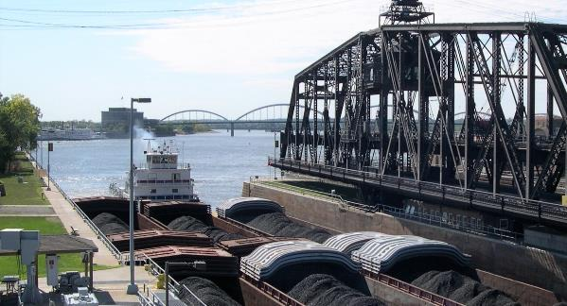
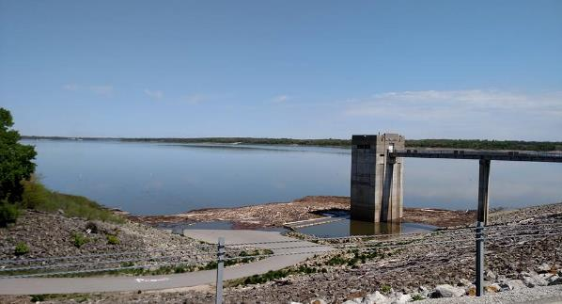
Defining What Consequences are Publicly Acceptable and Aligning Floodplain Policies to Get There
Jason T. Smith, PE, CFM
Flood Risk Management Program Manager
IA Silver Jackets Federal Lead
USACE - Rock Island District
Date: 25 October 2018

Slide 2
Defining Consequences
What are the different kinds of consequences we may face? (Identification/Evaluation)
Are we willing to accept the consequence considering the risk? (Values/Trade-offs)
What do we do when consequences are unacceptable? (Decision/Action)

Slide 3
Potential Consequence Areas
Economic
  Built Infrastructure Damages, Water Supply, Energy (Power Plants, Ethanol, etc.), Revenue (Urban and Rural), Transportation
Social
  People displaced, mental health, community cohesion, demographics, critical infrastructure
Environmental
  Contamination, Fish and Wildlife, Water Quality, Compliance, Recreation

Slide 4
Potential Consequence Areas
Other Potential Areas of Impact: tax revenue base, quality of life, job growth, modernization, technology, aging population, education, regulation, homelessness, health care, current vs future landuse, climate, global trade, and many more

Slide 5
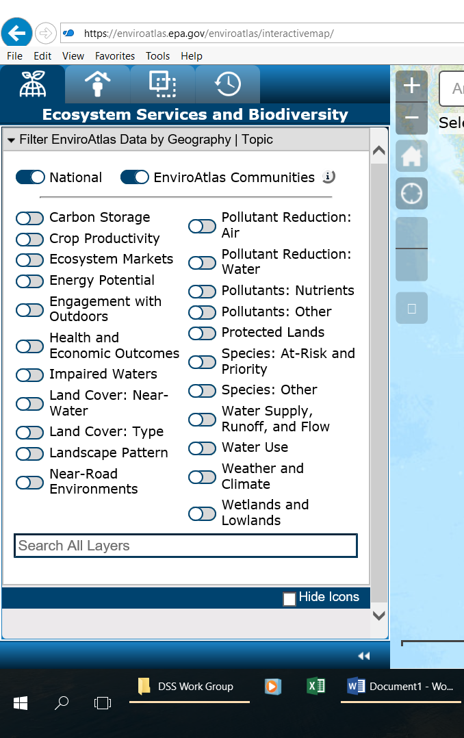
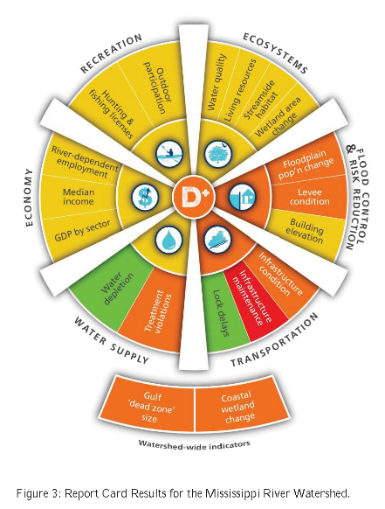
Values/Trade-offs
MS River Report Card
EPA Enviroatlas

Slide 6
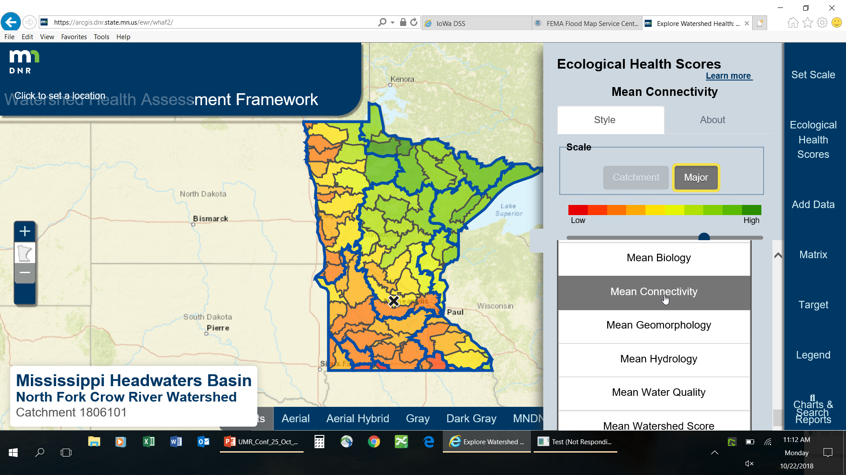
Values/Trade-offs

Slide 7
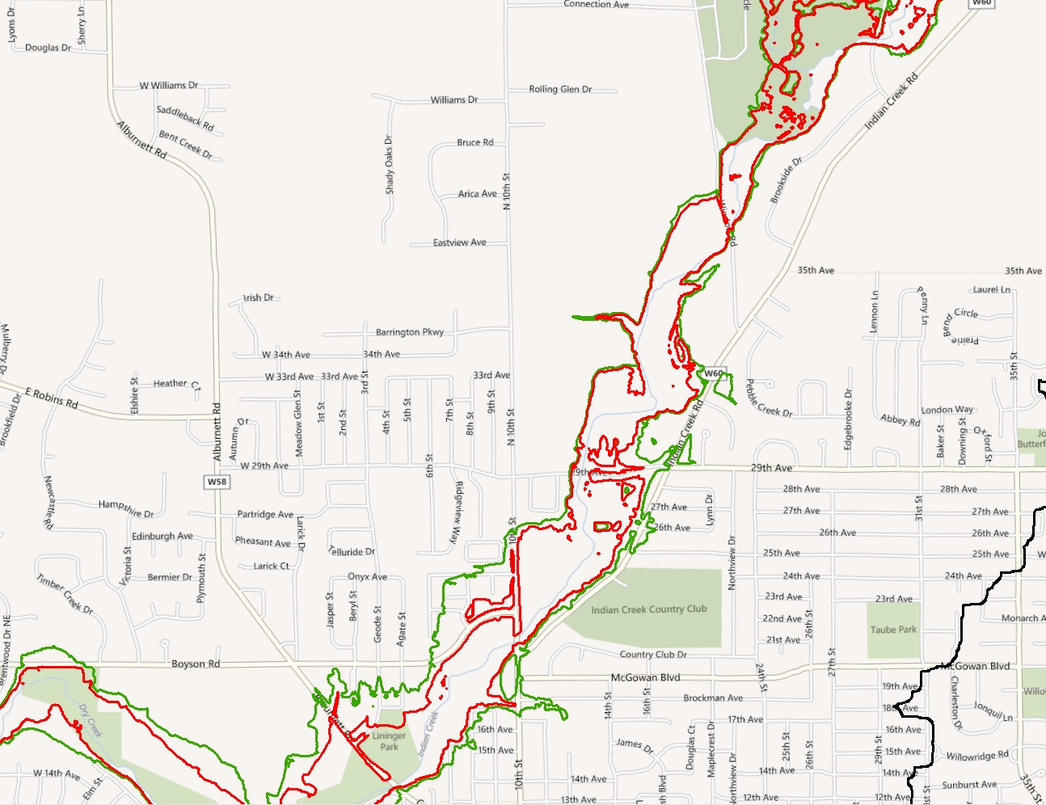
Values/Trade-offs
What is lost and gained by allowing maximum room for River? Is this too much? For who, why, when?
Flow (cfs)
Moderately Frequent Event – Different Land Uses, Different Precipitation Intensity

Slide 8
Decision of Unacceptable Consequences, Mitigation Action
  Mitigation through Planning
    Flood warning system, emergency response planning, future development planning, etc.
  Mitigation through Practices
    Levees, elevations/relocations, diversion, Ag BMPs, urban BMPs, etc
  Mitigation through Policy
    Laws, Regulations, Ordinances, Zoning Restrictions

Slide 9
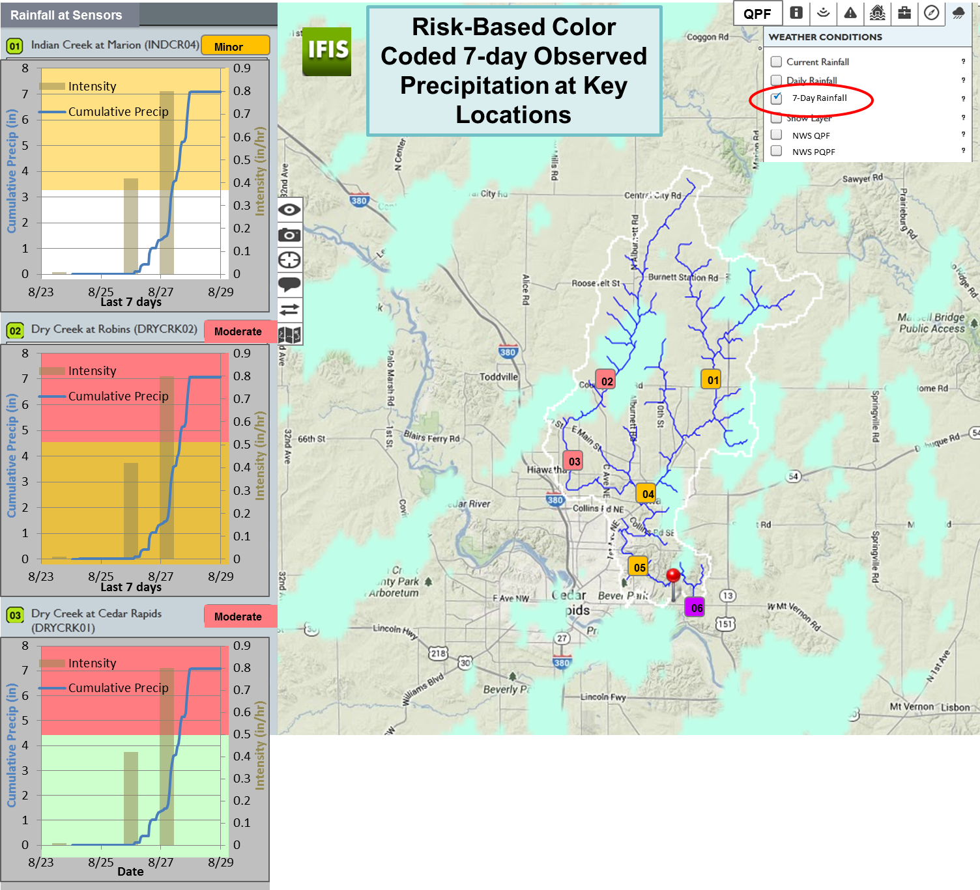
Indian Creek Flood Warning System

Slide 10
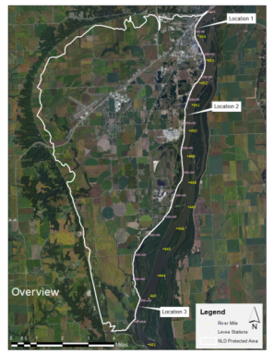
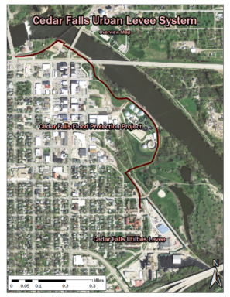
Muscatine and Cedar Falls Levee Breach Scenarios
Purpose:
Risk Identification
Risk Communication
Emergency Preparedness
Evacuation Planning
Key Take-Away:
Levees are systems, failure in one area may impact other areas with perceived greater protection.
Muscatine Island Downtown Cedar Falls
  The studies were not initiated because of any known or imminent risk of failure to the levee protecting these communities.

Slide 11
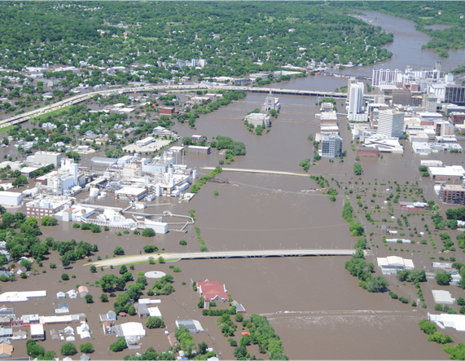
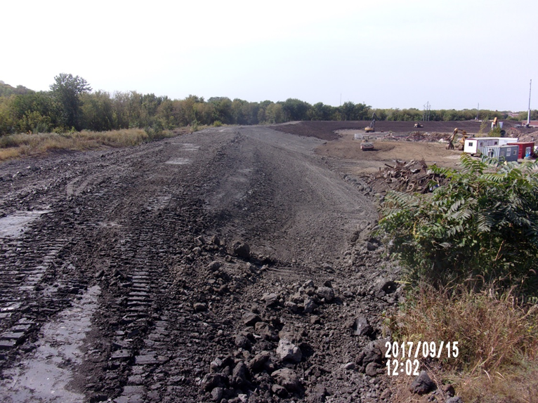
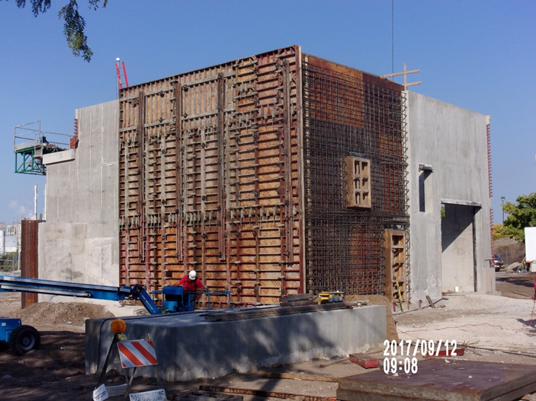
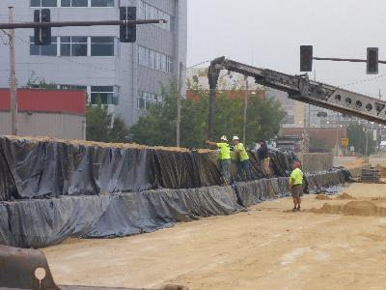
Cedar Rapids Flood Protection System
Unacceptable Consequence
Temporary Mitigation
Practice
Permanent Mitigation
Practices

Slide 12
Aligning Floodplain Policies
National and State floodplain policies provide a starting point for what consequences are publicly acceptable
Local communities and stakeholders decide if policies are adequate to mitigate unacceptable consequences or not
Unacceptable consequences come in many forms; economic, social, and environmental

Slide 13
Aligning Floodplain Policies
Consistent floodplain management regulations across UMR states which align with stakeholder values
Higher (500-yr) regulatory standard in some communities
Hierarchy of beneficial uses: Codify the hierarchy and establish compensation mechanisms

Slide 14
KEY TAKEAWAYS
No Magic: People define what are acceptable and unacceptable consequences based on their perspective
Trade-offs Must be Understood for ANY Compromise: The best plan may not be the optimized plan for any single mission area
Mitigation of unacceptable consequences requires Planning, Practices, and Policy

Slide 15
Thank You!
Questions?
Please Contact
Jason T. Smith, P.E., CFM
Flood Risk Management Program Manager
Jason.T.Smith2@usace.army.mil
309-794-5690

