Slide 1
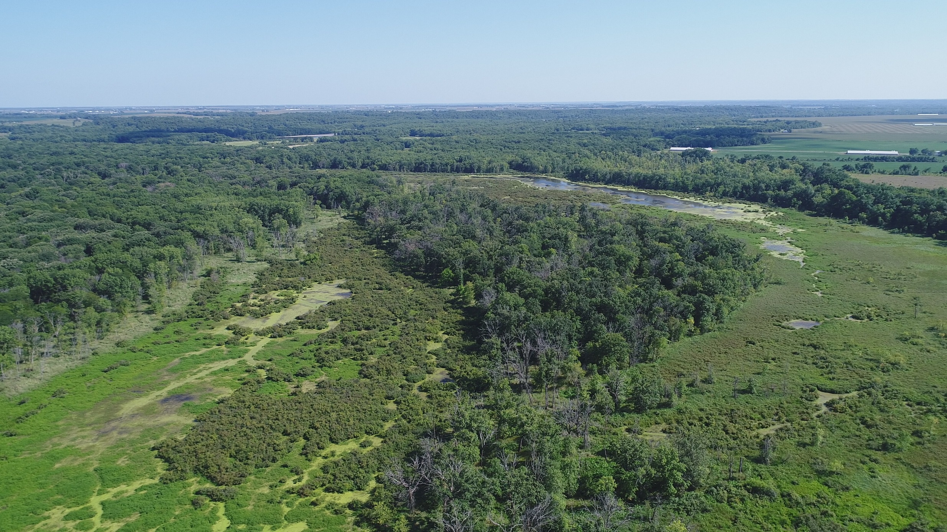
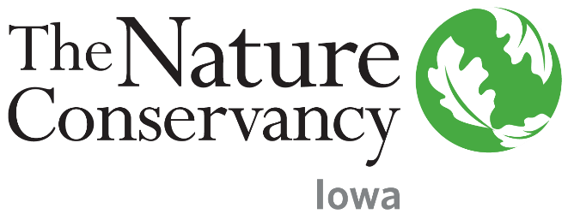
Land of the Swamp White Oak
Floodplain Conservation in Iowa’s
Most Biologically Diverse Landscape
Notes:
My name is Josh Spies and I am Associate Director of Conservation for The Nature Conservancy in Iowa. I’m going to talk a little bit about Iowa’s most wild and diverse landscape what we call the Land of the Swamp White Oak.

Slide 2




Our Mission: To conserve the lands and waters on which all life depends
3,800/
550
employees/
scientists
50
>1 mil
U.S. state chapters
active members
120 mil
acres of land protected
72
countries
100
Marine conservation
projects
1,400
preserves managed
5,000
river miles protected
Notes:
A little background about the Nature Conservancy, we are the world’s largest non-government conservation organization. We protect land and water for people and nature. We own and manage over 2 million acres of nature preserves in the US. We use a science-based, collaborative approach to help solve the world’s most complex conservation challenges. Here in Iowa that would include disappearing grasslands, poor water quality, unsustainable soil loss, and unnatural flooding.

Slide 3
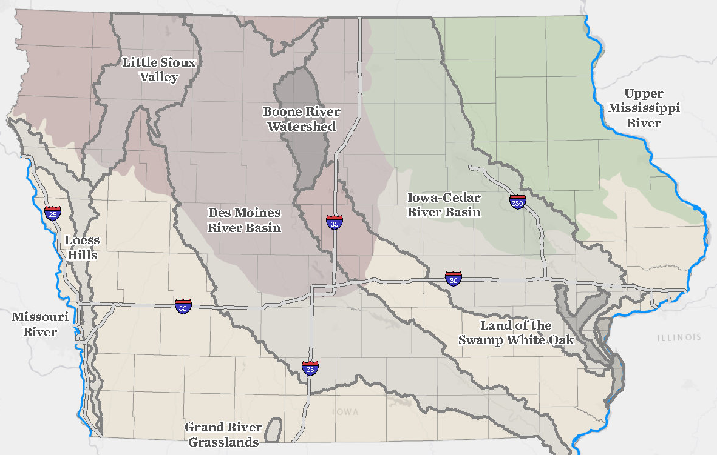
Notes:
Here is a map of our project areas in Iowa. As you can see, we work with partners in many places in Iowa to protect land and water in a variety of ways, but there are only 2 places in Iowa where we are currently protecting land to permanently own and manage as a nature preserve. One of those is our Broken Kettle Grasslands which is Iowa’s largest remnant prairie located out in the Loess Hills of western Iowa. The other is the Land of the Swamp White Oak located here in southeast Iowa at the confluences of 3 large rivers, the Cedar, the Iowa, and the Mississippi.

Slide 4
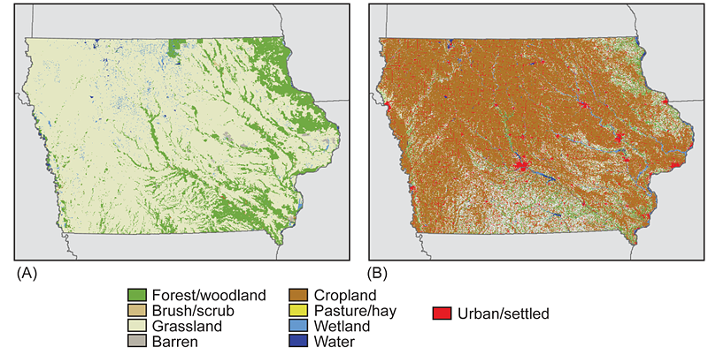
Notes:
Of course one of the reasons that places like the Land of the Swamp White Oak are especially important here in Iowa is that we are the most altered state in the entire nation having lost more than 95% of our wetlands and more than 99% of our prairie.

Slide 5
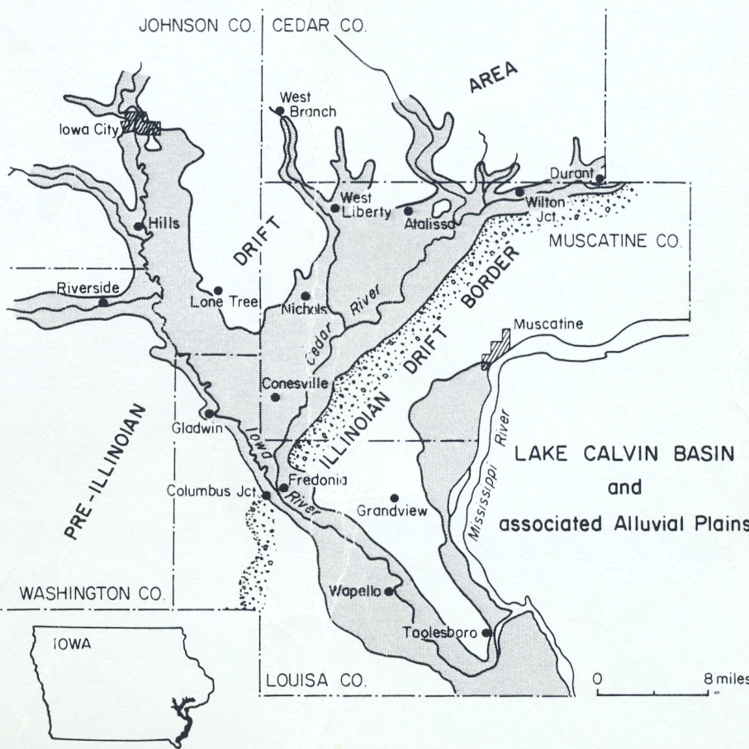
Notes:
People have also known for a while that there was something special about this landscape. In the early 20th Century, geologist Walter Schoewe theorized that this lowland region was formed by the westward expanse of the Illinoian Glacier which may have backed up water for about 25 miles upstream creating a v-shaped glacial lake along the present day Iowa and Cedar Rivers. However, the lack of soils associated with such a lake suggest that either the lake never existed or that a complex history has caused those deposits to have been buried or removed.

Slide 6
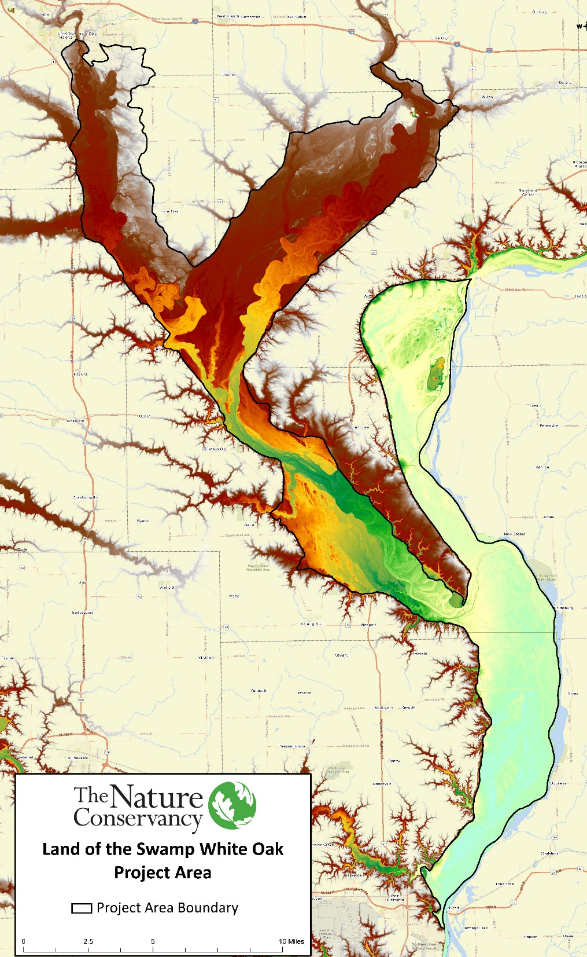
Notes:
Regardless of whether the formation was glacial or alluvial, it remains a special place today. These rivers remain very dynamic and flooding has certainly limited agriculture and development here. Within this 300,000 acre floodplain landscape over half is currently in a natural land use such as prairie, forest, wetland, or aquatic areas. Over 40,000 acres of public and private conservation lands have been voluntarily protected by landowners here making it the largest concentration of permanently protected land in Iowa.

Slide 7
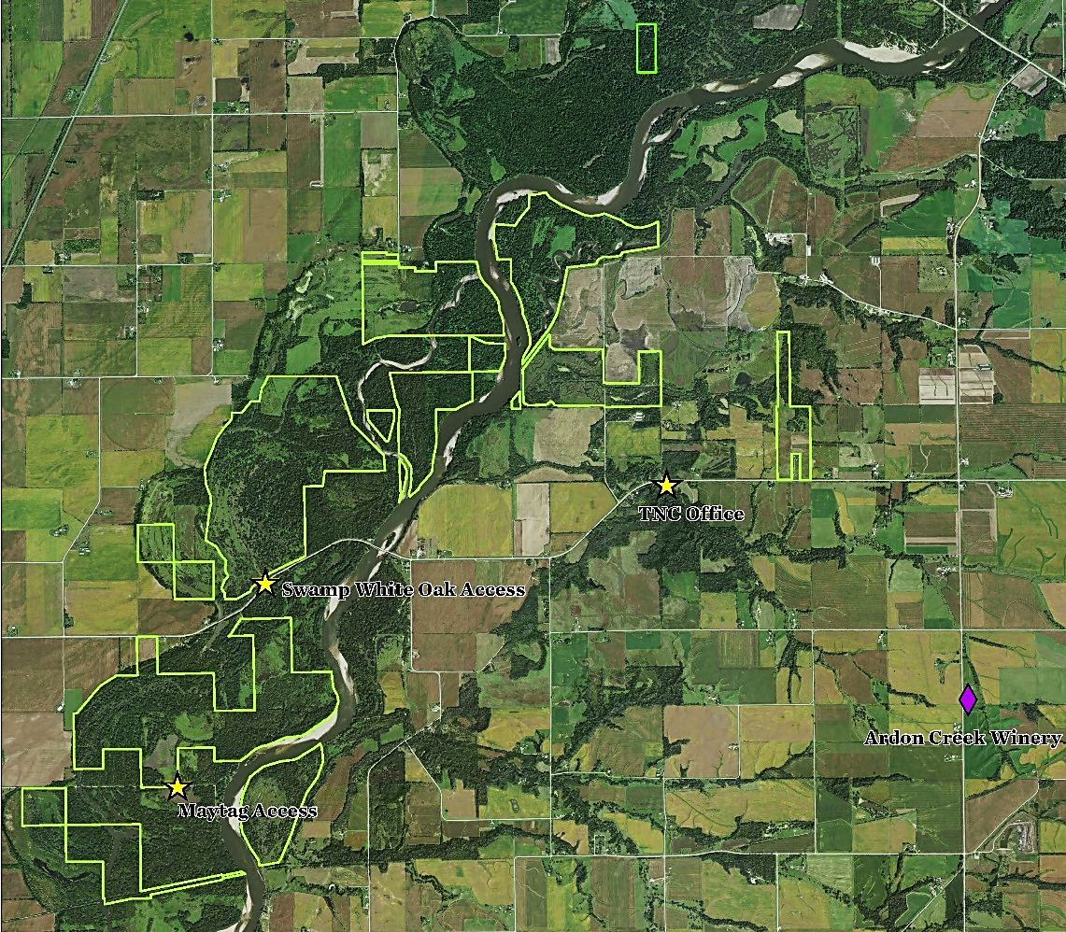
Notes:
The Nature Conservancy owns and manages nearly 4,000 acres here as our Land of the Swamp White Oak Preserve. Most of those acres are concentrated in Muscatine County in this section of the Cedar River floodplain. You can see the Cedar River meandering from north to south. This main east west road is CR G28 where our office is located as well as the main entrance to the preserve. Of course we want to attract everybody not just scientists so I always like to point out our proximity to Ardon Creek Winery just down the road.

Slide 8
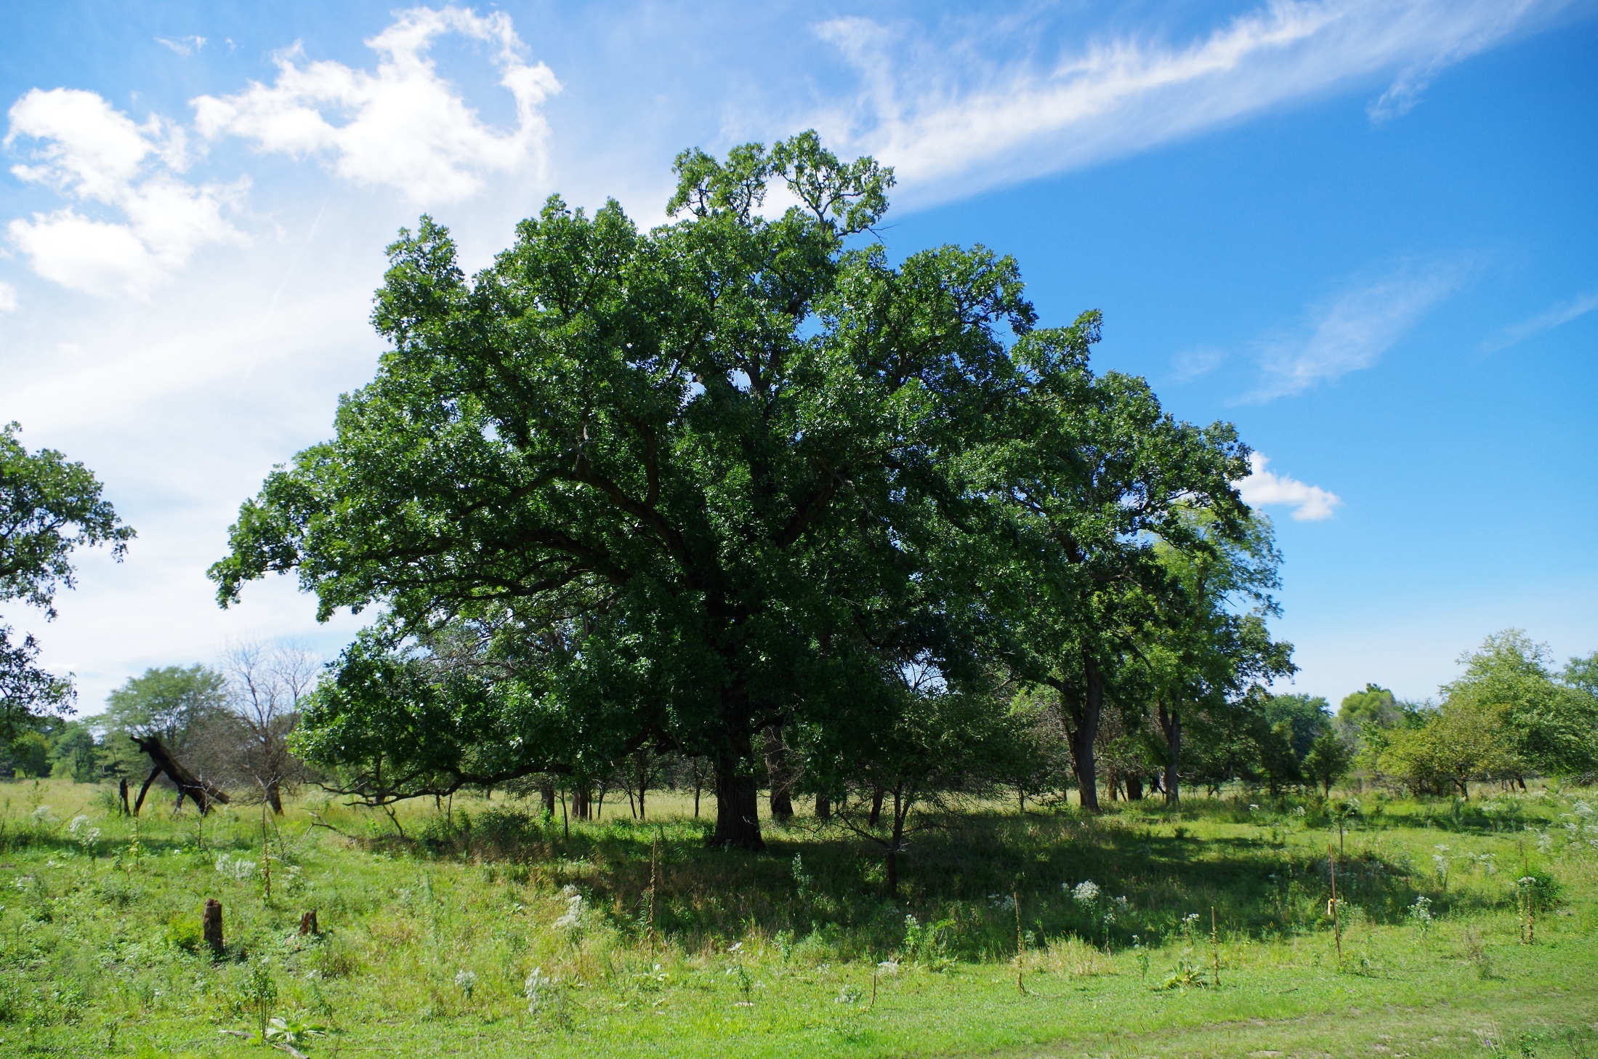
Floodplain Oak Savanna
Notes:
Our Preserve is home to one of the best remaining examples of floodplain oak savanna in the world. In case you aren’t familiar with the term savanna, a savanna is just a prairie that has some scattered trees on it. Nearly all savannas in Iowa have either been clearcut for agriculture or have become overgrown with weedy brush and trees due to lack of management. We work to protect and preserve this ecological community here.

Slide 9
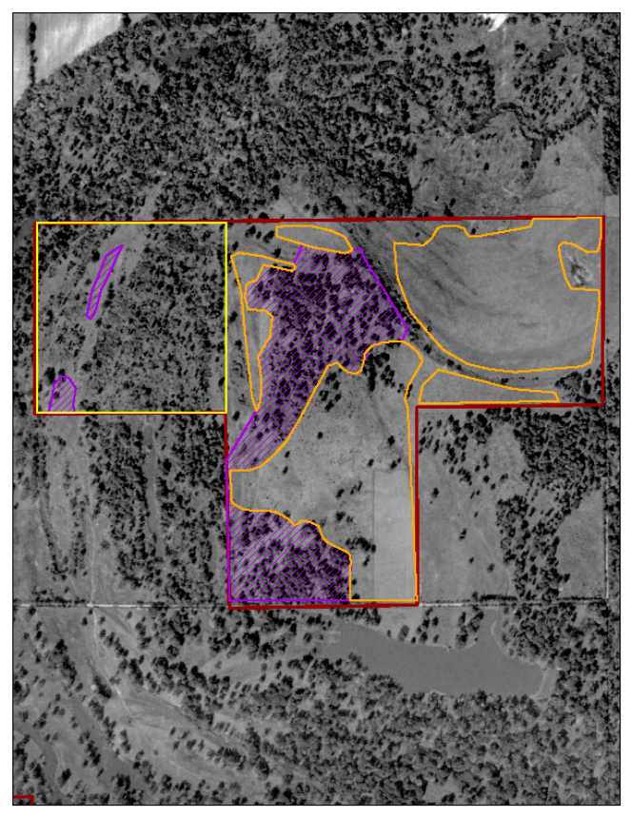
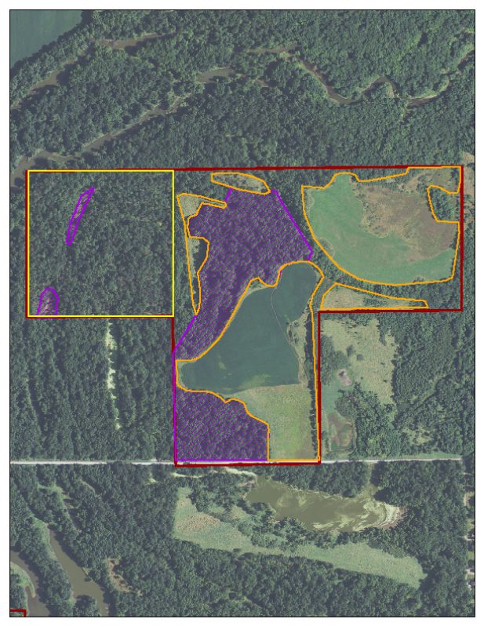
Notes:
Here is an aerial photo of part of our preserve on the left you have 1950 and on the right you have one from about 5 years ago. I think this image highlights that these floodplain areas were historically a more open canopy mix of prairie and savanna habitat with very few small pockets of actual forest habitat.

Slide 10
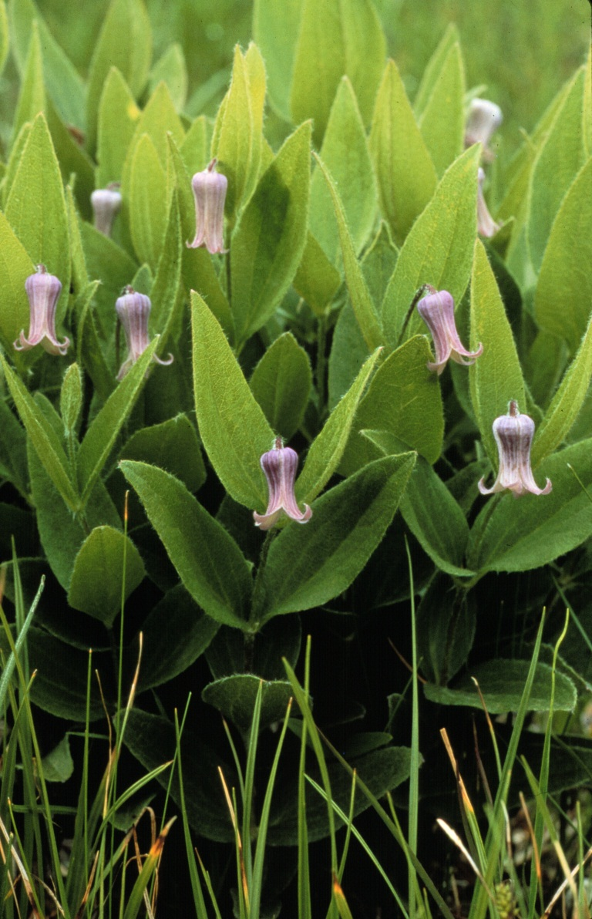
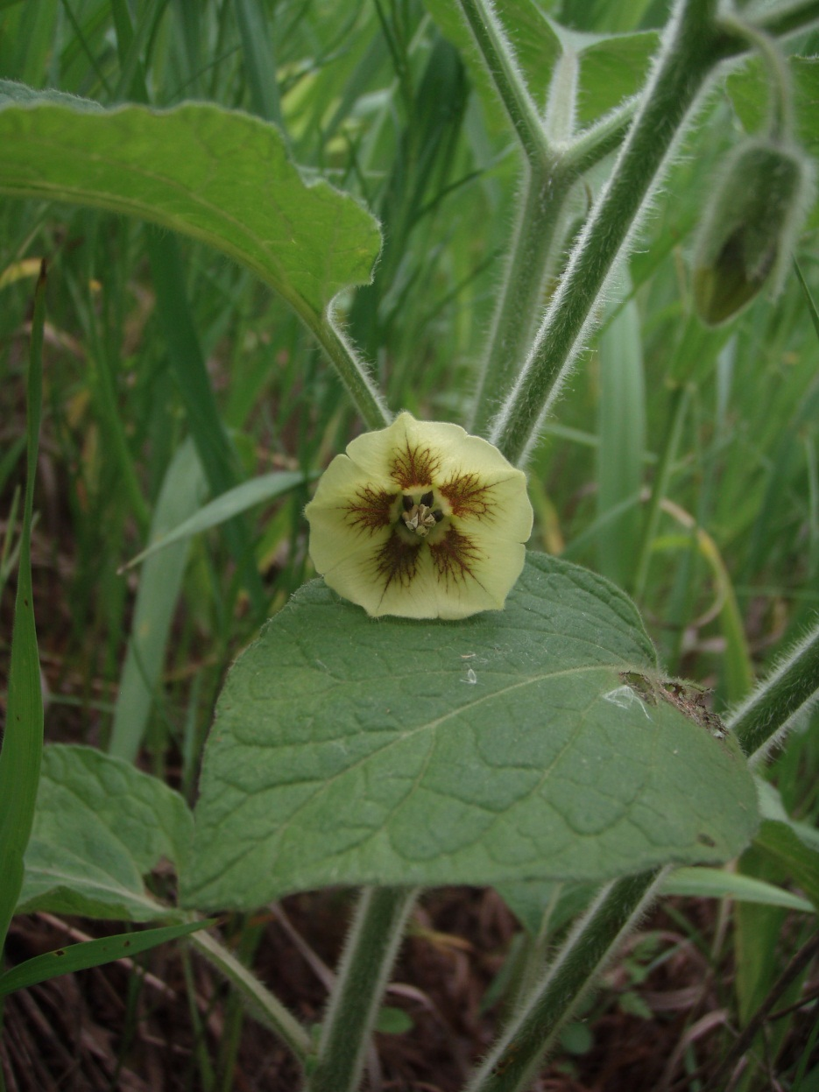
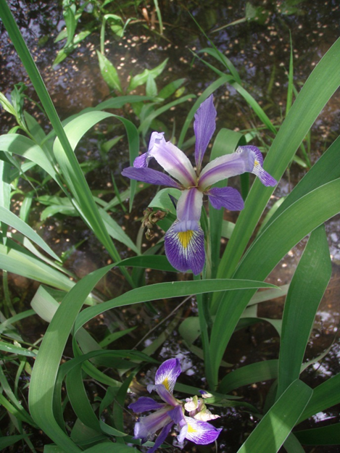
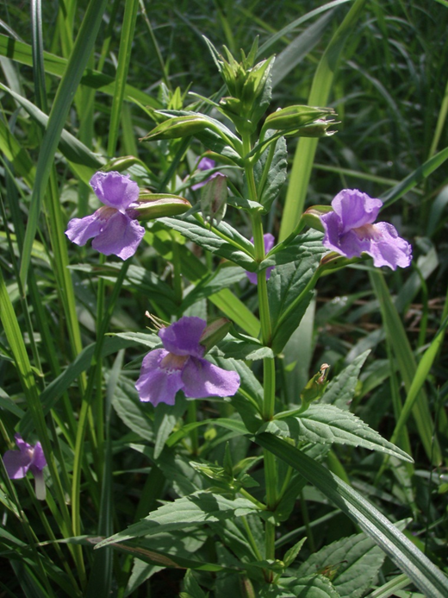
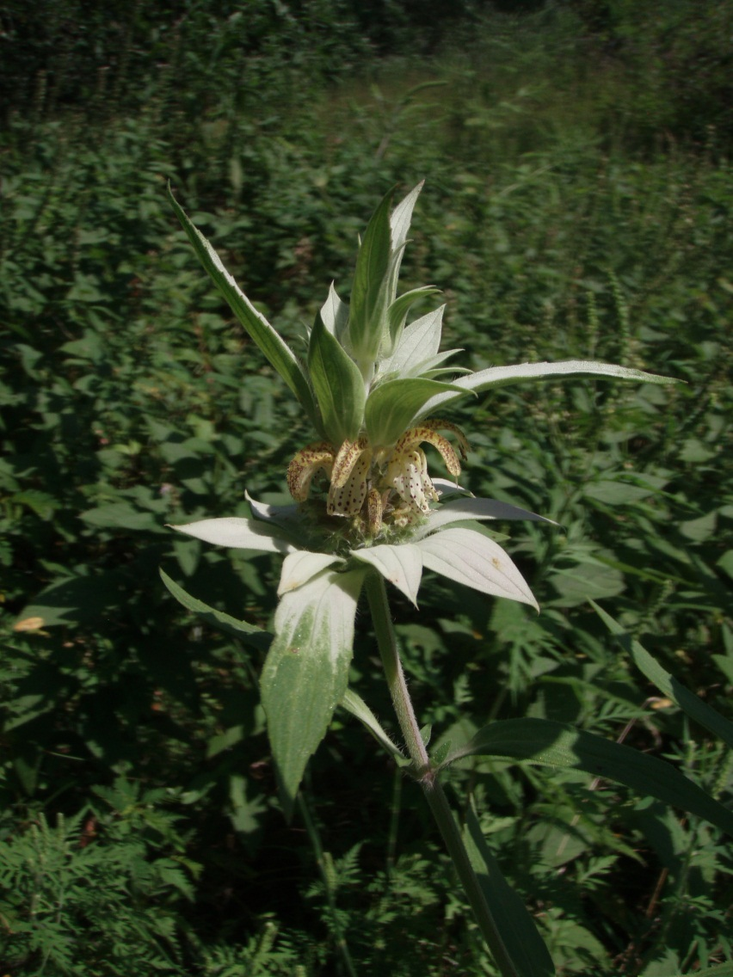
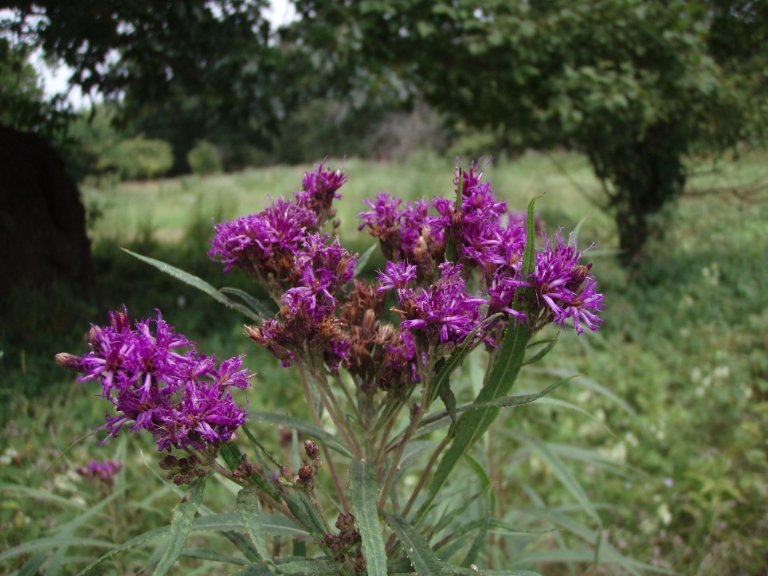
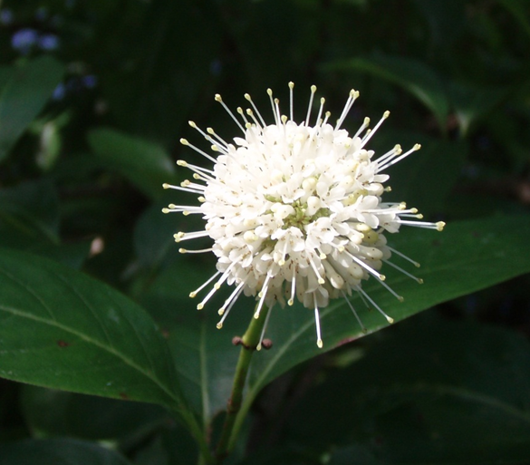
Notes:
That sort of gradient of the canopy cover in this area along with an abundance of sandy soils, and the ridge and swale topography found in the floodplain creates conditions suitable for more than 550 plant species.

Slide 11
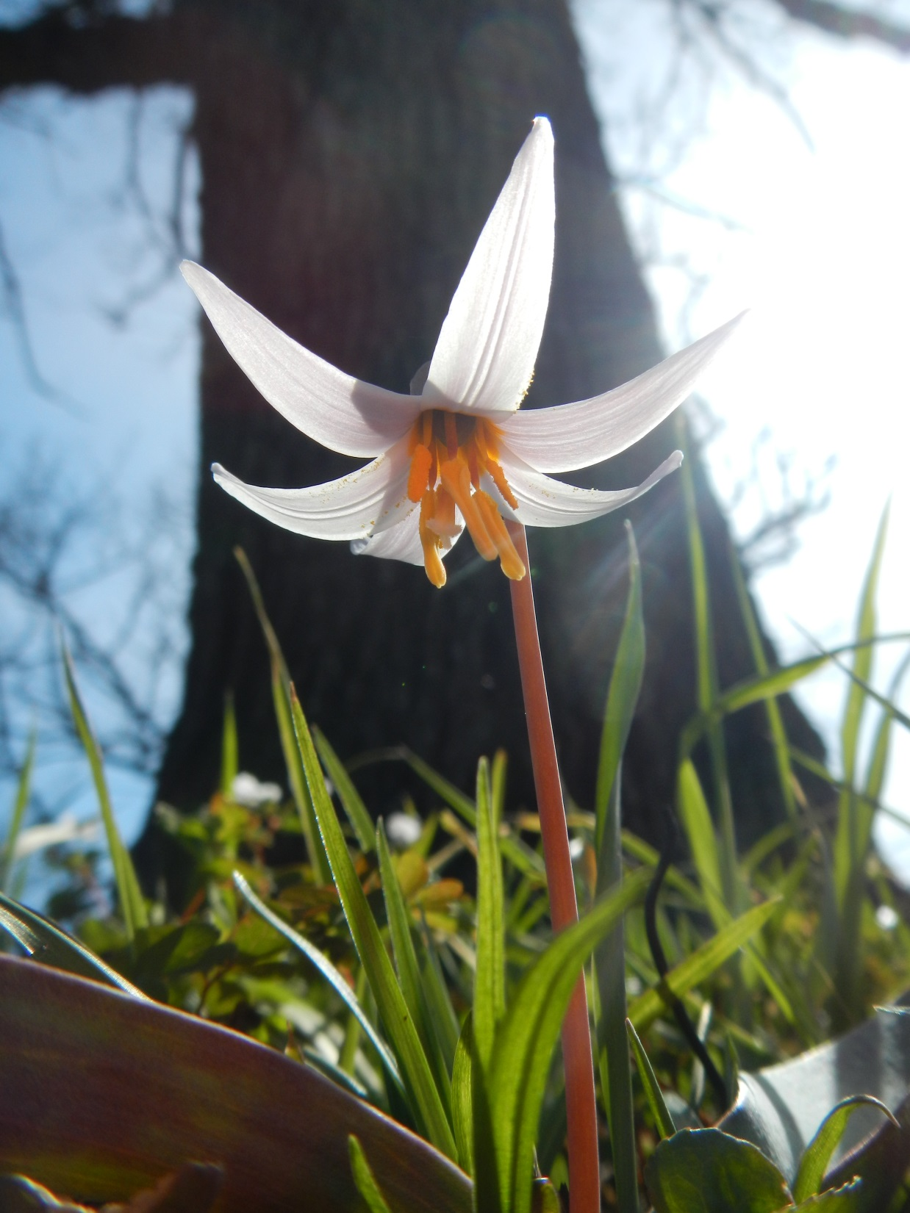
Notes:
A couple of specific examples, shade tolerant “woodland species” like this trout lily find their savanna niche on the north side of the large open grown oaks, and within the snowberry, haw and crabapple thickets.

Slide 12
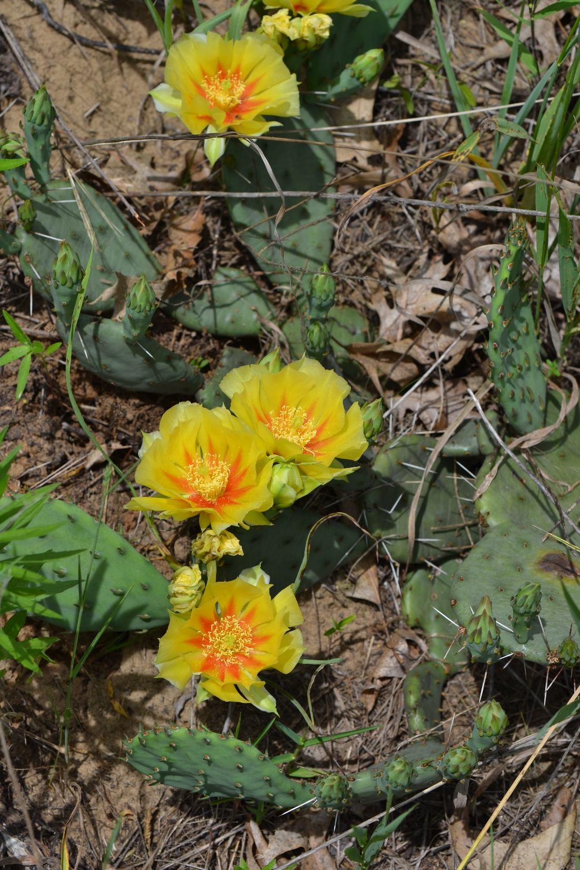
Notes:
Further down the trail, you may come to a sand prairie opening dotted with prickly pear cactus.

Slide 13
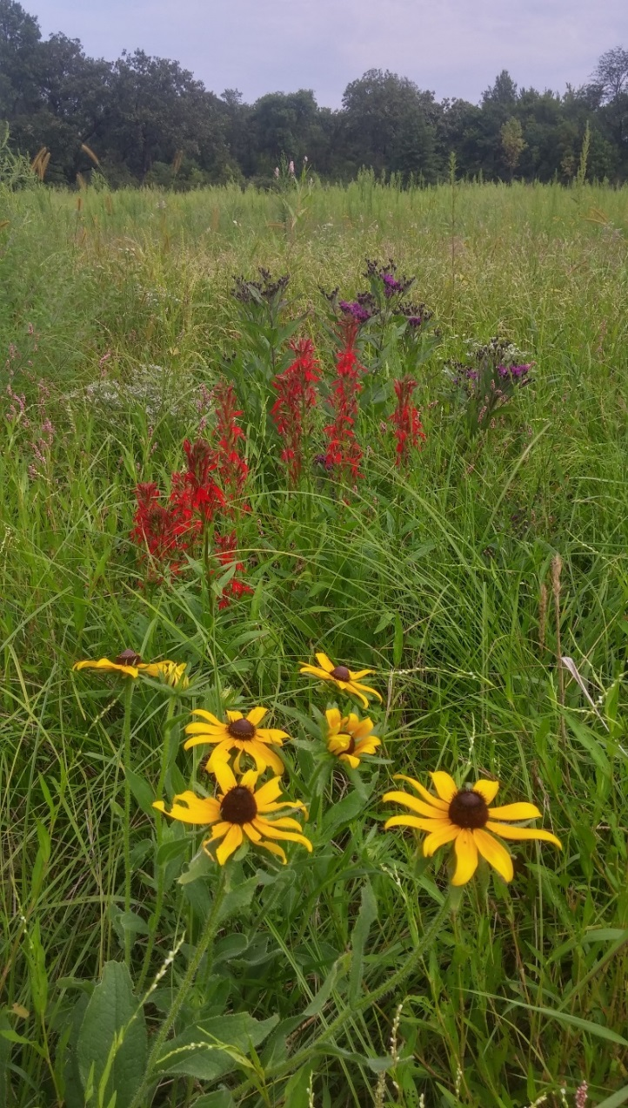
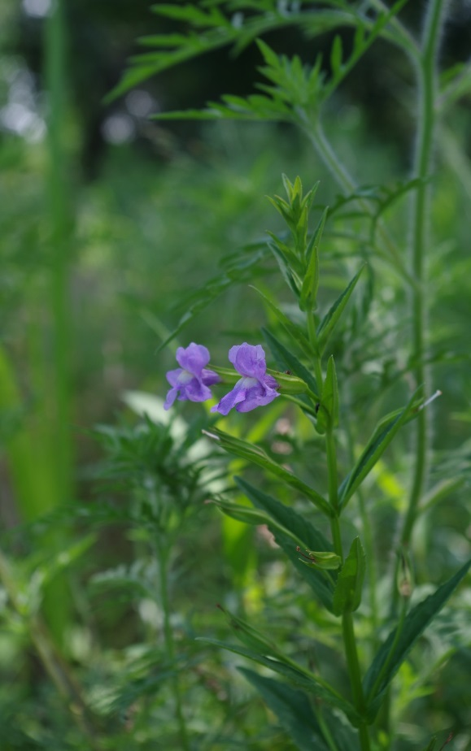
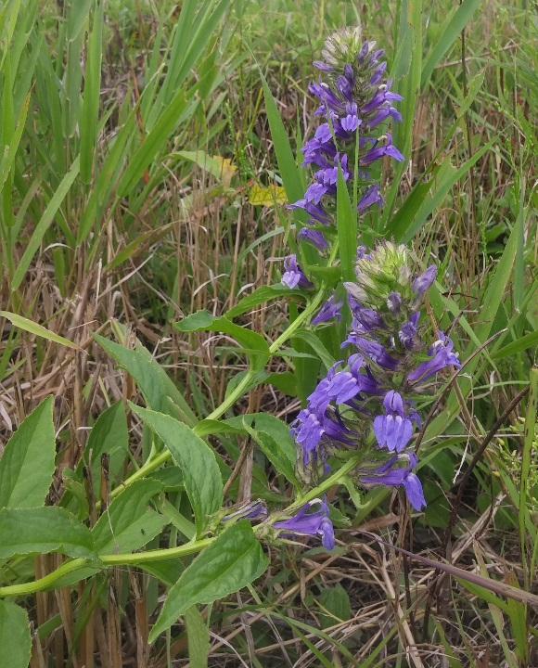
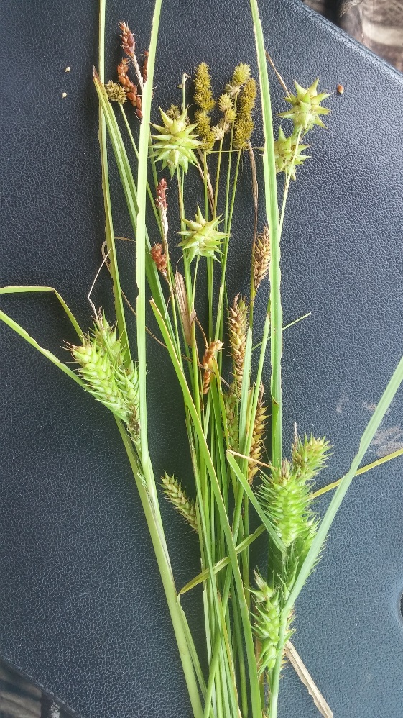
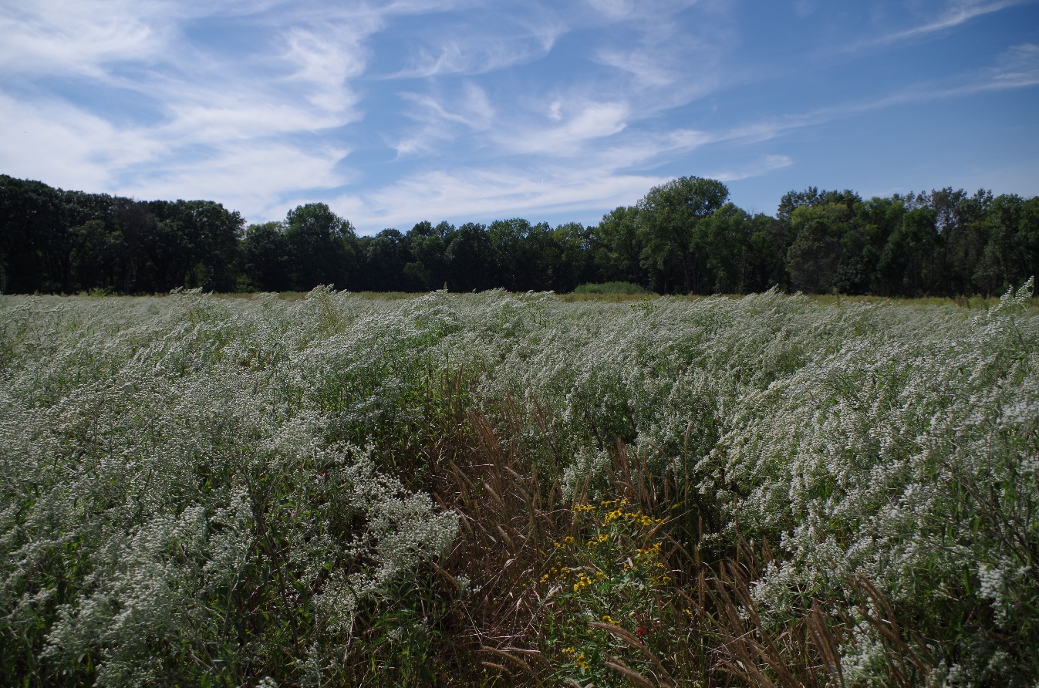
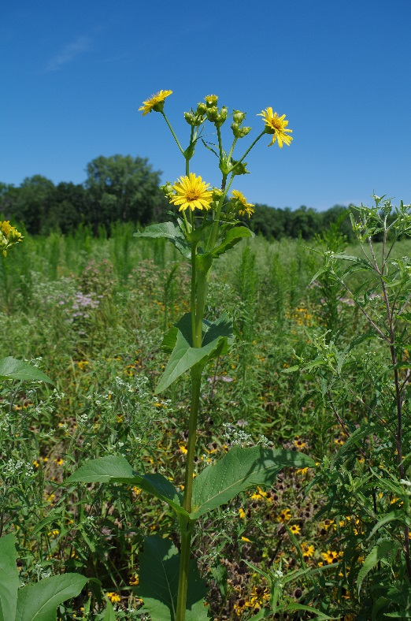
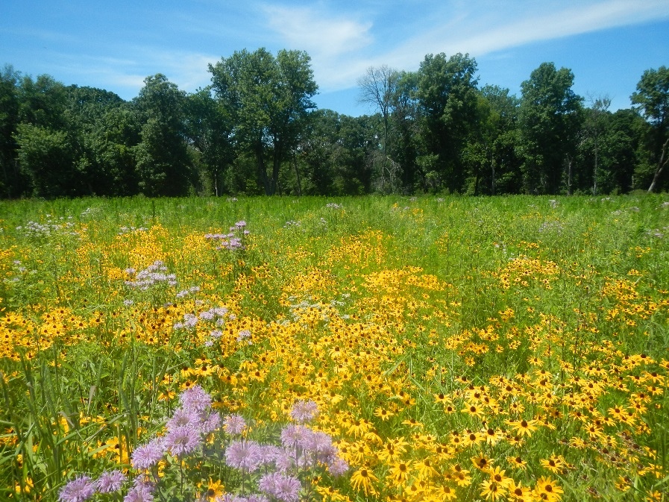
Notes:
When we do our prairie and savanna reconstructions in this area, we use moderately diverse mixes featuring a strong cool season species like sedges and virginia wild rye with a heavy forb component so that we can compete with invasive species like reed canary grass.

Slide 14
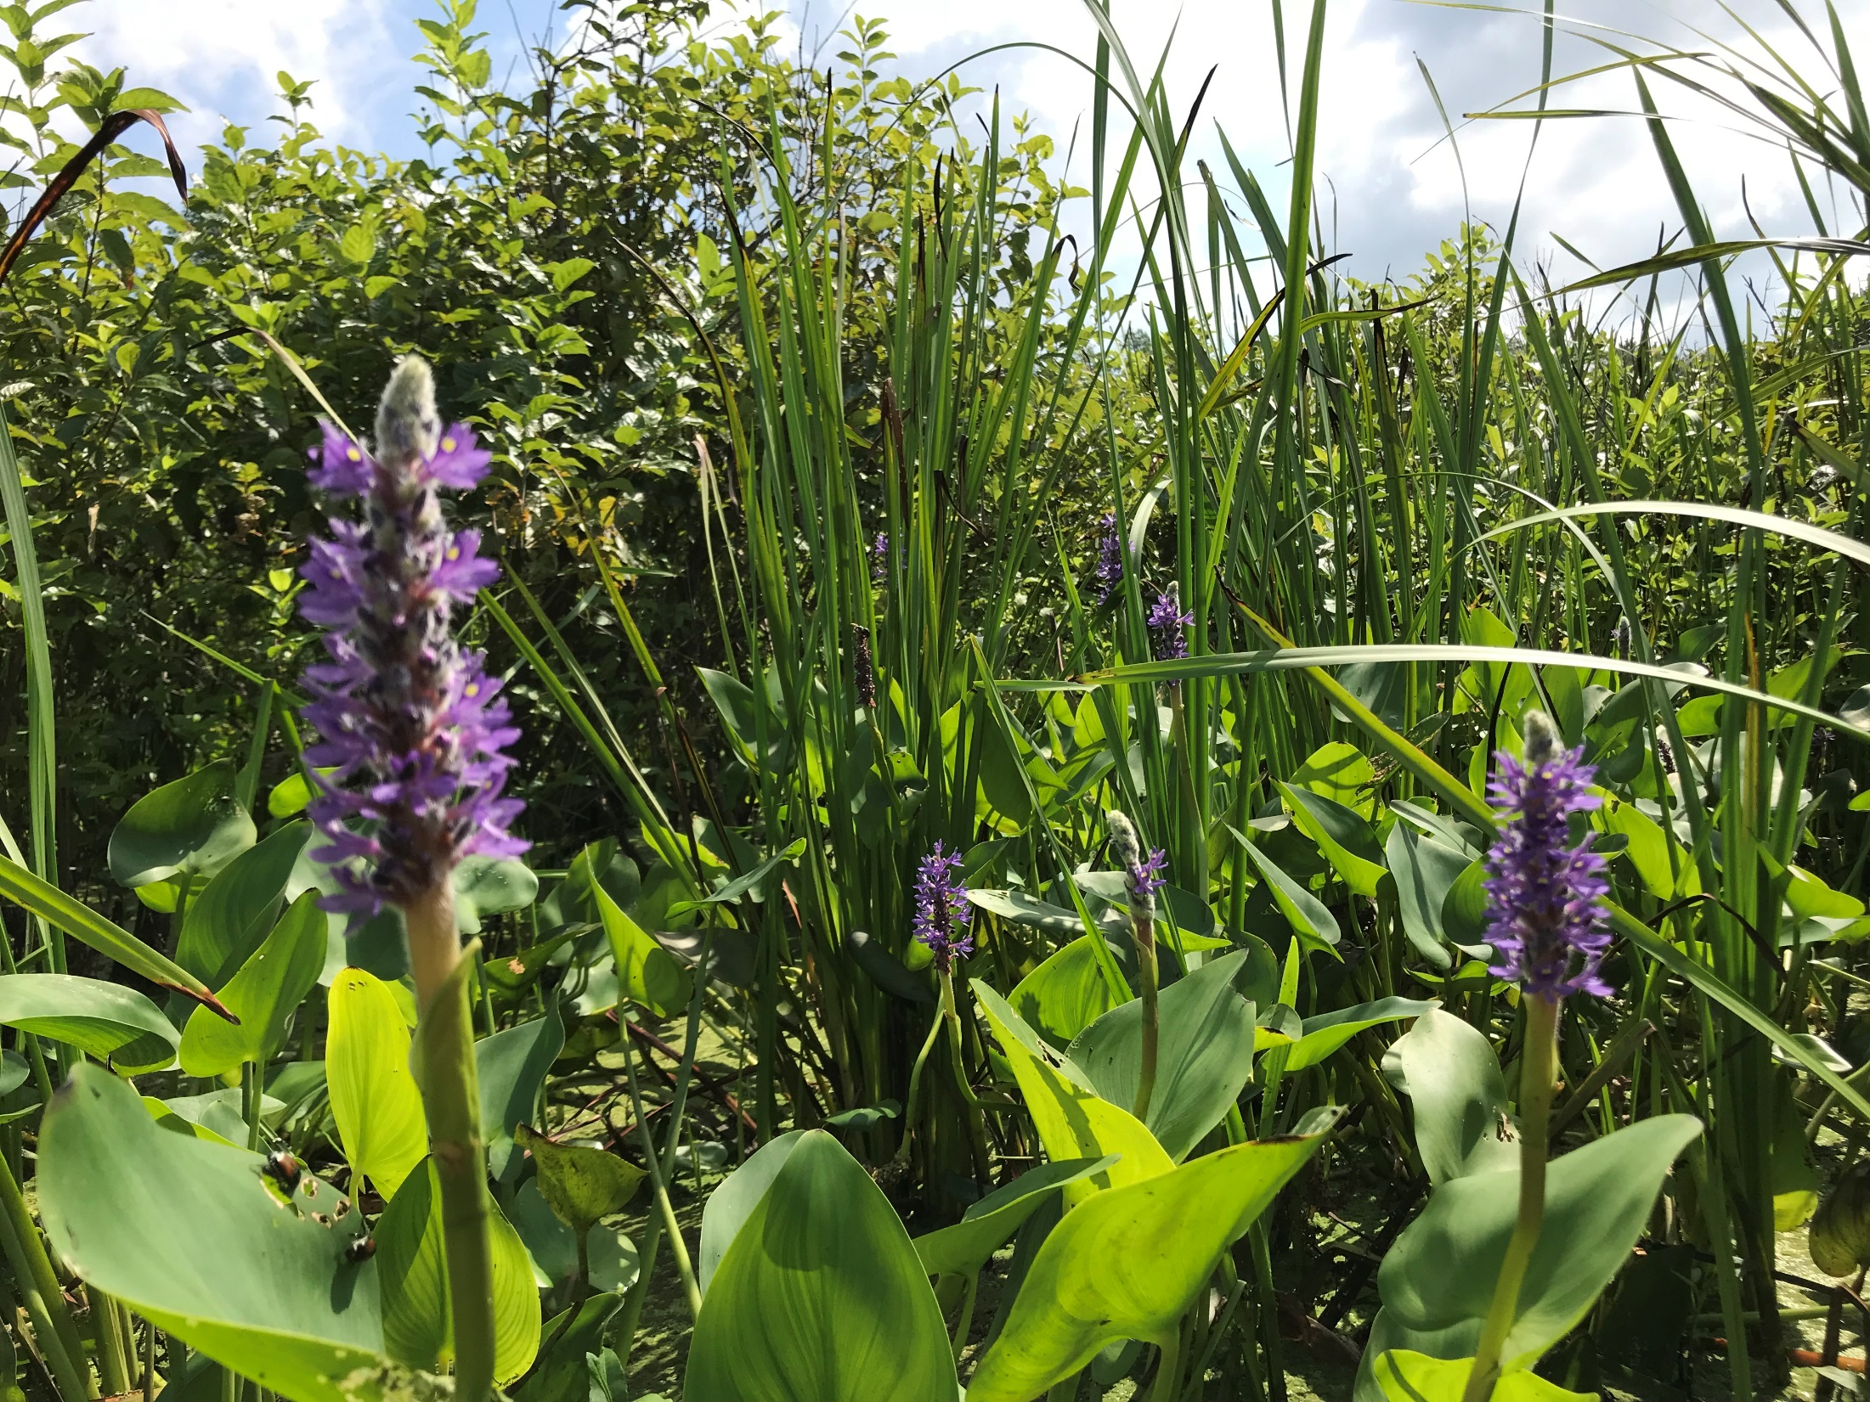
Channel Fen
Notes:
Land of the Swamp White Oak Preserve is also home to one of the best remaining examples of a channel fen.

Slide 15
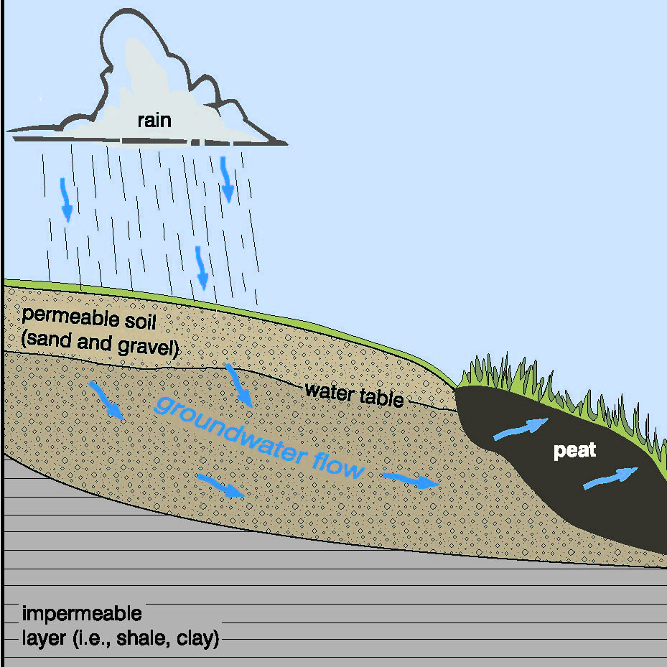
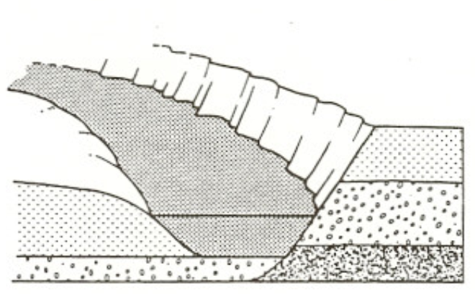
Notes:
A fen is a unique type of wetland that is formed when groundwater flow hits clay or another impermeable layer below and seeps out saturating the soil and creating peat or muck soils. Our channel fens are located in abandoned channels of the Cedar River as the river has migrated many times creating a relatively wide floodplain. The partially decomposed plant material creating a floating mat of vegetation above the saturated muck below.

Slide 16
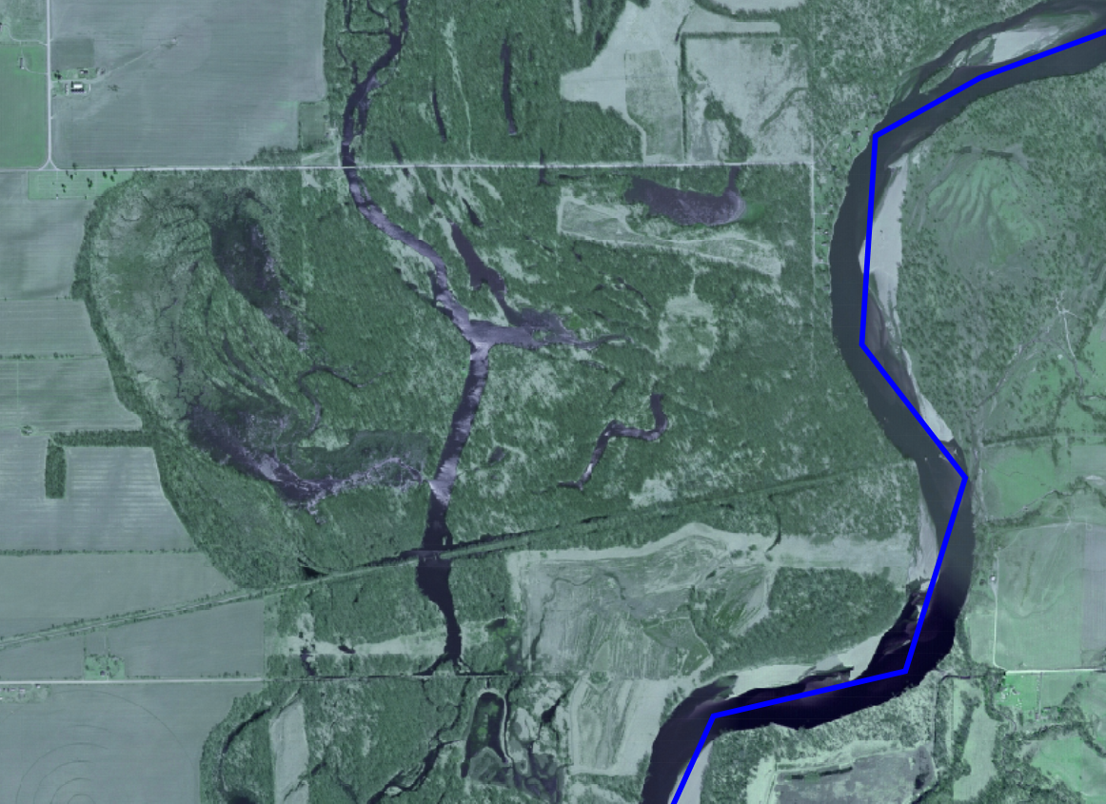
Notes:
Here is an aerial photo and you can sort of make out the abandoned channel and oxbow shape.

Slide 17
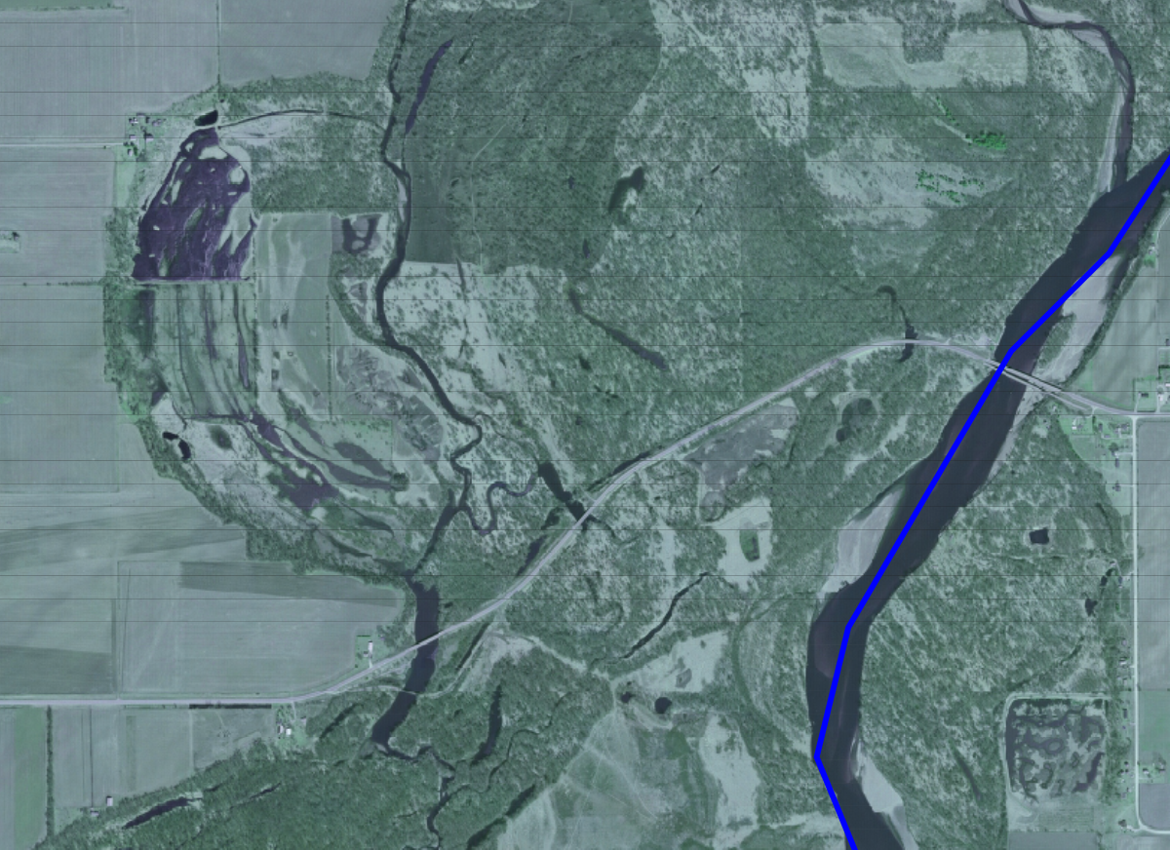
Notes:
There are several of these features along the western edge of the floodplain

Slide 18
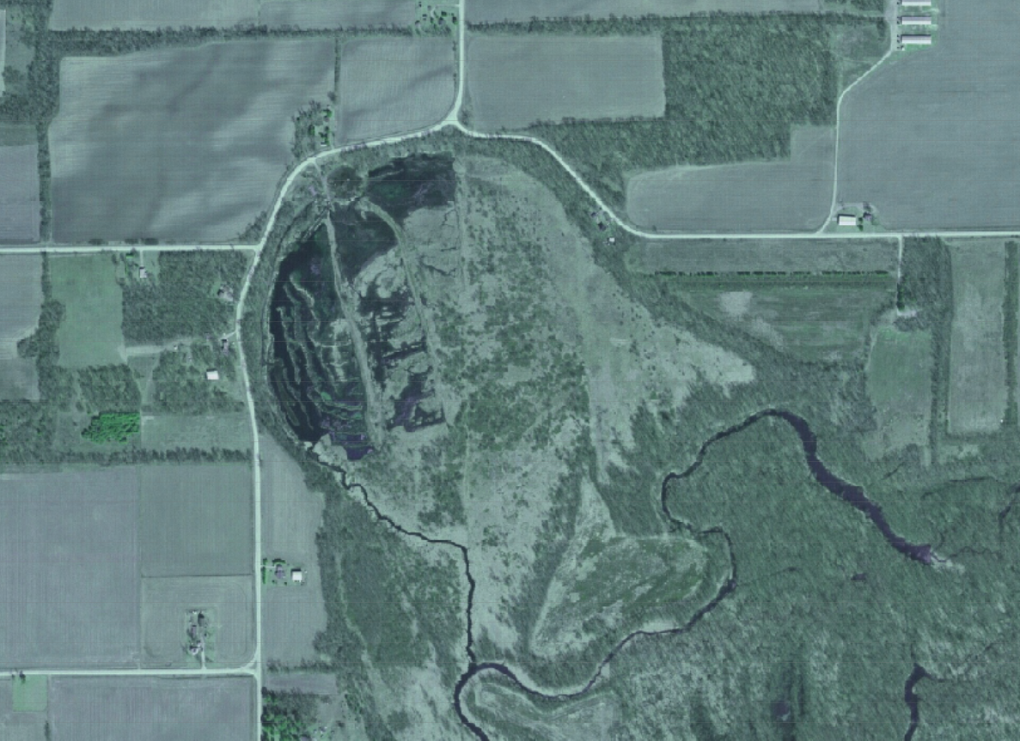
Notes:
This one here is partly owned by the Iowa DNR and managed as a wildlife area and part of the fen is actually owned by a company that has been mining peat from the site for decades.

Slide 19
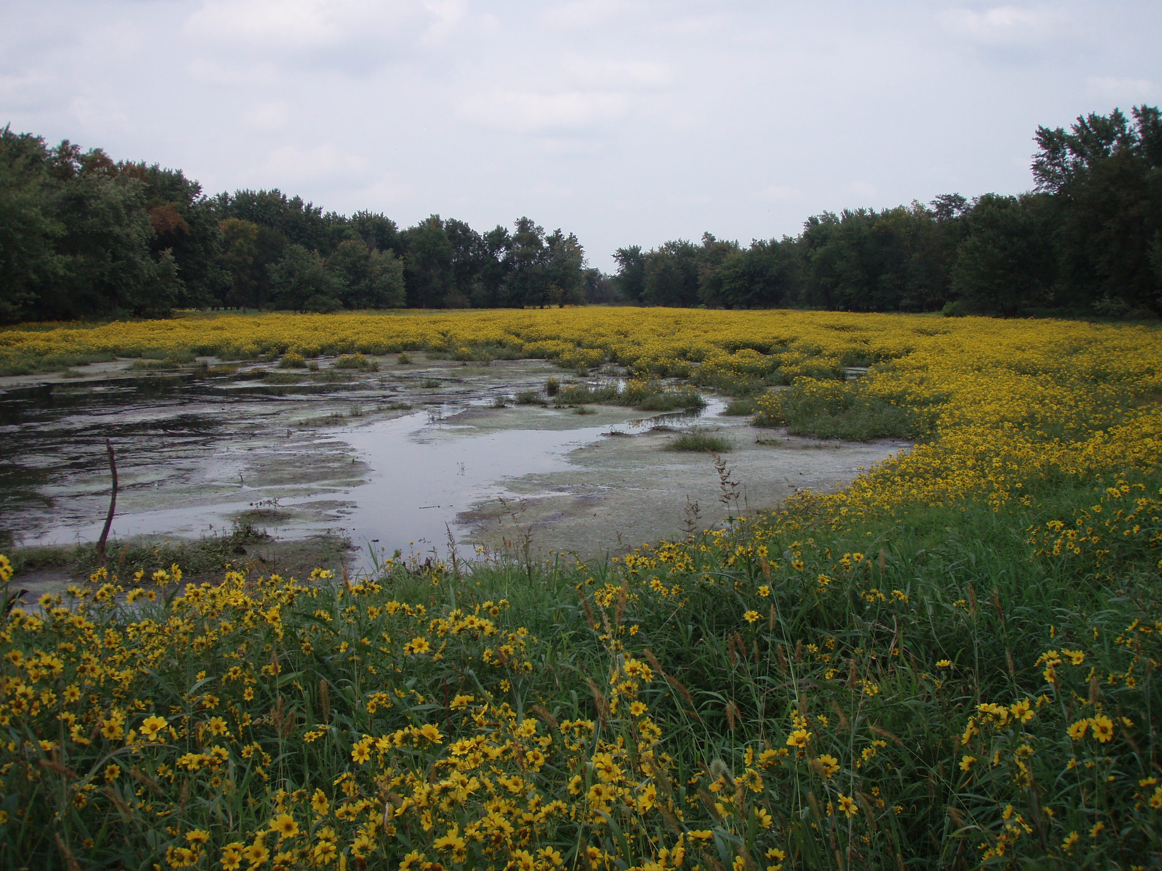
Alluvial wetlands
Notes:
In addition to these channel fens the floodplain here contains a variety of alluvial wetlands and streams. Some hold water for long periods of time, others not so much.

Slide 20
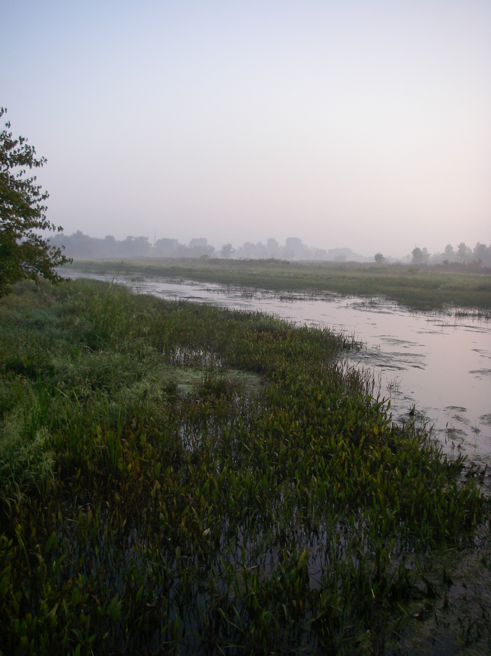
Alluvial streams
Notes:
Some of the alluvial streams found here are true tributaries of the Cedar River originating outside of the floodplain, others like Pike Creek are actually just side channels of the Cedar River.

Slide 21
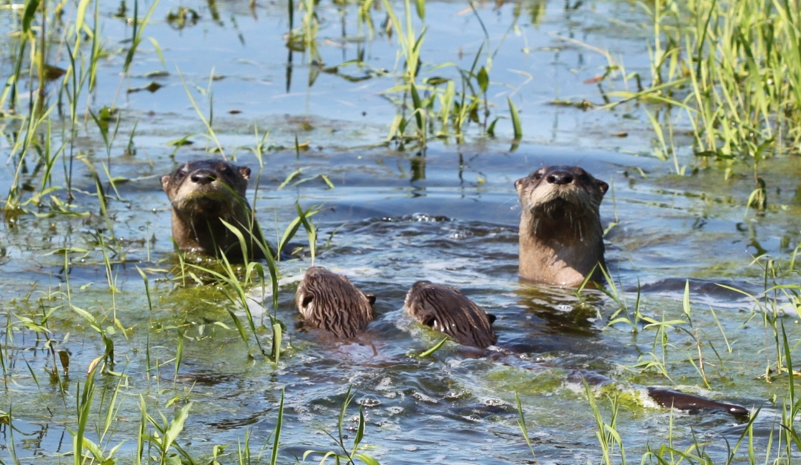
Notes:
This mosaic of habitat found here creates a home for a variety of wildlife species including many threatened and endangered species. Ranging from the most charismatic species like these river otter.

Slide 22
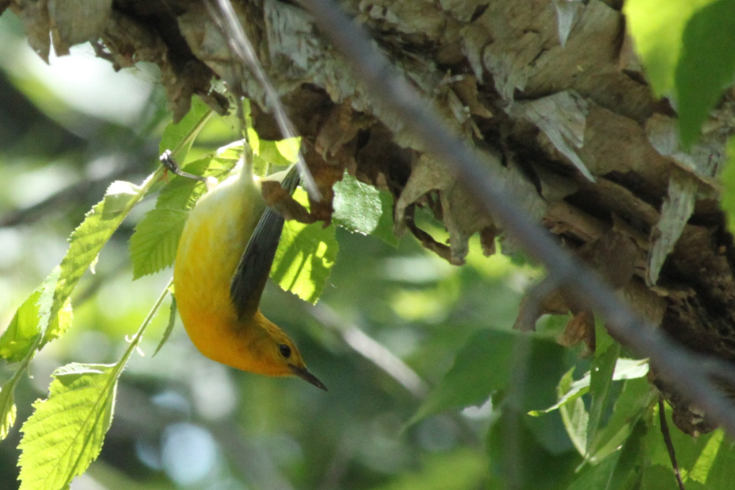
Notes:
To the beautiful prothonotary warbler, wildlife watching opportunities are everywhere in the Land of the Swamp White Oak.

Slide 23
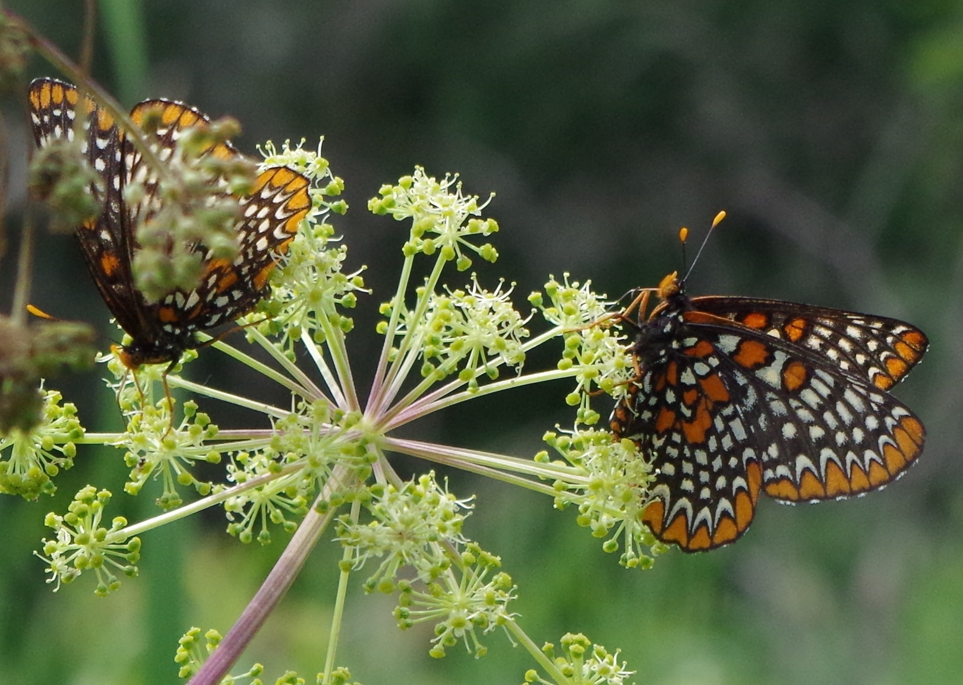
Notes:
The region is a hotspot for pollinators. You’ve all heard about the monarchs and the important work that’s being done to save that species, but many pollinators face similar issues because they are often obligate to a particular host plant. Here is a Baltimore checkerspot, nectaring on great purple angelica.

Slide 24
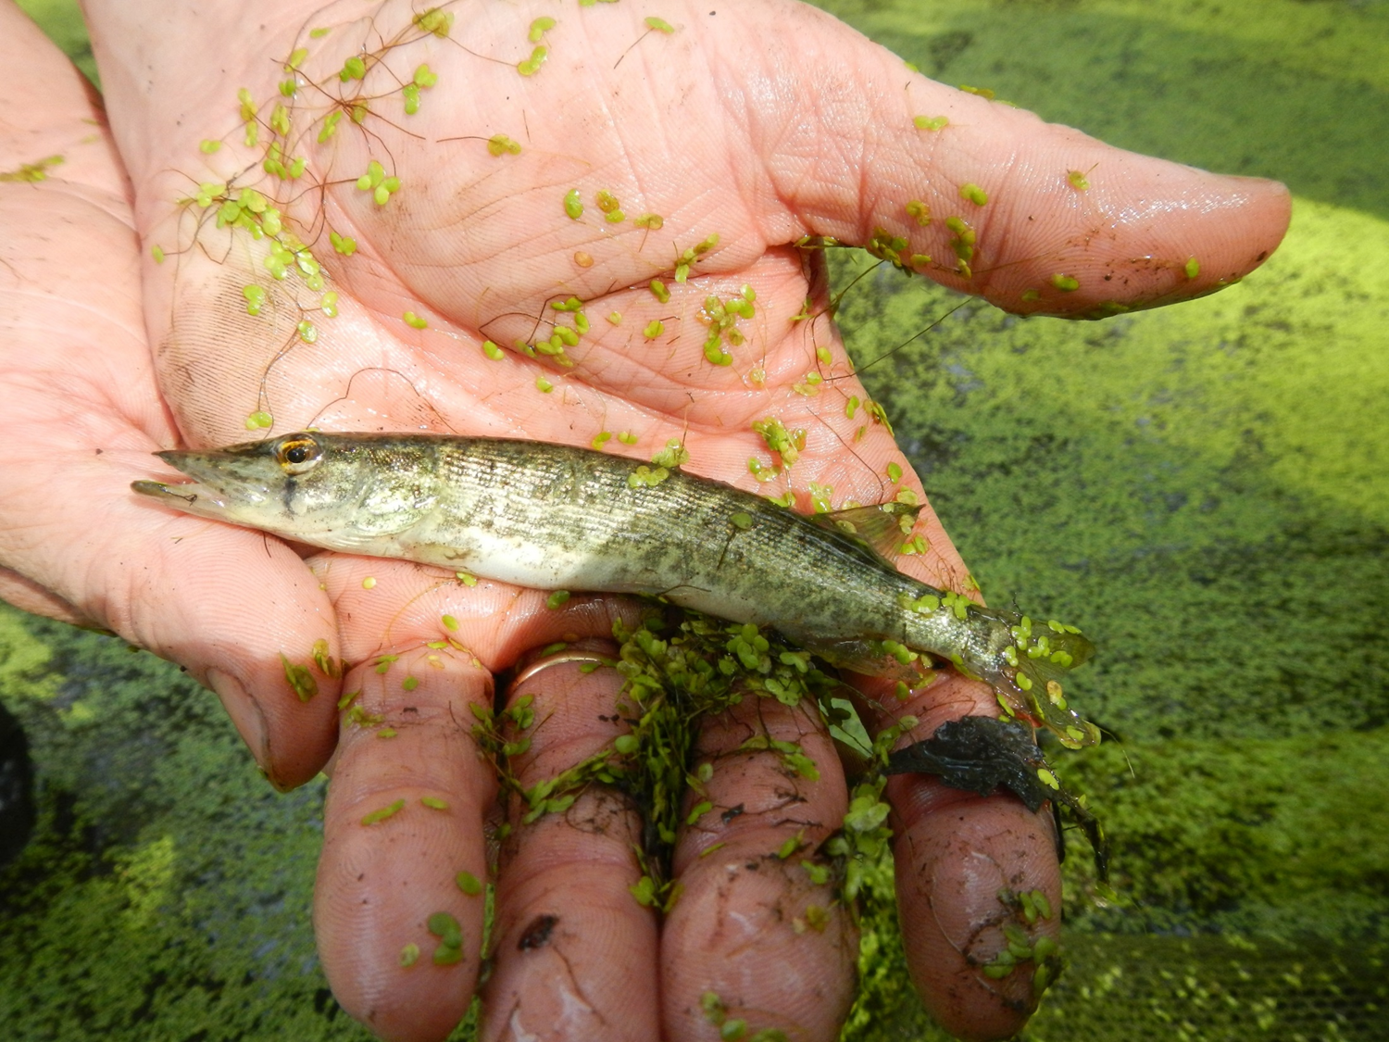
Notes:
These backwaters are home to a variety of rare fish such as this grass pickerel…

Slide 25
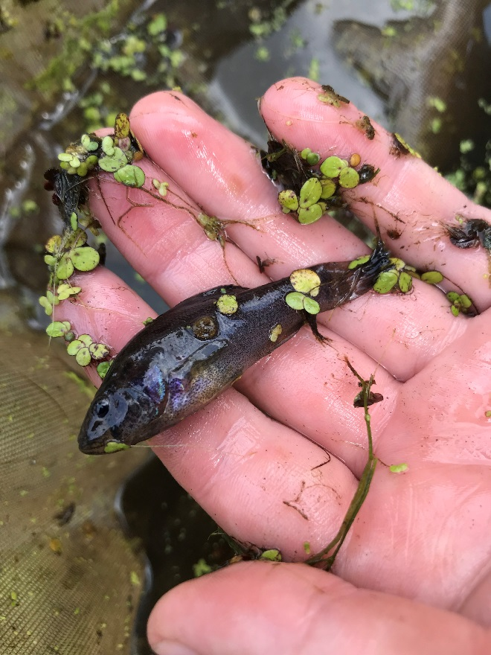
Notes:
And this pirate perch with it’s wonderful blue and purple coloration

Slide 26
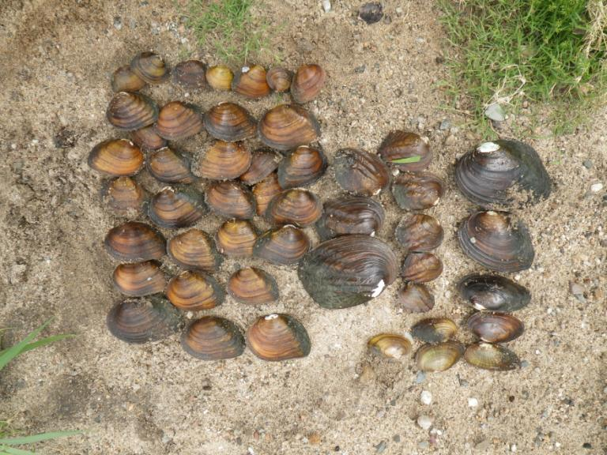
Mussels
37 Species in Iowa/Cedar; 12 T&E
Notes:
The area is home to more than 40 species of mussels including over a dozen threatened and endangered.

Slide 27
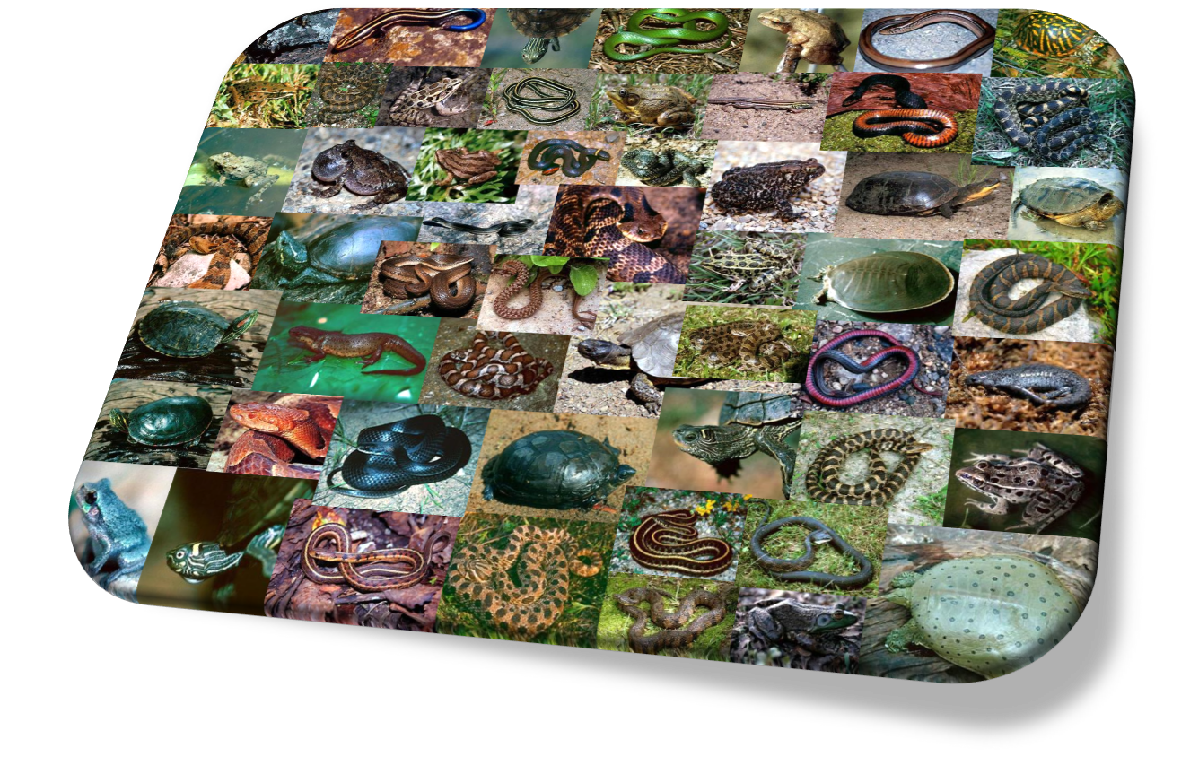
Amphibian & Reptile Conservation Area
Notes:
The Land of the Swamp White Oak is especially important for Amphibians and Reptiles. In 2007, the Iowa DNR designated this area as the very first Amphibian and Reptile Conservation Area in the country! A few more have been designated in other states since then, but this area is home to more than 50 species of amphibians and reptiles which is more than 80% of Iowa species.

Slide 28
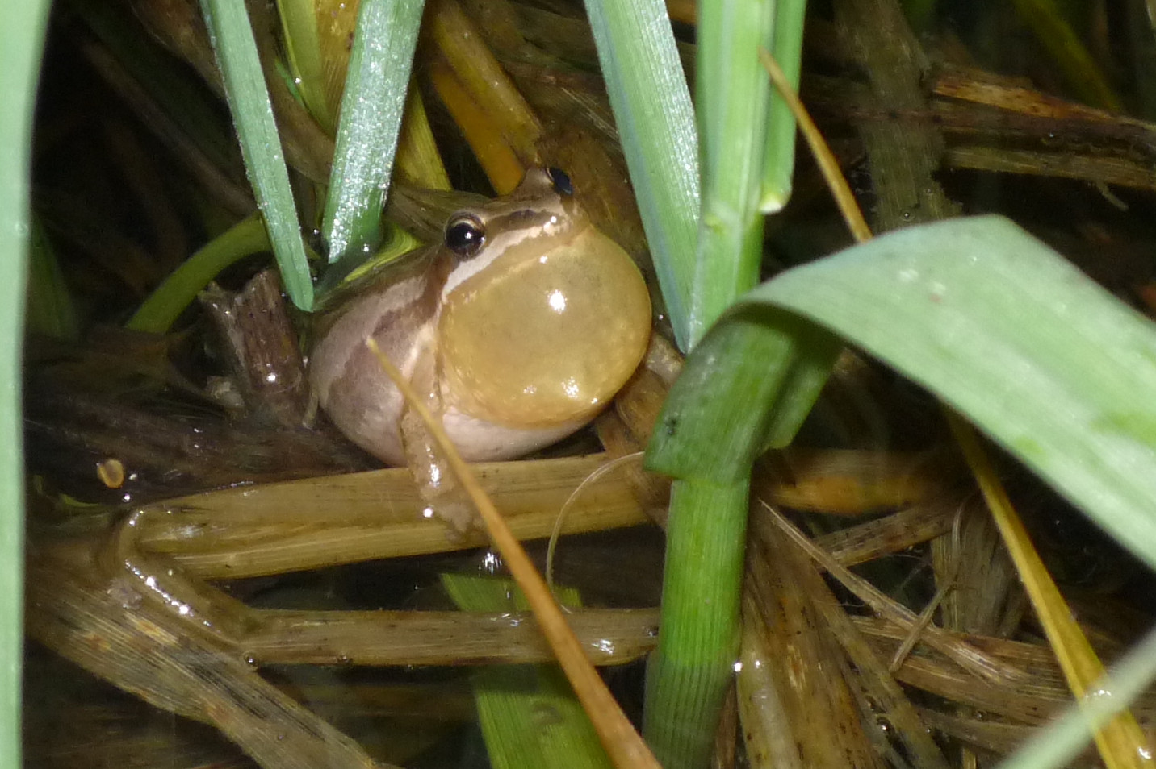
Notes:
Lets pretend we’re all having fun outside for a moment and take a closer look at a few. Let’s start with Iowa’s smallest frog, the chorus frog at just a hair over 1 inch.

Slide 29
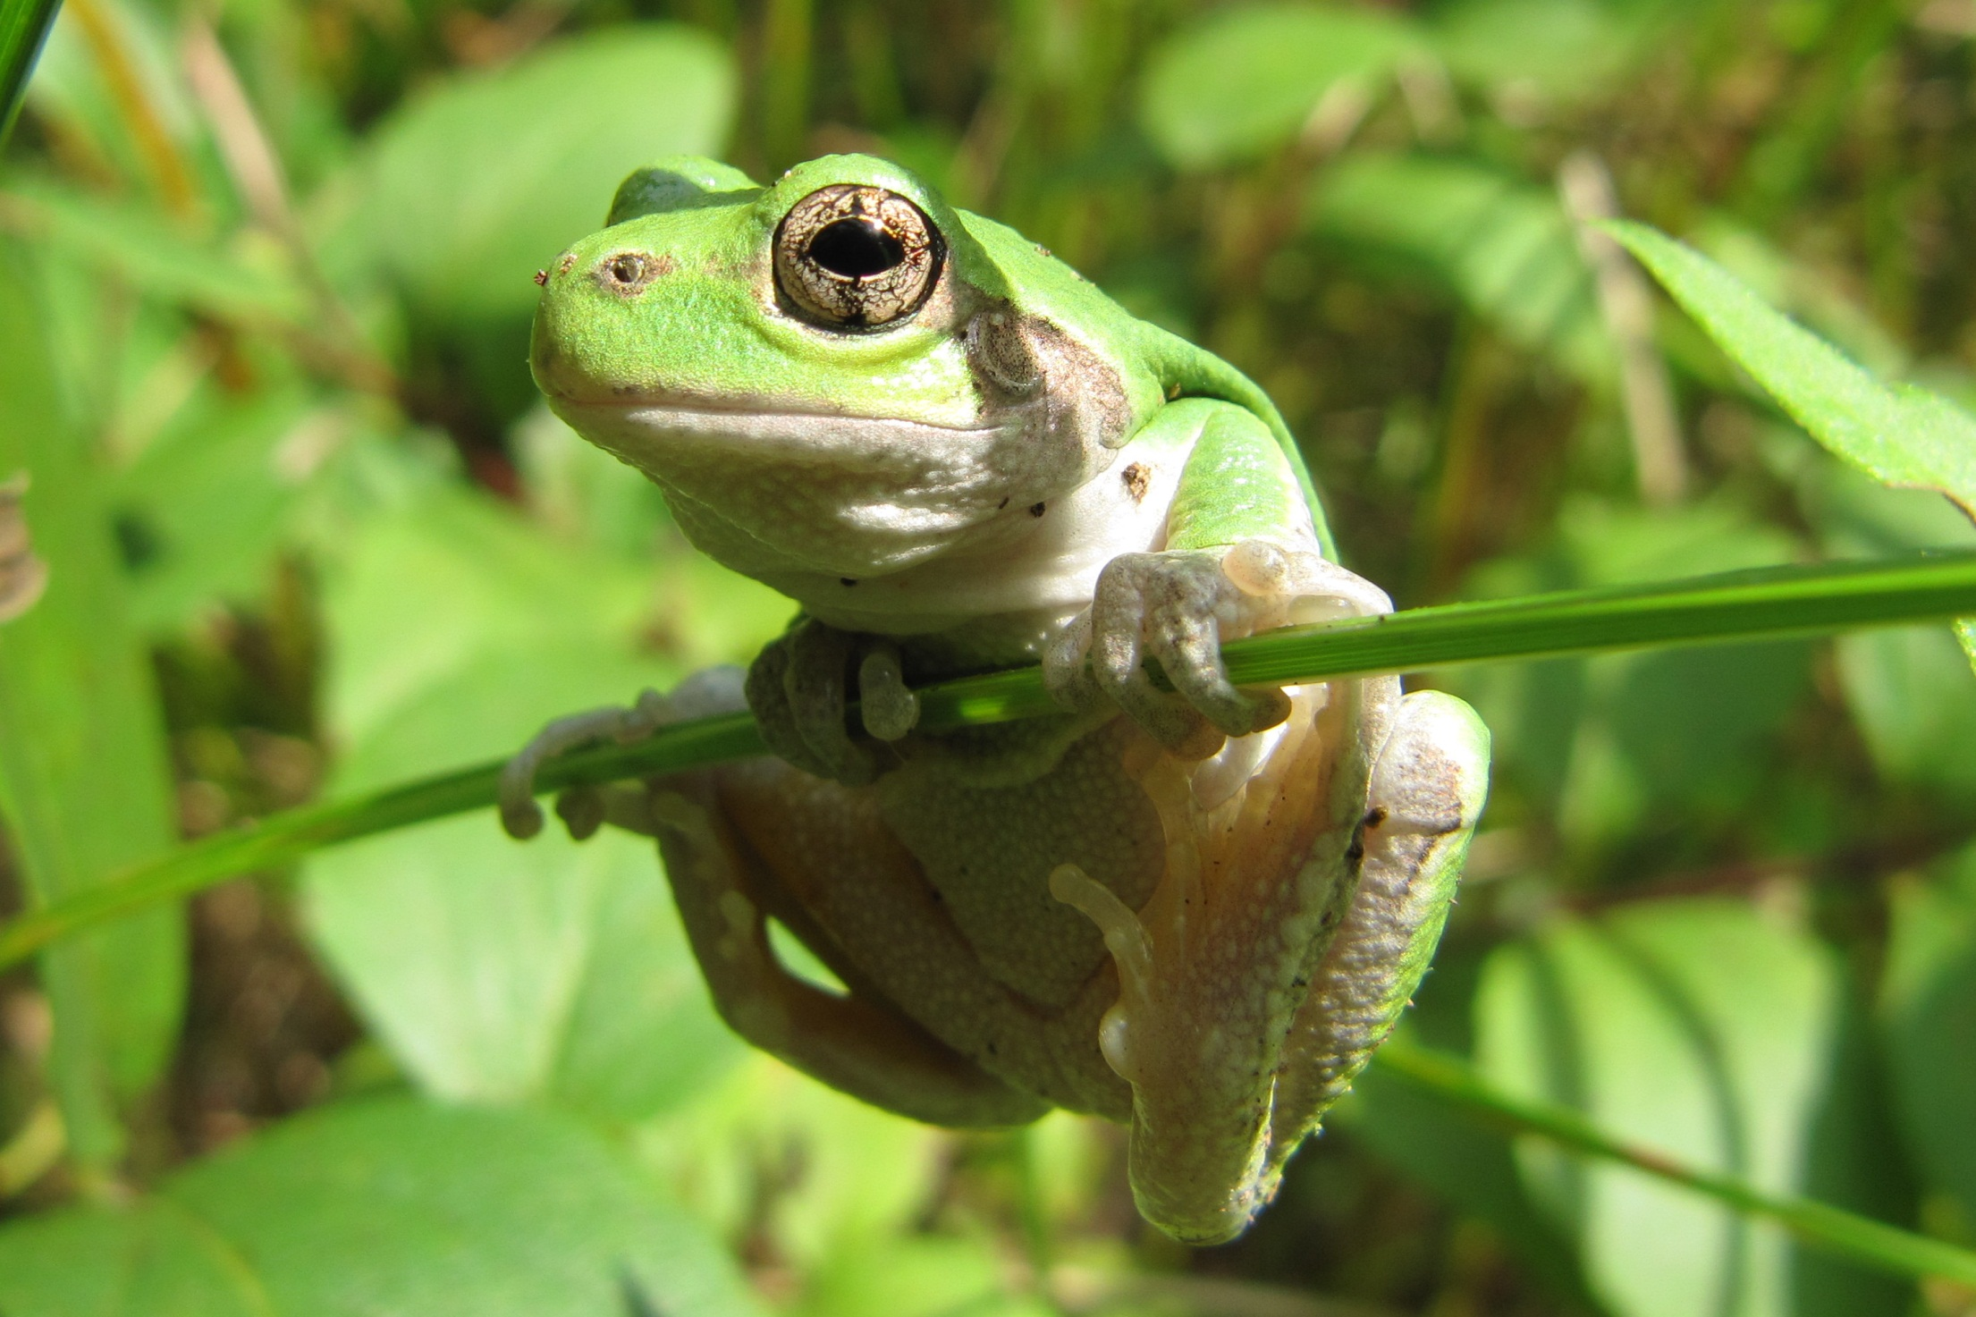
Notes:
Gray tree frogs can turn from this bright green color to a gray in a couple seconds.

Slide 30
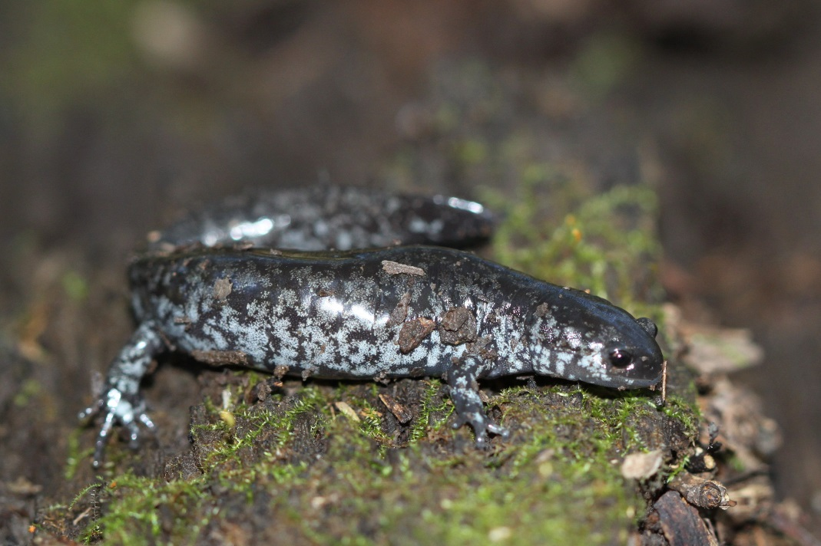
Notes:
Smallmouth salamanders require ephemeral wetlands to breed along these floodplain corridors. They are medium sized salamanders about 5 inches long.

Slide 31
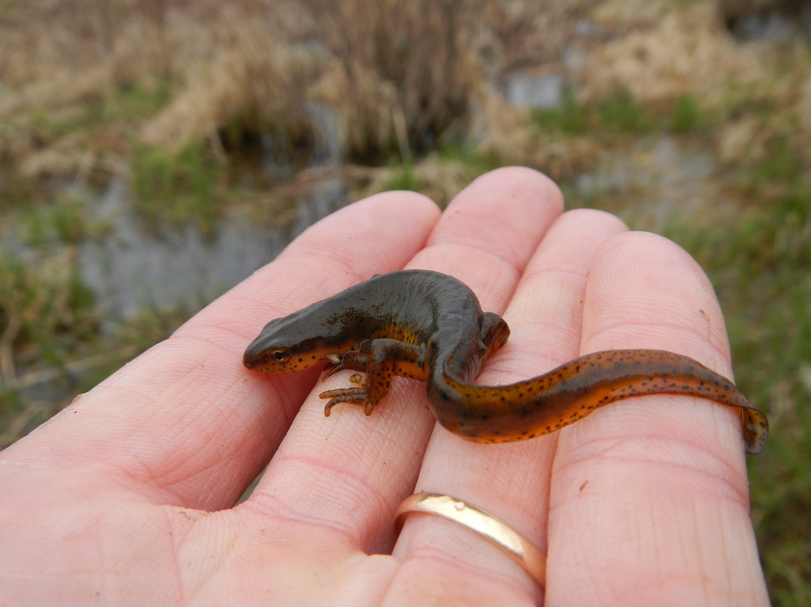
Notes:
The central newt is slightly smaller usually about 4 inches. This critter has a complex life cycle containing both terrestrial and aquatic forms. Like many of the species I’m showing today they are protected and it is illegal to handle them and they are toxic as well.

Slide 32
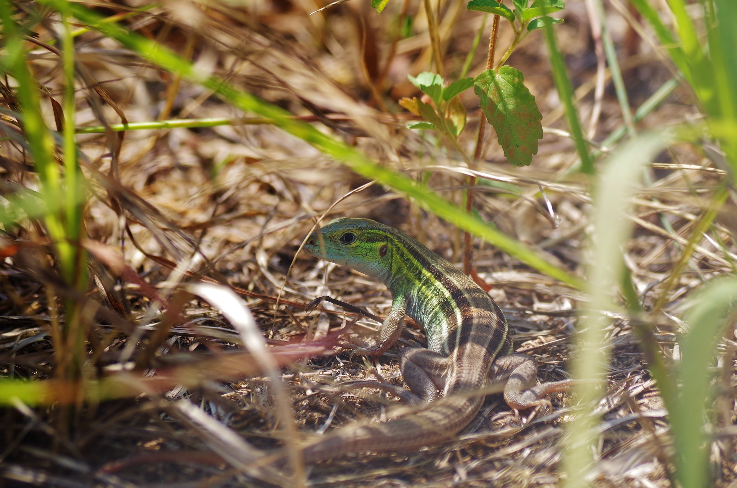
Notes:
Here is a six-lined racerunner Iowa’s fastest lizard reaching about 9-10 inches in length found in the sand prairies here

Slide 33
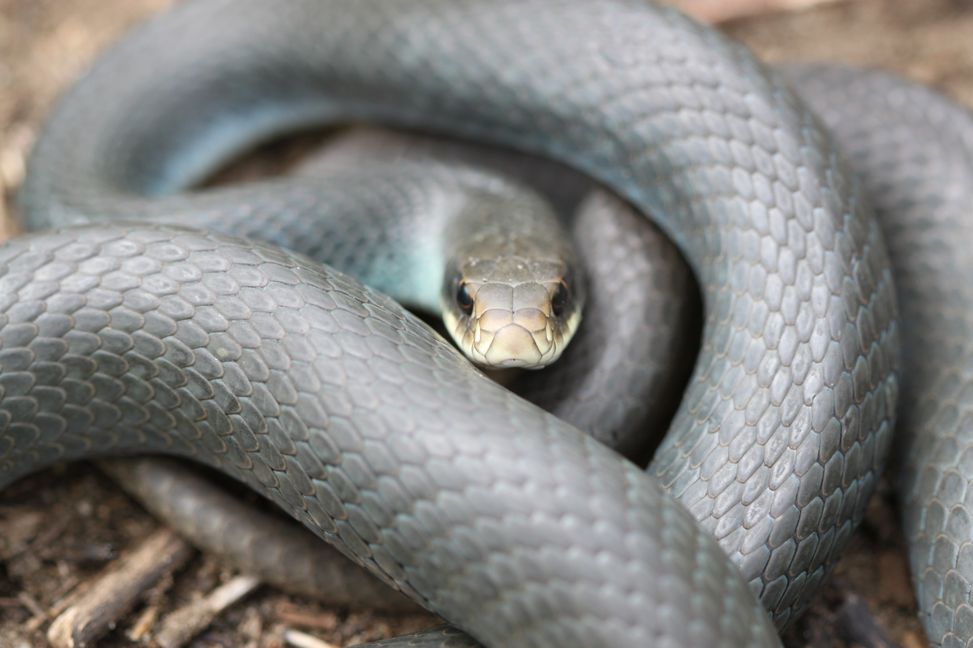
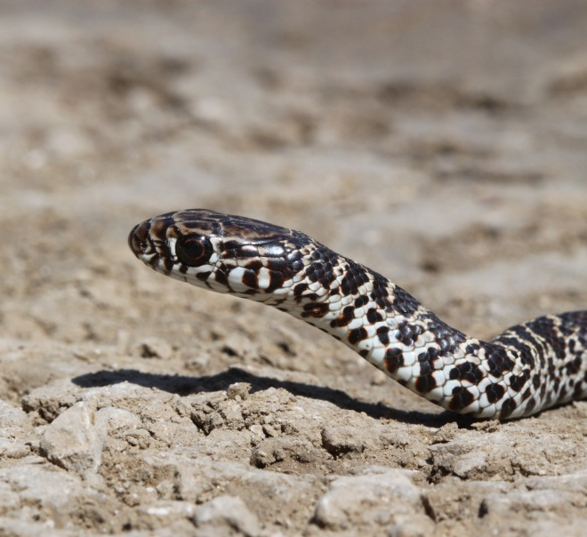
Notes:
Snakes also like to race apparently, this is a racer and the smaller photo is a juvenile racer.

Slide 34
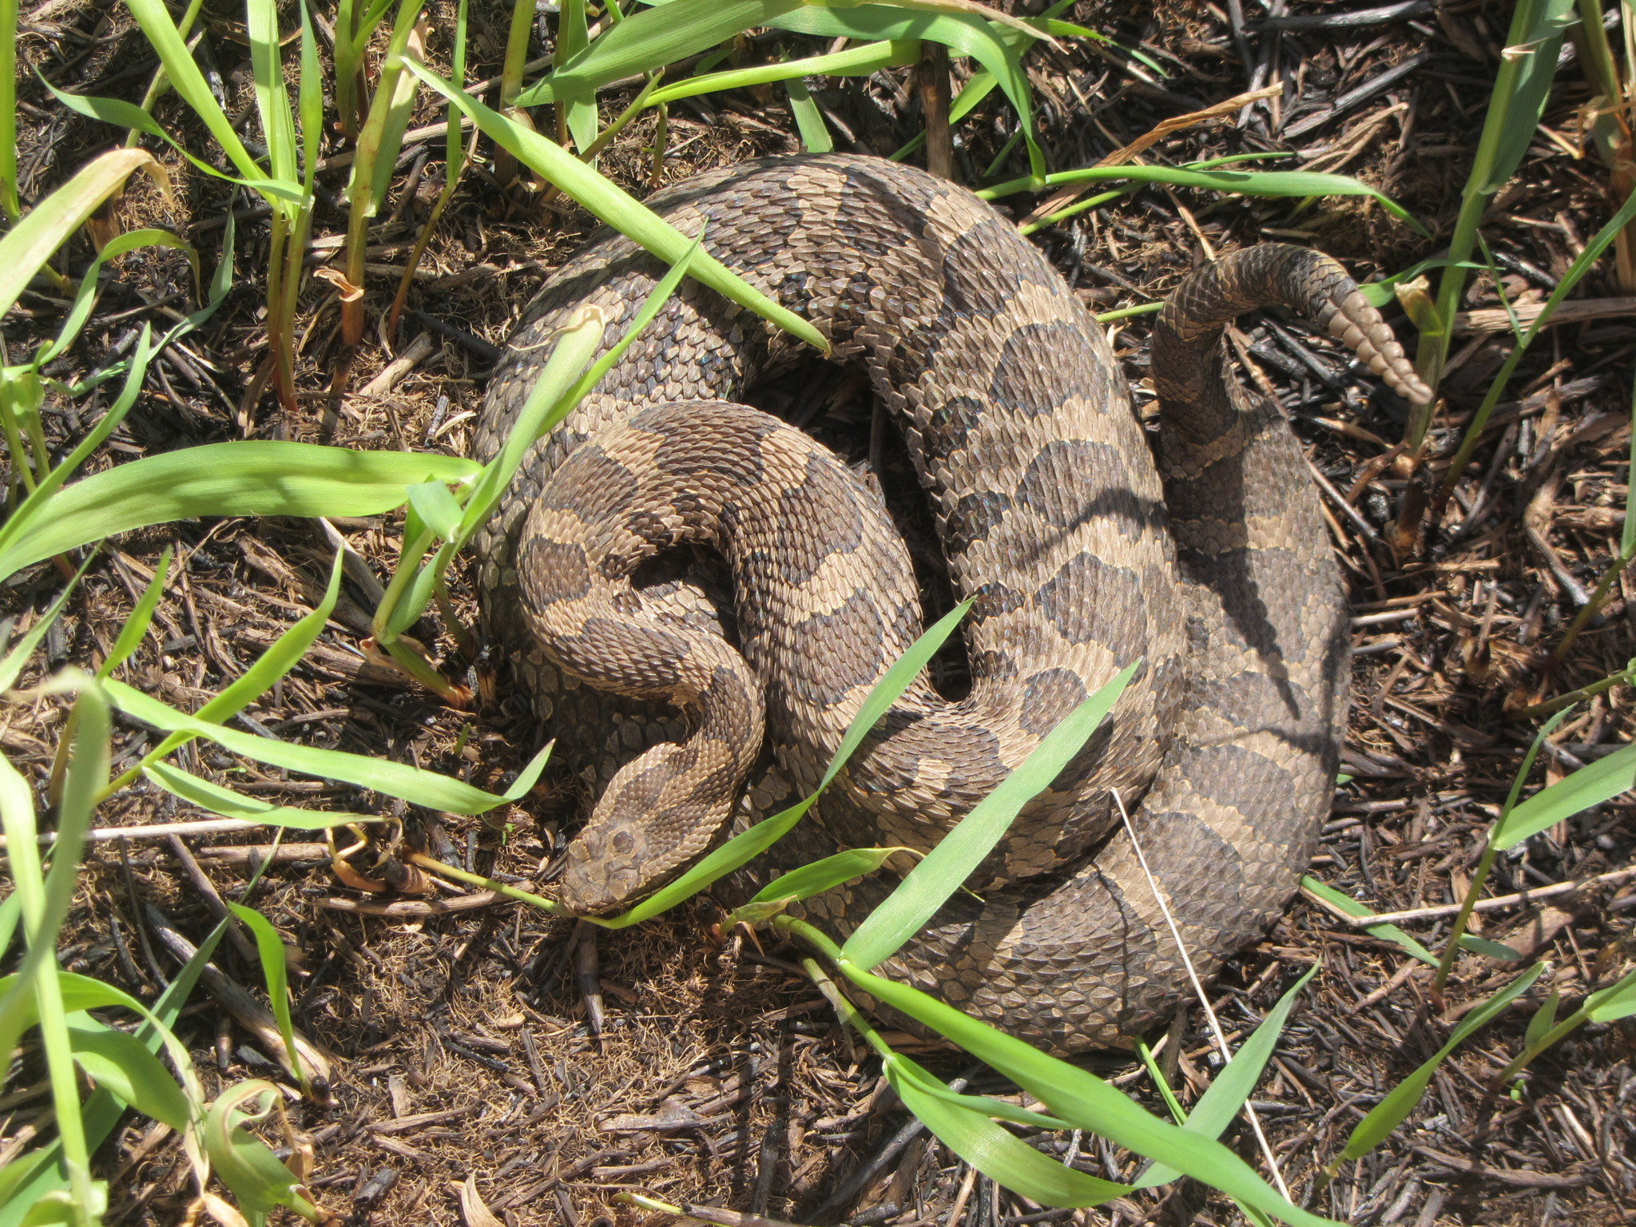
Notes:
Eastern Massasauga rattlesnake. These elusive swamp rattlers are venomous. They are also extremely rare and protected by both the state and federal endangered species act so please leave them alone.

Slide 35
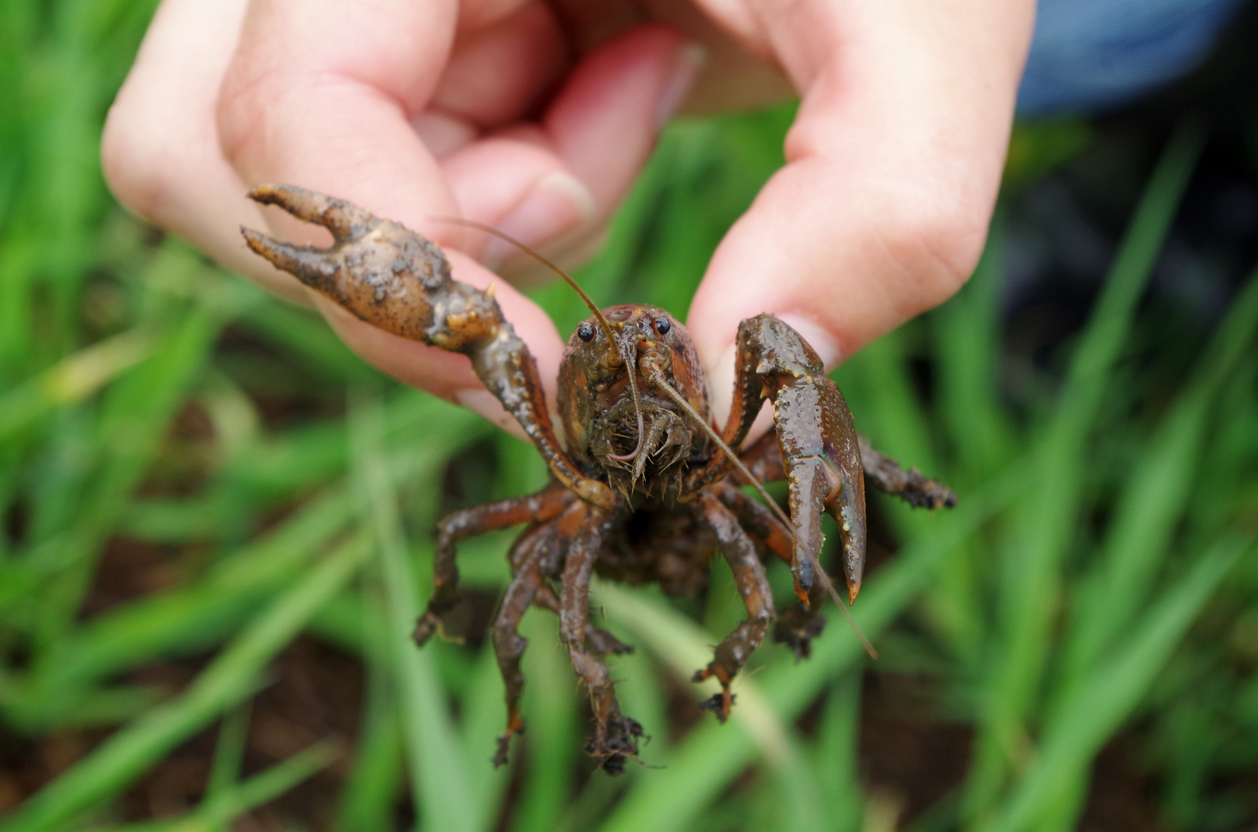
Notes:
They are amazing snakes that will actually overwinter in crayfish burrows..

Slide 36

Notes:
Blanding’s Turtles…can live to be 100 years old. They are a migrating turtle that historically would migrate across the prairie from wetland to wetland, but with their habitat being so fragmented many of them become roadkill so remember to brake for turtles.

Slide 37

Notes:
The Stinkpot is Iowa’s smallest turtle species named for it’s musk glands and spends much of it’s time buried in sandy bottom streams and wetlands.

Slide 38

Notes:
Iowa’s only fully terrestrial turtle is the ornate box turtle. About 5 inches long, these turtles use open sandy areas in the Land of the Swamp White Oak.

Slide 39









Notes:
We own about 4,000 acres of land here and we don’t just manage this special place for ornate box turtles or for any one species in particular. We protect and manage for the entire ecological community. To do that we restore natural processes and functions to the landscape.

Slide 40

Maskouten
Fire Nation
Notes:
Historically, the Land of the Swamp White Oak burned through wildfire and from people. The native Maskouten, or translated to “fire nation”, describes the region now known as Muscatine. The Maskouten people used fire as a management tool for hunting and gathering lands.

Slide 41

Notes:
We now utilize prescribed burning as a management tool on our nature preserve and collaboratively with partners on state, county, and federal lands nearby. We also work to inspire private landowners to burn their natural areas and ditches.

Slide 42

Notes:
We work with 2 local cattle producers to implement conservation grazing on several hundred acres of our preserve. This is a tool that mimics the disturbance caused by historical herbivores like bison and elk. This generally keeps the preserve more open, we can strategically use it to graze down invasive species like reed canary grass which we combine with other treatments like fire and spraying to increase diversity and competition in infested areas.

Slide 43

Notes:
Here is the main entrance to Land of the Swamp White Oak Preserve during a summer flood about 5 years ago. Another natural process that we are trying to restore is the hydrology, however these are large watersheds with complex solutions.

Slide 44


Floodplain
Wide and relatively functional
Notes:
The floodplains in the Land of the Swamp White Oak are very wide and relatively functional. The vast majority of the Cedar River and Iowa River floodplains are connected to their river here so it’s not like the larger levee districts along the mainstem of the Mississippi River.

Slide 45


Unnatural Flooding
Frequency and intensity
75 years of USGS data
Flood frequency has doubled since 1990
4 of 5 top flood crests since 2004
Notes:
Just down the road from our Preserve there is a USGS sensor that has provided us with 75 years of data on the Cedar River and of course, natural floods do provide many benefits to nature such as increased habitat for wading birds and waterfowl, recharging isolated ponds for amphibian breeding, etc., but what we are experiencing is flooding in an unnatural way. Frequency has more than doubled. All of the top 5 flood crests on record since ‘93.

Slide 46

Unnatural Flooding
Early Spring floods
Flow in Summer months has doubled since 1990
seasonality
Notes:
We have also seen a change in the seasonality of flooding. Flooding historically occurred most frequently in March and April when snow melt aligned with heavy rain events. However, flooding now regularly occurs in summer months when much of our native flora and fauna and relying on lower water levels. The endangered wood turtle is a prime example of a species that is in decline, due to these changes. Flooding in Iowa now occurs commonly during the turtle’s egg incubation period and most available nesting sites are subjected to this flooding. We’ve also had extremely rare flood events throughout the fall and winter months in recent years.

Slide 47

Unnatural Flooding
Prolonged duration
Historical floods averaged a few days
7 floods > 2 weeks since 2008
3 floods > 4 weeks
77 days above flood stage in 2008
62 days above flood stage in 2010
55 days above flood stage in 2013
Notes:
Prolonged flooding of bottom-land areas can destroy native wetland plants and even kill mature swamp white oaks that are adapted to flood conditions. These extreme floods often give advantages to pest plants like Reed canary grass. The effects on wildlife populations can also be severe when there is little to no habitat outside of the floodplain.

Slide 48

Conservation Outcomes
Protection Opportunities
Stewardship Challenges
Resilience Strategies
Whole system approach
Notes:
Unnatural flooding impacts our work in a few ways. Landowners have voluntarily protected over 40,000 acres here through sale or easement. People generally understand that these floodplain areas are best left natural and everyone’s learning that ongoing management of these areas takes time and money. That’s part of The Nature Conservancy’s mission here so many farmers are choosing to sell their floodplain ground to The Nature Conservancy and do what they call a 1031 exchange to purchase a more productive piece of cropland up out of the floodplain with cash from sale and tax benefits of the exchange. The flooding certainly creates a lot of problems for us and anyone else that wants to own land here over the long-term because extended periods of inundation. A prairie won’t burn if it’s underwater and we can’t even get equipment to many sites on the preserve when the soils have become saturated. The trends we are seeing force us to think about the future. How can we make this special place more resilient to unnatural flooding and warmer temperatures? Part of the solution will be to strategically acquire some uplands and create a corridor from the bluff down the ravines to the river providing refuge during a variety of flood events. One thing we know for sure to be more resilient we have to use a whole system approach. The Nature Conservancy is doing this in Iowa at the Cedar River Watershed Scale. I also work with a team of Conservancy colleagues from states throughout the Mississippi River Basin to address water quality and the dead zone in the Gulf of Mexico. Big problems require whole systems thinking and strategies for resilience.

Slide 49


Connecting People and Nature
Annual celebration of nature!
Sunday, October 6^{th, 2019}
1:00 to 6:00 pm
Ardon Creek Winery
Live bluegrass music, hiking tours of Land of the Swamp White Oak Preserve, live critters, educational displays, kids games and activities, wine tasting and more!
Notes:
Sometimes this is working to connect with new audiences and we host several community engagement events each year. Our biggest event is Swamp Stomp! It’s the first Sunday in October each year at Ardon Creek Winery which is only a couple miles from our preserve. There is live bluegrass music, preserve tours (shuttle provided), local wildlife, games and activities fun for everyone so mark your calendar for next year!

Slide 50
Josh Spies
Associate Director of Conservation jspies@tnc.org
319-726-3041
Notes:
I’d like to thank River Action and the other conference organizers for putting this important event on. I’m happy to answer questions while I’m here or you can contact me at this email address at another time. I can also put you in contact with TNC colleagues where you might be working. Thanks.

