Slide 1
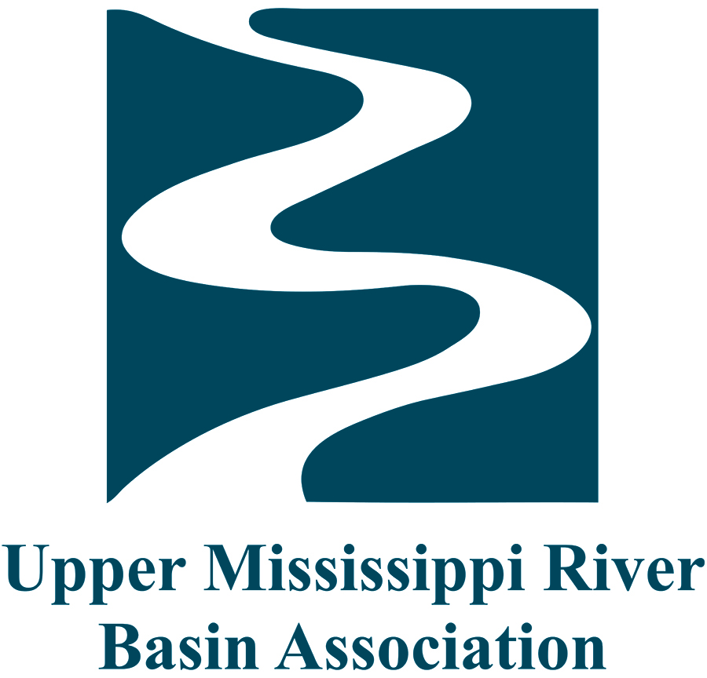
UMRS Flood and Sediment Management Study
Andrew Stephenson
Upper Mississippi river conference, moline, il
October 25, 2018
Notes:
Today, I’ll be talking about an ongoing process regarding Flood and Sediment Management in the Upper Mississippi River System.

Slide 2
Roadmap
Framing the Issue
Section 729 request
2017 Flood Risk and Channel Management Summit
2018 (Jun) Planning Assistance to the States (PAS)
2018 (Aug) communications workshop
Recap and next steps
Photo credits: Indiana Public Media and St. Paul Corps of Engineers

Slide 3
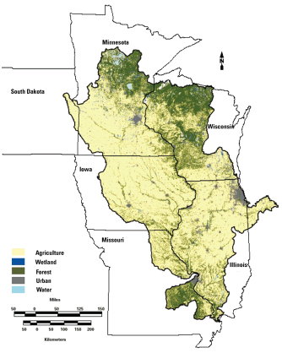
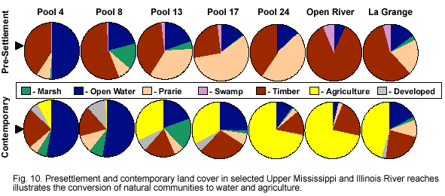
Framing the Issue
Image credits: USGS and USGS UMESC HNA Summary Report
Notes:
According to UMRR work done by the USGS through funding provided by the Corps.
What’s happening in the river is a reflection of what’s happening in the watershed. To understand flow of water, we need to better understand the characterization of the floodplain. Our past is not our present, which is not going to be our future. What we do know is that floodplain acting different than it has, that we may not be at a steady state yet, and that weather is also changing. What we want to discuss is resilience in the system and the actions we can take to strive for that.
We can’t manage the river based on historical trends anymore.

Slide 4
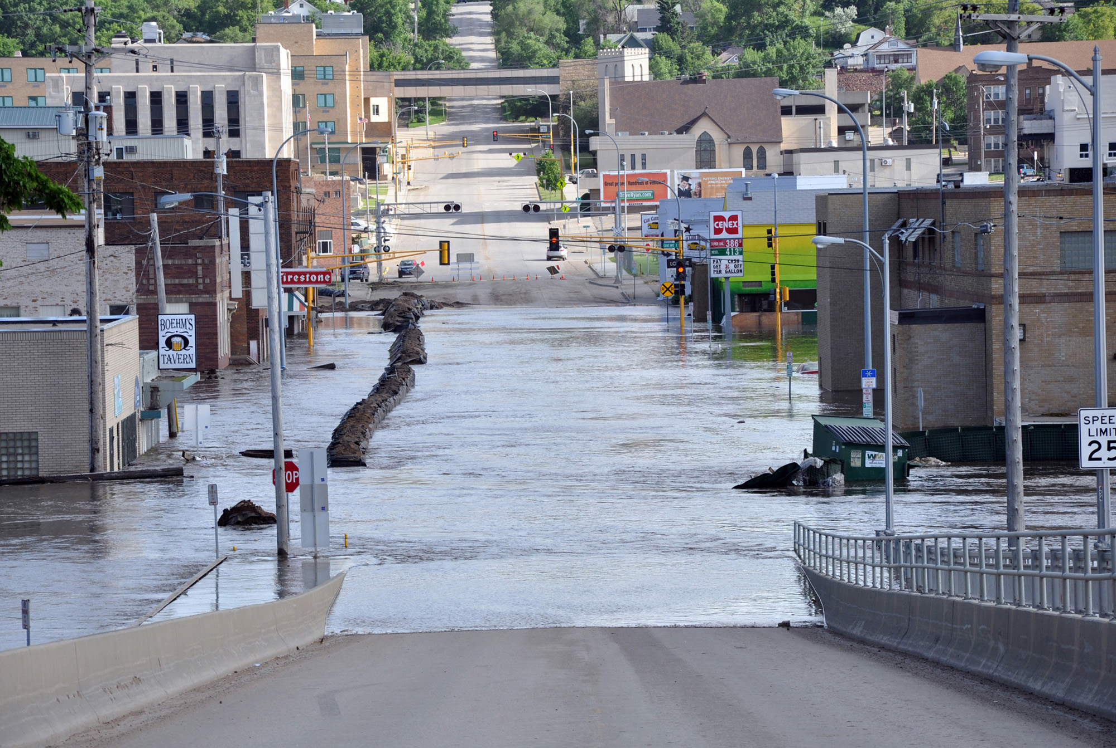
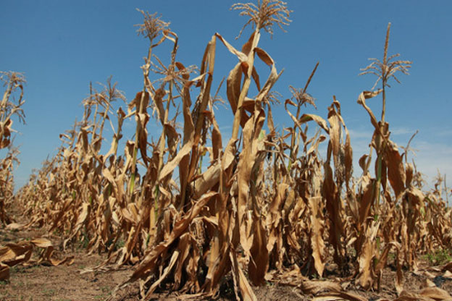
Framing the Issue
Land use changes
Flood events
Extended drought
Photo credits: Indiana Public Media and St. Paul Corps of Engineers
Notes:
Substantial changes in land use throughout the Upper Mississippi River watershed compounded with increasing frequencies and severity of flood events are impeding the economic resilience of local river communities as well as the safety and reliability of commercial navigation.
Recurring closures of the navigation channel due to sediment deposition, flood events, or drought conditions along the Upper Mississippi River System (UMRS) continue to demonstrate the need for proactive, integrated, and strategic management of the river system. A wide range of UMRS river partners have called for federal and state action to this end.

Slide 5
Section 729
“Watershed Plan”
Problems
Opportunities
Objectives
Constraints
Watershed Goals
Recommended alternatives
Strategies to advance the shared vision.
Notes:
One process for taking action is through a Section 729 study.
Section 729 of the Water Resources Development Act of 1986, as amended, authorizes the U.S. Army Corps of Engineers to assess the water resource needs of river basins and watersheds of the United States including needs relating to: ecosystem protection and restoration; navigation and ports; flood risk management; watershed protection; water supply and; drought preparedness.
Since 2016, UMRBA has requested to work with the Corps through the Section 729 planning authority to develop a coordinated, systemic planning effort to improve flood risk and channel maintenance management in the Upper Mississippi River.

Slide 6
Section 729 – Watershed Plan
Integrate structural and nonstructural floodplain management measures
Comprehensive long-term channel maintenance management strategies
Improve resilience to flooding and drought of UMRS communities and economies
Support UMRS goals for environmental sustainability, restoration, and water quality
Address other floodplain problems, needs, and opportunities in concert with flood risk and channel management measures
Notes:
We believe a watershed study will allow for a consensus-based approach to:
-Develop an integrated, comprehensive, and systems-based approach to minimize the threat to health and safety resulting from flooding by using structural and nonstructural floodplain management measures.
-Develop new, or renew existing, comprehensive long-term channel maintenance management strategies.
-Make communities and economies adjacent to, or dependent on, the UMRS more resilient to flooding and drought events
-Identify opportunities to support environmental sustainability, restoration, and water quality goals for the UMR and Illinois River channel and floodplain and
-Seek opportunities to address, in concert with flood risk and channel management measures, other floodplain specific problems, needs, and opportunities.
That 729 request is still pending, but in the meantime the work can’t stop.

Slide 7
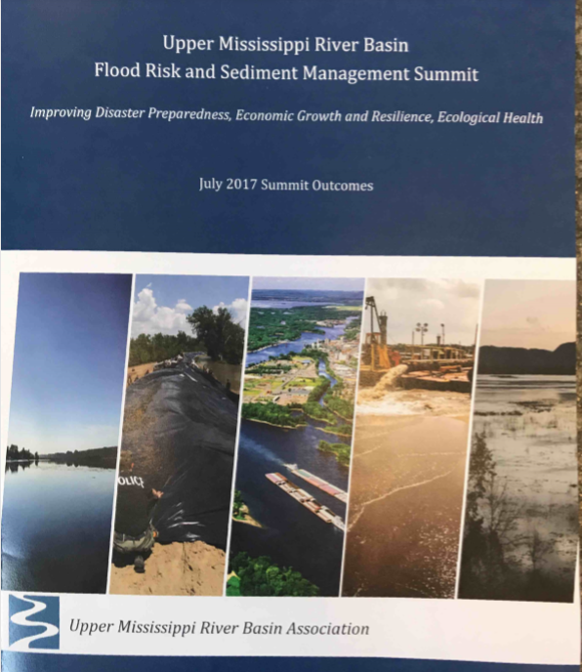
Flood Risk and Sediment Management Summit, July 2017
Participants:
State Government -16 (IL, IA, MN, MO, WI)
Federal Government – 31 (USACE, USCG, USFWS, USGS, NWS)
U.S. Congressional Offices – 3 (Senate, House)
Industry, Levee Districts, Nonprofit Organizations, and Private Citizens - 39
Notes:
In 2017, UMRBA hosted the Upper Mississippi River Basin Flood Risk and Sediment Management Summit that brought together key stakeholders in the region to discuss the challenges as well as potential solutions for improving flood and sediment management.

Slide 8
Flood Risk and Sediment Management Summit, July 2017
Perspectives of Challenges:
Lack of coordination to achieve a common vision
Management and assumption of risk based on outdated information
Lack of systemic, agreed upon approach to management
Lack of investment to improve system infrastructure (structural and nonstructural)
Notes:
The primary purpose of the summit was to initiate its longer-term vision for fostering a dynamic, balanced, objective, and adaptive approach to improving management of floods and the 9-foot navigation channel.
-No existing forum for the river-floodplain community to discuss challenges and new information and to work towards shared goals.
-Current channel maintenance and flood risk plans assume the historic risk of sedimentation and flooding without considering the impacts of weather and land use changes.
-Conflicting, duplicative, or inconsistent policies and enforcement across multiple layers of federal, state, and local management authorities can result in subjective and oftentimes unfair flood protection decisions for neighboring floodplain communities.
-Overall decline in federal, state, and local investment has resulted in antiquated and unreliable navigation and flood control infrastructure.

Slide 9
Flood Risk and Sediment Management Summit, July 2017
Solutions and Actions:
Develop a coordinated, systemic flood and sediment management plan
Establish a regional coordinating (governance body)
Address policy impediments and fiscal resource needs
Improve and better utilize knowledge
Notes:
-Plan would create a systemic monitoring network/strategy to help assess the river’s existing conditions and trends, and evaluate progress towards a desired condition.
-to convene the floodplain-river community to discuss issues and collaborate on solutions.
-including modifications to state or federal policies and regulations as well as securing resources to perform levee maintenance and repair.
-by continuing ongoing data collection, analysis, and reporting and employing a gap analysis to determine new data, modeling, and research needs.
Watershed activity - consolidate post-its into this report that reflects the voice of attendees.

Slide 10
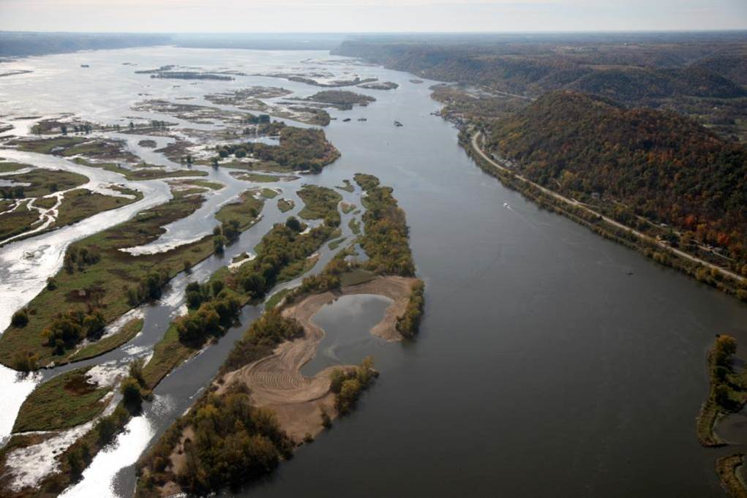
Planning Assistance to the States Proposal, June 2018
PAS Study objectives:
Clarify key issues affecting flood and channel maintenance management
Develop immediate solutions to those problems
Identify challenges that need to be addressed through 729 study authority
Photo credit: WI DNR
Notes:
June 2018, UMRBA submitted a formal request to the Corps to partner through the planning assistance to the states (PAS) authority. The letter requested assistance from the Corps to clarify the key issues affecting flood and channel maintenance management, develop immediate solutions to those problems, and identify challenges to be addressed through a Section 729 study authority. UMRBA requested that the PAS scope also include planning for extended drought events.
The PAS approach would allow for 1) developing a more detailed vision and scope of work for exploring complex issues through the Section 729 study while 2) exploring solutions for which federal, state, local, and private partners can take immediate action.

Slide 11
Planning Assistance to the States Proposal, June 2018
PAS Issue Areas Groups:
Channel Management
Flood Risk Management
Extended Drought
Communications
Section 729 Study
Photo credit: WI DNR
Notes:
Each PAS Group will be led by a team from the UMRBA partnership.
Groups will engage with stakeholders and interested citizens to identify ACTIONS that can be taken NOW to address their issue area, as well as identify additional actions that need more study (Scoping the 729 Study).
The Communications Groups will use a Systematic Development of Informed Consent or (SDIC)-inspired approach to communicating and engaging with important potentially affected interests during the PAS.

Slide 12
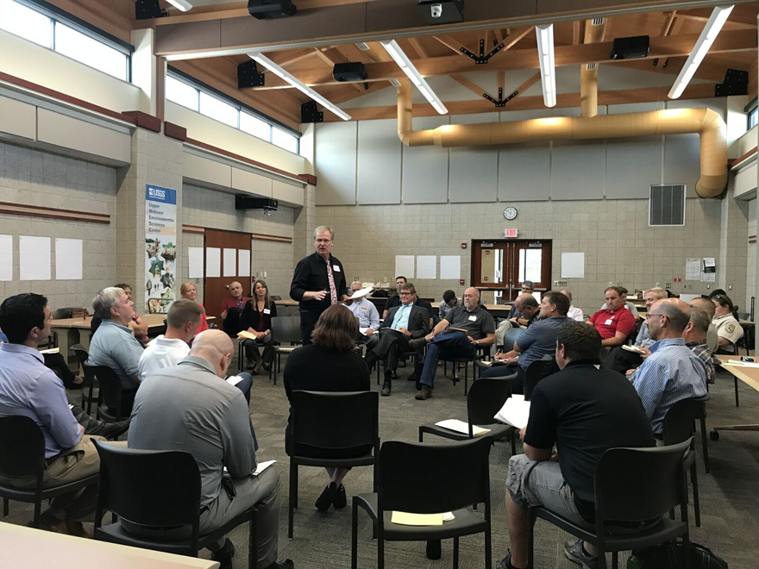
UMRBA-USACE Communications Workshop, August 2018
Funded by Integrated Water Resource Management Pilot
SDIC Framework approach, facilitated by Brian Stenquist, MN DNR
Small group discussion organized by issue areas:
Channel Maintenance
Flood Risk Management
Extended Drought
Photo credit: Lauren Salvato
Notes:
The Corps’ Institute for Water Resources awarded a Pilot Study for the Corps’ Integrated Water Resource Management team (IWRM). Through the Pilot Study, the Corps convened the UMRBA, federal partners, and key affected interests to develop an engagement and communications strategy for the PAS utilizing the Systematic Development of Informed Consent (SDIC) framework. Gaining public support, understanding, and consensus is critical to making progress toward a systemic and collaborative plan for the watershed. The SDIC framework facilitates a process of shared understanding and allows for clear communication and support.

Slide 13
Scope of Work, Ongoing
Examples of PAIs
Land Owners and General Public
Agribusiness
Local, State and Federal Agencies
Non Governmental Agencies
Industry Agencies
Levee Districts
Task 1: Execute the Engagement and Communication Strategy
A. Identify potentially affected interests (PAIs), including key stakeholder groups as and other individuals.
B. Convene a series of open forums in strategic parts of the Upper Mississippi River System to gain a better understanding of knowledge, perspectives, and insights from the PAIs.
C. Assign a third-party (agency-neutral) meeting facilitator for each open forum.
D. Identify issue area group leads for each of the issue areas
Notes:
The first task of the PAS effort will be to deploy a communication strategy that includes an SDIC framework as developed by the IWRM Pilot Study. The ultimate goal of the SDIC approach is to utilize a civic engagement approach in order to develop a coordinated systemic and comprehensive vision for addressing the three target issues channel management, flood risk management, and extended drought.
Though not complete, some examples of PAIs

Slide 14
Scope of Work, Ongoing
Task 2: Develop Issue Area Assessments
A. Develop an assessment for each issue area group.
B. Based on the input generated from the summit, open forums, and other meetings, identify potential actions that can be taken within each issue area and distinguish between short and long-term actions.
C. Distribute draft Issue Area Assessments to the PAIs for review
Channel Maintenance
Flood Risk Management
Extended Drought
Notes:
Develop issue area assessments that will synthesize the input obtained from the workshops and any other listening sessions as identified in Task 1.
Identify potential actions that can be taken within each issue area, distinguishing between short and long-term actions.
Listen, reflect, respond.
See ability to get wins all around, with some challenges that may result in compromise.
Transparent process is important.

Slide 15
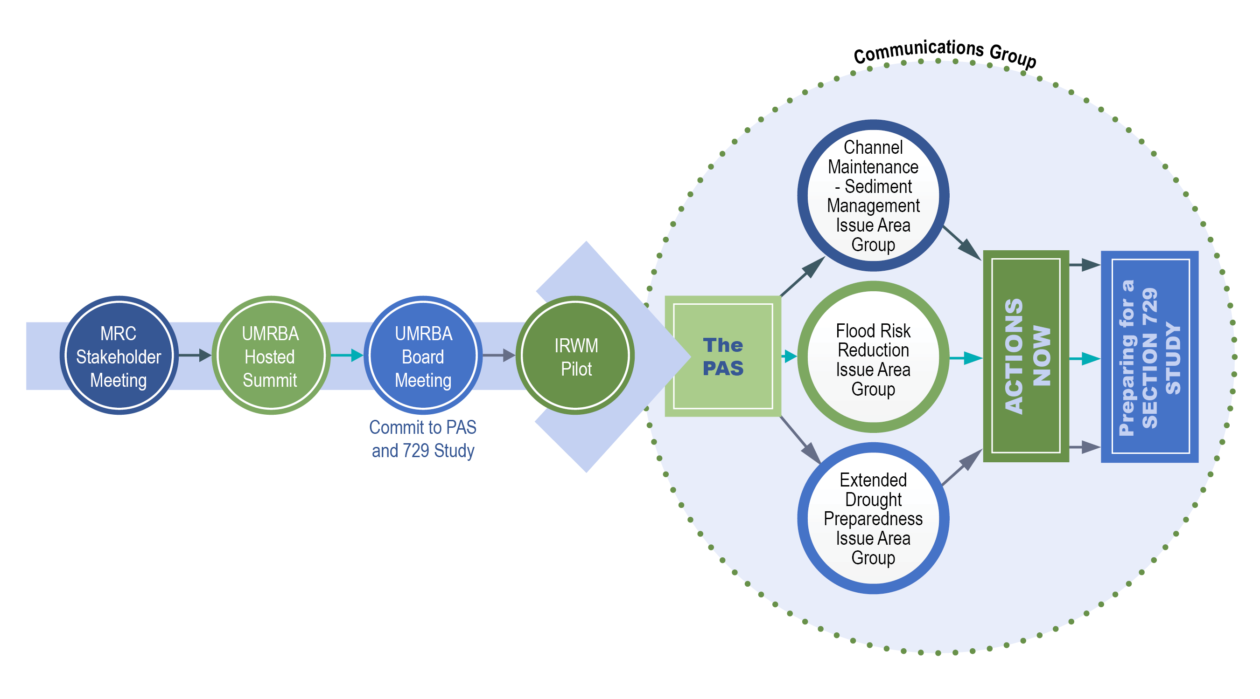
Recap and Next Steps
IWRM
Pilot
Notes:
The PAS is targeted for 2019-2020.
Each PAS group will be lead by a team from the UMRBA partnership.
Groups will engage with stakeholders and interested citizens to identify Actions that can be taken Now to address their issue area, and those actions that need more study.
Groups will use an SDIC-inspired approach to communicating and engaging with important potentially affected interests during the PAS.
These steps will help inform and prepare for a Section 729 study that will include actions that promote 1). A systemic flood and sediment management plan, 2) better preparation for the next extended drought. And 3) practical solutions to policy and fiscal constraints.

Slide 16
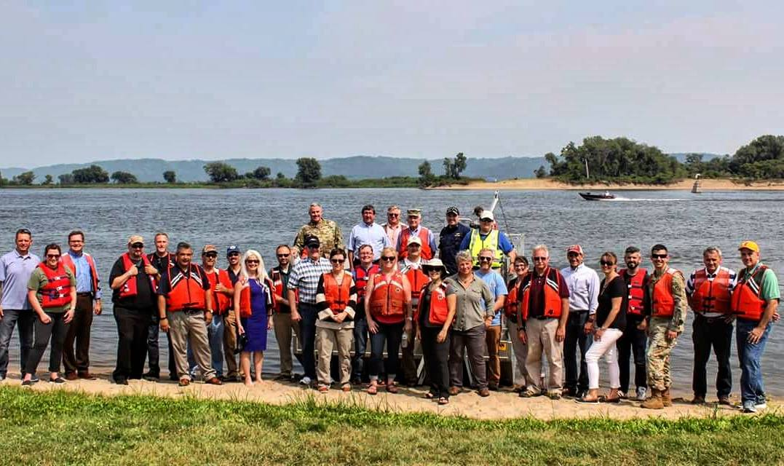
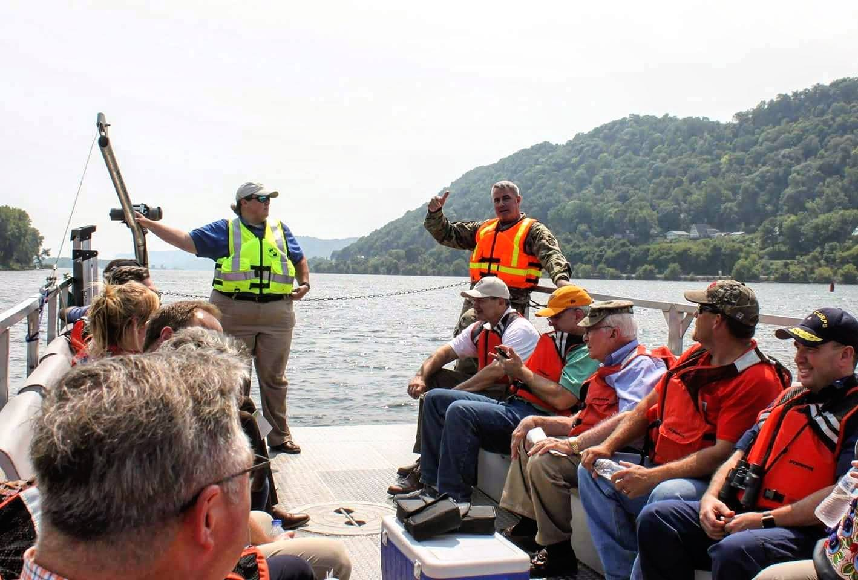
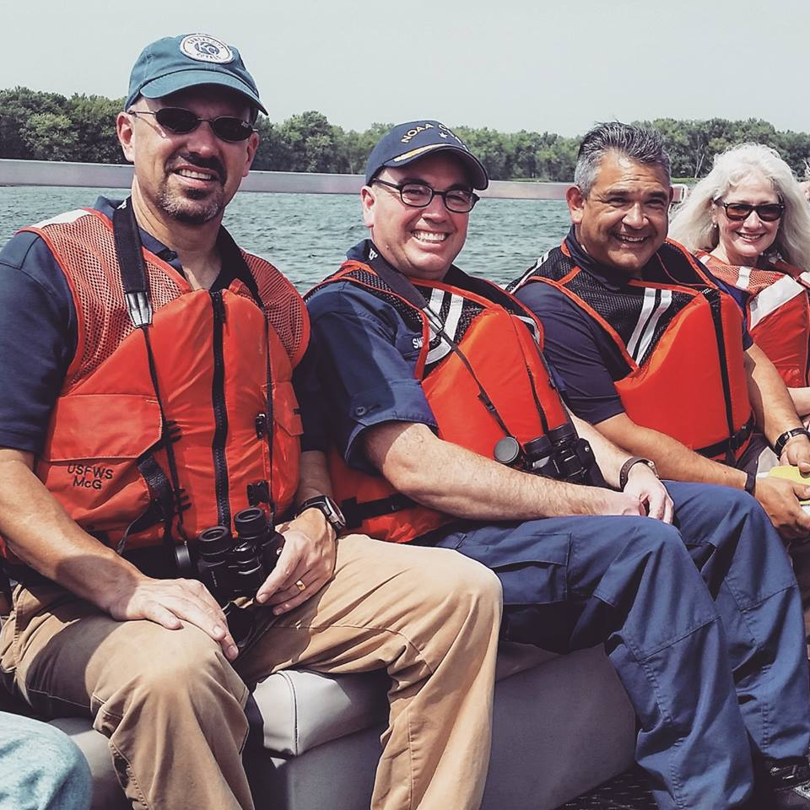
Mississippi River Commission Visit, August 2018
Notes:
This Mississippi River Commission recognized the necessity and value in addressing and resolving these issues at the UMRBA’s quarterly meeting in August 2018.

Slide 17
Kirsten Wallace
KWallace@umrba.org
612-224-2880

